Slide 1
Reproducibility
Today’s agenda:
Making code reproducible
R Markdown
Work on .Rmd files

Slide 2
Reproducibility
When using code, this means:
Analyses could be re-run and would give the same results
Code and data are available and usable
Reproducibility is a spectrum:
Poorly structured code and data are less reproducible

Slide 3
Elements of reproducibility: the 4 D’s
Design (structure and style)
Documentation
Dependencies
Data
Deposit

Slide 4
Design
Well thought-out folder structure
E.g., folders for:
Functions
Scripts
Raw Data
Clean Data
Figures

Slide 5
Design
Well thought out code
If you do something multiple times, make it a function
Make code modular
Break up scripts into different files (e.g., data cleaning, data analyses, etc.)

Slide 6
Design
Use a consistent code style
We discussed this previously when talking about tidyverse
We also discussed R function to help style your code

Slide 7
Documentation
Use comments!
Document what different sections do
Document any decisions or assumptions
Explain complicated bits of code

Slide 8
Documentation
Include readme files
One at the project’s root directory
Explain the purpose
Is there anything special needed to know to run the code?
Can be relatively simple or very complex and detailed
Can contain a link to any resulting publications
Other readme files where needed
Add readme files in any folder where information is helpful
Example: noting data sources, file naming structure, etc.
Readme files that accompany datasets are often very helpful

Slide 9
Documentation
Document functions
You can document any functions you write using comments
R also has a special way of documenting functions: Roxygen comments
Example (edited to fit on slide):
#' @name dr_rulsif
#' @title Density-ratio SDM estimation with RuLSIF
#' @description dr_rulsif is an internal function for density-ratio estimation with RuLSIF
#' @param presence_data dataframe of covariates
#' @param background_data dataframe of covariates
#' @importFrom densratio RuLSIF
#' @importFrom Rdpack reprompt
#' @keywords internal
#' @references
#' \insertAllCited{}

Slide 10
Documentation
Document functions
Include things like:
A description of what they do
What the parameters are and the expected data types
What the function returns
What functions it relies on (if any)
An example of how to use it

Slide 11
Dependencies
Your code relies upon the R program as well as various packages
R and R packages change over time
Code written at one time may not work in the future as things change
It's useful to note which versions of things you use

Slide 12
Dependencies
The renv package is designed to manage dependencies for you
Keeps track of which packages you use and which versions
Stores the packages inside our directory
Set up with renv::init()
Update with renv::shapshot()
See https://rstudio.github.io/renv/ for details

Slide 13
Dependencies
If you REALLY want to be reproducible, you can use containers
Package all the code you need to run analyses
Even include a lightweight operating system
This means you can run the same exact code on any OS
Prevents OS-related issues
Also useful if you want to work on a cluster

Slide 14
Data
Keep raw data untouched, seperate from clean data
Use scripts for cleaning so that it can be replicated
Comments in cleaning scripts document your decisions and why you made them
Use relative paths to load data
Data should be accessible to others

Slide 15
Data
Data should be permanently archived somewhere on the internet
Code ideally downloads the data from the internet
Small amounts of data can be put on Github
Large datasets need specialized storage locations, e.g.:
OSF (https://osf.io/ )
Dryad (https://datadryad.org/ )
FigShare (https://figshare.com/ )

Slide 16
Deposit
Like data, code should be deposited in a permanently archived location
Github is a good step, but isn’t permanent
Zenodo (https://zenodo.org/ ) can permanently archive Github code easily
Zenodo assigns a DOI, so code can be cited

Slide 17
Elements of reproducibility: the 4 D’s
Design (structure and style)
Documentation
Dependencies
Data
Deposit

Slide 18
Other ways to help with reproducibility
For small bits of code, reprex are useful
You can also make use of Rmarkdown and Quarto (.rmd and .qmd) files

Slide 19
R markdown
Details at: https://rmarkdown.rstudio.com/lesson-1.html
Cheatsheet at: https://rstudio.github.io/cheatsheets/html/rmarkdown.html
Runs code and produces documents
Can be fully reproducible
Can call other programs (e.g., python)

Slide 20
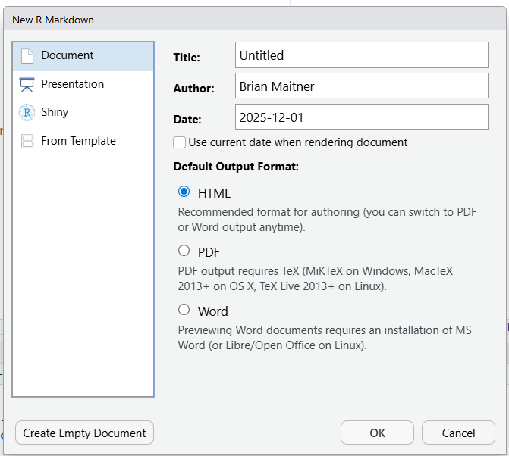
R markdown
Let’s play with R markdown a bit
First, create a new Rmd file
In RStudio:
File > New File > R Markdown

Slide 21
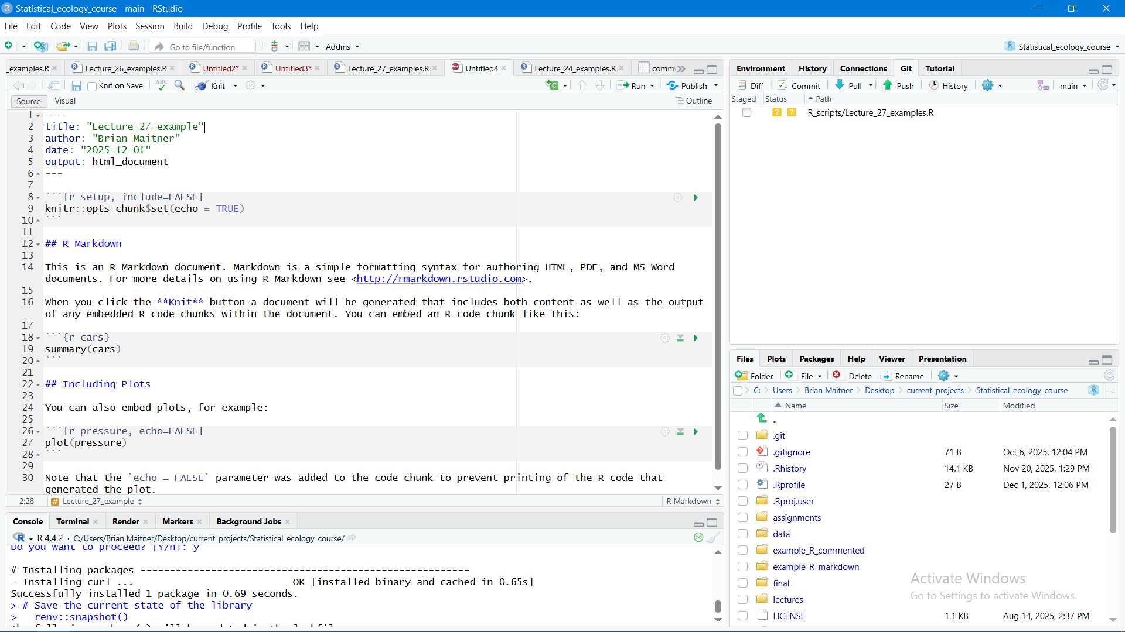
R markdown: 3 types of content
Yaml header
R code block
Markdown text

Slide 22
R markdown: Yaml header
Yaml header
Contains metadata on the file
Also contains information on how to render the file
Output tells it to render as an html_document
Could also render as PDF, .docx, etc.
There are other advanced option like:
Adding a table of contents
Incorporating a citations
Changing the page margins
https://rstudio.github.io/cheatsheets/html/rmarkdown.html#chunk-options

Slide 23
R markdown: code blocks
R code block
Can have as many as you like
Begin with ```{r}
End with ```
Optional arguments go inside {r}
Specify whether messages and warnings should be shown
Tell R not to run the chunk
Specify figure sizes and captions
https://rstudio.github.io/cheatsheets/html/rmarkdown.html#chunk-options

Slide 24
R markdown: Markdown text chunks
Markdown text
Can have as many as you like
Syntaxy to specify how to render text, e.g.,
#, ##, ## denote section headers
**text** italicizes
* Adds a bullet point
https://rstudio.github.io/cheatsheets/html/rmarkdown.html#write-with-markdown

Slide 25
R markdown: Rendering
rmarkdown::render()
Click “knit” button

Slide 26
Markdown practice
For the remainder of class I want you to try making your own Rmarkdown files
Create a blank R markdown file (or use the one we created earlier)
Populate it with content copied from a previous R script
Comments become text blocks
Code is placed in code chunks
Once you’ve got something that looks good, try rendering it!

Slide 27
Before next class:
Read:
https://doi.org/10.1126/science.aab2374
https://doi.org/10.1002/ece3.70030
May be a quiz

