Slide 1
Model Fitting II
Today’s agenda:
Issues with model fitting (7.4)

Slide 2
Last time
We discussed different approaches for model fitting
Today, we’ll discuss some challenges you might encounter

Slide 3
High Dimensionality
Touched on this last time
With brute force, time to fit increases as a power law:
time per fit * number of values per parameter^{n parameters}
Only possible to use brute force for a few parameters
This is why we rely on faster algorithms
Even faster algorithms can be slow with lots of parameters

Slide 4
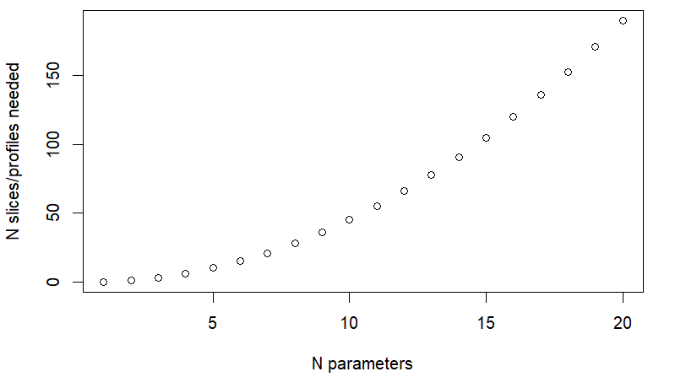
High Dimensionality
Also causes issues for trying to understand likelihood surfaces
1 parameter model: likelihood function
2 parameter model: likelihood surface
More than 2 parameter: need to use slices or profiles
This can be a lot of slices/profiles!

Slide 5
Slow function evaluations
Slowness of high dimensional problems makes speed important!
Most of the models we’ve fit take less than a second
More complex models (or lots of models) can take MUCH longer!
Not uncommon for advanced analyses to take weeks or months to run

Slide 6
Dealing with slow functions
Try to use a faster algorithm
Rewrite the code:
Apply is faster (but worse on memory)
for() is slower (but better on memory)
Use a simpler model
Run analyses in parallel
Switch to a better computer or cluster
Wait a long time
make sure to include code to resume interrupted runs

Slide 7
Discontinuities and thresholds
Likelihood surfaces with many “flat” areas can cause problems
E.g., if there is only a small area where the likelihood surface changes
Derivative based metrics fail
Other metrics will fail if not given the right starting parameters
because there is no likelihood variation to “climb”

Slide 8
Discontinuities and thresholds
Potential options:
Try different algorithms, starting values
Use profiles for parameters with these issues
Modify the function to something smoother and easier to optimize

Slide 9
Multiple Minima
Likelihood surfaces can have multiple minima
Optimizers can get stuck in one of these and give an erroneous answer
You can check for this by using multiple algorithms, multiple starting values
If they don’t agree, you might have multiple minima

Slide 10
Multiple Minima
Dealing with multiple minima:
Check that models converged (this is reported by optim and mle2)
Compare AICs of the different fits and take the best one
Use likelihood profiles to examine the surface (including known minima)

Slide 11
Impossible Parameter values
Sometimes, there are constraints on parameter values
E.g., total prey consumption has to be equal to consumption of each species
In some cases, model optimization will select values that don’t make sense
(This is why you should check your model predictions)

Slide 12
Impossible Parameter values
Dealing with impossible parameter values:
Try different algorithms or starting values and hope you get something good
Transform parameter values to avoid impossible values
E.g., log (keep parameters positive) and logit (keep between 0 and 1) transformations
Use a method that allows you to constrain values (L-BFGS-B, nlminb)
Modify your NLL function to penalize nonsensical values
Note: this is roughly the order I would recommend trying these in.

Slide 13
Example: returning to the tadpole from last time
library(emdbook)
library(bbmle)
data("ReedfrogFuncresp")
m2.bad_start <- mle2(
Killed ~ dbinom(size = Initial,
prob = a / (1 + a * h * Initial)),
start = list(a = 0.01, h = 10),
data = ReedfrogFuncresp
)

Slide 14
Example: returning to the tadpole from last time
We can compare our model estimates using the “predict” function
plot(x = ReedfrogFuncresp$Initial,
y = ReedfrogFuncresp$Killed)
points(x = ReedfrogFuncresp$Initial,
y = predict(m2.bad_start),
col = "red")

Slide 15
Example: returning to the tadpole from last time
We might also plot the actual data against the predicted data
plot(x = predict(m2.bad_start),
y = ReedfrogFuncresp$Killed,
xlab = "Predicted Killed",
ylab = "Actually Killed")

Slide 16
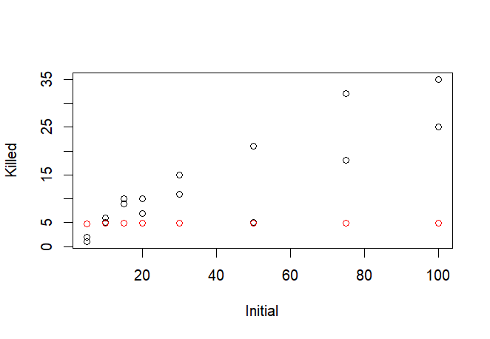
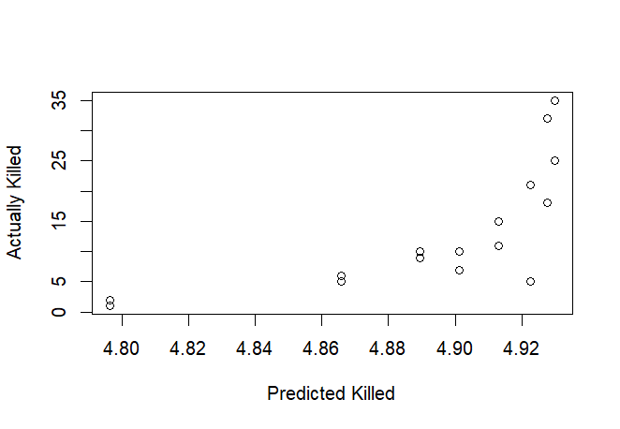
Our model doesn’t fit great

Slide 17
Profiling our model
Take a look at the parameters of your model: which value seems more extreme?
It makes sense to start with whichever parameters seems less sensible

Slide 18
Profiling our model
Since a is around 33, we’ll start with that one
First, make a vector of “a” values to check, then a vector to store output data:
a_profile_seq <- seq(from = 0.1,to = 40,by=0.1)
a_profile_nll <- numeric(length(a_profile_seq))

Slide 19
Profiling our model
Now, we calculate NLL for each a value in the vector and record the output
for(i in 1:length(a_profile_seq)){
out_i <- mle2(
Killed ~ dbinom(size = Initial,
prob = a / (1 + a * h * Initial)),
start = list(a = 0.01, h = 10),
data = ReedfrogFuncresp,
fixed = c(a = a_profile_seq[i])
)
a_profile_nll[i] <- out_i@min
} #end for loop
Run this loop. What happens?

Slide 20
Handling errors
The optimization threw errors for some values, stopping the loop
R has different error handling functions for these instances
tryCatch() is among the most powerful
It allows you to “catch” the error

Slide 21
tryCatch
The usual way to use tryCatch is:
output <- tryCatch(expr = <some code to run>,
error = function(e){e})
If there is an error, your output will be of class “error”
We can then replace the output with NA or whatever we like

Slide 22
Revising our profile with tryCatch
for(i in 1:length(a_profile_seq)){
out_i<- tryCatch(
mle2( Killed ~ dbinom(size = Initial,
prob = a / (1 + a * h * Initial)),
start = list(a = 0.01, h = 10),
data = ReedfrogFuncresp,
fixed = c(a = a_profile_seq[i])
), error = function(e){e})
if(inherits(x = out_i, what = "error")){
a_profile_nll[i] <- NA
}else{
a_profile_nll[i] <- out_i@min
}
}

Slide 23
Plotting our likelihood profile
plot(x = a_profile_seq,
y = a_profile_nll,
xlab = "a",
ylab = "NLL")
abline(v = m2.bad_start@coef["a"]) # add a line for our model fit estimate
Does out estimate for a correspond to the best NLL? What went wrong?

Slide 24
Plotting our likelihood profile
plot(x = a_profile_seq,
y = a_profile_nll,
xlab = "a",
ylab = "NLL")
abline(v = m2.bad_start@coef["a"]) # add a line for our model fit estimate
Does out estimate for a correspond to the best NLL? What went wrong?

Slide 25
Updating out model
We can get a new starting estimate for “a” based on our profile
best_guess_a <- a_profile_seq[which.min(a_profile_nll)]
Then we re-run the model with the new starting estimate
m2.good_start <- mle2(
Killed ~ dbinom(size = Initial,
prob = a / (1 + a * h * Initial)),
start = list(a = best_guess_a, h = 10),
data = ReedfrogFuncresp
)

Slide 26
Comparing the updated model
Check out the parameters
m2.bad_start
m2.good_start
Compare using aic
AICtab(m2.bad_start,m2.good_start)
Which model is best?

Slide 27
Plotting out new model results
Plot predictions on top of actual
plot(x = ReedfrogFuncresp$Initial,
y = ReedfrogFuncresp$Killed,
ylab = "Killed",
xlab = "Initial")
points(x = ReedfrogFuncresp$Initial,
y = predict(m2.good_start),
col = "red")
Plot killed vs predicted killed
plot(x = predict(m2.good_start),
y = ReedfrogFuncresp$Killed,
xlab = "Predicted Killed",
ylab = "Actually Killed")
Does the model predictions seem better?

Slide 28
Take-aways
Compare your model predictions to reality
If the model fit seems poor, try:
Different optimizers or starting values
profiles/slices
Using constraints
Transforming model parameters
Using a different model

Slide 29
Before next class:
Read 7.5

