Slide 1
Exploratory Analyses II
Today’s agenda:
Discuss Assignment 1
Discuss potential data sources to work with
Continue working through 2.6 (if needed)
Start to apply techniques from chapter 2 to dataset of interest

Slide 2
Assignment 1
Full information online (see Canvas/Github)

Slide 3
Assignment 1
Overview:
Select a dataset (you want one that can ask multiple questions)
Do some exploratory analyses (and document them)

Slide 4
Assignment 1
In this assignment, students will need to:
Select a dataset, provide a description, note where it came from
Read in their dataset
Note the class of the dataset itself (e.g., matrix, list, dataframe, etc.)
List the variables of interest and their classes (e.g., numeric, character, etc.)
Examine the structure of the dataset and correct any formatting mistakes
Provide summary statistics for variables of interest
Produce at least 3 different figures that convey different information
For the figures in 6, briefly describe what the figures show

Slide 5
Assignment 1: what you’ll submit
Needs to document what you did and be reproducible
Either:
The output of an .Rmd file showing code and outputs
See example_R_markdown/ for .Rmd file and potential output types, e.g. html, pdf
A .R file that can be run anywhere
See example_R_commented/ for .R file with comment examples

Slide 6
Assignment 1: what you’ll submit
Assignments can be submitted on canvas.
You can either:
Upload your file to Github and submit the link on Canvas
(require for grads, extra credit undergrads)
Upload the file on canvas
Due Friday, Sept. 19th before midnight.

Slide 7
Questions so far?

Slide 8
Getting data
Collect it
pro: you know it best, can be tailored to a specific question
con: time-consuming, possibly expensive, probably requires cleaning
Download it
pro: quick
con: less knowledge of collection, probably still needs cleaning
Aggregate it
pro: data volume and breadth
con: even less knowledge of collection, lots of standardization and cleaning required

Slide 9
Where to look for data
Course Github site:
Links to resources
Data folder contains some options
Scientific Publications
Supplementary Information
Data Publications (e.g., https://www.nature.com/sdata/ )
Data repositories
Dryad https://datadryad.org/
TRY https://www.try-db.org/TryWeb/Home.php

Slide 10
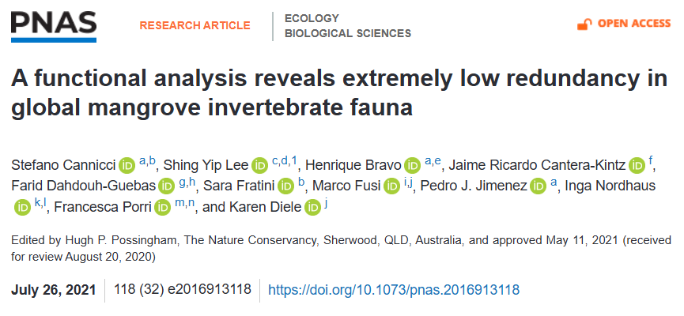
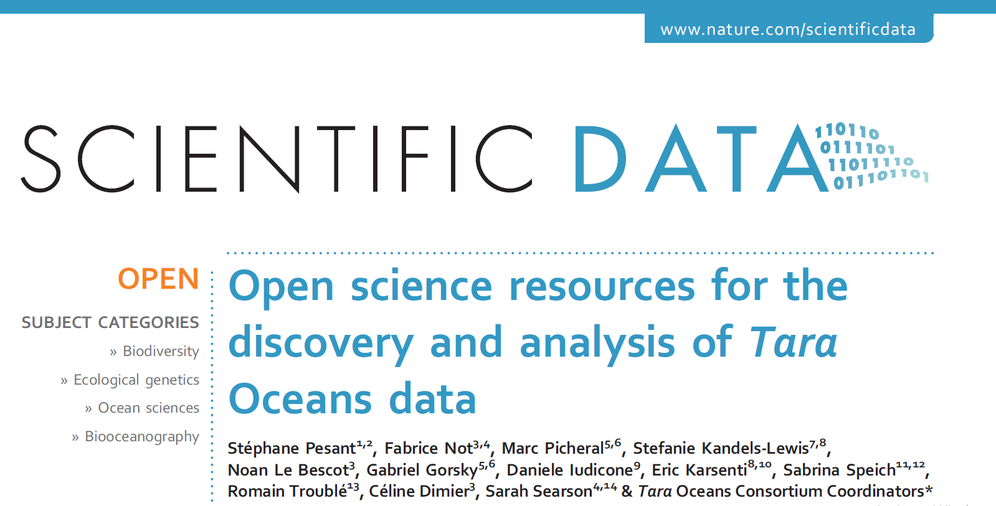
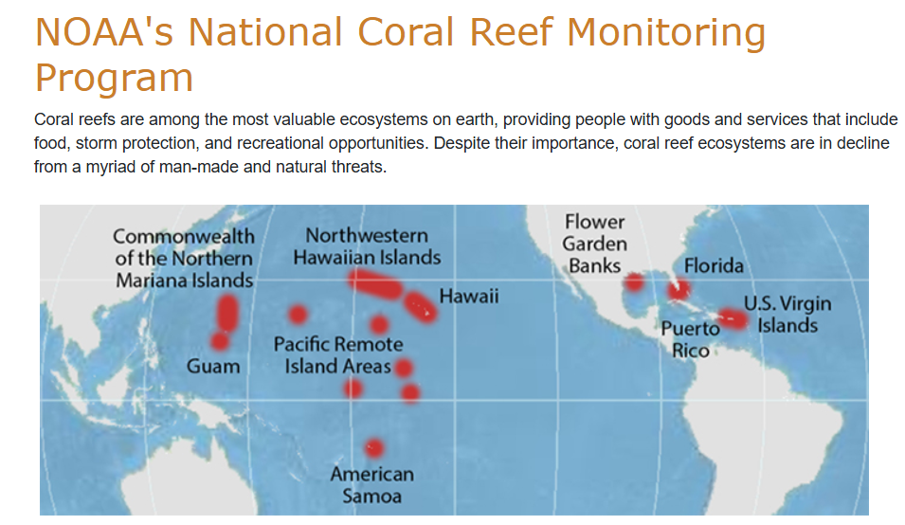
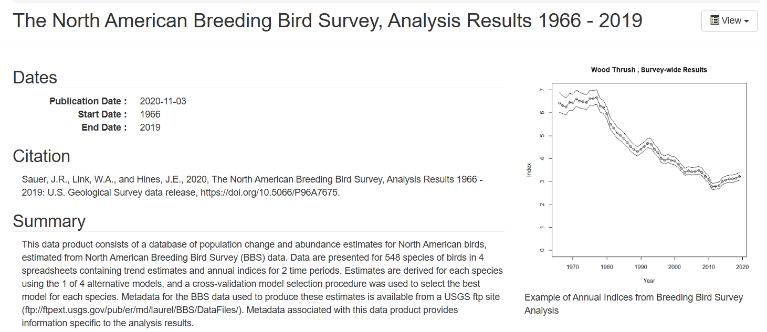
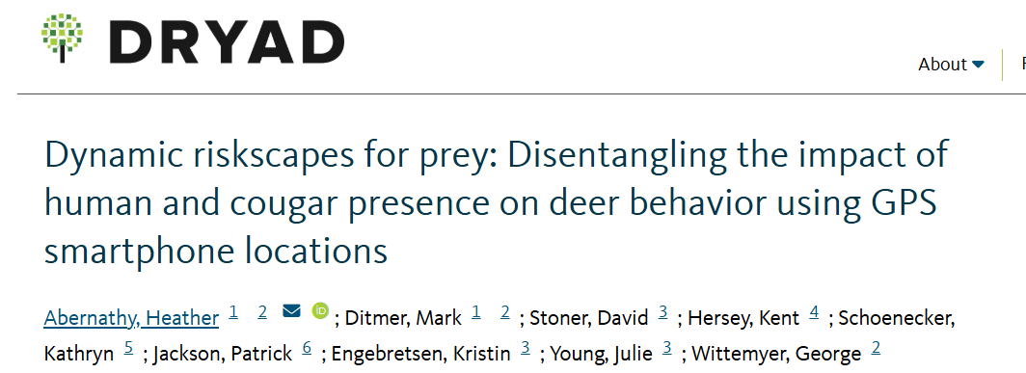
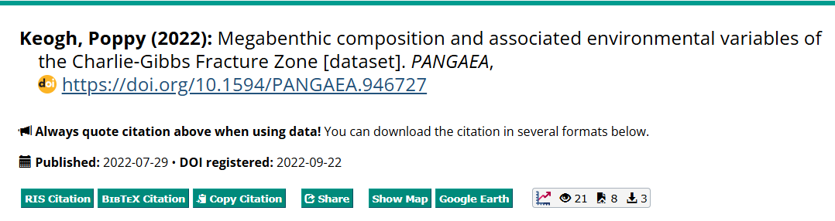
Datasets of interest to this class
Mangrove invert communities
Marine microorganisms
Deep sea megabenthos
Bird Survey Data
Coral populations
Rhino Deer Movement

Slide 11
Datasets of interest to this class
General places to look for data noted on the course Github homepage
Data folders on course Github
The “README” files in each folder contain useful information
May need to look up the data sources to understand all the column names.

Slide 12
Remainder of class:
Continue working on 2.6
Start working on Assignment 1
Next week:
I’ll be out of town
Do chapter 3
Complete Assignment 1

