Slide 1
Power analysis
Today’s agenda:
Discuss power analyses
Example power analyses

Slide 2
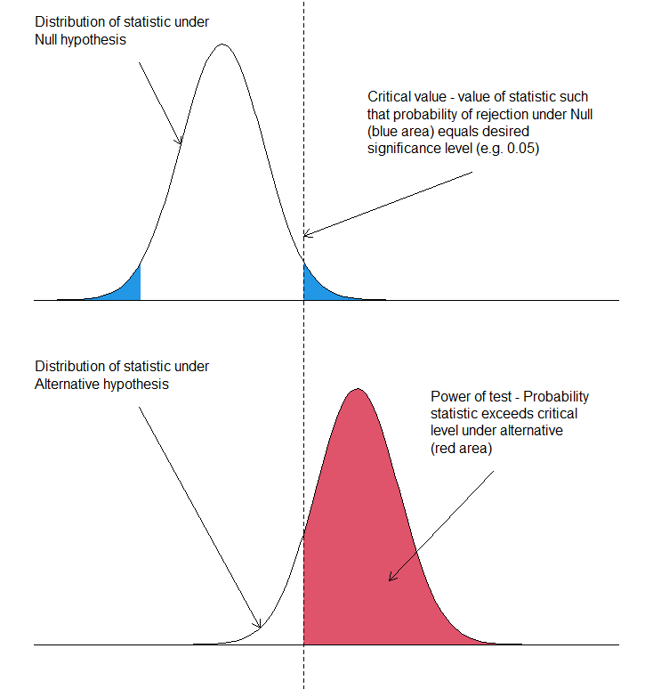
What is power?
 | Probability to reject H₀ | Probability to NOT reject H₀
If H₀ is true | 𝛼 | 1 - 𝛼
If H₁ is true | 1 - 𝛽 | 𝛽
1 - 𝛼
𝛽
1 - 𝛽
By Fangz - Own work, CC BY 4.0, https://commons.wikimedia.org/w/index.php?curid=150467695

Slide 3
What is power?
 | Probability to reject H₀ | Probability to NOT reject H₀
If H₀ is true | 𝛼 | 1 - 𝛼
If H₁ is true | 1 - 𝛽 | 𝛽
1 - 𝛼
power
𝛽
1 - 𝛽
By Fangz - Own work, CC BY 4.0, https://commons.wikimedia.org/w/index.php?curid=150467695

Slide 4
Power in a broader sense
Rather than focus on p-values, better to focus on:
How does data quantity impact my answers?
How does data quality impact my answers?
How do I trade off experimental costs vs effectiveness?

Slide 5
How do we estimate power?
In some cases, you can use fancy math
Most cases are easiest using simulations!

Slide 6
Things to think about with power analyses
Number and distribution of sites
Number of total observations
Distribution of observations across sites
Stratified vs even sampling
Amount of variation
Control vs quantification of variation
Effect sizes

Slide 7
Things to think about with power analyses
Say I wanted to measure leaf area for species across an elevation gradient:
What kind of factors might I need to consider?

Slide 8
Costs of research
More data is always better
BUT data collection has costs in terms of time and money
Power analyses help us allocate available time and money better

Slide 9
Data quality metrics
Bias: difference between the estimate and the true value
Variance: variability of estimates around mean estimate
Confidence interval width: how precise is the estimate?
Mean Squared Error: (bias² + variance) total variation around the true value
Coverage: probability the CI includes the true value
Power: probability of correctly rejecting the null hypothesis

Slide 10
Simple example: Linear Regression
We’ll simulate a linear function with normal error:
Slope = 1
Intercept = 2
SD = 8
Samples: x = 1,2,3,... 20
How do we simulate this?

Slide 11
Simple example: Linear Regression
x <- 1:20
a <- 2
b <- 1
sd <- 8
N = 20
set.seed(1)
y_det <- a + b*x
y <- rnorm(n = length(y_det),
mean = y_det,
sd = sd)

Slide 12
Simple example: Linear Regression
x <- 1:20
a <- 2
b <- 1
sd <- 8
N = 20
set.seed(1)
y_det <- a + b*x
y <- rnorm(n = length(y_det),
mean = y_det,
sd = sd)
Once you’ve done this, make a plot of y ~ x
Compare your plot with others, are they the same?

Slide 13
Simple example: Linear Regression
Now we need to:
Check whether the relationship we simulated is supported
Compare how close our estimates are to the true values
# fit a linear model
m <- lm(y ~ x)
# get the model coefficients
coef(summary(m))
Is b significant?
How close is the estimate of b to the true value?

Slide 14
Simple example: Linear Regression
Remember: Power = probability of rejecting a false null hypothesis
One random draw doesn’t tell us that
We need to do this lots of times and record the results

Slide 15
For loops
Basic structure:
for(<index> in <some vector>){
Do some function
}

Slide 16
For loops
for(i in 1:100){
print(i)
}

Slide 17
For loops
x_unif<- runif(n = 50,min = 0,max = 100)
for(x in length(x_unif)){
x_unif[x] <- rnorm(n = 1,mean = x_unif[x],sd = 2)
}

Slide 18
Simple example: Linear Regression
nsim <- 400
pval <- numeric(nsim)
for(i in 1:nsim){
y <- rnorm(n = length(y_det),
mean = y_det,
sd = sd)
m <- lm(y ~ x)
pval[i] <- coef(summary(m))["x","Pr(>|t|)"]
}
sum(pval < 0.05)/nsim

Slide 19
Simple example: Linear Regression
nsim <- 400
pval <- numeric(nsim)
for(i in 1:nsim){
y <- rnorm(n = length(y_det),
mean = y_det,
sd = sd)
m <- lm(y ~ x)
pval[i] <- coef(summary(m))["x","Pr(>|t|)"]
}
sum(pval < 0.05)/nsim
Do these components make sense?

Slide 20
Nested for() loops
for(i in 1:10){
for(j in 1:20){
print(paste("i = ",i," j = ",j))
}}

Slide 21
Comparing different parameters
bvec <- seq(-2, 2, by = 0.1)
power.b <- numeric(length(bvec))
for(j in 1:length(bvec)){
for(i in 1:nsim){
b <- bvec[j]
y_det <- a + b*x
y <- rnorm(n = length(y_det),
mean = y_det,
sd = sd)
m <- lm(y ~ x)
#get p-value
pval[i] <- coef(summary(m))["x","Pr(>|t|)"]
}#end i lloop
power.b[j] <- sum(pval< 0.05)/nsim
}#end j loop

Slide 22
Comparing different parameters
bvec <- seq(-2, 2, by = 0.1)
power.b <- numeric(length(bvec))
for(j in 1:length(bvec)){
for(i in 1:nsim){
b <- bvec[j]
y_det <- a + b*x
y <- rnorm(n = length(y_det),
mean = y_det,
sd = sd)
m <- lm(y ~ x)
#get p-value
pval[i] <- coef(summary(m))["x","Pr(>|t|)"]
}#end i lloop
power.b[j] <- sum(pval< 0.05)/nsim
}#end j loop
Check the slope impacts power.
What is the relationship?

Slide 23
Remainder of Class:
Challenge: does sample size impact power?
Can you use fewer samples when the slope is higher?
Update your code to check this
Hints:
Add another for() loop that loops over different sample sizes
Use col or pch for plotting different sample sizes
Before next class:
Turn in Assignment 2 (due Friday)
Read 6.1 - 6.2 (6.2.2 is optional)

