Slide 1
Likelihood
Today’s agenda:
Midterm explained
Likelihood

Slide 2
Midterm
Due October 14th by the end of the day (11:59 pm firm deadline)
Take-home
Open everything (but no AI for written components)
Submit via canvas (file or Github link to a file)

Slide 3
Midterm
3 parts:
Writing about analyses
Draft part of a short paper
Use data of your choice
Builds heavily on assignment 1
Identify which mathematical functions and distributions to use
Given 3 datasets, decide which function and distribution to use for each. Explain why.
Power analysis to understand how sample size and slope impact power
Builds off of what we did in class.
I provide code to help get you started.
Possible solutions range from pretty easy to more complicated.

Slide 4
Midterm
In part 1 I ask you to cite R and any packages used.
Here’s how to get that information:
# Citing R
citation()
# Citing an R package
citation("bbmle")

Slide 5
Midterm
Any questions?

Slide 6
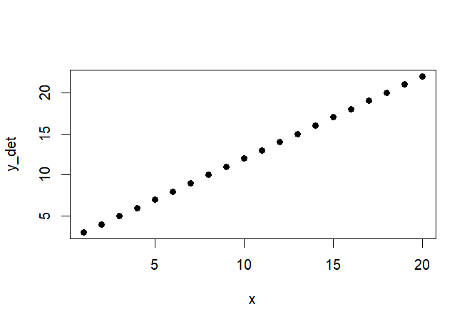
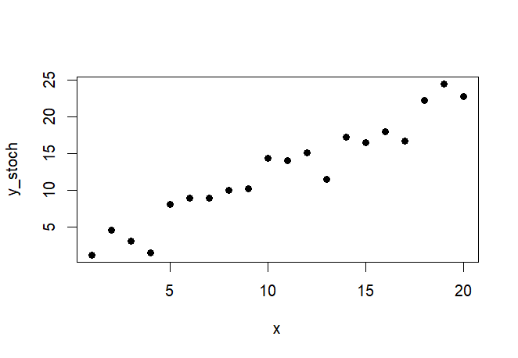
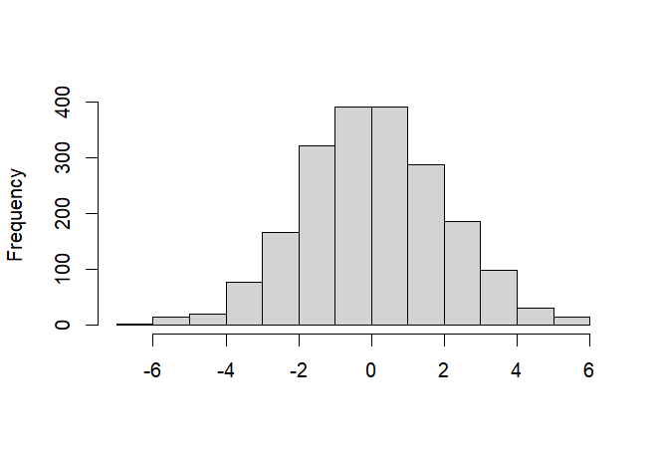
Last time: going from parameters to data
y = 2 + 1*x
SD = 2

Slide 7
Now: Going from data to parameters
y = 2 + 1*x
SD = 2

Slide 8
Why do we estimate parameters from data?
In most cases, we have data but what we want to know are the parameters, e.g.:
Slope:
how much does body size change with latitude?
How does species richness change with depth?
Intercepts:
Do some species consume more than others?
Are some species usually more common than others?
Variation:
Does variation in egg size change with body size?
Do leaves vary more within a given species at high latitude?

Slide 9
How do we estimate parameters from data?
Select models
Adjust the model parameters to maximize likelihood
Figure out which model(s) fit the data best

Slide 10
How do we estimate parameters from data?
Select models [We’ve done this]
Adjust the model parameters to maximize likelihood [This week]
Figure out which model(s) fit the data best [Next week]

Slide 11
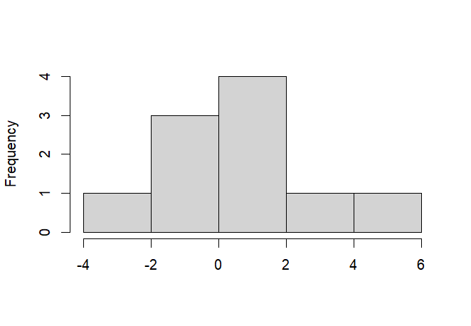
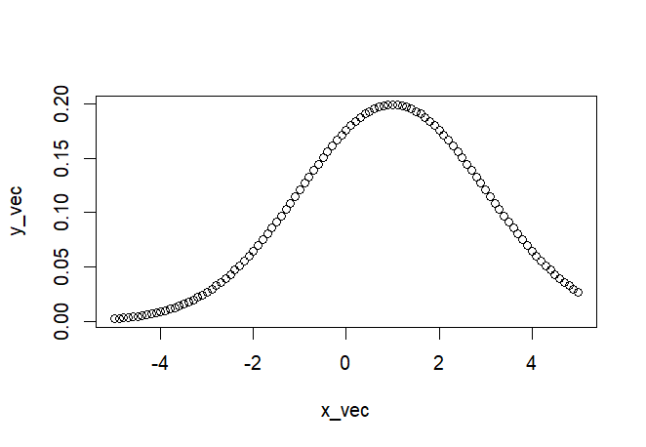
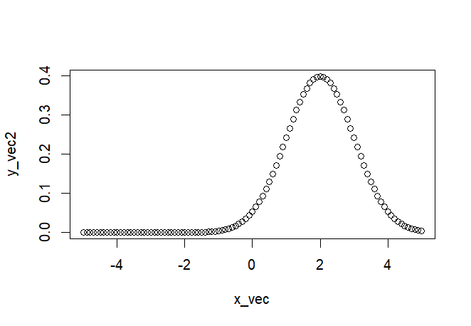
What is likelihood?
In this case:
The probability of seeing the data we collected, give a particular model.
Observed
Model A
Model B

Slide 12
How do we maximize likelihood?
Given data an a model, we find the parameters that give us the highest likelihood
Observed
Normal distribution with:
Mean = ?
Variance = ?

Slide 13
Example: Tadpole data
Load the data on tadpole predation from the emdbook package
Contains information on number of tadpoles initially and the number that survived
library(emdbook)
data("ReedfrogPred")

Slide 14
Example: Tadpole data
To simplify things, we’re going to start with a single treatment:
Small individuals
Stocking density of 10 tadpoles per tank
How might we narrow down the data to only this subset?

Slide 15
Subsetting
Use the subset() function
subset(x, subset, select, drop = FALSE, ...)

Slide 16
Subsetting
x <- subset(x = ReedfrogPred,
subset = density == 10 &
pred == "pred" &
size=="small")
Check to make sure x only has the expected subset

Slide 17
Functions
Now that we have data, we need a function to optimize.
Functions in R
Lots of them built in (e.g., lm(), mean(), plot())
Others in packages (e.g., ggplot(), readxl())
Can easily write your own! (super helpful)

Slide 18
Functions
Structure of a function in R:
function_name <- function(x,y){
output <- some_operation_using_variables(x,y)
return(output)
}
Then you use it like any other function:
function_results <- function_name(x = 1, y = 2)

Slide 19
Function example
calculate_mean <- function(x){
out <- sum(x)/length(x)
return(out)
}
Should give the same results as R’s mean function:
calculate_mean(x = c(1,2,3))
mean(c(1,2,3))

Slide 20
Negative log likelihood function
R has ways of optimizing the values in functions
However, to use them we need a function to optimize:
binomNLL1 <- function(p,k,N){
-sum(dbinom(x = k,
prob = p,
size = N,
log = TRUE)
)
}

Slide 21
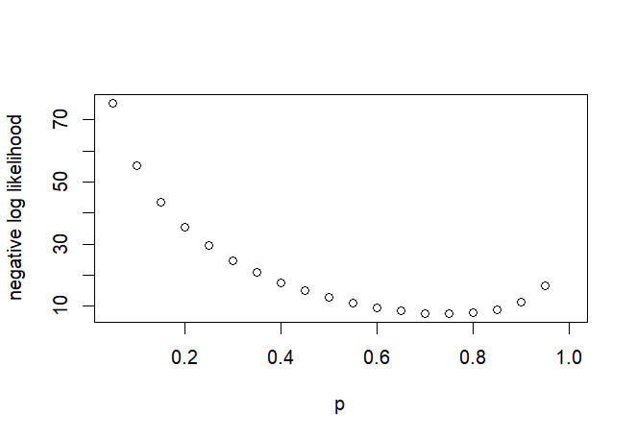
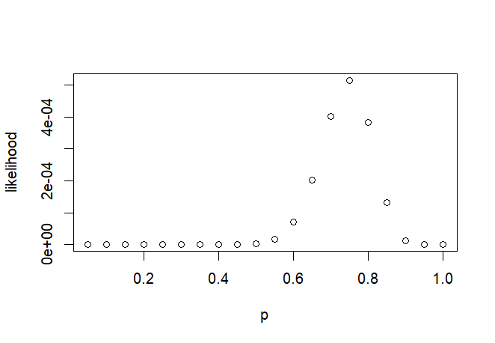
Optimization
Brute force option: try a bunch of numbers and pick the best one
Algorithms are usually a better option. R has many options
The shape of the NLL surface makes it easier to optimize

Slide 22
Optimizing using optim
optim() handles optimization/minimization and is used for model fitting:
opt1 <- optim(fn = binomNLL1,
par = c(p = 0.5), # starting parameter estimate
N = x$density, # individuals in each trial
k = x$surv, # survival rate
method = "BFGS")

Slide 23
optim results
opt1$par # the optimal parameter estimate for predation prob p
opt1$value # negative log likelihood
To get likelihood, make it positive and exponentiate:
exp(-opt1$value)
Try this out and see what values you got

Slide 24
Optimization using mle2
mle2 is a function by Ben Bolker designed to be more intuitive
library(bbmle)
m1 <- mle2(minuslogl = binomNLL1,
start = c(p=0.5), #starting parameters
method = "BFGS",
data = list(N= 10, k = k) #individuals pertrial (N) and survival (k)
)
m1@coef # estimated parameters (p)
exp(-m1@min) # maximum likelihood

Slide 25
Remainder of Class:
Work through the example in 6.2.1.2
Before next class:
Read 6.3

