Slide 1
Probability and stochasticity
Today’s agenda:
Check-in
Variability
Probability theory
Analyzing probability theory

Slide 2
Check-in
Reminder: Assignment 1 was due last Friday
Typo in lecture notes (notes said read chapter 4, syllabus said chapter 3)
If you’ve worked through chapter 3, great!
If you worked through chapter 4, work through chapter 3 when you get a chance (esp 3.4-3.6)

Slide 3
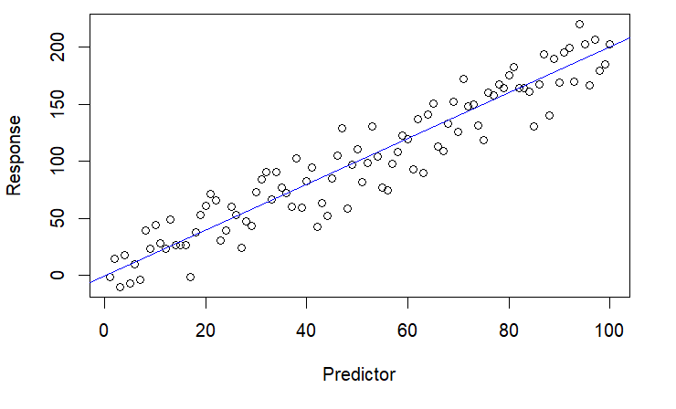
Variability
Increasing recognition of importance biologically (e.g., intraspecific variation)
Important component of statistical models (“signal” vs “noise”)

Slide 4
Variability
Different sources of variability
Unmeasured variables (e.g., environmental stochasticity)
Measurement error
Inherent uncertainty
Demographic stochasticity (50% survival in a population of 3)
Nonlinear dynamics can increase/decrease variation

Slide 5
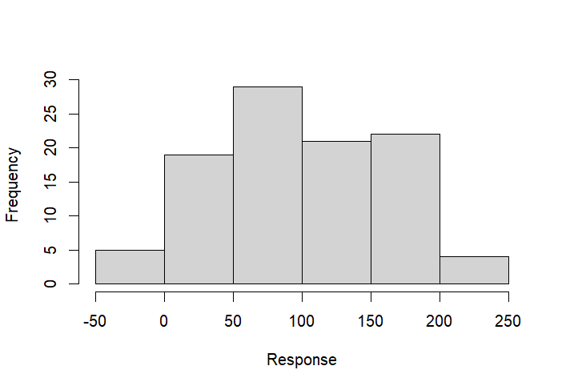
Variability
Different ways of handling variability
Try to explain it vs. treat as error

Slide 6
Probability theory refresher
Probabilities sum to 1

Slide 7
Probability theory refresher
For mutually exclusive events: Probability A or B = P(A) + P(B)
P(Dead or alive) = P(Dead) + P(Alive) = 1
If P(Dead) = 0.4, P(Alive) = 0.6
P(SIR) = P(S) + P(I) + P(R) = 1
If P(S) = 0.1, and P(R) = 0.2, P(S or R) = 0.3
Then P(I) = 0.7

Slide 8
Probability theory refresher
 | Male | Female
Blue | 20 | 30
Green | 15 | 35
For non-mutually exclusive events,
Have to account for double counting:
P(Blue OR Male) =
P(Blue) + P(Male) - P(Blue AND Male) = 0.65
Corrects for double-counts

Slide 9
Probability theory refresher
Conditional probability: Probability of something, given something else
P(A|B) = P(A and B) / P(B)
P(Male|Blue) = P(Blue male) / P(Blue)
0.40 = 0.20/.50
 | Male | Female
Blue | 20 | 30
Green | 15 | 35

Slide 10
Probability theory refresher
Independent variables: P(A and B) = P(A)*P(B)
If Sex and Color were independent, we’d expect:
P(Blue Male) = P(Blue) * P(Male)
0.175 = 0.5 * 0.35
0.20 != 0.175, measurement error? dependence?
 | Male | Female
Blue | 20 | 30
Green | 15 | 35

Slide 11
Questions so far?

Slide 12
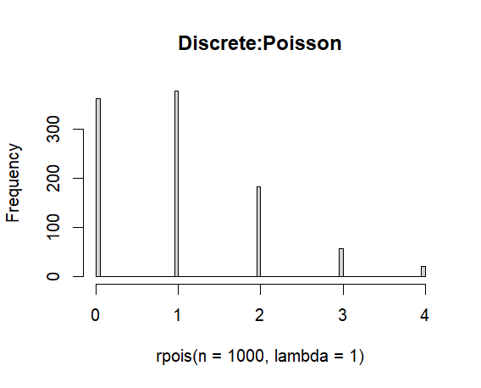
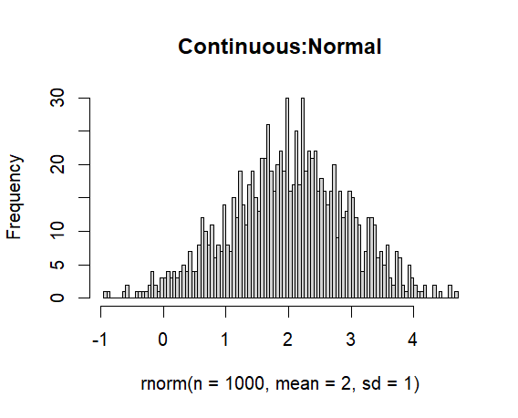
What to know about probability distributions
2 classes: Discrete vs continuous
Discrete:
Integers
E.g., individuals, # events
Continuous:
Any real number (or a subset, e.g. positives)
E.g., body sizes, speeds, etc.
P(any exact number) = 0
Focus on P(some number or more extreme)
E.g. P( x >= 4)

Slide 13
Continuous or discrete?
Organisms
Body Mass
Age
Leaf Area
Population size
Population density
Species richness
Functional diversity
Individuals per transects
Mean body mass
Environment
Temperature
Elevation
Depth
Hurricane severity
Evolution
Base pair substitution
Evolutionary rate
Species per taxon

Slide 14
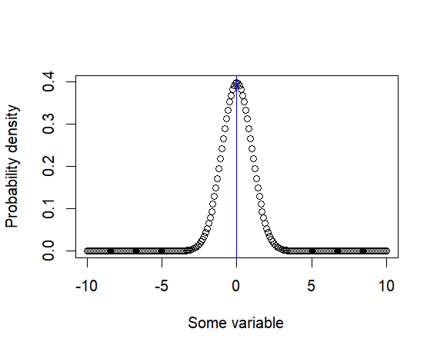
What to know about probability distributions
Central tendencies:
Mean
“Average”
Expected value (denoted E[x])
Also denoted
Use function mean()

Slide 15
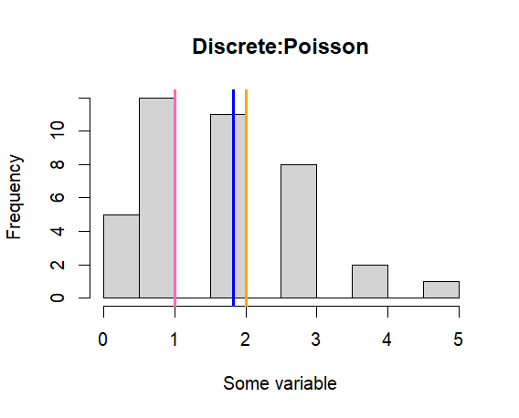
What to know about probability distributions
Central tendencies:
Median
More robust than mean
Less sensitive to outliers and skew
Use function median()
Blue = mean
Orange = median
Pink = mode

Slide 16
What to know about probability distributions
Central tendencies:
Mode
Most likely or most common value
No built-in function
DescTools package has Mode()
Blue = mean
Orange = median
Pink = mode

Slide 17
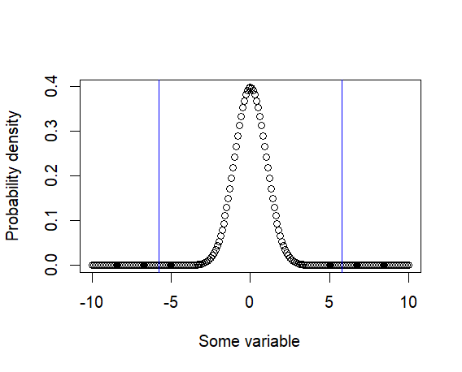
What to know about probability distributions
Spread:
Variance and standard deviation
Variance:
SD²
Additive
Units of mean squared
Function var()
SD
√variance
Not additive
Same units as mean
Function sd()
Blue lines: Mean +/- SD

Slide 18
Activities
Load data and calculate mean, variance, std dev, median, mode, etc.
Use data on github

Slide 19
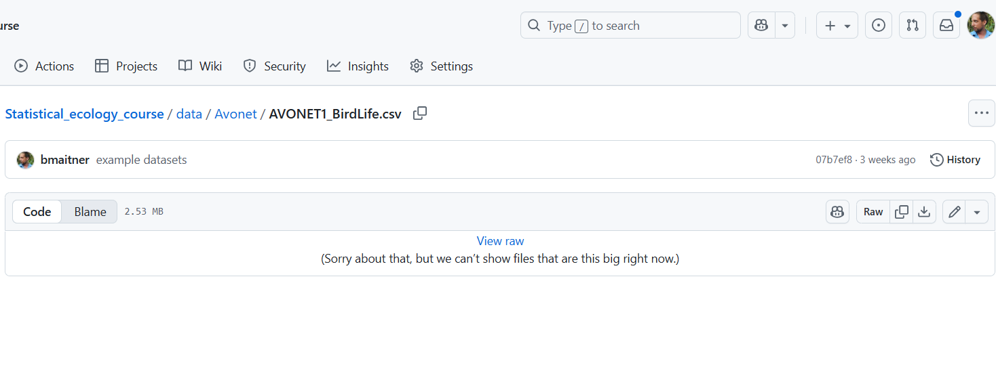
Working with probability distributions
To get link:
Right click on “Raw”, copy the URL
Load the avonet data

Slide 20
Working with probability distributions
Load the avonet data
avonet <- read.csv("https://github.com/bmaitner/Statistical_ecology_course/raw/refs/heads/main/data/Avonet/AVONET1_BirdLife.csv")

Slide 21
Working with probability distributions
Using the avonet data:
Generate a histogram of Hand-Wing Index (high HWI = long-distance flyer)
Use hist() function
Calculate mean and median Hand-Wing Index
mean() and median()
Generate a histogram of Body Mass
Also try generating a histogram of the log of body mass (use log10() or log())
Calculate mean and median body mass
How similar are they?
(optional) Try calculating the mode of body mass
Mode()in the DescTools package

Slide 22
Working with probability distributions
Using the avonet data:
Calculate the variance and standard deviation of Mass
var() and sd()
Check that variance equals SD²
Use “==” to test whether things are equal
R uses “^” to denote raising something to a power, e.g., x^2 mean x²
For square roots, use either sqrt() or x^0.5
Calculate the mean and variance of Range.Size

Slide 23
Remainder of class:
Load in your focal data
Use today’s functions to better understand your key variables
Before next class:
Look over 4.5 and 4.6

