Slide 1
Better figures with ggplot2
Today’s agenda:
ggplot2 (R for Data Science Chapter 1)

Slide 2
ggplot2
A package in the tidyverse
“gg” refers to “grammar of graphics”, a consistent format for plotting
Offers a lot of options for publication-quality figures
Additional packages play (usually starting with “gg”) add more features
Syntax can be tricky at first

Slide 3
Getting set up
library(tidyverse)
library(ggplot2)
library(ggpubr)
avo <- read_rds("https://tinyurl.com/avonetdata")
Go ahead and run this

Slide 4
Understanding ggplot
Today, we’re going to work through some examples
We’ll start with single variables, then work up to more complicated figures

Slide 5
Distributions
Let’s start with the single variable case and look at distributions
Base R:
hist(avo$Hand.Wing.Index)
ggplot:
avo |>
ggplot(mapping = aes(x = Hand.Wing.Index)) +
geom_histogram()
Try this out now and examine the output

Slide 6
Distributions
You could also use a density plot:
avo |>
ggplot(mapping = aes(x = Hand.Wing.Index))+
geom_density()
Try this out now and examine the output

Slide 7
ggplot syntax
avo |>
ggplot(mapping = aes(x = Hand.Wing.Index)) +
geom_histogram()
What happens if we omit the “geom_histogram” bit?
Maps data to plot elements
Tells ggplot what type of plot to make

Slide 8
ggplot syntax
avo |>
ggplot(mapping = aes(x = Hand.Wing.Index)) +
geom_histogram()
What are some of the other “geom_” options? (hint: use tab completion)
Do they result in a figure if we call them instead of geom_histogram?
Plot functions begin with “geom_”

Slide 9
Two variables
Options depend on type of data:
 |  | y
 |  | Continuous | Categorical
x | Continuous | geom_point, geom_line | geom_density_ridges, coord_flip()-ed versions
 | Categorical | geom_bar, geom_boxplot, geom_violin | geom_tile, geom_raster,

Slide 10
Continuous x, continuous y

Slide 11
geom_point
avo |>
ggplot(mapping = aes(x = Hand.Wing.Index,
y = Kipps.Distance))+
geom_point()
Try this out. Then, plot two other continuous variables

Slide 12
geom_point
avo |>
ggplot(mapping = aes(x = Hand.Wing.Index,
y = Kipps.Distance))+
geom_point()
How would we plot a line showing the relationship between the two?

Slide 13
lines
Three main approaches:
geom_line() adds a line connecting adjacent points
Doesn’t work in this case
geom_abline() allows you to add a line you specify
Good option here if we fit a line first
geom_smooth() fits a line for you and add it
Good option here

Slide 14
geom_line()
avo |>
ggplot(mapping = aes(x = Hand.Wing.Index,
y = Kipps.Distance))+
geom_line()
Try this out. Is it useful?

Slide 15
geom_line()
avo |>
mutate(rounded_hwi = round(Hand.Wing.Index)) |>
group_by(rounded_hwi) |>
summarise(mean_kipps = mean(Kipps.Distance)) |>
ggplot(mapping = aes(x = rounded_hwi,
y = mean_kipps))+
geom_line()
Try this one. Is this useful?

Slide 16
geom_abline()
With this, we can add a fitted line to a plot.
First, we need to decide on a line, or model one
kipps_v_hwi_model <- avo |>
lm(formula = Kipps.Distance ~ Hand.Wing.Index)
What data do we need from the model to plot the fitted line?

Slide 17
geom_abline()
ggplot(data = avo,mapping = aes(x = Hand.Wing.Index,
y = Kipps.Distance))+
geom_point()+
geom_abline(slope = kipps_v_hwi_model$coefficients[2],
intercept = kipps_v_hwi_model$coefficients[1],
color = "blue")
Run this. How does it look? Any changes you’d want to make?

Slide 18
geom_smooth()
Fits a line for you
By default uses a loess fit
In many cases, we want an lm instead
ggplot(data = avo,mapping = aes(x = Hand.Wing.Index,
y = Kipps.Distance))+
geom_point()+
geom_smooth()
Run this now. How does the fitted line look?

Slide 19
geom_smooth()
ggplot(data = avo,
mapping = aes(x = Hand.Wing.Index,
y = Kipps.Distance)) +
geom_point() +
geom_smooth(method = "lm")
Run this. How does it compare with the plot you made using geom_abline?

Slide 20
Categorical x, continuous y

Slide 21
geom_bar
avo |>
group_by(Order1) |>
summarise(mean_mass = mean(Mass)) |>
slice_max(n = 5, order_by = mean_mass) |>
ggplot(mapping = aes(y = mean_mass, x = Order1)) +
geom_bar(stat = "identity")
Try this out. Then, try it for different variable(s)

Slide 22
geom_bar
By default, geom_bar uses count data.
We forced it to use the raw data we gave it (mean_mass)
Let’s try the default setting

Slide 23
geom_bar
avo |>
filter(Order1 %in% c("Struthioniformes",
"Cathartiformes",
"Gaviiformes",
"Sphenisciformes",
"Ciconiiformes")) |>
ggplot(mapping = aes(x= Order1)) +
geom_bar()
Try this one. Why don’t we have to specify y in the aesthetics?

Slide 24
geom_boxplot
avo |>
filter(Order1 %in% c("Struthioniformes",
"Cathartiformes",
"Gaviiformes",
"Sphenisciformes",
"Ciconiiformes")) |>
ggplot(mapping = aes(x= Order1,
y = Wing.Length)) +
geom_boxplot()
Run this now. Who remembers what the different features denote?

Slide 25
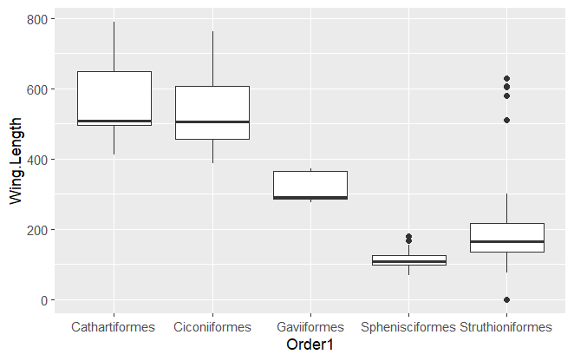
geom_boxplot
Horizontal line = Median
Hinges = Q1 and Q3
Whiskers =
Furthest data within 1.5*IQR from Q1/Q3
IQR = Q3-Q1
Dots = outliers (points outside whiskers)

Slide 26
geom_violin
A sort of combination of a density plot and a boxplot
Contains more information than a boxplot
Revise the code we used for our boxplot to make a violin plot instead

Slide 27
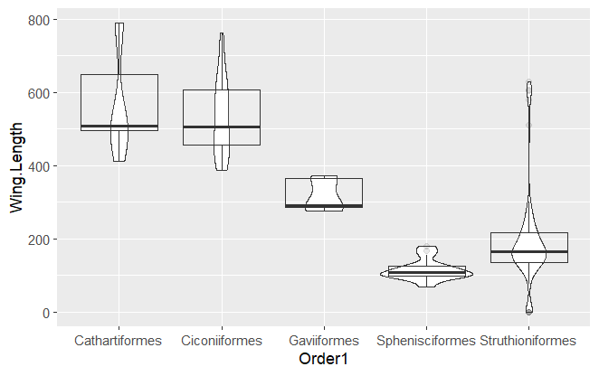
Box vs violin

Slide 28
Continuous x, categorical y
Same functions as for categorical x and continuous y
Just flip the x and y variables
Can also use “coord_flip)
avo |>
group_by(Order1) |>
summarise(mean_mass = mean(Mass)) |>
slice_max(n = 5, order_by = mean_mass) |>
ggplot(mapping = aes(y = mean_mass, x = Order1)) +
geom_bar(stat = "identity")+
coord_flip()
Try this one out

Slide 29
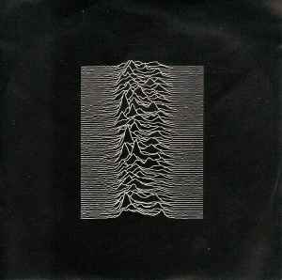
Joy Plots (aka Ridgeline plots)
Inspired by Joy Division’s album, Unknown Pleasures (1979)
Essentially a stacked set of distributions
Implemented in R using geom_density_ridges()

Slide 30
geom_density_ridges
avo |>
group_by(Order1) |>
mutate(mean_mass = mean(Mass)) |>
filter(Order1 %in% c("Struthioniformes",
"Cathartiformes",
"Gaviiformes",
"Sphenisciformes",
"Ciconiiformes")) |>
ggplot(mapping = aes(x = Wing.Length,
Y = Order1,
group = Order1))+
geom_density_ridges()
Try this out!

Slide 31
Categorical x, categorical y
Not a common thing
Sometimes done to show the counts in the different categories

Slide 32
geom_count
avo |>
filter(Family1 %in% c("Psittacidae","Cacatuidae"))|>
ggplot(mapping = aes(x = Family1,y = Habitat))+
geom_count()
Try this out. Are there situations where it might be useful?

Slide 33
geom_tile
avo |>
group_by(Family1, Trophic.Level) |>
mutate(n_species = n(),
log10_species = n() |> log10()) |>
filter(Family1 %in% c("Psittacidae", "Cacatuidae"))|>
ggplot(mapping = aes(x = Family1,
y = Trophic.Level,
fill = log10_species))+
geom_tile()
Try this one out as well.

Slide 34
More than 2 variables?
When you have more than two variables, options include:
Using color/fill
Using shape/line type
Using size
Using faceting

Slide 35
Color and fill
Color used for lines and points, fill for polygons
Example of using color to show three variables:
avo |>
filter(Family1 %in% c("Psittacidae","Cacatuidae"))|>
group_by(Family1,Habitat) |>
summarise(mean_mass = mean(Mass)) |>
slice_max(n = 5, order_by = mean_mass) |>
ggplot(mapping = aes(y = mean_mass,
x = Family1, fill = Habitat)) +
geom_bar(stat = "identity", position = "dodge")
Try this one out

Slide 36
faceting
facet_wrap and facet_grid split up plots into different facets
Try out this example:
avo |>
filter(Family1 %in% c("Psittacidae", "Cacatuidae"))|>
ggplot(mapping = aes(x = Mass,
y = Wing.Length))+
geom_point()+
facet_wrap(~Family1)

Slide 37
faceting
Facet grid allows you to have plots divided into rows/columns
avo |>
filter(Family1 %in% c("Psittacidae", "Cacatuidae"))|>
ggplot(mapping = aes(x = Mass,
y = Wing.Length))+
geom_point()+
facet_grid(Family1 ~ Trophic.Niche)
Try this one out as well. Note the structure of the facet_grid arguments (y ~ x)

Slide 38
Soooo many more options
What we’ve done today only scratches the surface
Many ways of combining plots, customizing, etc.
Lots of blogs and tutorials to look at once you have the basics down
Check out the cheat sheet at: https://rstudio.github.io/cheatsheets/html/data-visualization.html

Slide 39
Before next class:
Read “R for Data Science” chapter 8:
https://r4ds.hadley.nz/workflow-help.html
Read Merow, et al. 2023
Merow, C., Serra-Diaz, J.M., Enquist, B.J. et al. AI chatbots can boost scientific coding. Nat Ecol Evol 7, 960–962 (2023). https://doi.org/10.1038/s41559-023-02063-3
May be a quiz
Turn in Assignment 4 (Friday, Nov 21 by midnight)

