Slide 1
Likelihood II
Today’s agenda:
Estimating complex functions

Slide 2
Last time
Likelihood
Functions
Different options for optimizing (optim, mle2, brute force)
How to identify the parameter for a simple model that maximizes likelihood
But we only did models with a single parameter

Slide 3
What do we do when there are lots of parameters?
Let’s return to the tadpole predation data
Remember, the experiment involved different treatments:
Tadpole size variation
Predation (presence/absence)
Stocking density
Last time we picked one density level
What if we want to understand how density impact predation rate?

Slide 4
What do we do when there are lots of parameters?
Load and plot the dataset:
data("ReedfrogFuncresp")
Plot both:
Number Killed ~ Initial density
Per capita death rate ~ Initial density

Slide 5
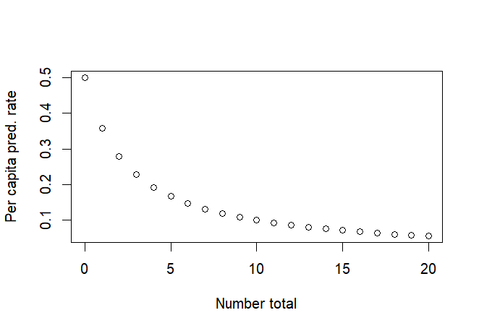
Predation model
We’ll model predation using a type II functional response
p = a/ (1+a*h*N)
p = predation rate
a = attack rate
h = handling time
N = number of prey

Slide 6
Predation model
We’ll model predation using a type II functional response
p = a/ (1+a*h*N)
p = predation rate
a = attack rate
h = handling time
N = number of prey
Attack rate is lessened by the amount of time it takes to consume prey. If handling time is zero, p = a.

Slide 7
Understanding the Predation model
When you come across a new model, it can be useful to play with it a bit to understand the parameters
Try plotting p ~ N
Try different values for a and h to understand how they control the behavior
What does “a” do? What does “h” do?
a <- .5
h <- .8
N_vec <- 0:20
plot(x = N_vec,y= a/(1+a*h*N_vec),
ylab = "Per capita pred. rate",
xlab = "Number total")
p = a/ (1+a*h*N)
p = predation rate
a = attack rate
h = handling time
N = number of prey

Slide 8
Predation model
We’ll model predation using a type II functional response
p = a/ (1+a*h*N)
We’ll use a binomial distribution for p (since prey are either eaten or not)

Slide 9
Translating the predation model to R
Reminder:
p = predation rate
a = attack rate
h = handling time
N = number of prey
K = number killed
Predation:
pred_prob = a/ (1+a*h*N)
Likelihood:
dbinom(x = k, size = N, prob = pred_prob)
We know k and N, are estimating a and h which tells us p

Slide 10
Translating the predation model to R
binomNLL2 <- function(params, N, k){
a = params[1]
h = params[2]
pred_prob = a/ (1+a*h*N)
-sum(dbinom(x = k,size = N, prob = pred_prob, log = TRUE))
}
Note that since we’re fitting two parameters,
we use a vector for the params

Slide 11
Optimizing with optim
data("ReedfrogFuncresp")
optim(fn = binomNLL2,
par = c(a=.5,h=.2),
N = ReedfrogFuncresp$Initial,
k = ReedfrogFuncresp$Killed
)

Slide 12
Optimizing with mle2
Note: mle2 requires you to name parameters of a NLL fx with multiple parms
parnames(binomNLL2) <- c("a","h")
m2 <- mle2(minuslogl = binomNLL2,
start = c(a=.5,h=2),
data = list(k = ReedfrogFuncresp$Killed,
N = ReedfrogFuncresp$Initial))

Slide 13
Checking our results
What are the estimated values for a and h?
Did the two approaches give the same values?

Slide 14
Checking our results
It’s helpful to plot your results to see if they make sense
plot( y = ReedfrogFuncresp$Killed / ReedfrogFuncresp$Initial,
x = ReedfrogFuncresp$Initial,
xlab = "Initial Density",
ylab = "Per capita predation rate" )

Slide 15
Checking our results
Now, add your predicted lines
Combine the equation with fitted parameters
First, we need a vector of x values to evaluate at
x_vec <- min(ReedfrogFuncresp$Initial):max(ReedfrogFuncresp)

Slide 16
Checking our results
Now, plug our fitted values into the equation:
p = a /
(1+a*h*N)
y_vec_optim <- opt2$par["a"] /
(1 + opt2$par["a"] * opt2$par["h"] * x_vec)

Slide 17
Checking our results
Add this fitted line to your figure using:
lines(x = x_vec, y = y_vec_optim, col = "orange")
Does it fit reasonably well?

Slide 18
Checking our results
Now check the mle2 results by plotting them in another color.
You can modify the code we just used:
y_vec_optim <- opt2$par["a"] /
(1 + opt2$par["a"] * opt2$par["h"] * x_vec)
lines(x = x_vec, y = y_vec_optim, col = "orange")
Hint: mle2 stores parameters using @coef instead of $par

Slide 19
Your turn!
How well would a linear function with a normal distribution fit these data?
Try to work out how you would write a normal NLL function, and then optimize
X = Initial #
Y = predation rate (# killed / Initial $)
Hint: sd needs to be positive, so you can optimize e^{sd}
sd = exp(params[3])

Slide 20
Remainder of Class:
Work through the example in 6.2.1.2
Before next class:
6.4 (6.4.2 optional),
Skim 6.5
Read 6.3

