Slide 1
Modelling Frameworks
Today’s agenda:
Discuss modelling frameworks,
Software installation and setup

Slide 2
What are some of the model choices mentioned?

Slide 3
What are some of the model choices mentioned?
General vs specific
Descriptive vs predictive
Mechanistic vs phenomenological
Analytical vs computational
Deterministic vs stochastic
Simple vs complex

Slide 4
Why are there so many different options?

Slide 5
Why are there so many different options?
Trade-offs: models differ in when they’re useful
E.g., mechanistic models can be linked to specific mechanisms,
but may require more data!
You’ll have to consider these trade-offs when selecting methods

Slide 6
Questions?

Slide 7
Our goal for today is setting up software
We’ll be installing:
R
RStudio
And, optionally, Git and Github

Slide 8
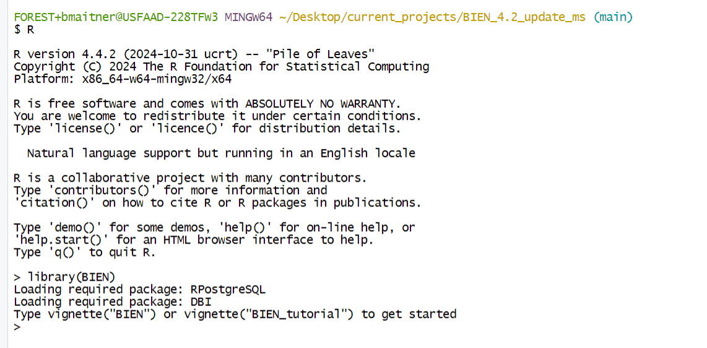
R

Slide 9
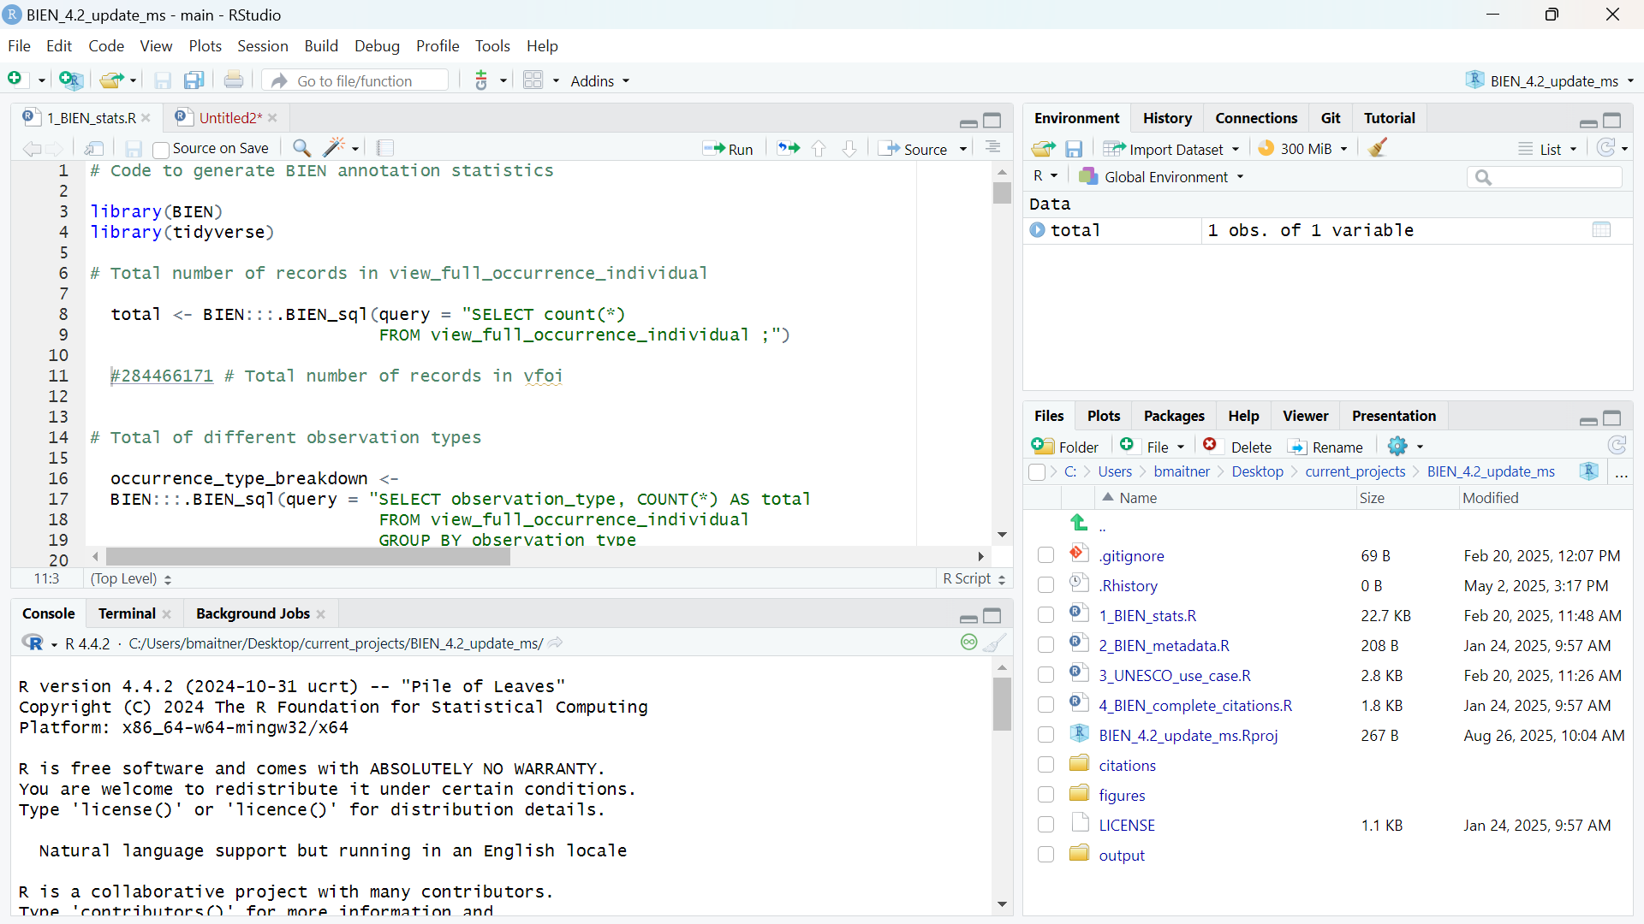
RStudio

Slide 10
RStudio
R

Slide 11
RStudio
Stuff to make R easier to use
R

Slide 12
Git
Program that tracks changes in files
Removes need for multiple versions of file (you can always go back)
Tracks what is added or removed in each version
Allows multiple users to work on files and combine their changes

Slide 13
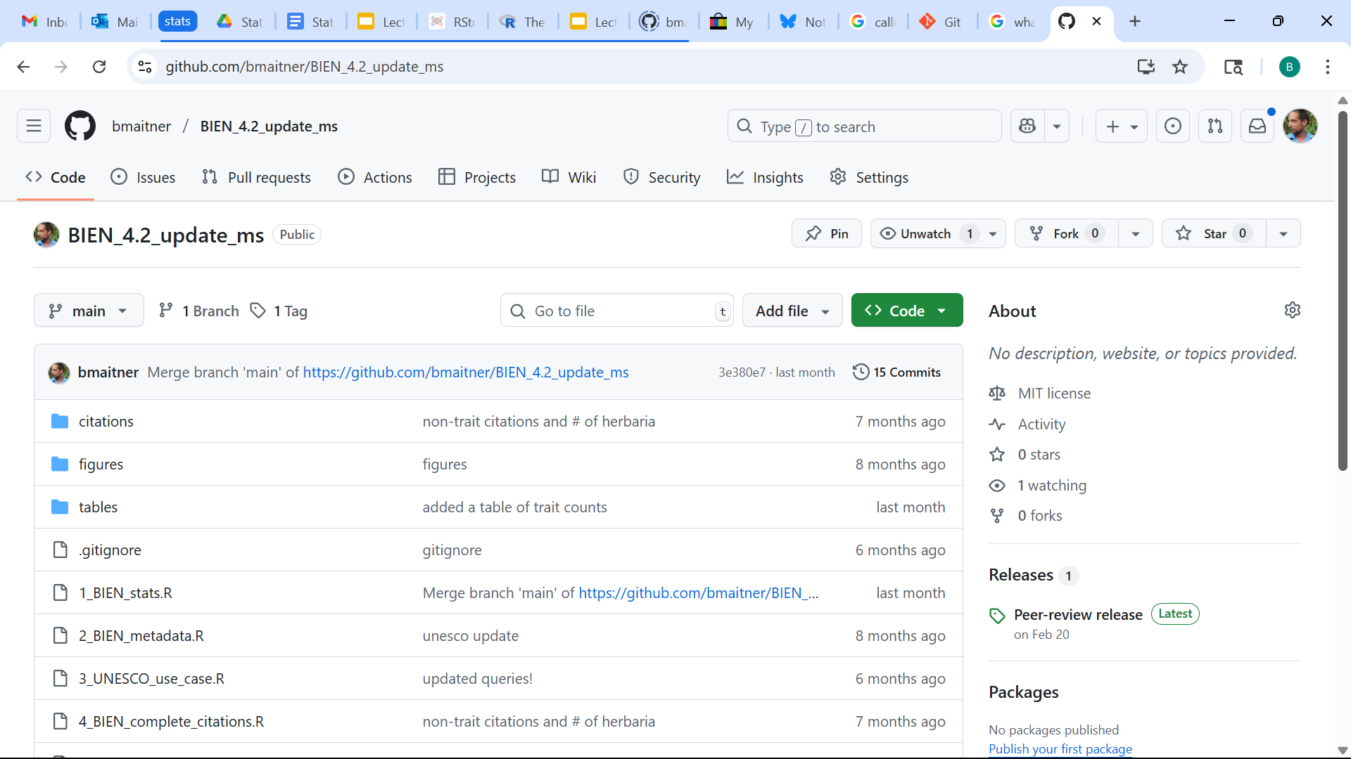
Github
A repository for Git
Stores your files
Also can be used for editing files
You can even set it up to run analyses for you!

Slide 14
Why use Github?
Secure backup of code (in case your computer dies…)
Helps when you use multiple computers
Collaboration
Transparency and reproducibility (if you make it public)
Letting other people use your code (forking/copying)
Increasingly expected of biologists
Can be archived, cited (e.g., via Zenodo)
Grad students have to, undergrads get extra credit

Slide 15
Installing the needed software
R (available for free at https://www.r-project.org/ )
RStudio (available for free at https://posit.co/download/rstudio-desktop/ )
Git (optional for undergrads. Available for free at https://git-scm.com/downloads )
Github account (optional for undergrads. Sign up for free at: https://github.com/ )

Slide 16
Did it work?
Should have a “Git” tab in RStudio

Slide 17
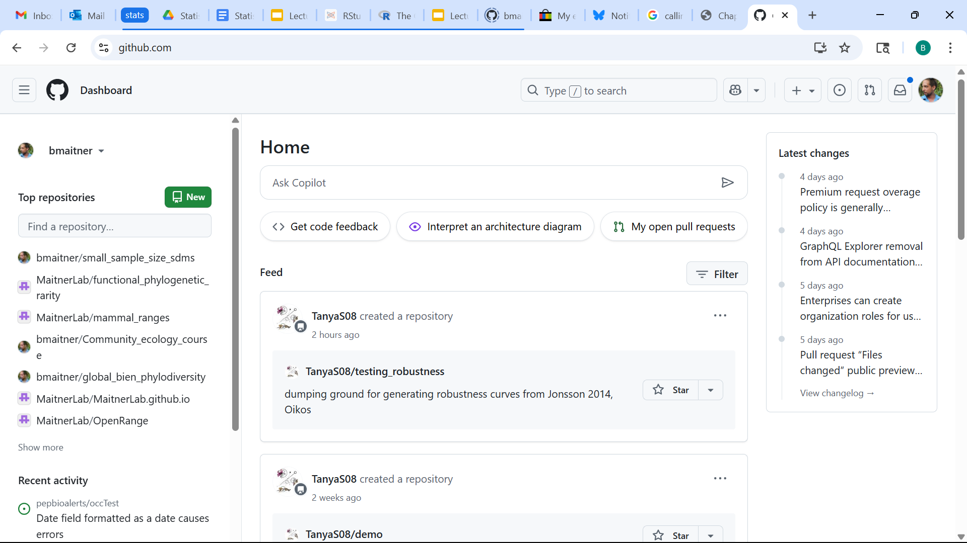
Make sure it works
Go to your Github page and make a new repo

Slide 18
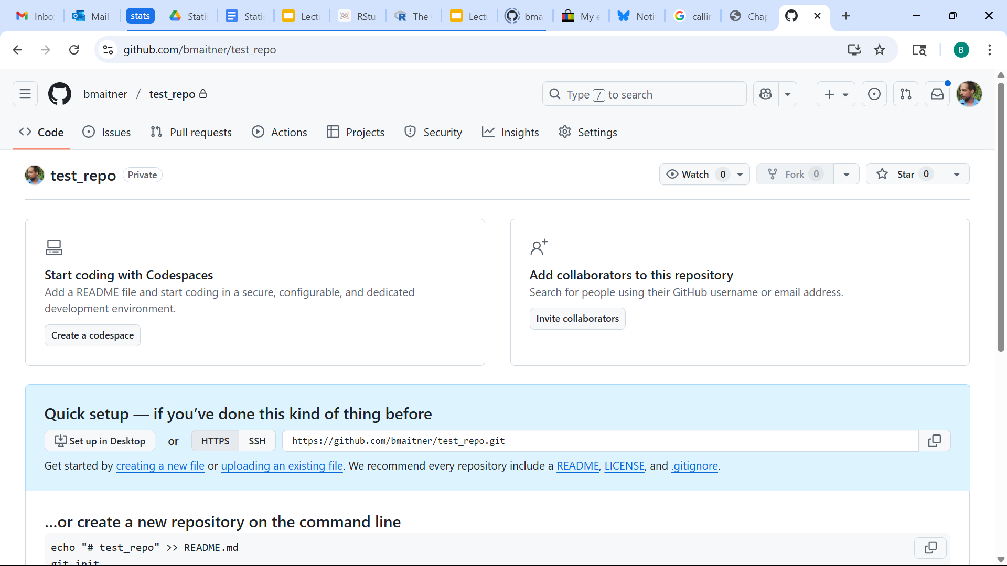
Make sure it works
Copy the URL

Slide 19
Make sure it works
In RStudio:
File > New Project…
Select “Version Control”
Select “Git”
Paste the copied URL into the “Repository URL” box
Pick a directory for it to be created in
Click “Create Project”

Slide 20
Next time:
Before class: read 1.4 - 1.6
During class:
Discuss 1.4-1.6
Work through 1.7

