Slide 1
Likelihood II
Today’s agenda:
Check-in
Confidence Intervals

Slide 2
Check-in
How are things going?
Anything that could be better?
Additional resources that could be added?
More assignments or examples?

Slide 3
Last time
Fitting functions with multiple parameters:
binomNLL2 <- function(params, N, k){
a = params[1]
h = params[2]
pred_prob = a/ (1+a*h*N)
-sum(dbinom(x = k,size = N, prob = pred_prob, log = TRUE))
}

Slide 4
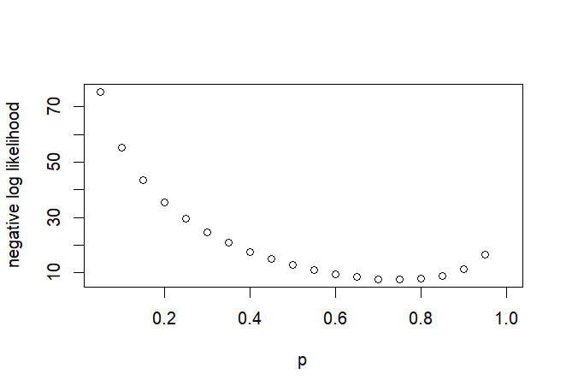
The time before last
Likelihood curves:
Likelihood depends on a parameter value

Slide 5
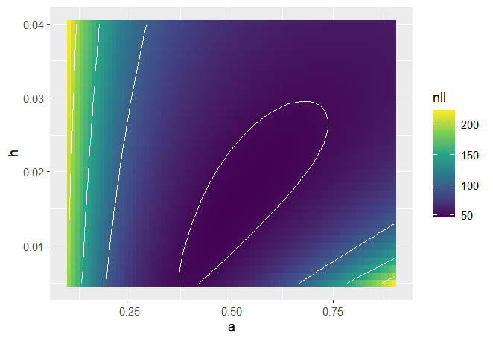
How do we handle likelihood plots in multiple dimensions?
Likelihood surfaces (instead of curves)
Essentially, you evaluate the likelihood at every combination of parameters

Slide 6
Other options
What if we have more than 2 parameters?
What if we want to visualize one parameter at a time? (surfaces hard to visualize)
Options:
Try plotting in more than 2 dimensions (not advised)
Take a slice through the data
Calculate likelihood profiles

Slide 7
Slices
Pick a focal parameter and a range of values to evaluate it over
Set other parameters to some value (e.g., their max likelihood estimates)
Calculate likelihood
May be useful, but are misleading
Parameters trade-off, so the parameter combinations you try aren’t always reasonable

Slide 8
Slices: Worked example pt 1
data("ReedfrogFuncresp")
binomNLL2 <- function(params, N, k){
a = params[1]
h = params[2]
pred_prob = a/ (1+a*h*N)
-sum(dbinom(x = k,size = N, prob = pred_prob,log = TRUE))
}
parnames(binomNLL2) <- c("a","h") # quirk of mle2: need to set the parm names
m2 <- mle2(minuslogl = binomNLL2,
start = c(a=.5,h=2),
data = list(k = ReedfrogFuncresp$Killed,
N = ReedfrogFuncresp$Initial))

Slide 9
Slices: Worked example pt 2
opt_a <- opt2$par["a"] # get the optimal parameter value for a then do a slice for h
h_vec <- seq(from = 0.01,to=0.04,by=0.005) # pick a sequence to optimize over
# we're going to use mle2 because it makes it easy to fix certain parameters
h_nll <- numeric(length(h_vec)) # this will hold our output
for(i in 1:length(h_vec)){
m2 <- mle2(minuslogl = binomNLL2,
start = c(a=.5,h=2),
data = list(k = ReedfrogFuncresp$Killed,
N = ReedfrogFuncresp$Initial),
fixed = list(a = as.numeric(opt_a),
h = h_vec[i]))
h_nll[i] <- m2@min
}

Slide 10
Slices: Worked example pt 3
Plot your slice (x= h_vec, y = h_nll )
How does the minimal value on your slice compare with the the optimization?

Slide 11
Slices: Your turn
You’ve done a slice for h (keeping a fixed at the optimized value)
Now, modify the code to do a slice for a (keeping h fixed)

Slide 12
Profiles
Pick a focal parameter and a range of values to evaluate it over
Allow other parameters to be optimized (*different from slices)
Calculate likelihood
Still not a complete picture, but represents actual parts of the surface

Slide 13
Profiles
How might we modify the slice code to calculate a profile?

Slide 14
Profiles
How might we modify the slice code to calculate a profile?
Since we used mle2, we can just remove “a” from the fixed arguments

Slide 15
Profiles
Modify your previous code to:
Leave out “a” from the fixed terms
Use a different object to store the new NLL values (e.g., h_nll2)
Store the “a” values that are being chosen
Plot 1:
Your profile for h (as before, the x-axis is the value of h, and y is the NLL)
Add points for the slice you took over the same values in another color
Plot 2:
For your profile, plot a vs h

Slide 16
Profiles
From your plots:
Which has the lower value for NLL?
What does the plot of a vs h tell us about why this is?

Slide 17
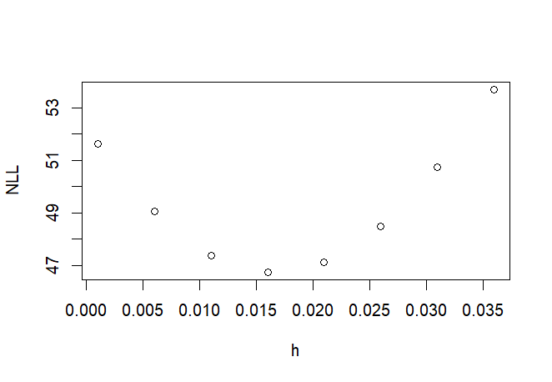
Parameter confidence limits
Parameters close to the best might be feasible
Those farther away are probably not
Commonly use likelihood-ratio tests

Slide 18
Likelihood Ratio test: General Idea
You can compare the likelihood of two combinations of parameters
Deviance = -2log(best model likelihood / restricted model likelihood)
Deviance follows a chi² distribution with r degrees of freedom
(r = number of fixed factors in the restricted model)

Slide 19
Likelihood Ratio Test in practice
You can do an LRT manually (see pg 193-194 in your books)
but R makes it easier:
m5 <- mle2(minuslogl = binomNLL2,
start = c(a=.5,h=2),
data = list(k = ReedfrogFuncresp$Killed,
N = ReedfrogFuncresp$Initial))
profile(m5)

Slide 20
Likelihood Ratio Test in practice
Likelihood profile:
$a
z par.vals.a par.vals.h
1 -4.2049805 0.294888378 -0.002924909
2 -3.1540453 0.341234208 0.002591865
3 -2.2328584 0.387580038 0.007020138
4 -1.4114294 0.433925867 0.010708266
5 -0.6687860 0.480271697 0.013875313
6 0.0000000 0.526617527 0.016648015
7 0.6370924 0.572963357 0.019132317
Difference in NLL from best
Best model

Slide 21
Likelihood Ratio Test in practice
Getting the confidence interval:
confint(profile(m5), level = 0.95)
Or equivalently
confint(m5, level = 0.95)
Try these and see what you get

Slide 22
Likelihood Ratio Test in practice
Plotting the profile
plot(profile(m5))

Slide 23
Likelihood Ratio Test in practice
Adding the CI to our profile plot:
ci_m5 <- confint(m5, level = 0.95)
plot(x = h_vec, y = h_nll2, ylab = "NLL", xlab = "h")
abline(v = ci_m5["h",]["2.5 %"])
abline(v = ci_m5["h",]["97.5 %"])

Slide 24
Before next class:
6.6 (6.6.3 optional)

