Slide 1
Modelling Frameworks
Today’s agenda:
How ecologists choose models
Where variability comes from
Software installation and setup

Slide 2
Why not just run a correlation?
How would you analyze this?
Reef fish in the Caribbean. You have population counts through time, and underwater video of predator visits.
Question: does living at high density make a fish more likely to be eaten?
How would you test this based on what you already know?

Slide 3
Why not just run a correlation?
Challenges to deal with:
Correlation assumes bivariate normal data.
Regression assumes a linear relationship and normal errors.
Mortality counts are neither (also there were lots of zeros)

Slide 4
Why not just run a correlation?
What Sandin & Pacala (2005) did instead:
Wrote the model down directly:
absolute mortality = r₀ + r₁n
per capita mortality = (r₀ + r₁n) / n
with binomial and Poisson variation instead of normal

Slide 5
Why not just run a correlation?
What Sandin & Pacala (2005) did instead:
This yields predator visits per hour per additional prey individual.
This number has ecological units with real meaning
(not just a p-value or a slope on transformed data.)
This course will help you add skills like this to your toolbox
(but also correlations and linear regressions)

Slide 6
Learning to model
"I want to learn how to model"
Too broad to act on.
Compare: "I want to learn genetics."
Population structure? Gene expression? Phylogenetics?
Which question are you actually asking?

Slide 7
Learning to model
This course covers one kind
Statistical modelling, leaning mechanistic
Lots of other modelling frameworks
Sometimes frameworks can be combined

Slide 8
What you should already know
What you should already know:
Statistics: basic familiarity (e.g., one undergrad semester)
Computers: beyond point-and-click
Math: rusty calculus is fine
Ecology: basics, e.g., growth, functional responses
Which is rustiest?
Statistics? Computers? Math? Ecology?
The book lists remedial reading for each

Slide 9
Iteration and repetition
We will often cover things multiple times
To see why details matter, you need the big picture
To grasp the big picture, you need some details
This also helps with long term memory

Slide 10
What are some of the model choices mentioned?

Slide 11
Scope and approach
What is the model for?
abstract ↔ concrete
strategic ↔ tactical
general ↔ specific
theoretical ↔ applied
qualitative ↔ quantitative
descriptive ↔ predictive
mathematical ↔ statistical
mechanistic ↔ phenomenological
pattern ↔ process
Adapted from Bolker (2008), Table 1.1

Slide 12
Note: Generality has a price
Theoretical models: general, oversimplified
Written in precise numbers of individuals, but used for qualitative predictions
Applied models: messier, more specific, better at actual forecasts, harder data requirements

Slide 13
Technical details
How is it built and analyzed?
analytical ↔ computational
dynamic ↔ static
continuous ↔ discrete
population-based ↔ individual-based
deterministic ↔ stochastic
Adapted from Bolker (2008), Table 1.1

Slide 14

Dynamic vs. Static Models
Dynamic Models
Most mathematical models
Today's state feeds tomorrow's
Static Models
Most statistical models
The relationship is fixed
Combining them is hard (Chapter 11)
Adapted from Bolker (2008), Table 1.1

Slide 15
Sophistication
Simple ↔ Complex
How long is the description?
Crude ↔ Sophisticated
How much conceptual depth is hidden?
Note on Model Classification
A model can be simple and sophisticated at once
Adapted from Bolker (2008), Table 1.1

Slide 16
Note: Simple is not crude
Virtual Coin Flips
Simple, crude
rbinom()
Simple, sophisticated
Random Walk
Simpler still, more sophisticated
predicts any birth/death rate without simulating
Sophistication buys power, costs transparency
Adapted from Bolker (2008), Table 1.1
Notes:
Notes: This is why we'll happily call R's optimisers and random number generators without deriving them, but will build the likelihood machinery by hand — sophistication in the tools, transparency in the reasoning.

Slide 17
Why are there so many different options?

Slide 18
Why are there so many different options?
Trade-offs: models differ in when they’re useful
E.g., mechanistic models can be linked to specific mechanisms,
but may require more data!
You’ll have to consider these trade-offs when selecting methods

Slide 19
Questions?

Slide 20
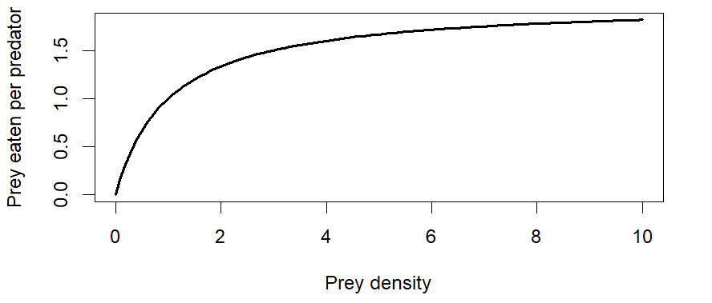
A shape you've seen before
Describe it in words.
Where else have you seen this shape?

Slide 21
Two ways to end up here
A. I needed a curve that starts at zero, rises, then flattens. This one does.
B. A predator can only handle so many prey per hour.
Mechanistic vs Phenomenological. Which is which?

Slide 22
Same curve, different claim
f(x) = ax / (b + x)
This version has a name: Holling type II functional response
Here, a and b are attack rate and handling time.
You can only interpret a and b that way if that's why you chose the curve.

Slide 23
Why does it matter?
Chose it for its shape?
You can describe your data.
Chose it for the mechanism?
You can talk about the process, extrapolate further, and be wrong in a specific way.

Slide 24
Two parts to every model
timelineDeterministic
The expected pattern
The structured, predictable core relationships modeled by mathematical formulas.
grainStochastic
How observations scatter
The random, unpredictable variation or noise superimposed on top of the system's deterministic trend.
We've done the first part. Where does the scatter come from?

Slide 25
Three Kinds of Randomness
straighten
Measurement Error
Observation Noise
parkparkpark
Demographic
Individual Heterogeneity
thermostatthermostat
Environmental
External Heterogeneity

Slide 26
Measurement error
Observations are (usually) imperfect
Measurements have intrinsic limits (e.g., nearest m or mm)
Almost always present
Usually modelled as normal variation around a mean

Slide 27
Demographic stochasticity
Different outcomes, by chance alone
One coin, 20 flips: 9 heads. Or 10. Or 11.
50% survival of 9 individuals: 4 or 5 survive, never 4.5
Matters most in small populations
20 identical tadpoles, one predator, a different number eaten each time

Slide 28
Environmental stochasticity
Variability from outside the system
Climate, season, topography
Only the unpredictable part (predictable seasonal change is deterministic)

Slide 29
Process vs. measurement
Demographic + environmental stochasticity = process variability
Process variability changes what happens next in a system
Measurement error doesn’t

Slide 30
Process vs. Measurement: Why It Matters
The scenario: A plot has 12 seedlings.
Measurement Error
What happens:
You miscount and record 9.
The consequence:
Recount next week: find 12.
Process Error
What happens:
A deer eats 3.
The consequence:
Recount next week: 9, and 9 forever.

Slide 31
Error types: your turn
Sort these into measurement / demographic / environmental :
Two observers, same transect, different counts
A hurricane kills a seedling cohort
50 tagged fish: 12 survive, then 15
A thermometer reads 0.4 °C higher than true
Seedlings differ with small-scale light

Slide 32
Your own system
Think of one question you’d like to ask in your system.
What type of model could you use to address it?
theoretical / applied
mechanistic / phenomenological
deterministic / stochastic

Slide 33
Questions?

Slide 34
Our goal for the remaining time is setting up software
We’ll be installing:
R
RStudio
Git (optional for undergrads)
Github (optional for undergrads)

Slide 35
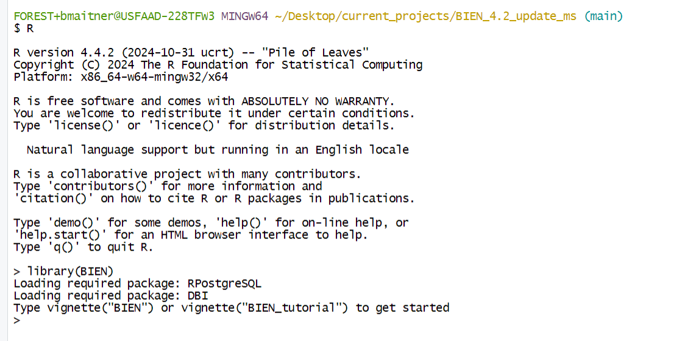
R

Slide 36
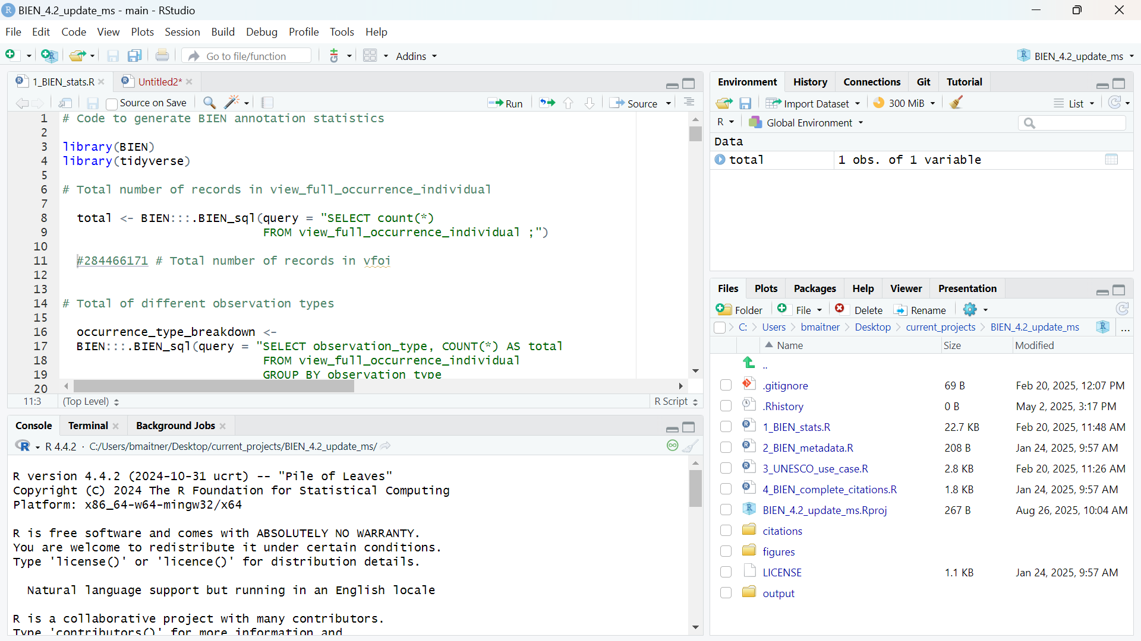
RStudio

Slide 37
RStudio
R

Slide 38
RStudio
Stuff to make R easier to use
R

Slide 39
Git
Program that tracks changes in files
Removes need for multiple versions of file (you can always go back)
Tracks what is added or removed in each version
Allows multiple users to work on files and combine their changes

Slide 40
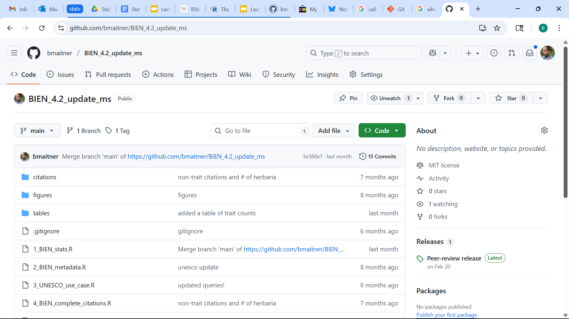
Github
A repository for Git
Stores your files
Also can be used for editing files
You can even set it up to run analyses for you!

Slide 41
Why use Github?
Secure backup of code (in case your computer dies…)
Helps when you use multiple computers
Collaboration
Transparency and reproducibility (if you make it public)
Letting other people use your code (forking/copying)
Increasingly expected of biologists
Can be archived, cited (e.g., via Zenodo)
Grad students have to, undergrads get extra credit

Slide 42
Installing the needed software
R (free at https://www.r-project.org/ )
RStudio (free at https://posit.co/download/rstudio-desktop/ )
Git (free at https://git-scm.com/downloads )
Github account (Sign up for free at: https://github.com/ )

Slide 43
Tell Git who you are
install.packages(c("usethis", "gitcreds"))
usethis::use_git_config(
user.name = "Your Name",
user.email = "your GitHub email"
)

Slide 44
Did it work?
Should have a “Git” tab in RStudio

Slide 45
No Git tab?
Tools → Global Options → Git/SVN
Is the git executable found?
Windows: C:/Program Files/Git/bin/git.exe
Restart RStudio after changing it

Slide 46
Other common problems
"Git not found" → restart RStudio, then restart the computer.
Windows, packages won't build → Rtools
Mac, packages won't build → xcode-select --install
Still stuck? Flag me down

Slide 47
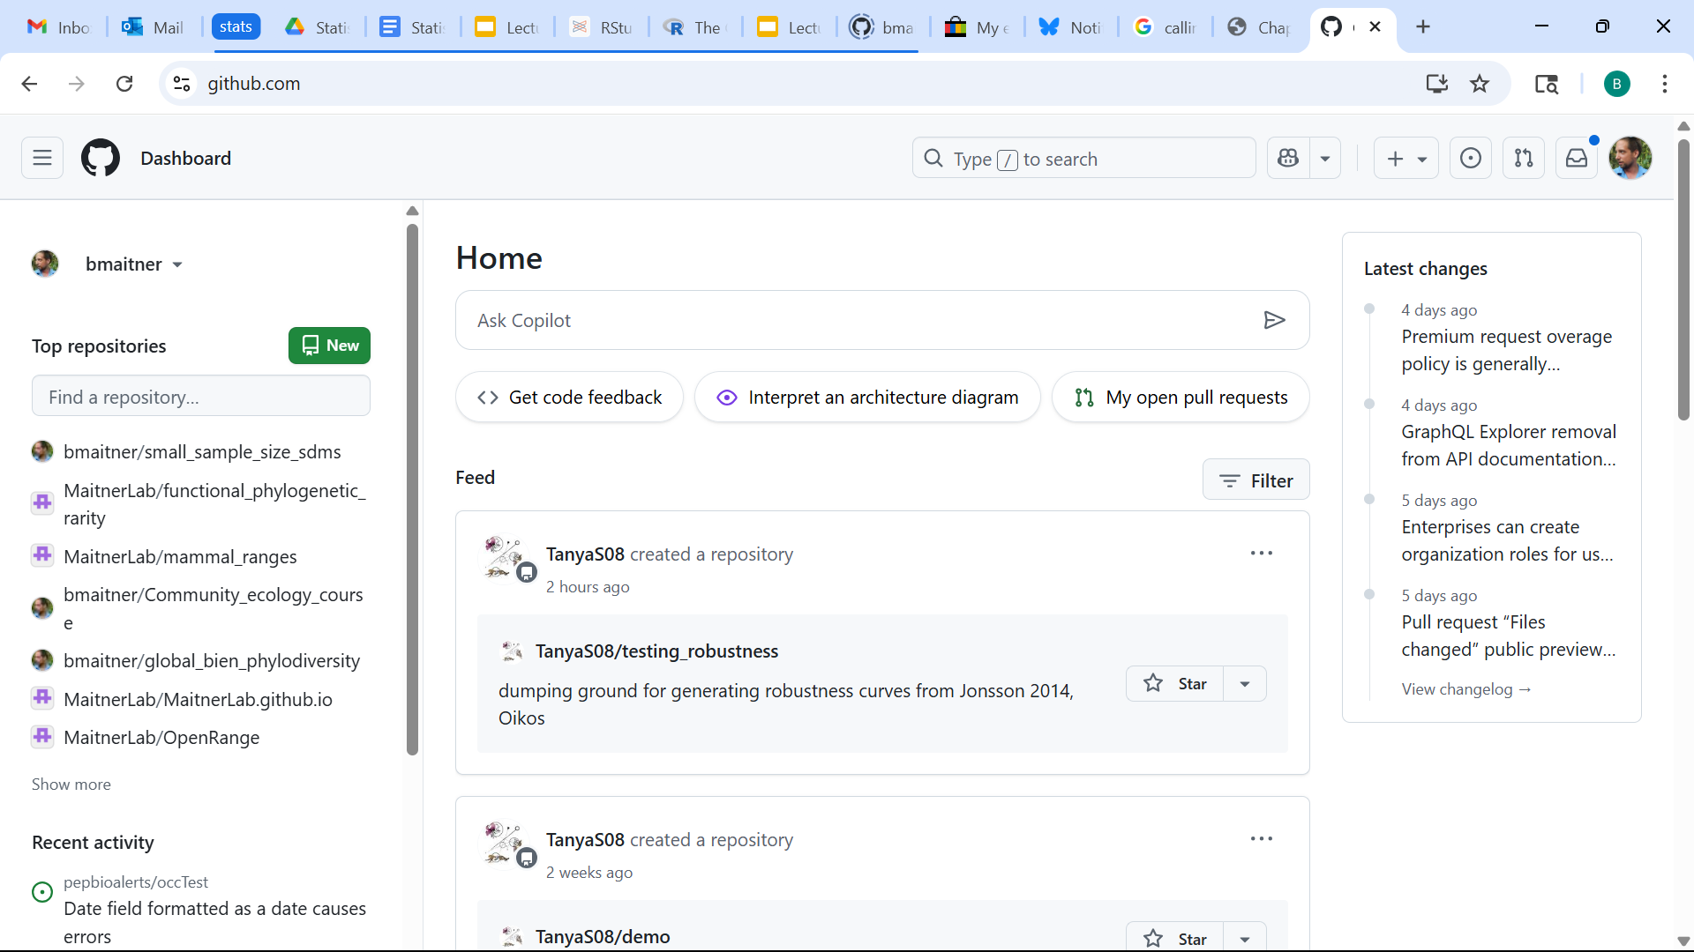
Make sure it works
Go to your Github page and make a new repo

Slide 48
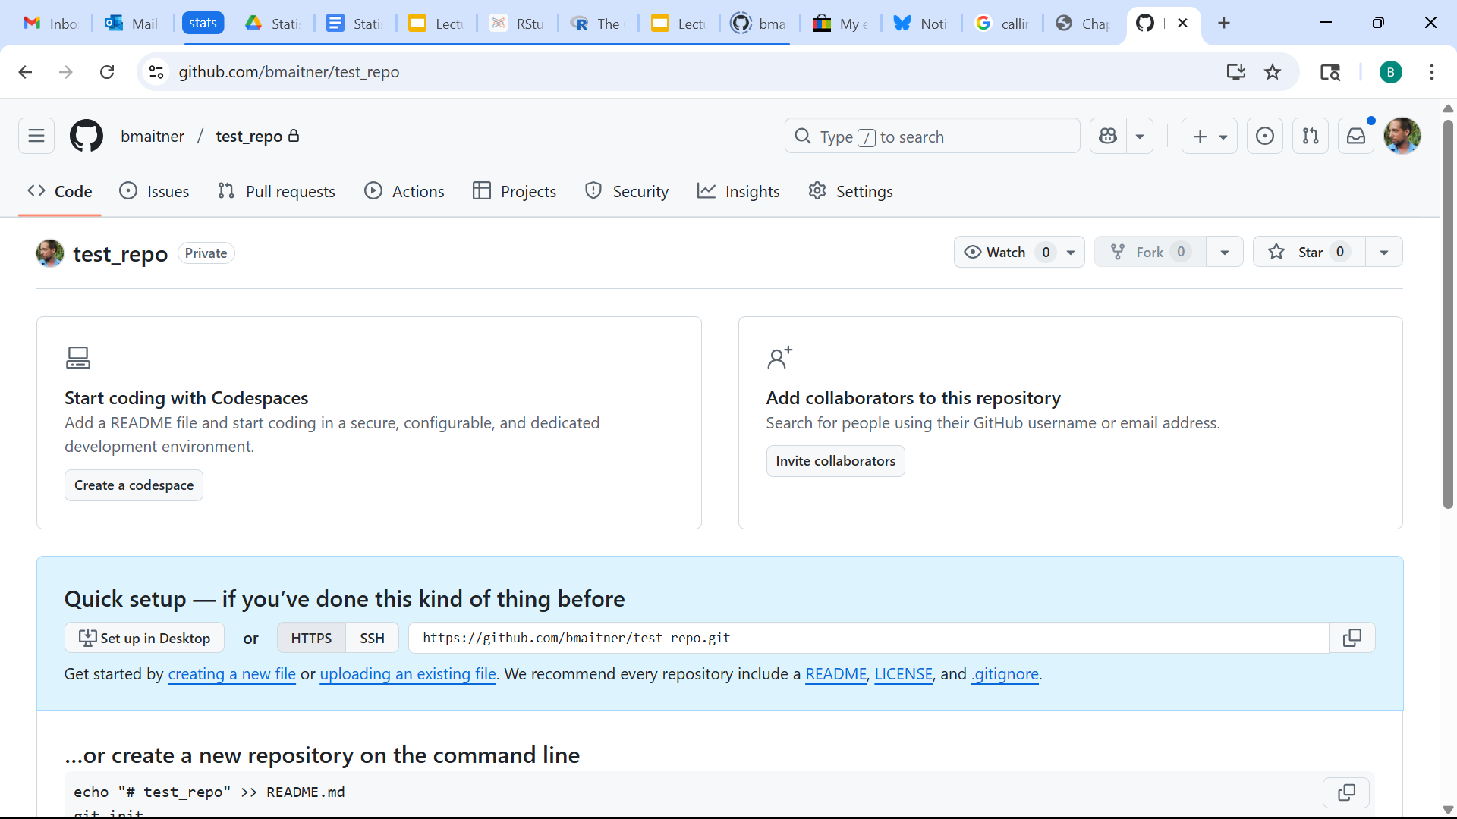
Make sure it works
Copy the URL

Slide 49
Make sure it works
In RStudio:
File > New Project…
Select “Version Control”
Select “Git”
Paste the copied URL into the “Repository URL” box
Pick a directory for it to be created in
Click “Create Project”

Slide 50
Cloning worked. Pushing won't
Downloading a public repo: no login
Sending changes back: requires login
GitHub stopped taking account passwords in 2021
Requires authentication

Slide 51
Get a token
usethis::create_github_token()
Opens GitHub with the right boxes ticked.
Name it, generate, copy it now (you won't see it again)

Slide 52
Store your token
gitcreds::gitcreds_set()
Paste when prompted. Once per machine.
usethis::git_sitrep()
Checks everything at once.
Treat the token like a password. Never use in a script.

Slide 53
Multiple repositories
Your Github repo: where your assignments will live.
Can keep public, or make private and grant me access
The course repo: lectures, scripts, data
github.com/bmaitner/biometry_course
Can browse online or pull everything using Git
Note: For grad students, one repo per paper/thesis chapter usually works well

Slide 54
Next time:
Before class: read 1.4 - 1.6
During class:
Discuss 1.4-1.6
Work through 1.7

