Slide 1
Biometry
Today’s agenda:
Introductions,
Syllabus,
Why we need stats,
Reproducibility and Openness

Slide 2
Introductions
Please take a moment to tell us about yourself:
01
Your Name
Introduce yourself to the class, including what you prefer to be called and your pronouns if you'd like to share.
02
Research
Describe your current research interests, what systems or questions you study, or what you hope to work on.
03
Fun Fact
Tell us something interesting or unique about yourself—hobbies, favorite travel spots, pets, or hidden talents!

Slide 3
Syllabus: basic stuff
Class Meeting Days: T, Th
Class Meeting Time: 2:00 – 3:50 pm
Class Meeting Location: DAV 265
Instructor: Dr. Brian Maitner
Office Location: DAV 226 (but I’m usually in URL 106, because it’s warmer)
Office Hours: TBD - ?
Email: bmaitner@usf.edu
Up to date syllabus: https://github.com/bmaitner/biometry_course

Slide 4
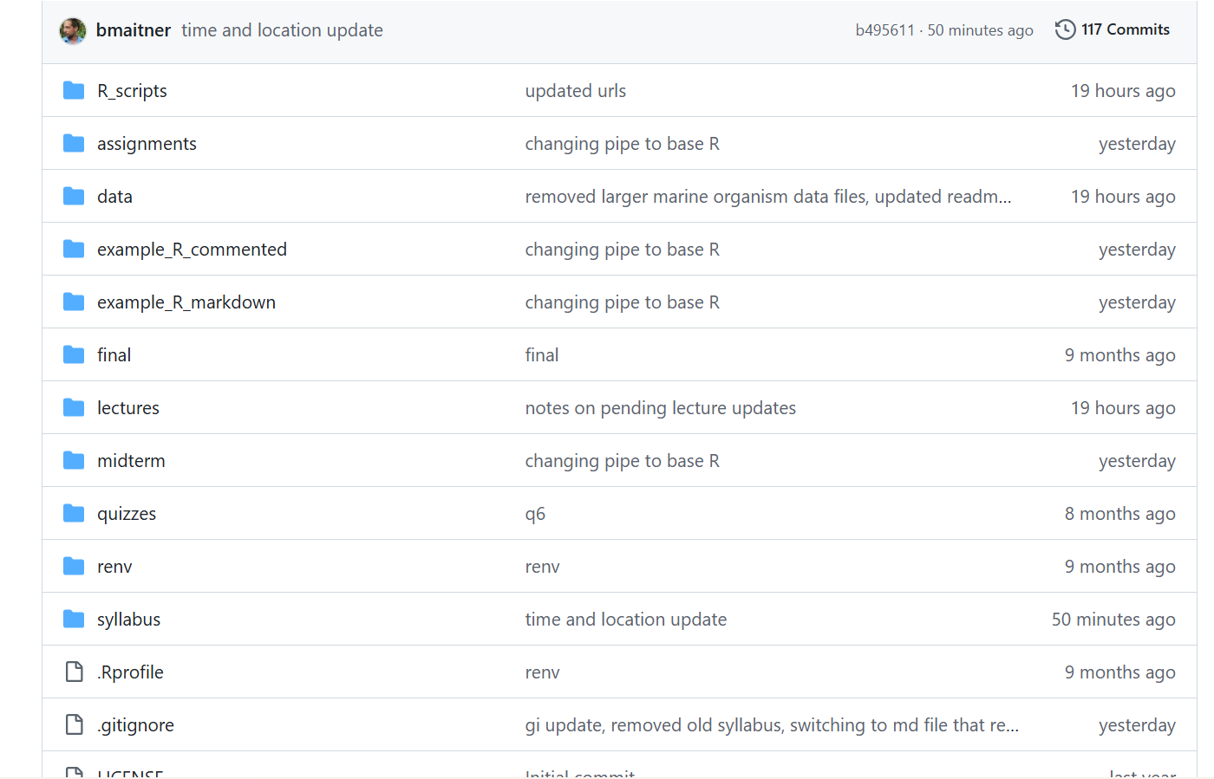
Course Github page
Full of useful stuff
Syllabus
Lectures
Previous quizzes

Slide 5
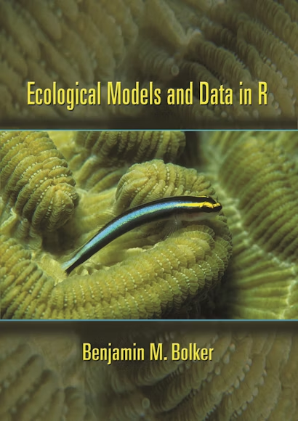
Syllabus: Course structure
Flipped course: read before class, work during class
Assignments will focus on data of your choosing
Graded Item | Percent of Final Grade
In-class participation | 20%
In-class quizzes | 20%
Assignments (4x) | 20%
Midterm (take-home) | 20%
Final (presentation + take-home) | 20%
Digital copies available through the library for free

Slide 6
Course Expectations
forum
sentiment_satisfied
Participate!
Ask questions. Share ideas, experiences, and knowledge!
Be Respectful.
Create a welcoming environment for everyone to learn, collaborate, and grow together.

Slide 7
Recommendations
assignment
Read the syllabus
menu_book
Read the book
edit
Take notes on paper
event
Plan ahead
laptop
Bring a laptop

Slide 8
Questions so far?

Slide 9
What will you get out of this class?
In general:
bar_chart
Practical Application
Ability to do common analyses and visualizations
trending_up
Future Growth
Ability to go further on your own

Slide 10
What will you get out of this class?
More specifically:
DATA & VISUALIZATION
Load data into R & perform common data-wrangling
Create plots using base R & ggplot2
STATS & ANALYSIS
Understand key statistical distributions and applications
Select correct analyses for ecological datasets
PROBLEM SOLVING
Troubleshoot & debug R code effectively
Approach novel coding challenges with confidence
Apply new programming skills directly to your own work

Slide 11

Learning Stats
People learn differently and stats can be non-intuitive
THE BOOK
Exposes you to verbal and mathematical descriptions of key statistical concepts.
IN CLASS
Hands-on coding and interactive visualizations help build intuitive understanding.
THE GOAL
Providing multiple teaching methods ensures that at least one appeals to everyone.

Slide 12
Learning Stats
What to Avoid
Don’t focus on memorization
What to Focus On
DO focus on practice and understanding

Slide 13
A Note on AI
Establishing core fundamentals before leveraging artificial intelligence
TIMING
We’ll cover AI later in the semester, once the foundations are established.
APPROACH
Strongly recommend that you start out without it to truly grasp the mechanics.
REQUIREMENT
You need reasonable fundamentals to be able to effectively and safely use AI.

Slide 14
Questions so far?

Slide 15
Why do we need statistics?

Slide 16
Why do we need statistics?
01 . COGNITIVE LIMITS
Imperfect Minds
We must overcome human biases, logical fallacies, and cognitive limitations.
02 . MEASUREMENT
Effect Sizes
Accurately quantifying the strength and magnitude of different relationships.
03 . VALIDATION
Hypothesis Testing
Systematically validating assumptions against empirical data.
04 . FORECASTING
Making Predictions
Building robust models to anticipate future outcomes and trends.
05 . CLARITY
Visualizations
Making complex numerical relationships instantly clear and intuitive.
06 . ETC
Lots of Other Stuff
From optimizing systems to driving data-informed strategic decisions.

Slide 17
What is R and why is it useful?
THE CORE IDEA
Scripted Language
Type commands instead of clicking buttons. This fundamental shift unlocks precision and power in data analysis.
REPRODUCIBILITY
Easily Re-run & Revise Analyses
Modify your inputs or parameters and re-execute entire workflows instantly.
EFFICIENCY
Re-use Code Across Projects
Build on top of previous work by recycling robust scripts for new datasets.
DOCUMENTATION
Code as a Methods Section
Your codebase serves as a transparent, step-by-step record of your methodology.

Slide 18
What is R and why is it useful?
01 . COST-EFFECTIVE
R is Free to Use
Anyone can download and use R without licensing costs, lowering the barrier to entry.
02 . EXTENSIBILITY
User-Contributed Packages
A massive ecosystem of user-developed packages is contributed for free, extending its capabilities.
03 . VERSATILITY
Incredible Flexibility
The vast range of libraries allows researchers to handle virtually any quantitative analysis task.
04 . COMMUNITY
Popular & Supported
An active, global developer and user base provides vast documentation and peer-to-peer help.

Slide 19
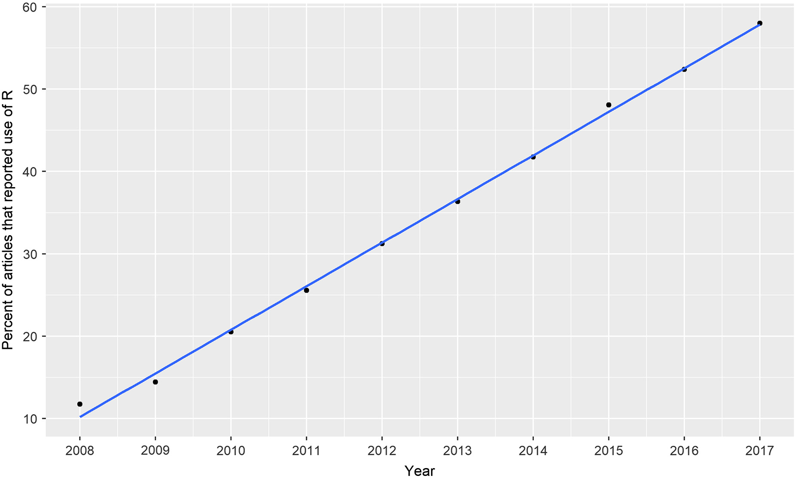
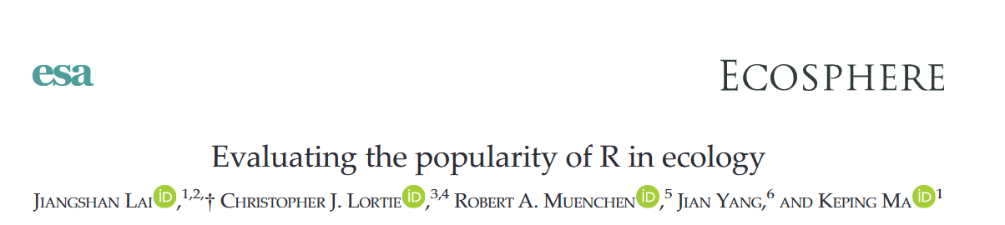
What is R and why is it useful?

Slide 20
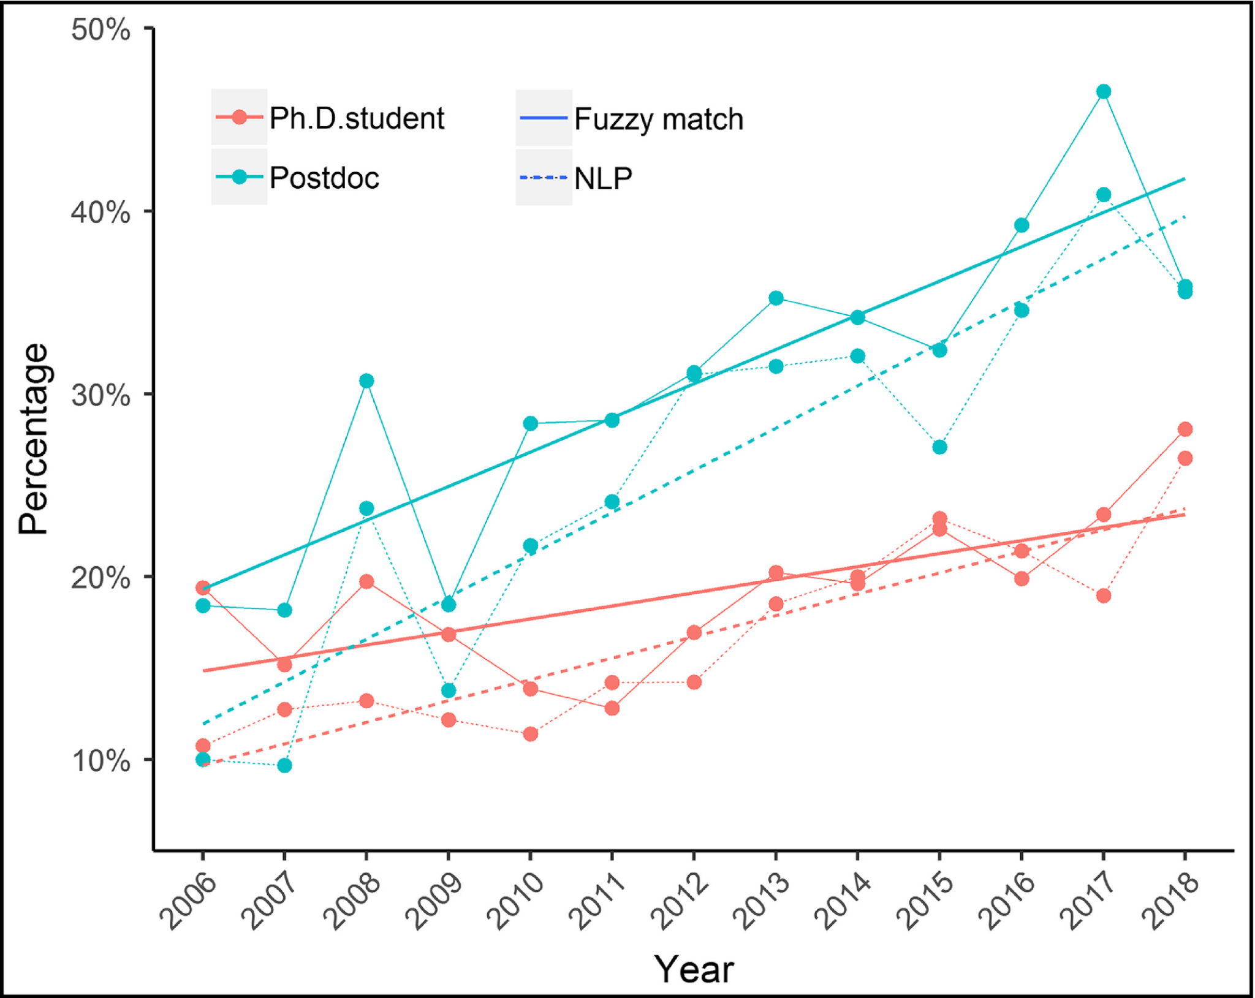
What is R and why is it useful?
Front Ecol Environ 2020; 18(3): 123–124

Slide 21
Transparency & Reproducibility
Science needs to be open, clear, and verifiable.
visibility
autorenew
Transparency
What was done is clear
Reproducibility
Can be re-done with the same results
R helps with both of these!
R

Slide 22
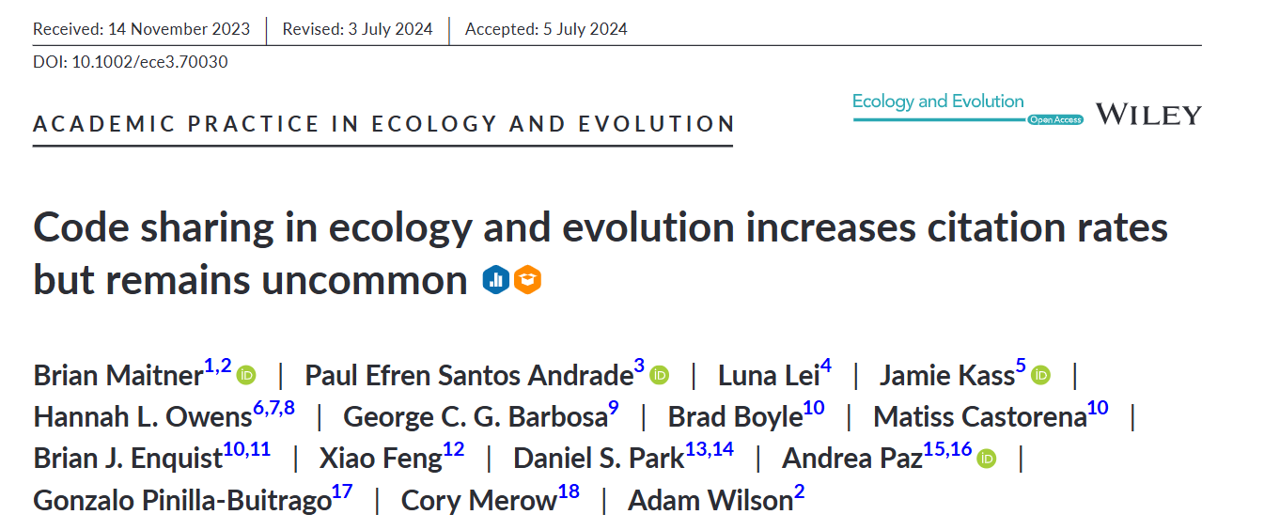
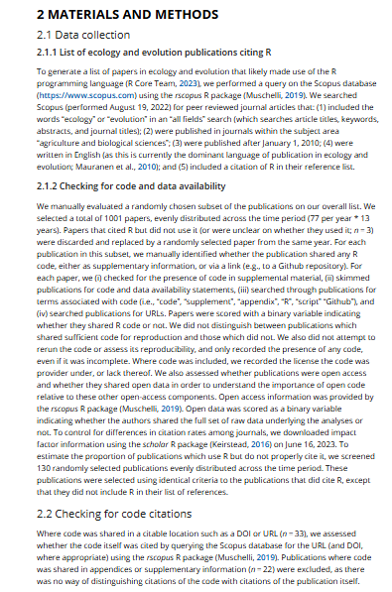
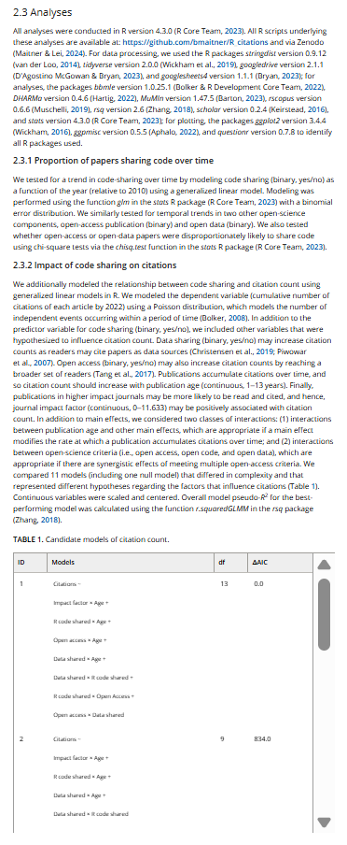
Transparency and Reproducibility

Slide 23
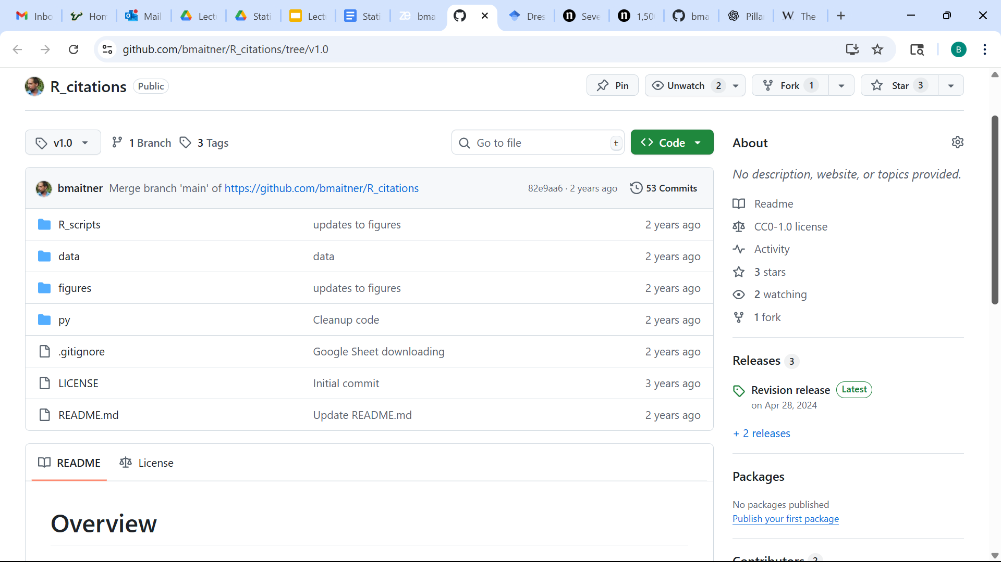
Transparency and Reproducibility

Slide 24
Transparency and Reproducibility
Note: many journals and funders are now requiring code to be published

Slide 25
Questions on any of this?

Slide 26
Next time:
Before class: read 1.1 - 1.3
During class:
Discuss 1.1-1.3
Installing and setting up R, RStudio, and Github (if needed)

