Slide 1
Probability and stochasticity
Today’s agenda:
Variability
Probability theory
Analyzing probability theory

Slide 2
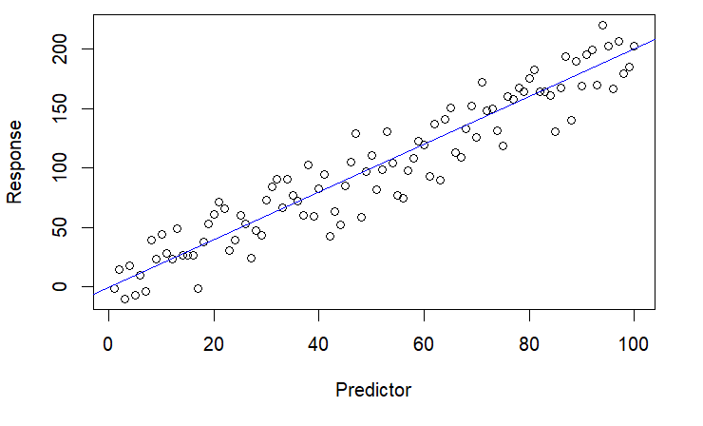
Variability
Increasing recognition of importance biologically (e.g., intraspecific variation)
Important component of statistical models (“signal” vs “noise”)

Slide 3
Variability
Different sources of variability
  Unmeasured variables (e.g., environmental stochasticity)
  Measurement error
  Inherent uncertainty
  Demographic stochasticity (50% survival in a population of 3)
  Nonlinear dynamics can increase/decrease variation

Slide 4
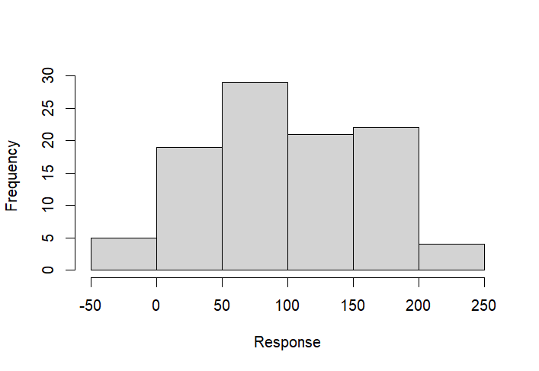
Variability
Different ways of handling variability
Try to explain it vs. treat as error

Slide 5
Probability theory refresher
Probabilities sum to 1

Slide 6
Probability theory refresher
For mutually exclusive events: Probability A or B = P(A) + P(B)
P(Dead or alive) = P(Dead) + P(Alive) = 1
If P(Dead) = 0.4, P(Alive) = 0.6
P(SIR) = P(S) + P(I) + P(R) = 1
If P(S) = 0.1, and P(R) = 0.2, P(S or R) = 0.3
Then P(I) = 0.7

Slide 7
Probability theory refresher
 | Male | Female
Blue | 20 | 30
Green | 15 | 35
For non-mutually exclusive events,
Have to account for double counting:
P(Blue OR Male) =
P(Blue) + P(Male) - P(Blue AND Male) = 0.65
Corrects for double-counts

Slide 8
Can you just add them?
P(A or B) = P(A) + P(B) only when A and B cannot both happen.
Which of these pairs can both happen at once?
1. A frog is infected / the frog is uninfected
2. A bird is male / the bird is blue
3. A site is a pond / the site is a stream
4. A tree flowered this year / the tree is more than 20 cm across

Slide 9
Probability theory refresher
Conditional probability: Probability of something, given something else
P(A|B) = P(A and B) / P(B)
P(Male|Blue) = P(Blue male) / P(Blue)
0.40 = 0.20/.50
 | Male | Female
Blue | 20 | 30
Green | 15 | 35

Slide 10
Probability theory refresher
Independent variables: P(A and B) = P(A)*P(B)
If Sex and Color were independent, we’d expect:
P(Blue Male) = P(Blue) * P(Male)
0.175 = 0.5 * 0.35
0.20 != 0.175, measurement error? dependence?
 | Male | Female
Blue | 20 | 30
Green | 15 | 35

Slide 11
Practice: frogs and a fungus
100 frogs, each scored for habitat and for infection with Bd.
Working in groups, figure out:
1. P(infected)
2. P(infected and pond)
3. P(infected, given pond)
4. P(infected, given stream)
5. P(infected or pond)
 | Pond | Stream | Total
Infected | 30 | 12 | 42
Uninfected | 20 | 38 | 58
Total | 50 | 50 | 100
Notes:
1. P(infected) = 42/100 = 0.42
the infected row total, over all 100 frogs
2. P(infected and pond) = 30/100 = 0.30
one cell, over all 100 frogs
3. P(infected | pond) = P(infected and pond) / P(pond)
= 0.30 / 0.50 = 0.60
or straight off the table: 30/50, the pond column only
wrong answer to expect: 30/100 = 0.30, dividing by everyone
4. P(infected | stream) = 0.12 / 0.50 = 0.24
or 12/50, the stream column only
5. P(infected or pond) = P(infected) + P(pond) - P(infected and pond)
= 0.42 + 0.50 - 0.30 = 0.62
check by counting: 30 + 12 + 20 = 62 frogs out of 100
wrong answer to expect: 0.42 + 0.50 = 0.92, the 30 counted twice

Slide 12
Answers
1. P(infected) = 42/100 = 0.42
2. P(infected and pond) = 30/100 = 0.30
3. P(infected | pond) = 0.30 / 0.50 = 0.60
4. P(infected | stream) = 0.12 / 0.50 = 0.24
5. P(infected or pond) = 0.42 + 0.50 - 0.30 = 0.62
Pond frogs are infected at 60%, stream frogs at 24%.

Slide 13
P(A | B) is not P(B | A)
P(A|B) = P(A and B) / P(B)
P(infected | pond) = 0.30 / 0.50 = 0.60
P(pond | infected) = 0.30 / 0.42 = 0.71
Same numerator. Different denominator. Different question.
P(spots | measles) is nearly 1.
P(measles | spots) is nearly 0.

Slide 14
Your turn: does habitat matter?
If infection and habitat were independent:
P(infected and pond) = P(infected) x P(pond)
Work out what that gives, and compare it to what we counted.
How many of the 100 frogs would be infected pond frogs?
 | Pond | Stream | Total
Infected | 30 | 12 | 42
Uninfected | 20 | 38 | 58
Total | 50 | 50 | 100

Slide 15
Answer: not independent
Expected if independent: 0.42 x 0.50 = 0.21, so 21 frogs
Actually counted: 30 frogs
More infected pond frogs than independence predicts.
Habitat and infection are associated.
Knowing the habitat changes the probability.
That is what a model is: P(outcome | what you know).

Slide 16
Questions so far?

Slide 17
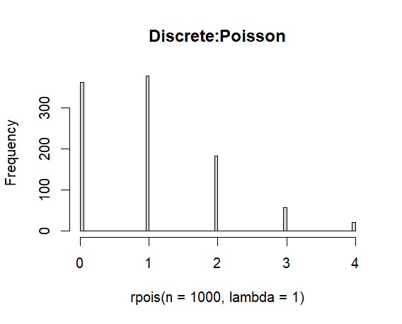
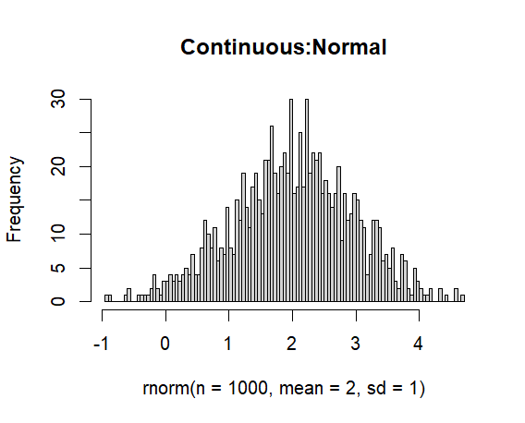
What to know about probability distributions
2 classes: Discrete vs continuous
Discrete:
Integers
E.g., individuals, # events
Continuous:
Any real number (or a subset, e.g. positives)
E.g., body sizes, speeds, etc.
P(any exact number) = 0
Focus on P(some number or more extreme)
  E.g. P( x >= 4)

Slide 18
Continuous or discrete?
Organisms
Body Mass
Age
Leaf Area
Population size
Population density
Species richness
Functional diversity
Individuals per transects
Mean body mass
Environment
Temperature
Elevation
Depth
Hurricane severity
Evolution
Base pair substitution
Evolutionary rate
Species per taxon

Slide 19
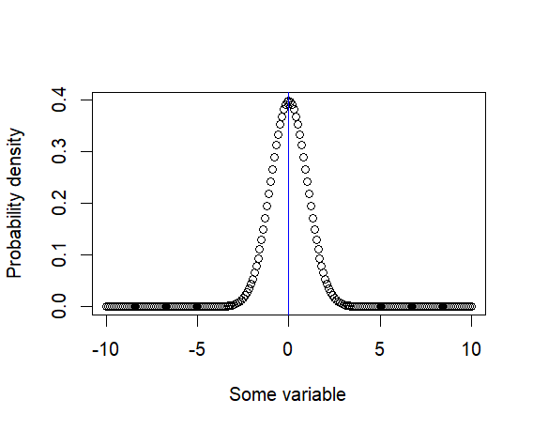
What to know about probability distributions
Central tendencies:
Mean
“Average”
Expected value (denoted E[x])
Also denoted
Use function mean()

Slide 20
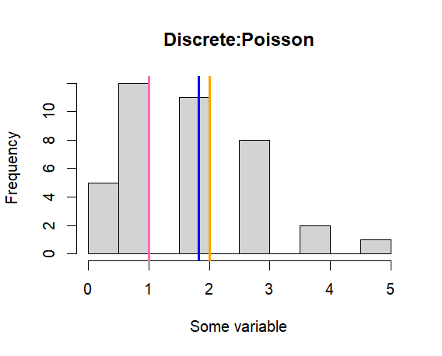
What to know about probability distributions
Central tendencies:
Median
More robust than mean
Less sensitive to outliers and skew
Use function median()
Blue = mean
Orange = median
Pink = mode

Slide 21
What to know about probability distributions
Central tendencies:
Mode
Most likely or most common value
No built-in function
DescTools package has Mode()
Blue = mean
Orange = median
Pink = mode

Slide 22
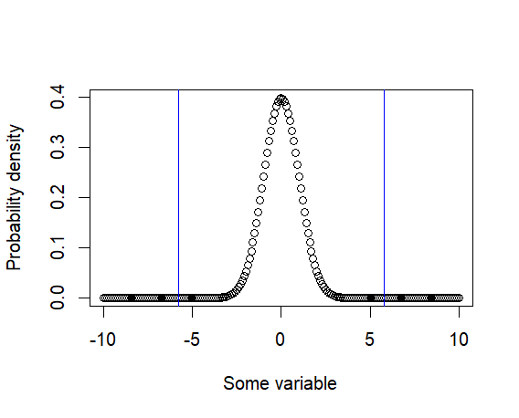
What to know about probability distributions
Spread:
Variance and standard deviation
Variance:
  SD²
  Additive
  Units of mean squared
  Function var()
SD
  √variance
  Not additive
  Same units as mean
  Function sd()
Blue lines: Mean +/- SD

Slide 23
Activities
Load data and calculate mean, variance, std dev, median, mode, etc.
  Use data on github

Slide 24
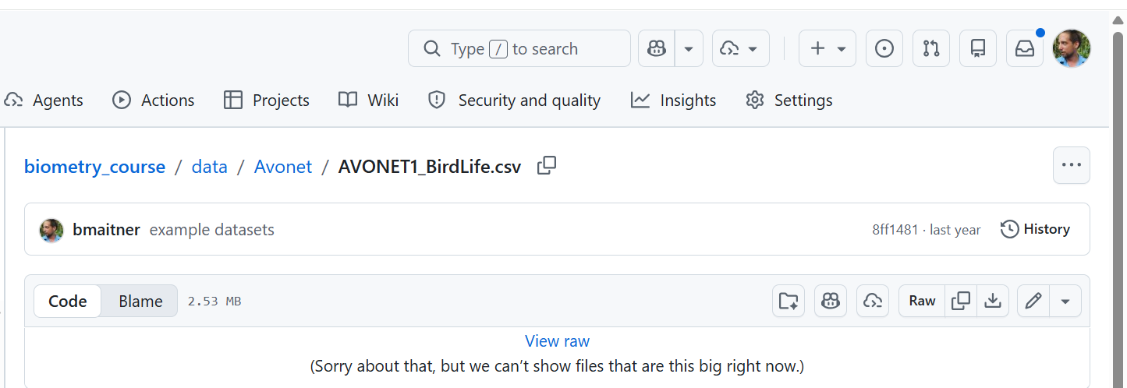
Working with probability distributions
To get link:
Right click on “Raw”, copy the URL
Load the avonet data

Slide 25
Working with probability distributions
Load the avonet data
avonet <- read.csv("https://github.com/bmaitner/biometry_course/raw/refs/heads/main/data/Avonet/AVONET1_BirdLife.csv")
Or
library(readr)
avonet <- read_rds("https://tinyurl.com/avonetbirddata")

Slide 26
Working with probability distributions
Using the avonet data:
Generate a histogram of Hand-Wing Index (high HWI = long-distance flyer)
  Use hist() function
Calculate mean and median Hand-Wing Index
  mean() and median()
Generate a histogram of Body Mass
  Also try generating a histogram of the log of body mass (use log10() or log())
Calculate mean and median body mass
  How similar are they?
(optional) Try calculating the mode of body mass
  Mode()in the DescTools package

Slide 27
Working with probability distributions
Using the avonet data:
Calculate the variance and standard deviation of Mass
  var() and sd()
Check that variance equals SD²
  Use “==” to test whether things are equal
  R uses “^” to denote raising something to a power, e.g., x^2 mean x²
  For square roots, use either sqrt() or x^0.5
Calculate the mean and variance of Range.Size

Slide 28
Remainder of class:
Load in your focal data
Use today’s functions to better understand your key variables
Before next class:
Skim 4.5 and 4.6, the bestiary of distributions

