Slide 1
Data in R
Today’s agenda:
Discuss loading data, data types, etc.,
Pointers on data
Load and examine some data

Slide 2
Electronic Formats
R can handle most common data formats
E.g., .csv, .txt
Proprietary data formats may require additional packages
E.g., Excel .xlsx files, ESRI .shp files
R has its own file types:
E.g., .RDS
Different pros/cons to data formats!

Slide 3
Why plain text?
Readable by anything, on any machine
Won't become obsolete with the next software version
Survive partial corruption
Note: A .csv is just a text file that tells you how to parse it
csv = comma separated value

Slide 4
We practise this
Your assignments: .R, .Rmd, .Qmd
This course's syllabus: Markdown
The data in data/: .csv
These are all basically “text” files
Not an accident!

Slide 5
Getting data into R
Functions used will depend on data types
Often multiple options for a given file type
Functions can mess things up when importing them!
R can pull from different places (online, locally, databases, etc.)

Slide 6
Getting data into R: example functions
File type | Extension(s) | Common R import function(s) | Package(s)
Comma-separated values | .csv | read.csv(), read_csv() | base, readr
Tab-delimited text | .tsv, .txt | read.delim(), read_tsv() | base, readr
Excel (old) | .xls | read.xls(), read_excel() | gdata, readxl
Excel (modern) | .xlsx | read.xlsx(), read_excel() | openxlsx, readxl
R object (binary) | .RData, .rda | load() | base
R object (single) | .RDS | readRDS() | base
SPSS | .sav | read.spss(), read_sav() | foreign, haven
Stata | .dta | read.dta(), read_dta() | foreign, haven
SAS | .sas7bdat, .xpt | read_sas(), read.xport() | haven, sas7bdat, foreign
JSON | .json | fromJSON() | jsonlite
XML | .xml | xmlParse(), read_xml() | XML, xml2
Feather/Arrow | .feather, .arrow | read_feather(), read_parquet() | arrow
HDF5 | .h5 | h5read() | rhdf5
NetCDF | .nc | nc_open() | ncdf4
SQLite database | .sqlite, .db | dbConnect(RSQLite::SQLite(), ...) | RSQLite
Shapefile (GIS) | .shp | st_read() | sf
GeoPackage | .gpkg | st_read() | sf

Slide 7
Getting data into R: example
Go to the course Github site https://github.com/bmaitner/biometry_course
Navigate to data/Avonet
Download the file “AVONET1_BirdLife.csv”

Slide 8
Getting data into R: example
Since the file “AVONET1_BirdLife.csv” is a csv, we’ll use read.csv()
We can do this using
Absolute paths
Relative paths
A remote copy of the file

Slide 9
Getting data into R: relative vs absolute paths
Absolute vs relative paths
Absolute: path from the root of your file system
Relative: path relative to your working directory

Slide 10
Getting data into R: relative vs absolute paths
Absolute vs relative paths
Absolute: path from the root of your file system
Relative: path relative to your working directory
Examples: which is which?
“C:/Users/bmaitner/Desktop/current_projects/biometry_course/data/Avonet/AVONET1_BirdLife.csv”
“data/Avonet/AVONET1_BirdLife.csv”

Slide 11
Getting data into R: relative vs absolute paths
Try to read in the file you downloaded (AVONET1_BirdLife.csv)
Try reading it using both relative and absolute paths
Use read.csv()
Tab completion makes it easier
read.csv("") then hit the TAB key
Cursor needs to be between the ""

Slide 12
Getting data into R: remote data
Many R functions can also read in online data
avonet <- read.csv("data/Avonet/AVONET1_BirdLife.csv")
avonet_v3 <- read.csv("https://github.com/bmaitner/biometry_course/raw/refs/heads/main/data/Avonet/AVONET1_BirdLife.csv")
identical(avonet, avonet_v3)
Same data, two routes.

Slide 13
Not everything is a .csv
Try this (download if needed):
amphibians <- read.csv(
"data/European_amphibians/oo_32985.xlsx")
What happens? Why?

Slide 14
That's not text
Warning message:
line 1 appears to contain embedded nulls
.xlsx isn't text. It's a zip file full of XML.
read.csv() reads text. It tried.
Notes:
an .xlsx really is a zip archive: you can rename one to .zip and open it. That's why base R can't read it without help, and it ties straight back to the "why plain text" slide from earlier. A .csv you can open in Notepad; an .xlsx you cannot.

Slide 15
You need a package
Base R can't read Excel files. Someone else wrote code that can.
install.packages("readxl")
Needed once per computer. Not once per session.

Slide 16
Installing is not loading
Try:
read_xlsx("data/European_amphibians/oo_32985.xlsx")
Error: could not find function "read_xlsx"
Installed ≠ available.
Run:
library(readxl)

Slide 17
Now read it
library(readxl)
amphibians <- read_xlsx(
"data/European_amphibians/oo_32985.xlsx")
head(amphibians)
Did it work?

Slide 18
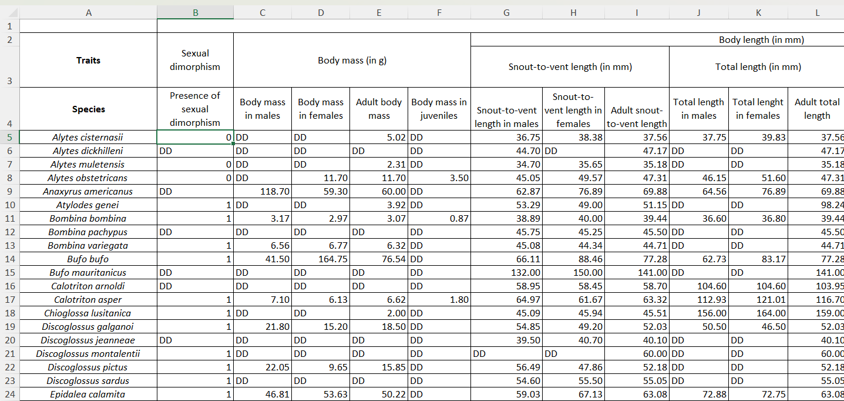
Look at the file first
Rows 1-3: various metadata
Row 4: the actual column names

Slide 19
Telling R where to start
amphibians <- read_xlsx(
"data/European_amphibians/oo_32985.xlsx",
skip = 3,
sheet = 1,
na = "DD")
skip = 3: ignore metadata rows
sheet = 1: only use the first sheet
na = "DD": “DD” (data deficient) is used instead of NA

Slide 20
Metadata
Data about data
The information that describes your data:
variable names,
units,
when and where collected
R has no system for this. Keeping it is on you.
Super important to do this well!

Slide 21
Column names are metadata
You need to strike a balance between clarity and brevity
Which of these examples would you prefer to be given?
larvdens
larval_density
not x
not larval_density_per_m3_in_ponds
Note: Use underscores or dots. Never spaces.

Slide 22
You can put metadata in the file
R ignores anything after #
You can use this to include metadata in a file, e.g.:
# Amniote traits, Myhrvold et al. 2015
# Missing values coded as -999

Slide 23
What we do in this course
Every folder in data/ has a README
Source, licence, and any gotchas
Open data/Amniote_traits/README

Slide 24
Data styles
The same data can be represented in multiple different ways

Slide 25
Long/skinny/tidy format
One row per observation
station | date | species | seeds
1 | 1999-03-23 | psd | 5
1 | 1999-03-27 | psd | 5
2 | 1999-03-23 | uva | 5
2 | 1999-03-27 | uva | 5

Slide 26
Wide format
One row per station, dates as columns
station | species | 03-23 | 03-27
1 | psd | 5 | 5
2 | uva | 5 | 5

Slide 27
Data Types in R
In R, all data have a type, e.g.:
Numeric (2005)
Logical (TRUE)
Character (“Optimus Prime”)
Factor (“Small” vs “Medium” vs “Large”)

Slide 28
Data Types in R
In R, all data have a type, e.g.:
Numeric (2005)
Logical (TRUE)
Character (“Optimus Prime”)
Factor (“Small” vs “Medium” vs “Large”)
To figure out what type something is, use class()

Slide 29
Data Types in R
Try class() out on a few things
class(“something”)
class(1)
class(1L)
class(TRUE)

Slide 30
Data Types in R
R tries to guess what type things are, but sometimes gets it very wrong!
Numeric vs logical
Date vs character or number
Factor vs Numeric
These mistakes can cause big problems in analyses!
It’s important to check your data!

Slide 31
R read it. Is it right?
Try this (may require downloading from Github):
amniotes <- read.csv("data/Amniote_traits/
Amniote_Database_Aug_2015.csv")
mean(amniotes$litter_or_clutch_size_n)
mean(amniotes$longevity_y)
What do you get?

Slide 32
What happened?
This dataset codes missing values as −999
Try this:
amniotes <- read.csv(
"data/Amniote_traits/Amniote_Database_Aug_2015.csv",
na.strings = -999)
mean(amniotes$litter_or_clutch_size_n, na.rm = TRUE)
We needed metadata to get this right!

Slide 33
The one that should worry you
Mean body mass, naive: 29,107 g
Mean body mass, correct: 37,493 g
Nothing about the first number looks wrong.
No error. No warning. Just wrong.

Slide 34
Higher data types
A single value is often not very useful, often we want sets of data:
Vector
the most fundamental structure;
an ordered collection of elements of the same type
Matrix
a 2D vector, all elements must be the same type
Array
an n-dimensional generalization of a matrix

Slide 35
Higher data types
List
ordered collection of objects that can be of different types or lengths
a very flexible container
Data.frame
tabular data
essentially a list of equal-length vectors, often used for datasets
Tibble
a modern variant of data.frame with cleaner printing and stricter rules

Slide 36
Higher data types
You can also use class() with these higher data types
Try this and see what class the avonet data you loaded earlier is

Slide 37
Accessing data within an object
For a vector or a list, you can access elements by their position:
test_vector <- c("Optimus Prime","Megatron")
test_vector[[1]]
test_vector[1]

Slide 38
Accessing data within an object
For a vector or a list, you can access elements by their name:
test_named_vector <- c("A" = "Optimus Prime",
"B" = "Megatron")
test_named_vector[["A"]]
test_named_vector["A"]

Slide 39
Accessing data within an object
For a vector or a list, you can access elements by their name:
test_named_vector <- c("A" = "Optimus Prime",
"B" = "Megatron")
test_named_vector[["A"]]
test_named_vector["A"]
You can find the names with the function names()
names(test_named_vector)

Slide 40
Accessing data within an object
For matrices, data.frames, and arrays there are more options!
Rows (name or number)
Columns (name or number)
Row and column (name or number)

Slide 41
Same shape, different rules
Dataframes and matrices look similar, but work differently
Data frame: names() or colnames()
Matrix: colnames() only
Data frame: x$a, x[["a"]], x[,"a"]
Matrix: x[,"a"] only
class(x) tells you which you have

Slide 42
Accessing data within an object
Let’s use the Avonet data from earlier
To access the species information, we can use:
avonet$Species1
avonet[1]
avonet[,1]
Try these out!
Notes:
Note: avonet[1] versus avonet[,1] : the first returns a one-column data frame, the second a vector. class() on each shows it. Common source of error

Slide 43
Accessing data within an object
Let’s use the Avonet data from earlier
To access the information for a particular row:
avonet[1,]
avonet["1",] (note: only works because the row is named “1”)
Try these as well

Slide 44
Checking data within the avonet dataset
Use class() to check the data type
class(avonet$Species1)
class(avonet[,2])

Slide 45
Checking data with str()
Can check all the fields using the structure command, str()
str(avonet)
Try it out!

Slide 46
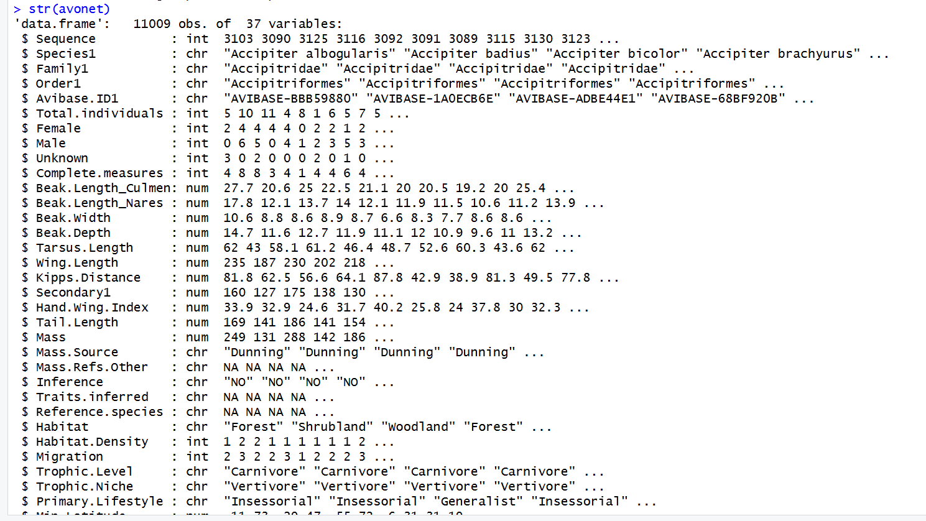
Checking data with str()

Slide 47
Other quick ways to check objects
str() - gives info on object structure
summary() - provides summary information that varies by column class
head() - shows the first few rows of data
table() - used for categorical variables, shows how often combinations occur
rownames() - row names
colnames() - column names
Try these out!

Slide 48
What if R gets the type wrong?
You can convert between many different types using “as” commands
as.factor()
as.character()
as.data.frame()
as.matrix()

Slide 49
Dealing with NAs
You can remove any record that contains an NA using na.omit()
Some functions have arguments for handling NA values
na.rm in mean()
na.action in lm()
use in cor()
You can turn the NA values into other values (e.g, 0)
Only do this if it makes sense (e.g., number of species seen in a day)
We’ll discuss how to do this later

Slide 50
Next time:
Before class:
read 2.4 - 2.5
During class:
Discuss 2.4 - 2.5
Discuss data we’re interested in
Work through 2.6

