Slide 1
Exploratory Analyses II
Today’s agenda:
Discuss Assignment 1
Discuss potential data sources
Apply chapter 2 techniques to your own data
Work through 2.6

Slide 2
Research Opportunity

Slide 3
Assignment 1
Full information online (see Canvas/Github)

Slide 4
Assignment 1
Overview:
Select a dataset (you want one that can ask multiple questions)
Do some exploratory analyses (and document them)

Slide 5
Assignment 1
In this assignment, students will need to:
Select a dataset, provide a description, note where it came from
Read in their dataset
Note the class of the dataset itself (e.g., matrix, list, dataframe, etc.)
List the variables of interest and their classes (e.g., numeric, character, etc.)
Examine the structure of the dataset and correct any formatting mistakes
Provide summary statistics for variables of interest
Produce at least 3 different figures that convey different information
For the figures in 6, briefly describe what the figures show

Slide 6
You already have the tools
Step | Where we did it
1. Describe it, cite it | READMEs, Lecture 4
2. Read it in | Lecture 4: read.csv, read_xlsx
3. Class of the dataset | Lecture 4: class()
4. Variables and classes | Lecture 4: str()
5. Fix formatting problems | Lecture 4: -999. Lecture 5: the kiwi
6. Summary statistics | Lecture 4: summary(), table()
7. Three figures | Lecture 5: hist, plot, boxplot, barplot
8. Describe the figures | Lecture 5: what log-log changed
We’re going to get more practice with some of these today as well

Slide 7
What counts as three different figures
"Three different figures that convey different information"
Three scatterplots of different variables is one kind of figure.
Different information means a different question, e.g.:
How is one variable distributed? hist
How do two relate? plot
How do groups compare? boxplot
How many in each category? barplot

Slide 8
Assignment 1: what you’ll submit
Needs to document what you did and be reproducible
Either:
The output of an .Rmd file showing code and outputs
See example_R_markdown/ for .Rmd file and potential output types, e.g. html, pdf
A .R file that can be run anywhere
See example_R_commented/ for .R file with comment examples

Slide 9
How and when
Assignments can be submitted on canvas.
You can either:
Upload your file to Github and submit the link on Canvas
(require for grads, extra credit undergrads)
Upload the file on canvas
Due Friday, Sept. 18th before midnight.

Slide 10
"Runs anywhere" includes the data
# Only works on my laptop
read.csv("C:/Users/bmaitner/Desktop/.../AVONET1_BirdLife.csv")
# Works if you have the course repo open
read.csv("data/Avonet/AVONET1_BirdLife.csv")
# Works for anyone, anywhere
read.csv("https://github.com/bmaitner/biometry_course/raw/refs/heads/main/data/Avonet/AVONET1_BirdLife.csv")
Using your own data? Put it in your repo and link it, or link the original source.

Slide 11
Documenting what you did
Open example_R_commented/Example.R
Comments say why, not what:
x <- log10(mass) # take the log of mass (not great)
x <- log10(mass) # mass spans 5 orders of magnitude (better)
Ctrl(cmd) + shift + r makes a section
Ctrl(cmd) + shift + c makes a comment (or comments out highlighted code)
Ctrl(cmd) + shift + o opens an outline
Try these command out

Slide 12
Questions so far?

Slide 13
Getting data
Collect it
pro: you know it best, can be tailored to a specific question
con: time-consuming, possibly expensive, probably requires cleaning
Download it
pro: quick
con: less knowledge of collection, probably still needs cleaning
Aggregate it
pro: data volume and breadth
con: even less knowledge of collection, lots of standardization and cleaning required

Slide 14
Where to look for data
Course Github site:
Links to resources
Data folder contains some options
Scientific Publications
Supplementary Information
Data Publications (e.g., https://www.nature.com/sdata/ )
Data repositories
Dryad https://datadryad.org/
TRY https://www.try-db.org/TryWeb/Home.php

Slide 15
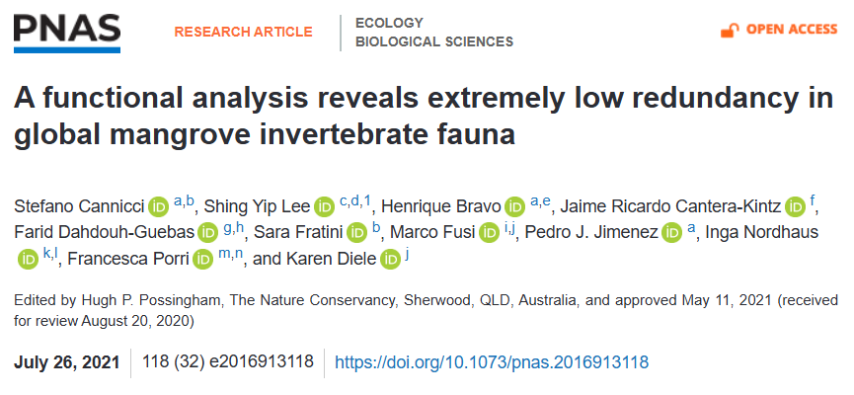
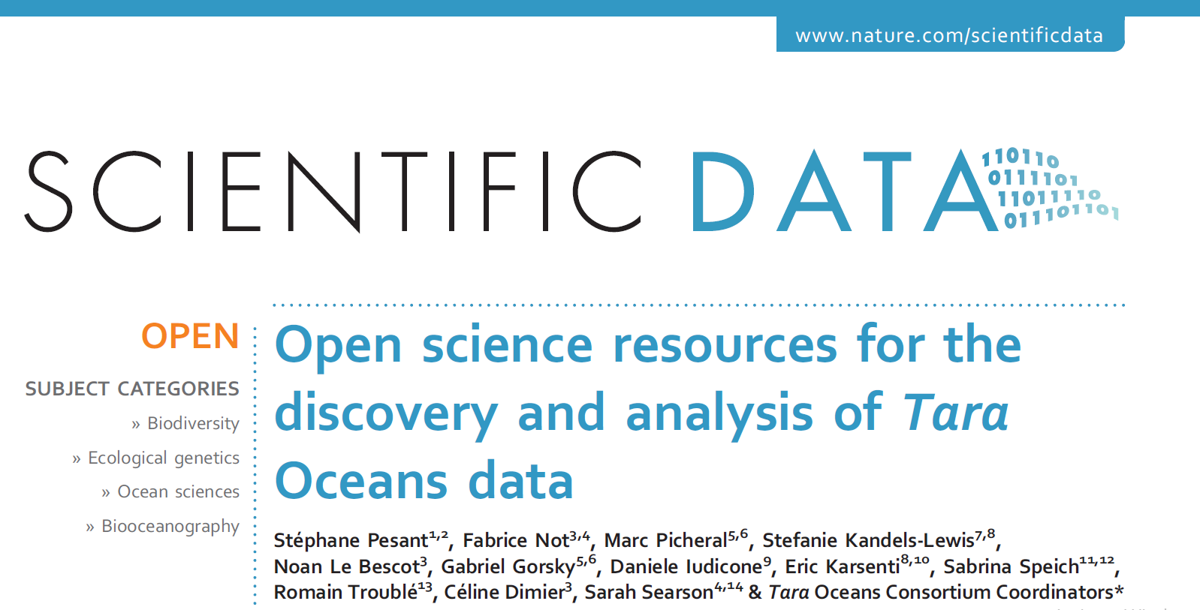
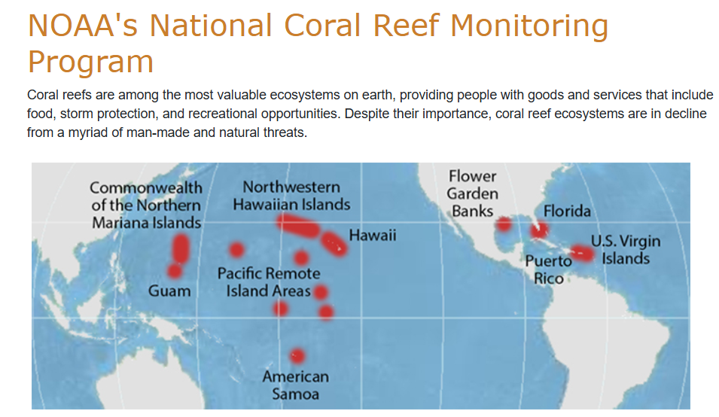
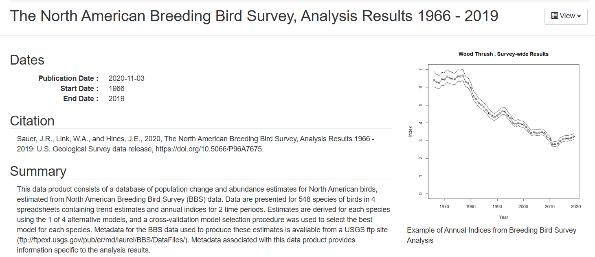
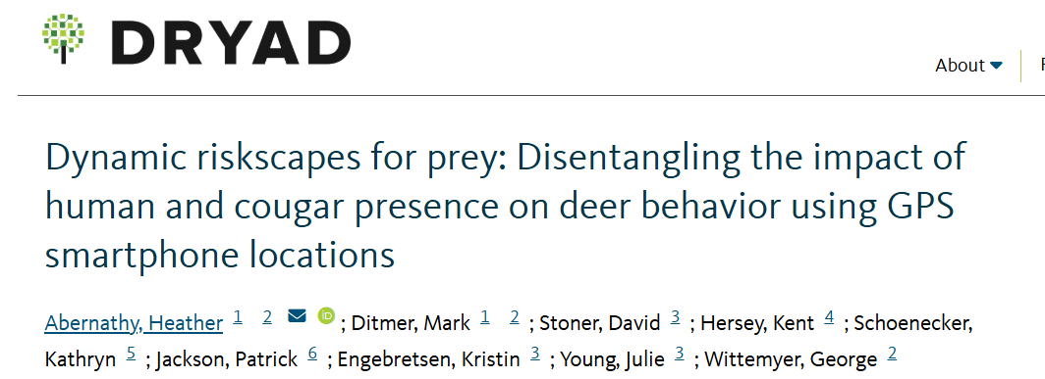
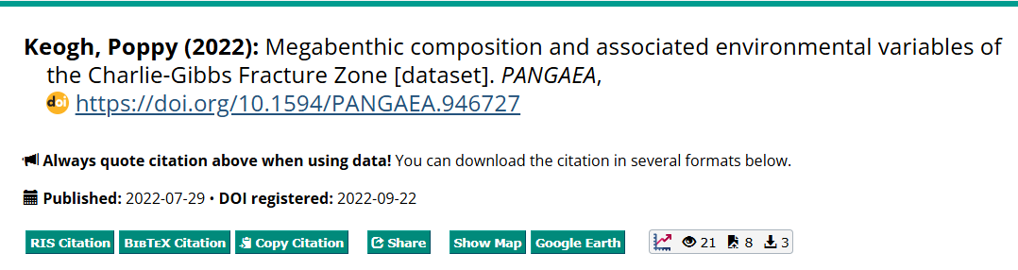
Datasets of interest to this class
Mangrove invert communities
Marine microorganisms
Deep sea megabenthos
Bird Survey Data
Coral populations
Reef fish data

Slide 16
Datasets of interest to this class
General places to look for data noted on the course Github homepage
Data folders on course Github
The “README” files in each folder contain useful information
May need to look up the data sources to understand all the column names.

Slide 17
Now do it to your own data
Open a new script. Read your dataset in.
I'll show each step on the bird data. Then you do it on yours.
By the end you'll have three figures, labelled and saved.
That's Assignment 1, steps 6 to 8.
No dataset yet? Use AVONET for now, modify your code later.

Slide 18
Assessing many variables at once
Note: if using a different dataset, use your variables
beak <- avonet[c("Beak.Length_Culmen",
"Beak.Length_Nares",
"Beak.Width",
"Beak.Depth")]
round(cor(beak), 2)
What do these lines of code do?
Culmen Nares Width Depth
Beak.Length_Culmen 1.00 0.97 0.74 0.71
Beak.Length_Nares 0.97 1.00 0.73 0.70
Beak.Width 0.74 0.73 1.00 0.91
Beak.Depth 0.71 0.70 0.91 1.00
Notes:
Remember: you may need to set use = "complete.obs" for your own dataset if it has NAs

Slide 19
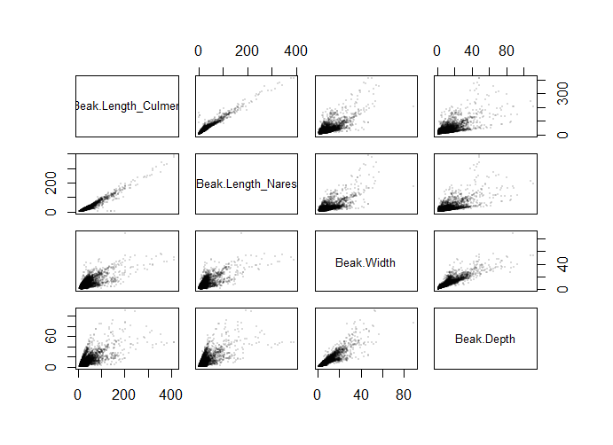
The same thing as a picture
pairs(x = beak,
pch = 16,
cex = 0.3,
col = rgb(red = 0,
green = 0,
blue = 0,
alpha = 0.15)
)
Same code, different style:
pairs(beak,pch=16,cex=0.3,col=rgb(0,0,0,0.15))
Try this on your data

Slide 20
Correlations in your own data
Did anyone find any suspiciously high correlations?
Or anything that might need log-scaling?

Slide 21
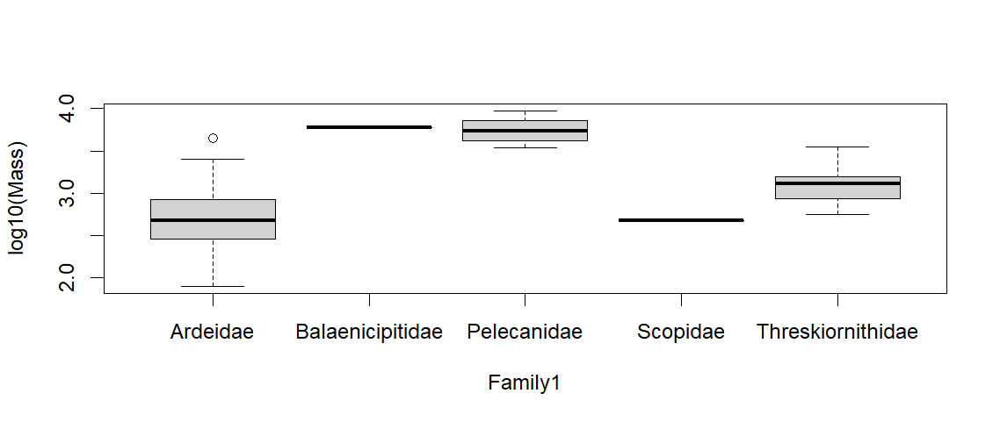
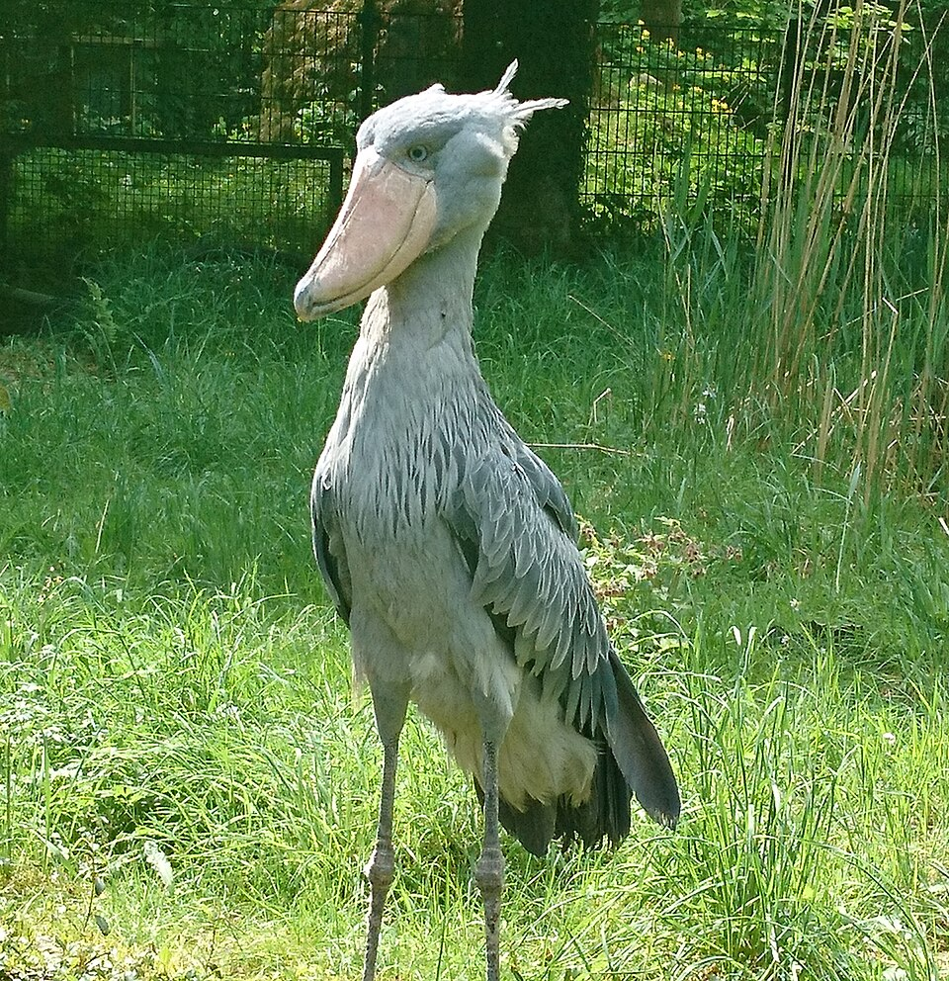
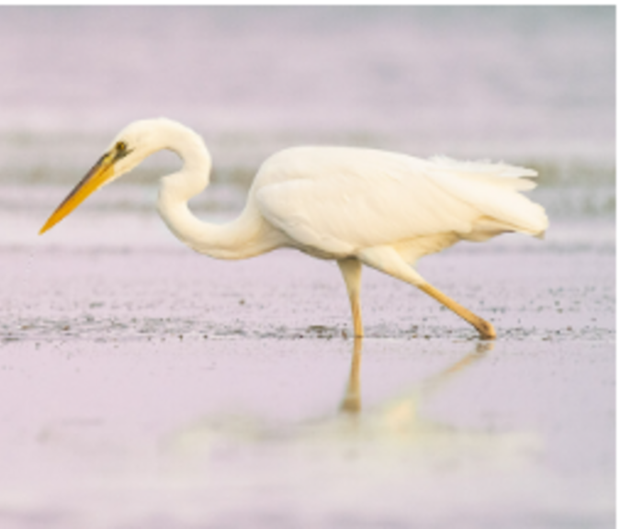
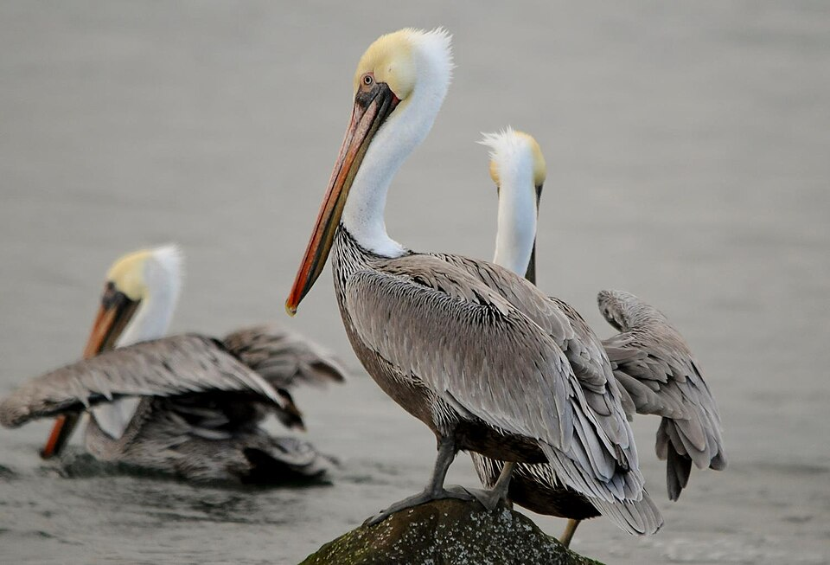
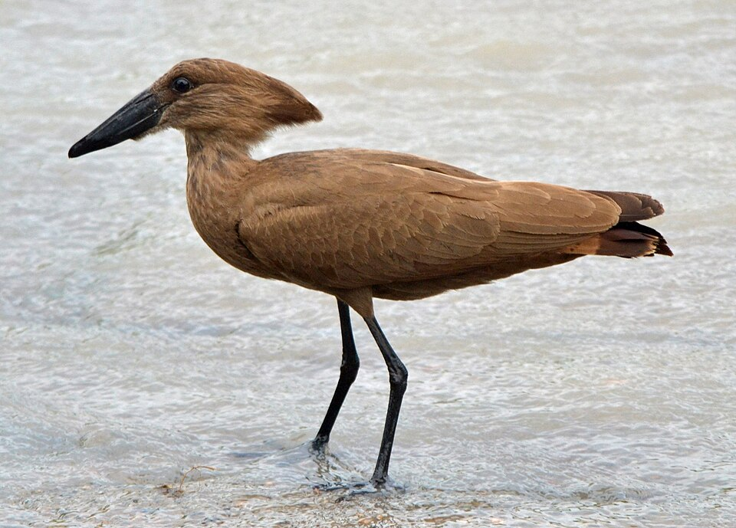
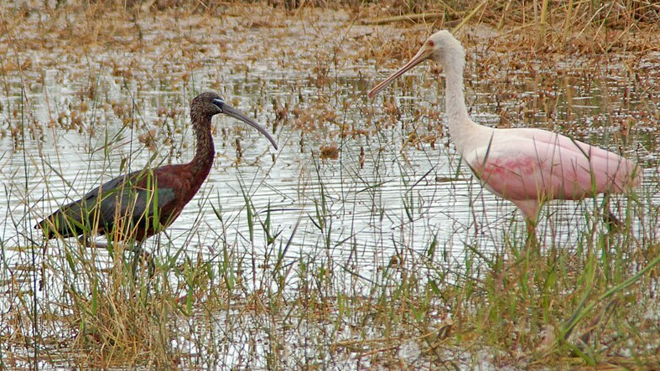
Comparing groups
pelicans <- avonet[which(
avonet$Order1 == "Pelecaniformes"), ]
nrow(pelicans) # 110
boxplot(log10(Mass) ~ Family1,
data = pelicans)
Note the use of which() to select only Pelecaniformes!
Try a boxplot on your data (figure 1 of 3!)

Slide 22
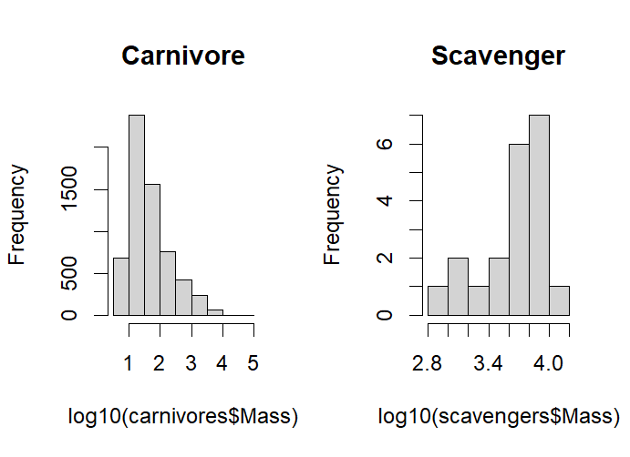
Two plots side by side
carnivores <- avonet[which(
avonet$Trophic.Level == "Carnivore"), ]
scavengers <- avonet[which(
avonet$Trophic.Level == "Scavenger"), ]
par(mfrow = c(1, 2))
hist(log10(carnivores$Mass),
main = "Carnivore")
hist(log10(scavengers$Mass),
main = "Scavenger")
par(mfrow = c(1, 1)) # put it back!

Slide 23
Look before you believe it
Scavengers look about as common as carnivores.
Read the y axes.
We can sanity check with:
nrow(carnivores) # 6115
nrow(scavengers) # 20

Slide 24
Two plots side by side
Your turn.
Plot two groups from your data
side by side
Potential figure 2 of 3.
carnivores <- avonet[which(
avonet$Trophic.Level == "Carnivore"), ]
scavengers <- avonet[which(
avonet$Trophic.Level == "Scavenger"), ]
par(mfrow = c(1, 2))
hist(log10(carnivores$Mass),
main = "Carnivore")
hist(log10(scavengers$Mass),
main = "Scavenger")
par(mfrow = c(1, 1)) # put it back!

Slide 25
Four groups, four blocks
What about all four groups?
herbivores <- avonet[which(
avonet$Trophic.Level == "Herbivore"), ]
omnivores <- avonet[which(
avonet$Trophic.Level == "Omnivore"), ]
...then four hist() calls, differing by one word each, with ylim written out four times.
What’s the issue with this approach?

Slide 26
For loops
A for() loop does it once
for (level in c("Carnivore", "Herbivore",
"Omnivore", "Scavenger")) {
print(level)
}
Runs the code in { } once per element, setting level to each in turn.
Now we put the plotting code inside!

Slide 27
For loops
par(mfrow = c(2, 2))
for (level in c("Carnivore", "Herbivore",
"Omnivore", "Scavenger")) {
print(level)
group_data <- avonet[which(
avonet$Trophic.Level == level), ]
hist(log10(group_data$Mass),
main = level,
xlab = "log10(Mass)",
ylim = c(0, 4000),breaks = c(0:6))
}
par(mfrow = c(1, 1))

Slide 28
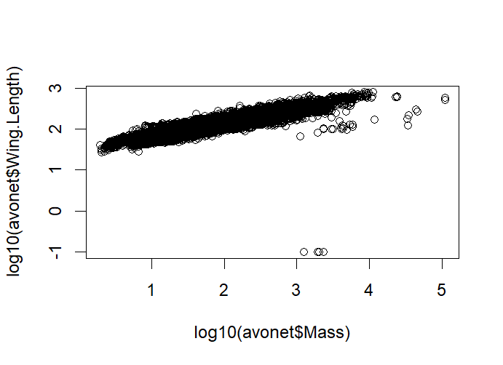
Making figures readable
plot(x = log10(avonet$Mass),
y = log10(avonet$Wing.Length))
Not bad, but could be improved.
How can we see the available arguments for plot()?

Slide 29
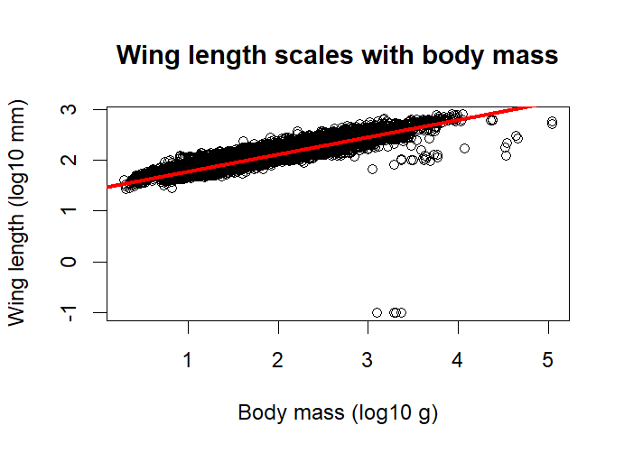
Making figures readable
plot(x = log10(avonet$Mass),
y = log10(avonet$Wing.Length),
xlab = "Body mass (log10 g)",
ylab = "Wing length (log10 mm)",
main = "Wing length scales with body mass")
fit <- lm(log10(Wing.Length) ~ log10(Mass),
data = avonet)
abline(fit, col = "red", lwd = 3)

Slide 30
Making figures readable
plot(x = log10(avonet$Mass),
y = log10(avonet$Wing.Length),
xlab = "Body mass (log10 g)",
ylab = "Wing length (log10 mm)",
main = "Wing length scales with body mass")
fit <- lm(log10(Wing.Length) ~ log10(Mass),
data = avonet)
abline(fit, col = "red", lwd = 3)
Your turn! Make a scatterplot from your own data. (potential plot 3)

Slide 31
Saving a figure
png("my_figure.png",
width = 900, height = 650)
plot(log10(avonet$Mass),
log10(avonet$Wing.Length))
dev.off() # nothing is written until this
Nothing appears in the Plots pane. That's normal.
Your turn. Save all three figures.
Write a commented-out sentence below the code describing what the plot shows.

Slide 32
Remainder of class:
Continue working on 2.6
Start working on Assignment 1
Next class:
Read and work through R for Data Science Chapter 3: https://r4ds.hadley.nz/data-transform.html

