Slide 1
Exploratory Analyses I
Today’s agenda:
Get the course repository
Discuss data of interest
Exploratory analyses and graphics
Work through 2.6

Slide 2
Exploratory Analyses and Graphics
Why do we do exploratory analyses and graphing?

Slide 3
Exploratory Analyses and Graphics
Why do we do exploratory analyses and graphing?
Detect errors
E.g. nonsensical values, perfect correlations, “weird” patterns
Understand statistical distributions/ check for violation of assumptions
E.g., non-normal distributions where normal are assumed
Find patterns and relationships
E.g., mapping variables, pairwise correlation plots, etc.
Identify variables to drop
E.g., highly correlated variables (in some cases)

Slide 4
Exploratory Analyses and Graphics
Critical part of science!

Slide 5
Getting data from Github
Last time you downloaded one file
Today you need several, and I'll add more all semester.
There's a better way: get the whole repo at once, and update it with one click.
github.com/bmaitner/biometry_course

Slide 6
Cloning a repo
Same as your own repo in Lecture 2, different URL
In RStudio:
File → New Project… → Version Control → Git
Paste https://github.com/bmaitner/biometry_course
Pick a folder. Create Project.
(Big download, we’ll continue while it runs)

Slide 7
Why a Project, not just a folder
Class scripts use paths like:
read.csv("data/Avonet/AVONET1_BirdLife.csv")
Those only resolve if R is in the correct directory
Opening it as a Project is what puts you there.
None of the confusion of looking for your files!

Slide 8
Getting updates later
I add lectures, scripts and data as we go.
To get those updates:
Git pane → Pull (the blue down arrow)
Do this before every class.

Slide 9
Don't edit existing files in this folder
If you change a script here, the next Pull may refuse to run.
(this can be fixed, but it’s a hassle)
Instead: copy what you want into your project, then edit.
Alternatively, you can create a folder with your name on it
Nothing in there should be overwritten
Treat the code and data I’ve provided as read-only.

Slide 10
What types of data are we interested in?
Let’s go around and discuss types of data and questions of interest.
(Reminder: you’ll be selecting one or more focal datasets to examine)
In particular, let us know:
If you already have data
If you need help finding data
Note: Have a look in data/ in the repo you just cloned, each folder has a README.

Slide 11
Exploratory Graphics

Slide 12
Which plot?
It depends on what kind of variables you have.
Predictor | Response | Plot
none | One continuous | hist, boxplot
One categorial | One continuous | boxplot
One continuous | One continuous | plot
none | One categorical | table, barplot
Two categorical | - | table, mosaicplot
(Bolker's Table 2.1 is the long version)

Slide 13
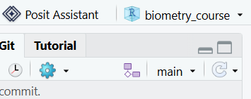
Start with one continuous variable
First, load the avonet data in as an object called “avonet”
Does everyone remember how to do that?
Make sure you're in the biometry_course project: check the top right
Then, view a histogram of mass values using:
hist(avonet$Mass)

Slide 14
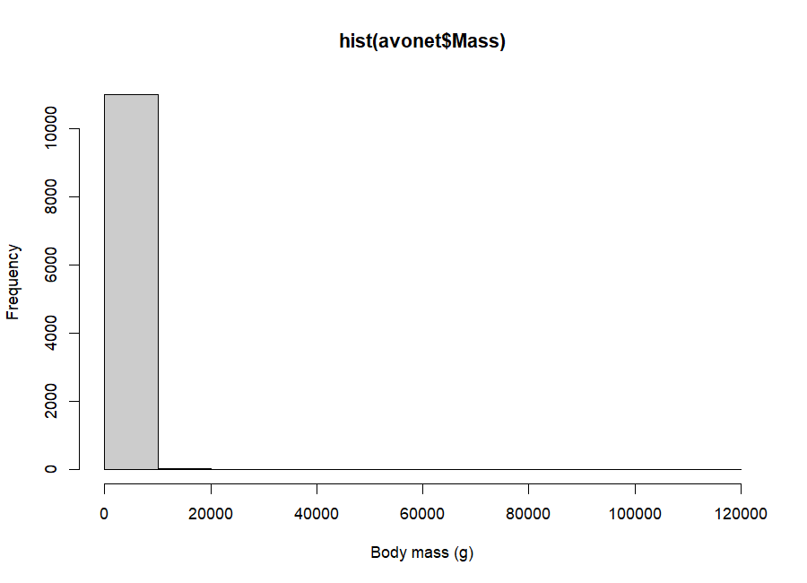
That's one bar
This is not broken. It's telling you the truth, badly.
10,995 of 11,009 species (99.9%) are in that first bin

Slide 15
Why
Try:
range(avonet$Mass)
[1] 1.9 111000.0
Peruvian sheartail: 1.9 g Ostrich: 111,000 g
A 58,000-fold range. Median mass is 35.5 g.
Notes:
Notes: Any linear axis wide enough for an ostrich makes every songbird a single pixel. This is not a quirk of these data — body size, abundance, range size, population density and seed count are all like this. It is the normal condition in ecology, not the exception.

Slide 16
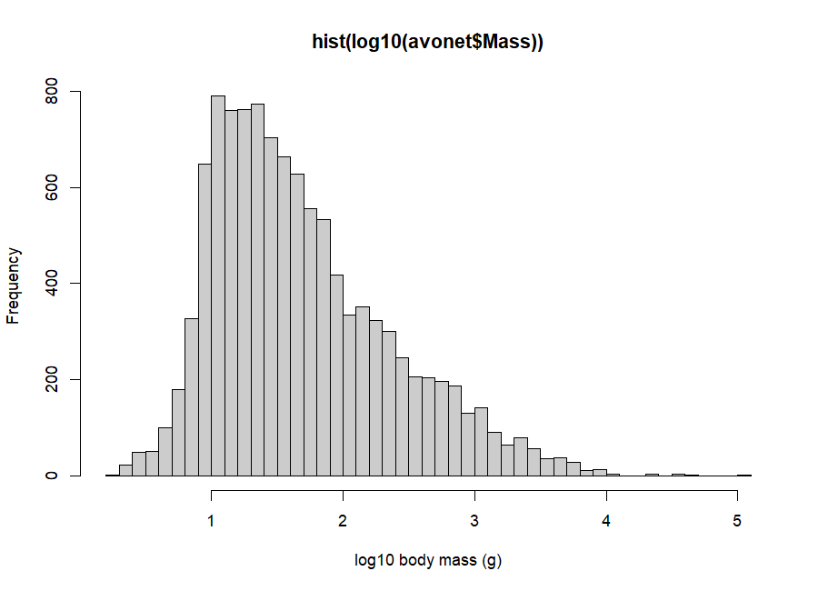

Log scaling and body size
Run:
hist(log10(avonet$Mass),
breaks = 40)

Slide 17
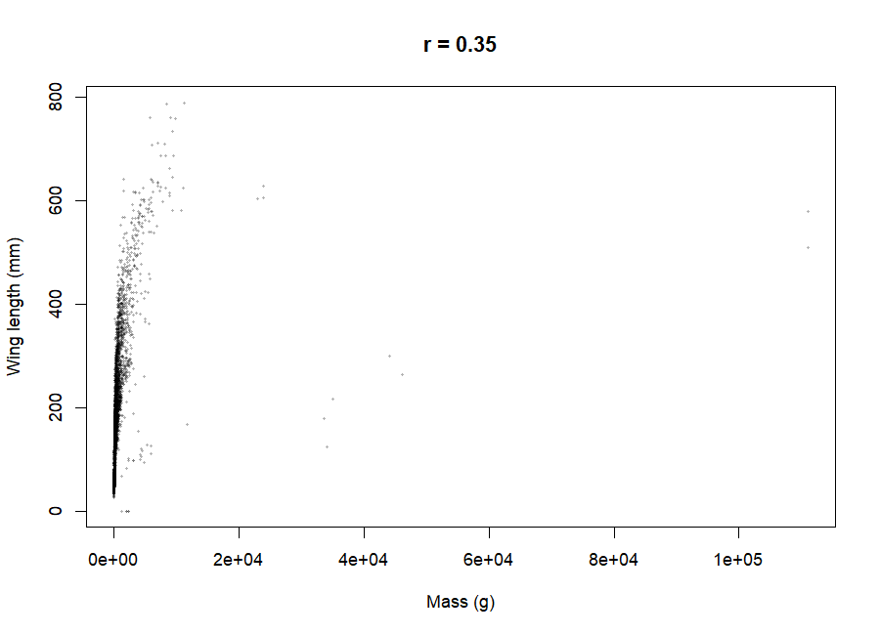
Two continuous variables
Now:
plot(x = avonet$Mass,
y = avonet$Wing.Length)
cor(avonet$Mass,
avonet$Wing.Length,
use = "complete.obs")
What is the correlation?

Slide 18
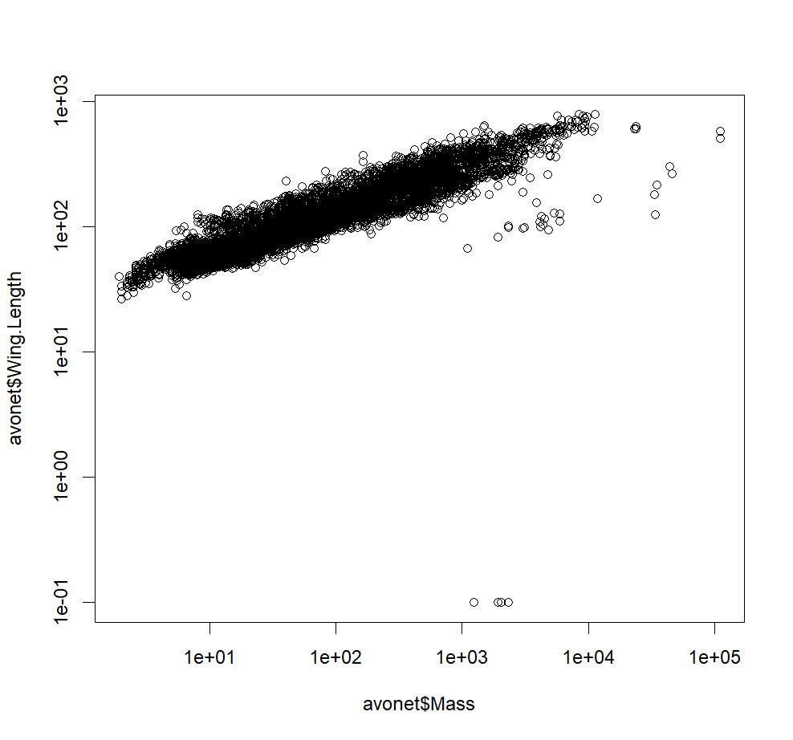
The same data, log-log
Try using a log-log plot:
plot(x = avonet$Mass,
y = avonet$Wing.Length,
log = "xy")
What is the correlation now?
Hint: use the log() function

Slide 19
What birds are those?
Any guesses?

Slide 20
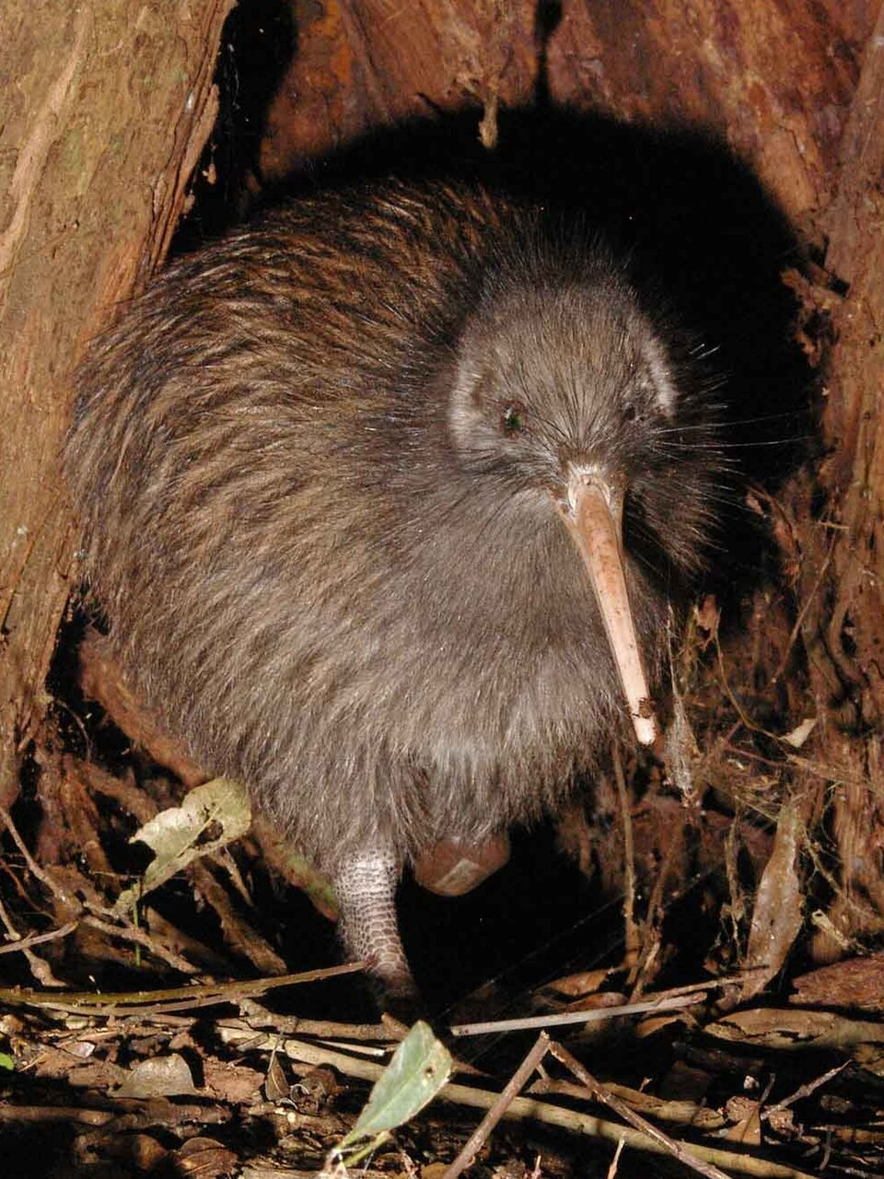
Kiwis
avonet[which(avonet$Wing.Length < 1),
c("Species1", "Family1",
"Mass", "Wing.Length")]
Species1 Family1 Mass Wing.Length
10853 Apteryx australis Apterygidae 2320.5 0.1
10854 Apteryx haastii Apterygidae 2022.7 0.1
10855 Apteryx mantelli Apterygidae 2320.5 0.1
10856 Apteryx owenii Apterygidae 1238.3 0.1
10857 Apteryx rowi Apterygidae 1924.0 0.1
0.1 is a placeholder for "too small to measure."
Notes:
Note: genus name

Slide 21
What birds are those?
Any guesses?

Slide 22
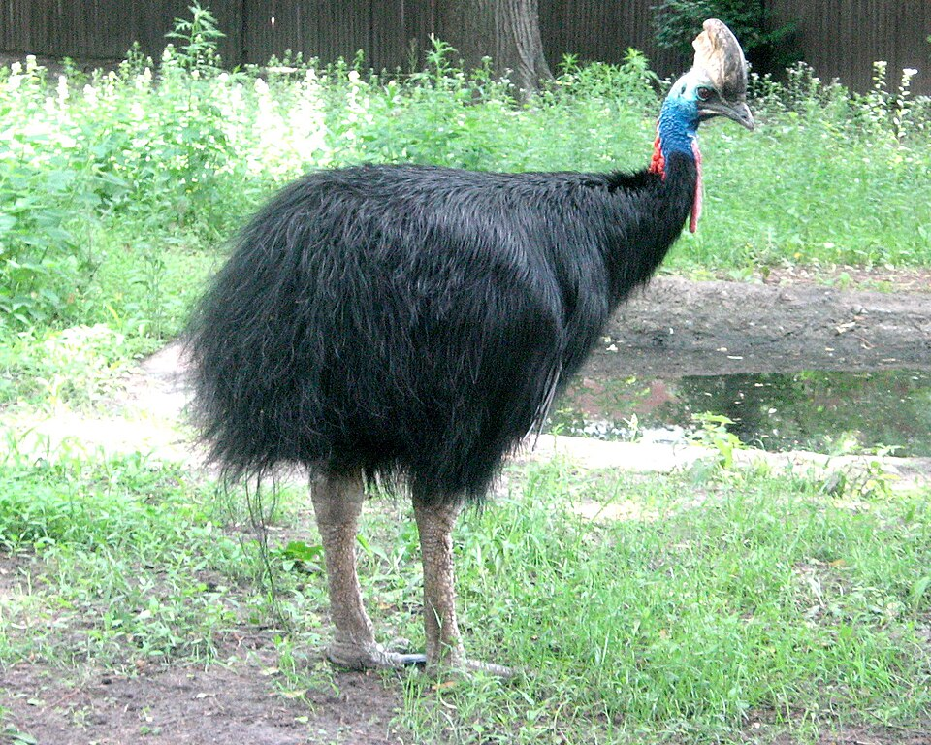
Outlier ≠ error
Try this:
avonet[which(avonet$Mass > 20000),
c("Species1", "Mass", "Wing.Length")]
Species1 Mass Wing.Length
10597 Aptenodytes forsteri 33569.3 179.4
10858 Casuarius bennetti 35000.0 216.8
10859 Casuarius casuarius 44000.0 300.8
10860 Casuarius unappendiculatus 46073.9 264.5
10861 Dromaius novaehollandiae 34093.3 124.5
10862 Rhea americana 23000.0 604.5
10863 Rhea pennata 23900.0 629.5
10864 Rhea tarapacensis 23900.0 607.0
10865 Struthio camelus 111000.0 579.0
10866 Struthio molybdophanes 111000.0 510.5
Also extreme. Also flightless. These are real measurements.

Slide 23
Too many points
plot(x = avonet$Mass,
y = avonet$Wing.Length,
log = "xy",
pch = 16,
cex = 0.4,
col = rgb(0, 0, 0, alpha = 0.3))
cex: controls point size
alpha: controls transparency
Now you can see where the density is.

Slide 24
A categorical predictor
Try this out:
boxplot(log10(Mass) ~ Trophic.Level,
data = avonet)
What trophic level is the largest?
Notes:
~ means "as a function of". You'll see this notation all semester.
Used “data” argument rather than “avonet$” approach

Slide 25
One categorical variable
Try both approaches. Which is more informative?
table(avonet$Habitat)
barplot(sort(table(avonet$Habitat),
decreasing = TRUE),
las = 2)
Note: las = 2 turns the labels sideways (Label Axis Style)

Slide 26
Numbers that aren't quantities
Migration is coded 1, 2, 3 (sedentary / partial / migratory)
Try:
mean(avonet$Migration)
mean(avonet$Migration, na.rm = TRUE)
What do you get?

Slide 27
Numbers that aren't quantities
R doesn’t know meaning, that’s up to you.
What class is R treating migration as?
Potential solutions (try them out):
Use table:
barplot(table(avonet$Migration))
Correct the class:
avonet$Migration <- as.factor(avonet$Migration)

Slide 28
Remainder of class:
Work through 2.6. Start at 2.6.2 (the plots), but first run:
install.packages("emdbook") # once
library(emdbook)
data(SeedPred)
str(SeedPred)
Skip the reconstruction in 2.6.1 — one line gets you the finished dataset.
Next time:
Before class:
review 2.5 - 2.6
During class:
Discuss Assignment 1
Discuss potential data sources to work with
Continue working through 2.6 (if needed)
Start to apply techniques from chapter 2 to dataset of interest

