Slide 1
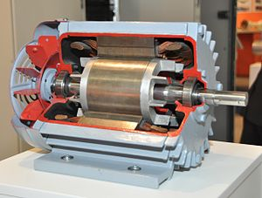
Electric Motors
First Recruitment Task
Teodoro Dias

Slide 2
Objectives
What is an electric motor?
Components of an electric motor
Types of electric motors
Advantages of different types of electric motors

Slide 3
What is an electric motor?
Electrical machine that converts electrical energy into mechanical energy
Using magnetic fields this convertion is achieved

Slide 4

History – The Begins
Can be dated to the begining of the study of electrical forces and magnetic forces
In 1740, Andrew Gordon created na electrostatic device

Slide 5
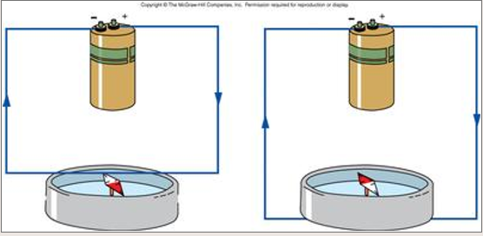
History - Development
1820, Ampère discovered the theoretical principles
1820, Oersted showed that a magnetic field is created from a flowing current in a wire – compass would shift whenever he connected a battery to a wire
1821, Faraday demonstrated the conversion of electrical energy into mechanical energy

Slide 6
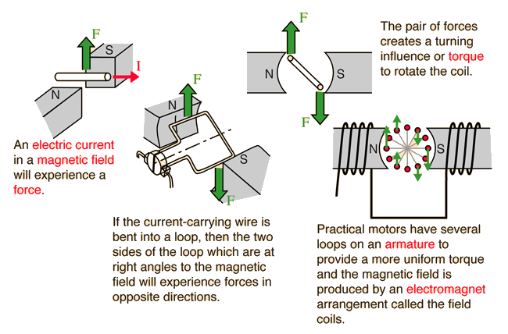
Electric Motor – How does it work?

Slide 7
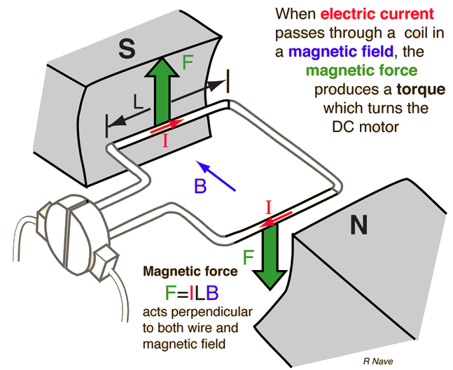
Electric Motor – How does it work? Force

Slide 8
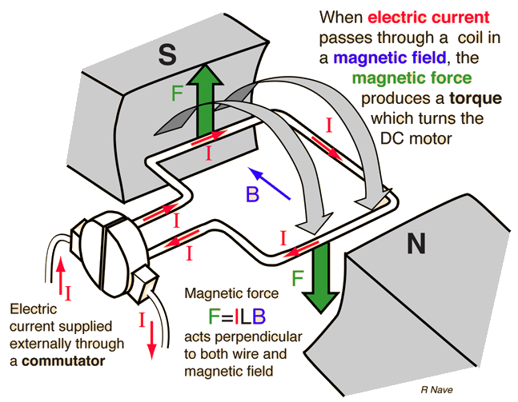
Electric Motor – How does it work? Operation

Slide 9
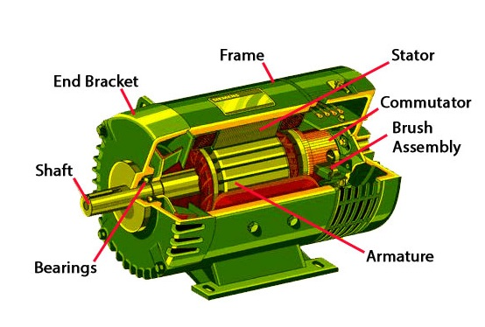
Electric Motor - Constitution
A simple motor is constituted by:
Rotor or Armature
Stator
Brushes
Commutator
Shaft

Slide 10
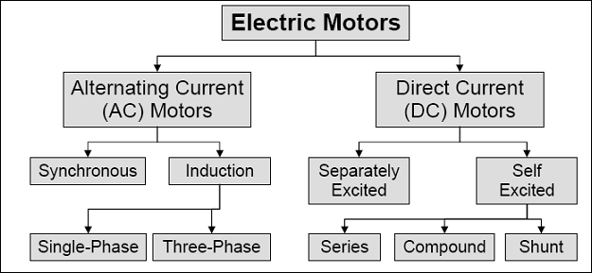
Types of Electric Motors

Slide 11
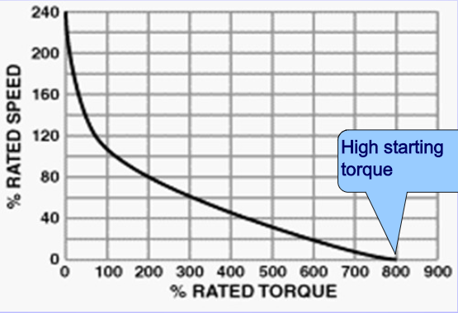
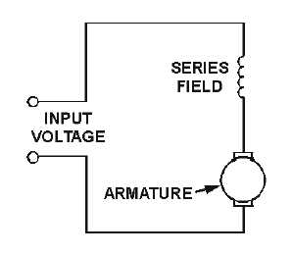
DC Motor – Series Wound
Torque is proportional to current
Used has starter motors, because of its high torque
Only used for a few seconds, because the high series current could burn out the series field coils

Slide 12
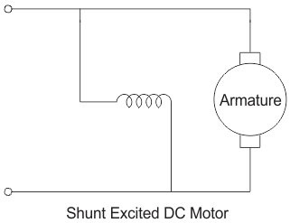
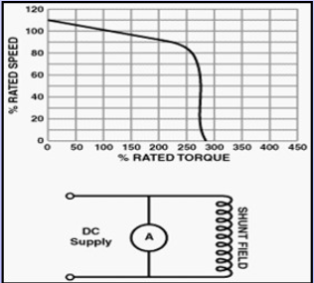
DC Motor – Shunt Wound
Ability to self regulate its speed according to load – this is why it’s also called constant speed motor
Doesn’t provide high starting torque
Used where precise speed control is necessary, like compressors

Slide 13
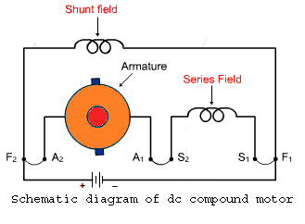
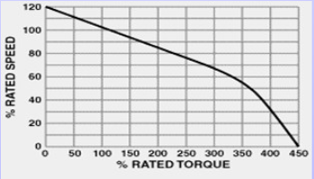
DC Motor – Compound Wound
It’s called compound because is basically the amalgamation of series and shunt wound
Has better starting torque than a shunt wound motor but less than a series wound motor
Can be used for almost any application

Slide 14
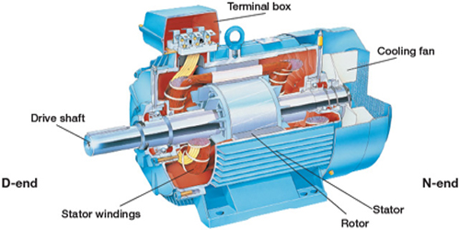
AC Motor vs DC Motor
In DC Motor, the commutator changes the polarity of the current in the coils – in AC motors, commutators aren’t need – the proper concept of alternating current (AC) already garantees this change in the polarity
Was invented later than DC Motors by Nikola Tesla and Galileo Ferraris independently
AC Motors have two basic electric parts: the rotor and the stator

Slide 15
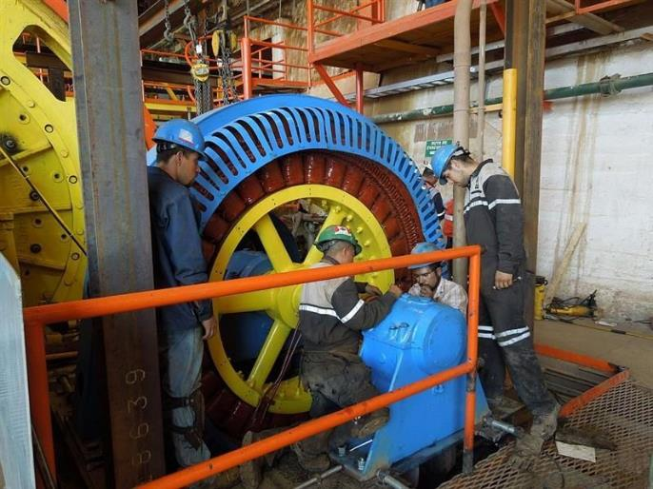
Synchronous AC Motor
A Synchronous AC Motor runs at a constant speed fixed by the frequency of the system
The synchronous speed is equal to the frequency * 60 divided by the number of pairs of poles of the motor
They are used where precision of speed and position is needed – for exemple a ball mill

Slide 16
Induction AC Motor
Divided in single phase and polyphase motors
Single phase motors are divided in:
Shaded-pole motor
Split-phase motor
Capacitor start motor
Resistance start motor
Permanent-split capacitor motor
Polyphase motors are divided in:
Polyphase cage rotor
Polyphase wound rotor

Slide 17
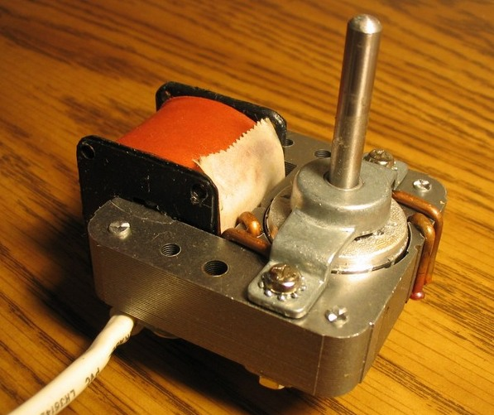
Shaded-pole AC Motor
Original AC single-phase induction motor
Has only one winding, doesn’t have any capacitor or starting winding, making them economical and reliable
They are not common for a power bigger than 250W, since other types of motors offer better characteristics
Used in applications requering low torque like small household appliances

Slide 18
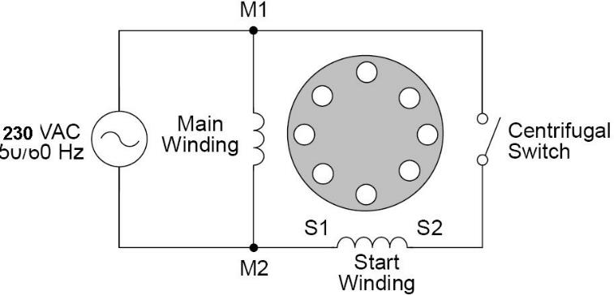
Split-phase AC Motor
Has a starting winding electrically 90 degrees to the main winding
Has bigger torque than shaded-pole ac motor
Used in bigger appliances, like air conditioners

Slide 19
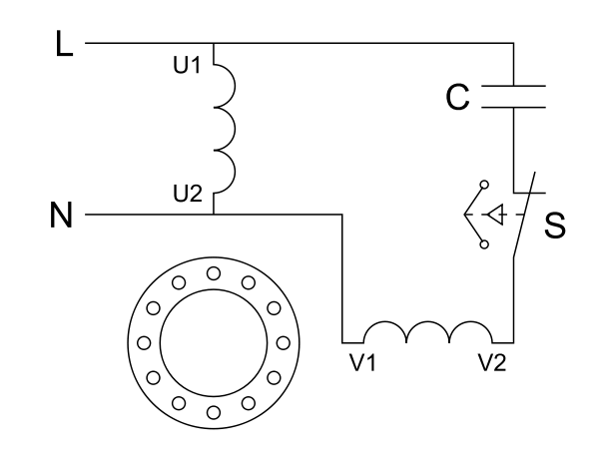
Capacitor AC Motor
Has a capacitor in series with the startup winding, creating na LC circuit, creating a bigger phase shift (more than 90 degrees) and so creating a greater starting torque than the shaded-pole and split-phase ac motor

Slide 20
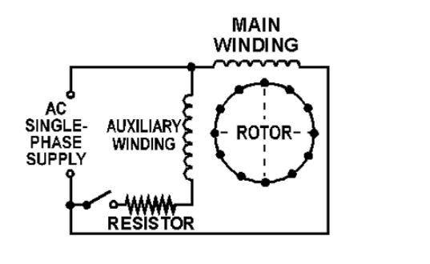
Resistance start AC Motor
Has a resistor in series with the auxiliary winding, creating reactance.
The added starter provides assistance in the starting and initial direction of rotation

Slide 21
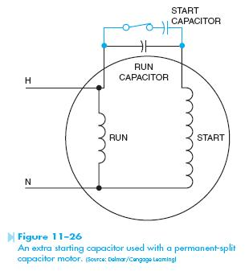
Permanent-split capacitor motor
Also known as capacitor-run motor
Uses non-polarized capacitor with a high voltage rating to generate an electrical phase shift between the run and start windings
This capacitor is connected in series with the start winding, creating a phase shift
Can operate at much lower speeds than the motor’s electrical speed

Slide 22
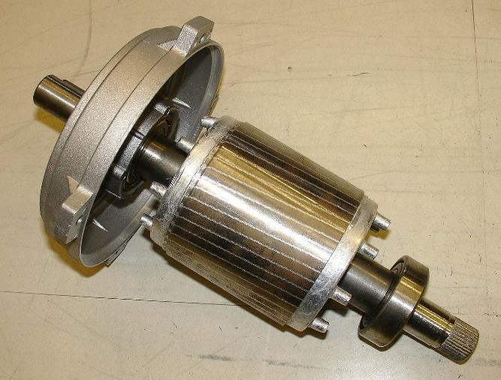
Polyphase cage rotor – Squirrel Cage
Squirrel cage motor can be viewed as a transformer with a rotating secondary
Rotor is constituted by metal strips that are connected to rings, each one with an oppose strip. They create a magnetic field
The electrical load is correspondent to the mechanical load (at no load speed only electrical load required is the necessary to overcome friction and resistance losses)
In case of stall, the overheating can happen and the windings can be destroyed
It’s the most used type of AC motor
Used for exemple in dishwashers

Slide 23
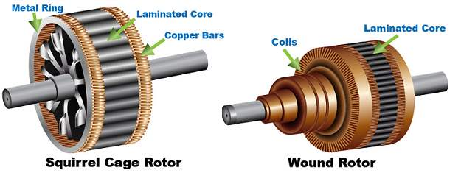
Polyphase wound rotor
Used when variable speed is required
Rotor has same number of poles than stator
Has brushes
Are more expensive than squirrel cage motors and require maintenance
Because of the advance of control electronics (modern inverters) they are becoming uncommon

Slide 24
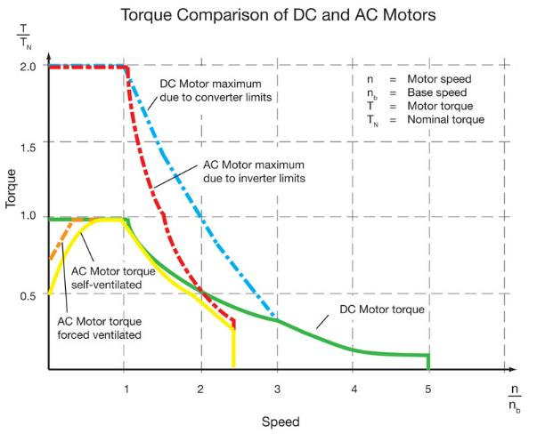
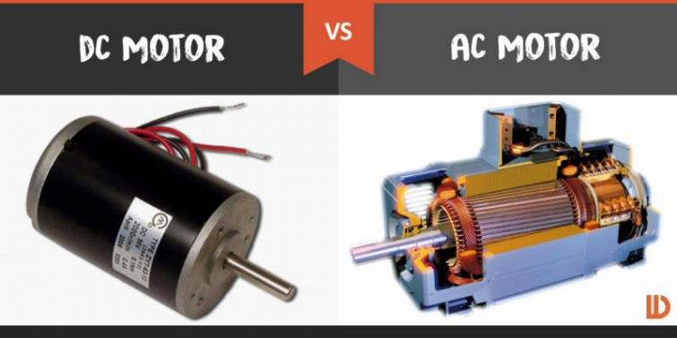
Final Thoughts
AC Motors are cheaper than DC motors and require less maintenance, because brushes aren’t used
DC motors are more used for position control and speed control because of the simplicity to control them (speed controlled by PWM)

Slide 25
END

