Slide 1


EMERGENCY CALLING
Ricardo Fagoaga
Bhupen Malik
Randy Yin

Slide 2

PURPOSE
To provide users with assistance during emergency situations such as:
Lost – Navigate the user to the nearest hospital or home from current location
Option to text emergency contact current location
Accident – Allow user to call / text emergency contact and / or emergency services
Natural Disasters – Provide users with safety information for natural disasters
Intoxicated – Provide user with UBER / LYFT option with listed price to return home

Slide 3






FEATURES
Geo Location – Find user current location
Firebase Authentication – User login
Firebase Real Time Database(JSON Storage) – Store user information
Direction API – Route user to nearest hospitals or home address
Places API – Find nearest hospitals in 10 mile radius
Navigation Drawer – Handles fragments
Map SDK – Show current location and hospitals
UBER / Lyft API – Show cost estimates to home address

Slide 4

Implemented the followings:
Signup using medical information , email , password etc.
Sign in
Forgot Password
Change Password , change email , Delete your profile & Sign out.
Homepage
Current location with nearby hospital in 10 miles radius.
In navigation , all kinds of emergency are listed .such as , lost , accident , all kinds of natural disasters & if you are drunk or intoxicated.?

Slide 5
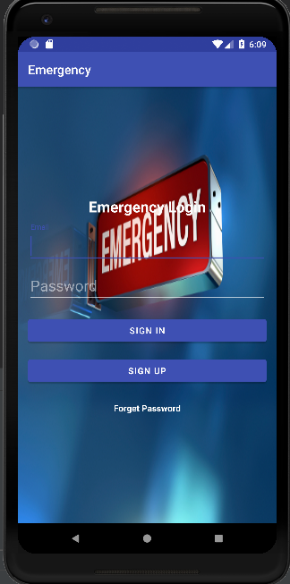
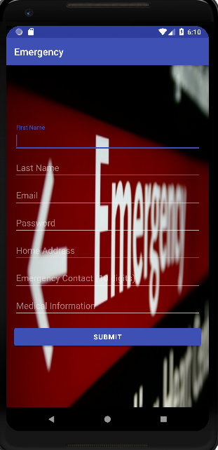
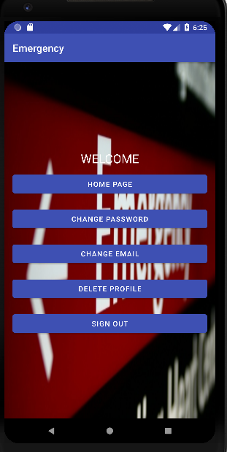

Slide 6
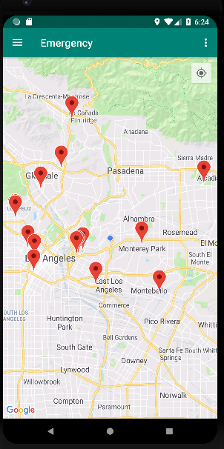
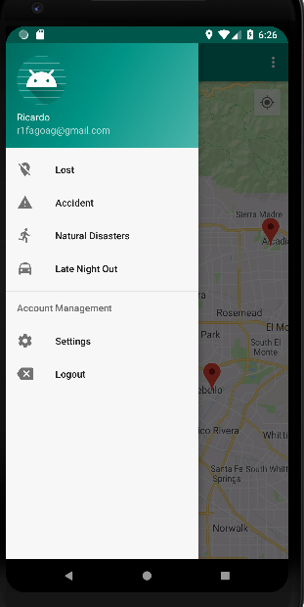

Slide 7
Thank You ! ☺

