Slide 1
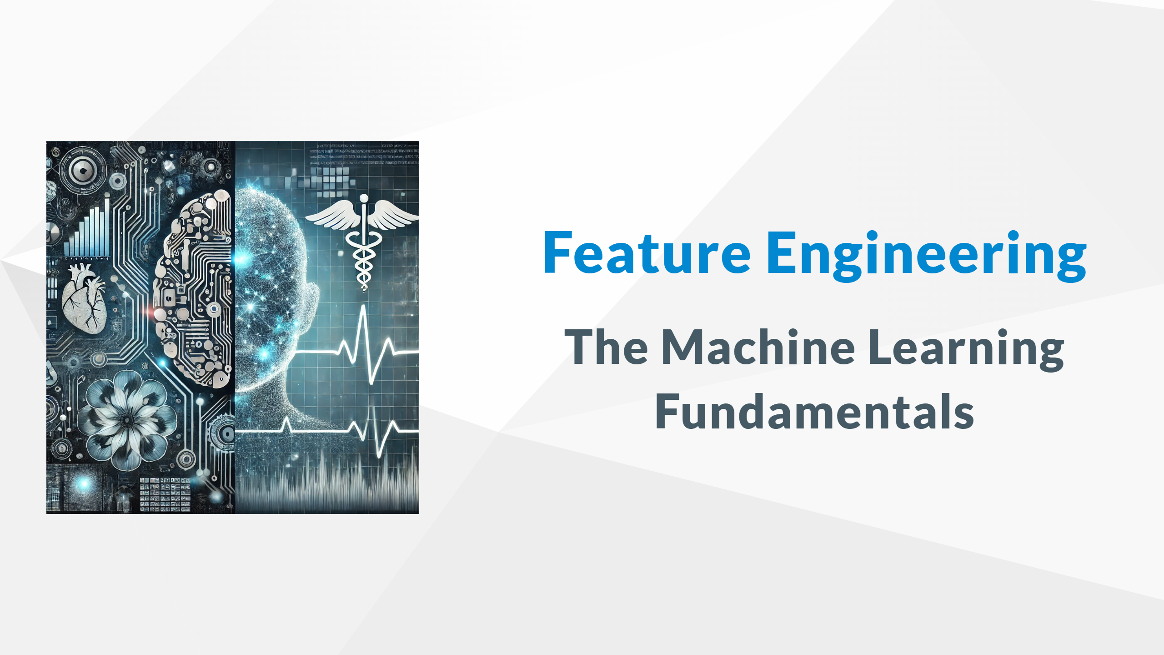

Slide 2
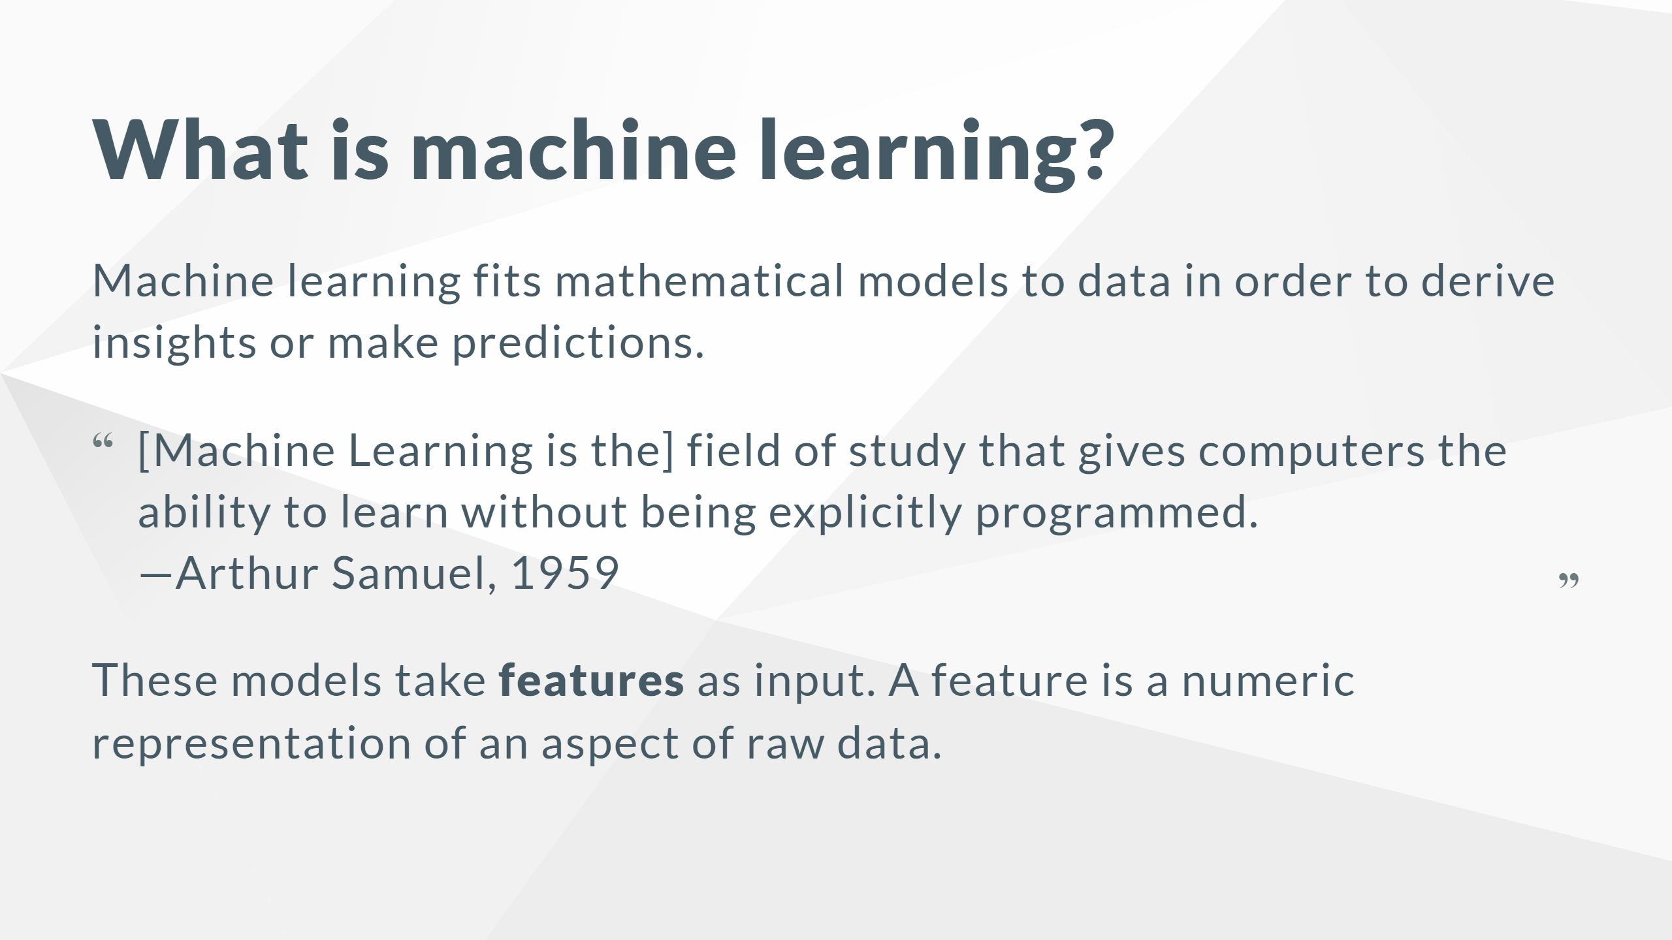
Notes:
Features are used as input variables in models that learn from data to make predictions or decisions without being explicitly programmed.

Slide 3
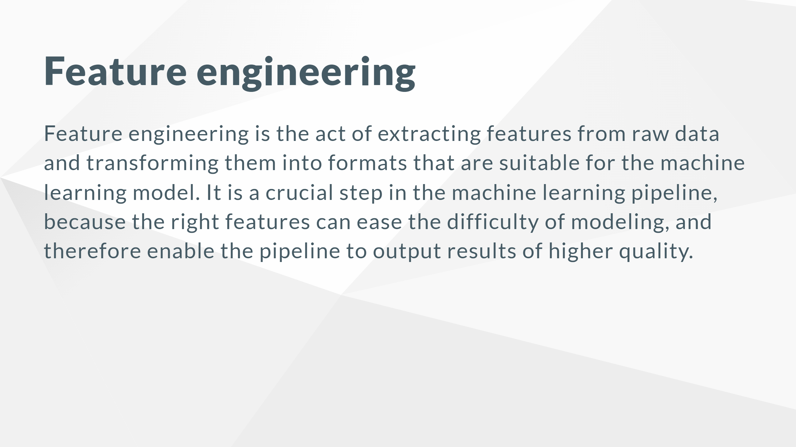

Slide 4
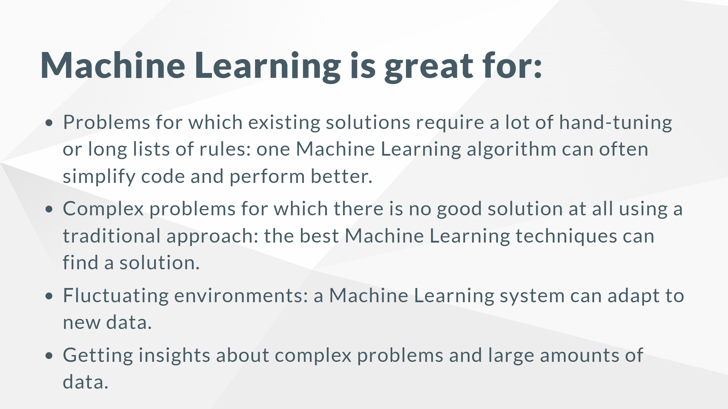

Slide 5
