Slide 1
Fat32 notes
Van Kelly
hexedit is your friend!!

Slide 2
You can mount fat32.img as a real filesystem on Mac or Linux VM
On Mac, just click the file and finder will mount it.
On Linux do the following commands
sudo mount –o loop fat32.img /mnt
cd /mnt
Once the file is mounted, you can go into the /mnt directory and use all your normal file system commands like ls, cat, cd, etc.

Slide 3
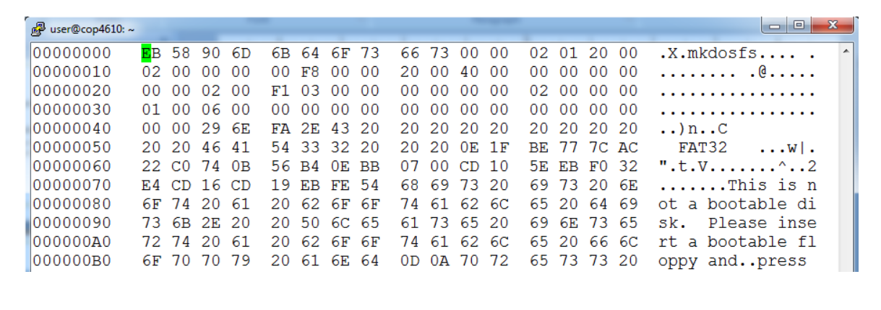
FileSystems are binary structures
You can't inspect them with a text editor
You need a hexadecimal file editor, like hexedit.
available for Windows, Mac, and Linux
displays content in 3 columns: offsets, hex, and ASCII
it can modify a file, so be careful!! (Linux hexdump can't modify)

Slide 4
Endian-ness count!
FAT32 structures are little-endian
What is the value of this number??

Slide 5
Some FAT Terminology
Partition = one entire file system
sector/block = native unit of data on drive
2 ways to specify a block
CHS = cluster-head-sector addressing (packed bit fields)
LBA = logical block addressing (this is what we use)
boot sector = first sector of partition
cluster = group of blocks allocated as one unit
FAT = file allocation table (linked list)
FAT and partition meta-data are NOT in clusters!!
Clusters start after the last FAT table!!

Slide 6
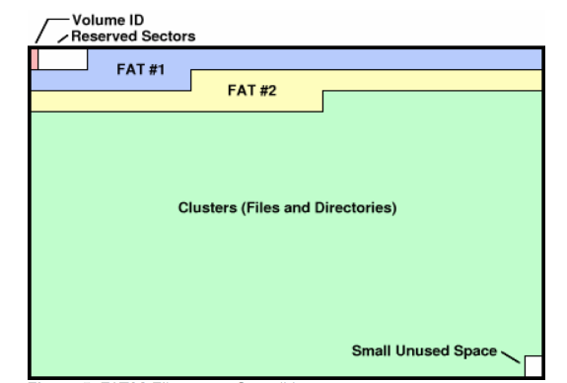



FAT32 Partition Layout
Volume ID
Reserved Sectors
FAT #1
FAT #2
cluster #02
Clusters (files and directories)
small unused space

Slide 7
Important Boot Sector Information
Size of each region
BPB_BytesPerSector
BPB_SecPerCluster
BPD_RsvdSecCnt
BPD_NumFATS
BPD_FATSz32
Root Directory
BPD_RootClus
Warning: this list is not exhaustive

Slide 8
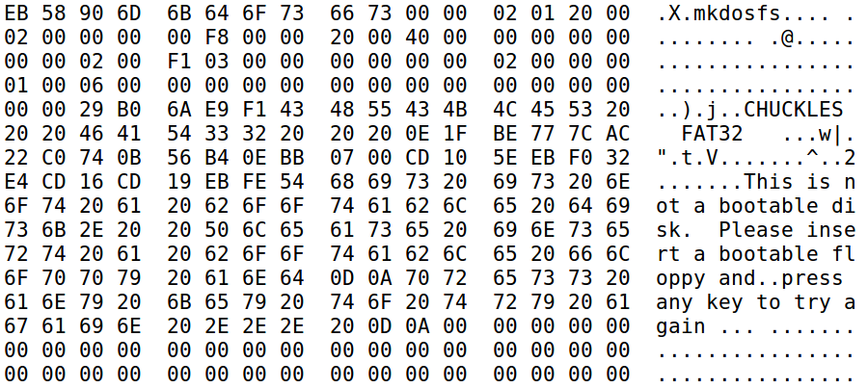

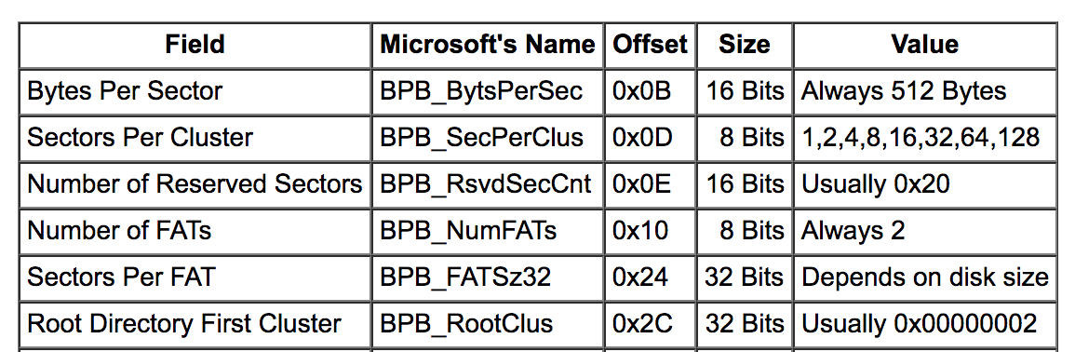
Hex Dump of Boot Sector
sectors per cluster
# of FATs
bytes per sector
sectors before FAT #1
sectors per FAT
cluster # of root directory

Slide 9
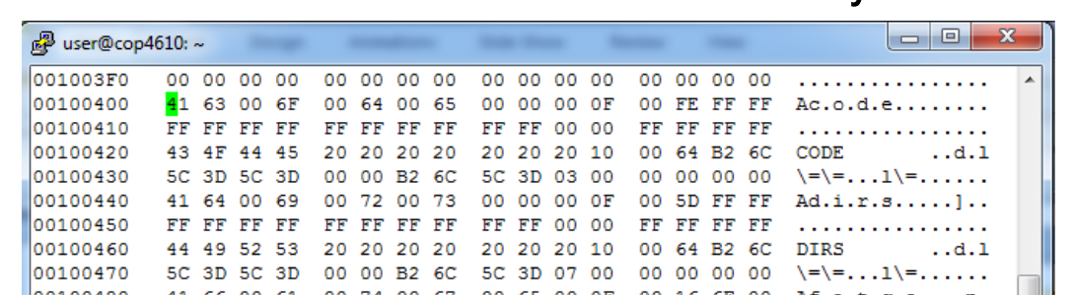
Finding the Root Directory
Figure out the root directory cluster number from the boot sector (see previous slide)
Figure out where the root directory starts in the data region where N = cluster number
FirstSecOfCluster = ((N – 2) * BPD_SecPerClus) + FirstDataSec
Read in the root directory structure located at the first sector of the root directory cluster, e.g.:

Slide 10
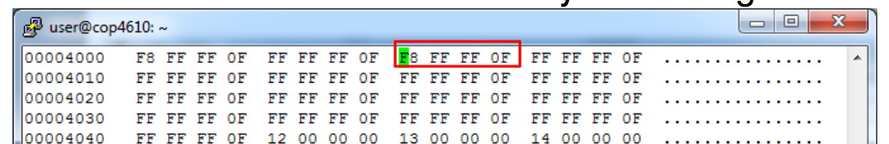
Finding the Root Directory
Does the root directory span more than 1 cluster? Look up the next cluster number in the FAT.
Find ThisFATSecNum and ThisFATEntOffset for current cluster number (definitions are in the spec document)
Go to ThisFATSecNum and read the 32-bit unsigned value at offset ThisFATEntOffset
FAT will give you either the next cluster number in the directory or the End of Cluster Chain value (0x0FFFFFF8)
(The FAT is a list of "pointers" to the next cluster number of each file or directory; in essence a linked list within a file)

Slide 11
Finding Files and Directories
Each directory is made up of one or more directory entries that contain
file/subdirectory name (maybe long and short forms)
attributes
first cluster number
more …
Files and sub-directory entries can be found by going to their first cluster number

Slide 12
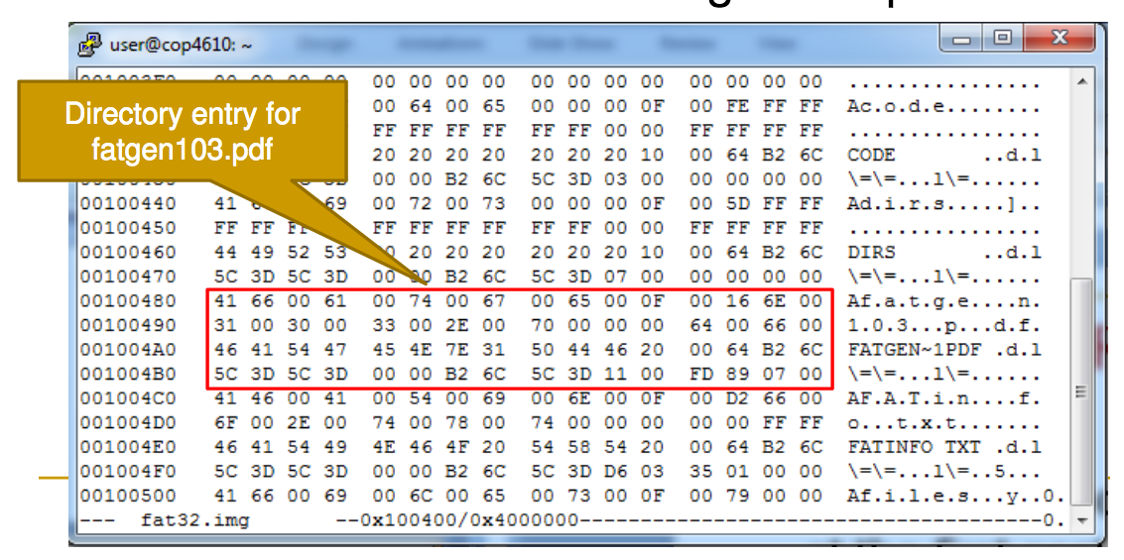
Finding files: Example
High bytes
of first cluster #
Low bytes
of first cluster #
Plug N = 0x11 into FirstSecOfCluster equation, go to that sector…

Slide 13
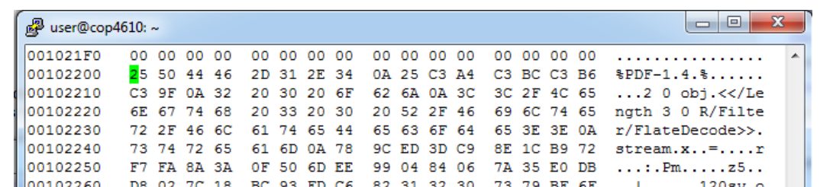
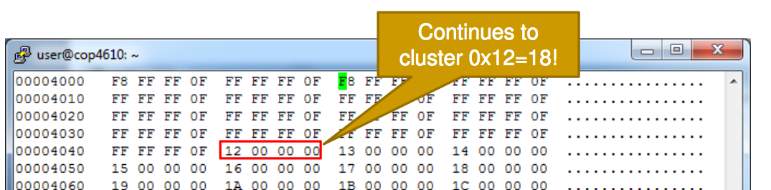
ooes the file continue after this cluster?
Look up cluster 0x11 in the FAT (cluster 17)

Slide 14
Directory Entries
List names of files and subdirectories in a directory
2 entry types
Long-name directory entry
precede corresponding short-name directory entry
give a file name in Unicode 16-bit-per-character encoding
Short-name directory entry
limits name size to 8 bytes with 3-byte file extension: ALL CAPS
compatibility with previous FAT versions
32 bytes total size
other important metadata: attributes, file size, first cluster number, etc.
If DIR_Name[0] == 0xE5, then the entry is free (no current file or directory name in this entry)
if DIR_Name[0] == 0x00, then the entry is free AND there are no allocated directory entries after this one.

Slide 15
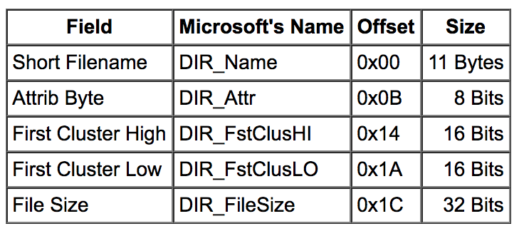
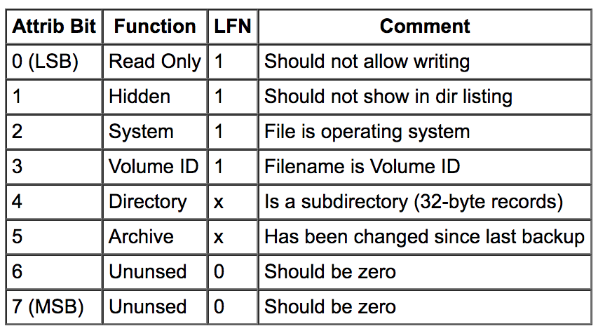
FAT32 Short-Name Directory Layout
Cluster Cluster
Short Name(8+3) Attrib. High Low Size
32-byte directory layout; short filename version
if attrib = 0x0F, 0x1F, or 0x2F you can ignore this entry

Slide 16
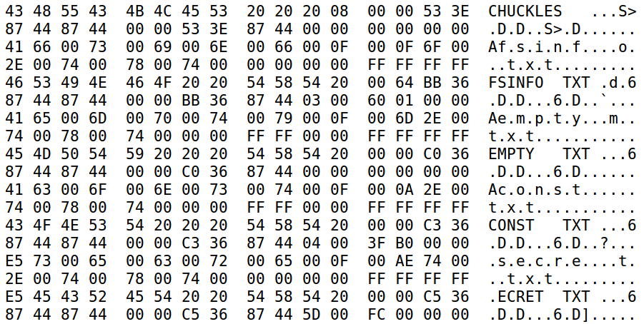
Hex Dump of Root Directory
Attrib.
???
First Clusters
File Sizes

