Slide 2
Cucumber Testing Behavior Driven Development June 17th 2015

Slide 3
Cucumber Background
Cucumber started as a rewrite of Rspec’s Story Runner
A Behavior Driven Development (BDD) tool for Ruby
Cucumber was written to address usability issues with Rspec
Rspec required that stories be written in Ruby
Cucumber uses feature files written in a domain specific language Gherkin
Gherkin uses a “Given When Then” format.
Feature steps are mapped to step definitions via regular expression
Step definitions are methods used to turn feature files into executable blocks of code
Cucumber was originally written for use with Ruby
There are now implementations for .NET, Flex, Perl, and JVM based languages
Source: cucumber.io

Slide 4
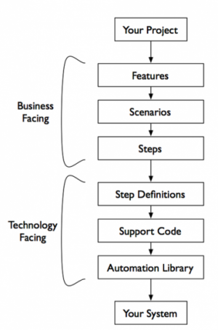
How Cucumber Works
Cucumber uses support (glue) code to interact with the application under test.

Slide 5
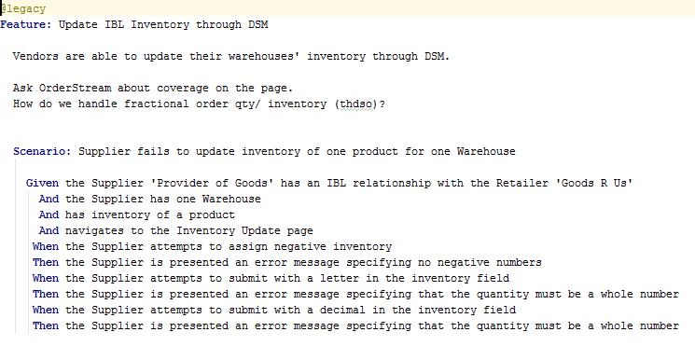
The Cucumber Feature File
Feature
Acts as a title for the file
Scenarios are grouped together into features

Slide 6
The Cucumber Feature File
Scenario
A description of how the application should behave when going through the given steps

Slide 7
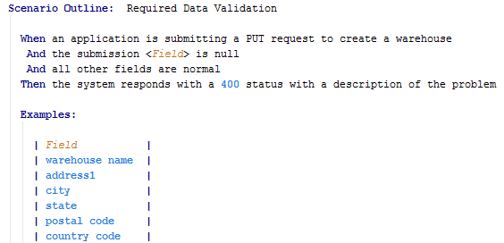
The Cucumber Feature File
Scenario Outline
Similar to a Scenario, but includes placeholders and examples.
Placeholders are contained within < >
Examples can be provided in a list or in a table
The Scenario Outline will execute for each example
Used to eliminate the need for repetitive copypasta Scenarios

Slide 8
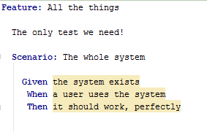
The Cucumber Feature File
Scenarios shouldn’t be too broad.
They should describe specific use cases

Slide 9
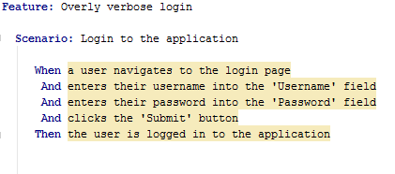
The Cucumber Feature File
Simple actions can be combined into a single step
No need to have four lines describing how to sign into the application

Slide 10
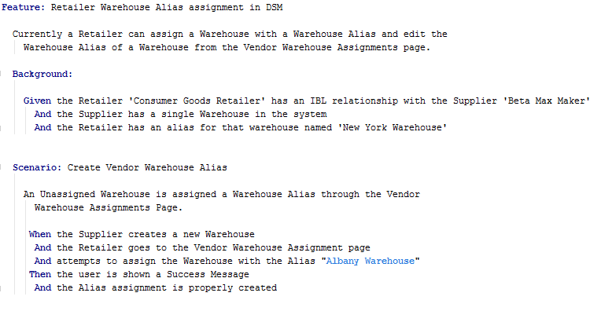
The Cucumber Feature File
Background
A block of steps that is executed before each Scenario or Scenario Outline

Slide 11
The Cucumber Feature File
Tags
Tags can be used to organize features into groups.
Tags can be applied to Scenarios, Scenario Outlines, and Features.
There is no limit to how many tags can be used.

Slide 12
The Cucumber Feature File
Given, When, Then, And, But
Steps to be executed for the Scenario
No functional difference between Given, When, and Then
Given – put the system in a known state
When – describe key actions
Then – Observe outcomes

Slide 13
The Cucumber Feature File
Given, When, Then, And, But
And and But act as whatever they come after

Slide 14
The Cucumber Feature File
Before and After
Before steps will run before each scenario
After steps will run after each scenario

Slide 15
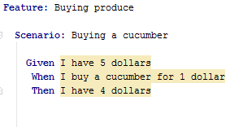
The Cucumber Feature File
Because step types are treated the same by cucumber, duplicate step text can lead to confusing results

Slide 16
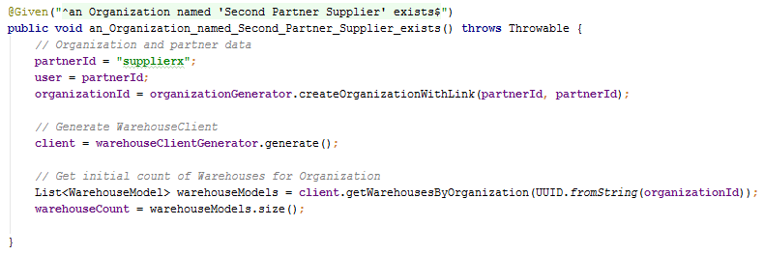
The Step Definition File
The Step Definition file contains the methods used to execute the feature.
Methods are matched to steps via regular expression

Slide 17
Demonstrations!
Here’s the fun part!

Slide 18
Questions
???

Slide 19
Thank You!
Example code can be found at: https://github.com/bmanley91/cucumber-test

