Slide 1
Python Testing Frameworks
@b_mannix
Notes:
----- Meeting Notes (3/21/13 11:12) -----
notes for me!

Slide 2

opportunities @ silo
we have open positions!
www.sciencelogic.com/company/careers

Slide 3
Overview
nose
unit test framework
nose-parameterized
Lettuce
BDD test framework
Robot Framework
keyword driven acceptance test framework
Multi-Mechanize
load and performance test framework

Slide 4
nose
unittest extension
What is a unit test?
code-level test
automated
narrow scope
minimal dependencies
unordered execution
there is some discussion about when a unit test becomes an integration or system test.
can be executed directly from the source tree

Slide 5
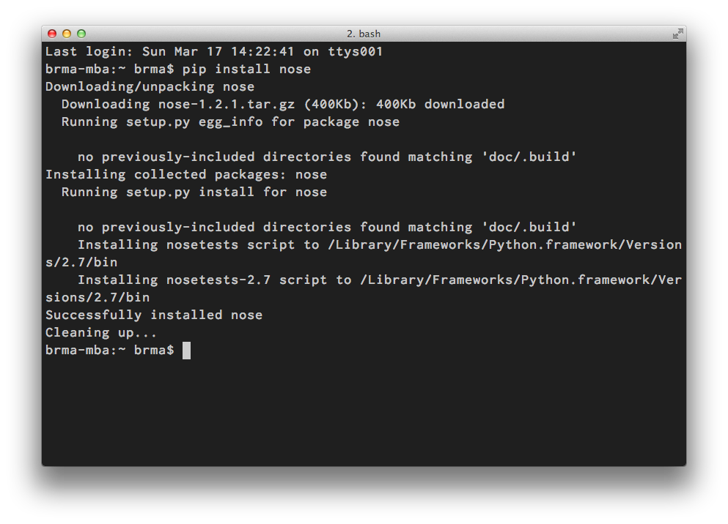
nose
Installation

Slide 6
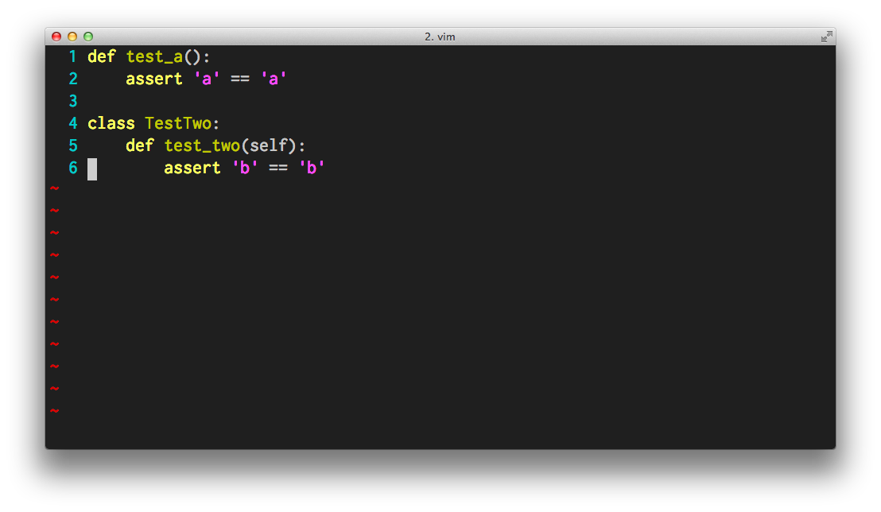
nose
existing unittest classes are compatible
simple examples

Slide 7
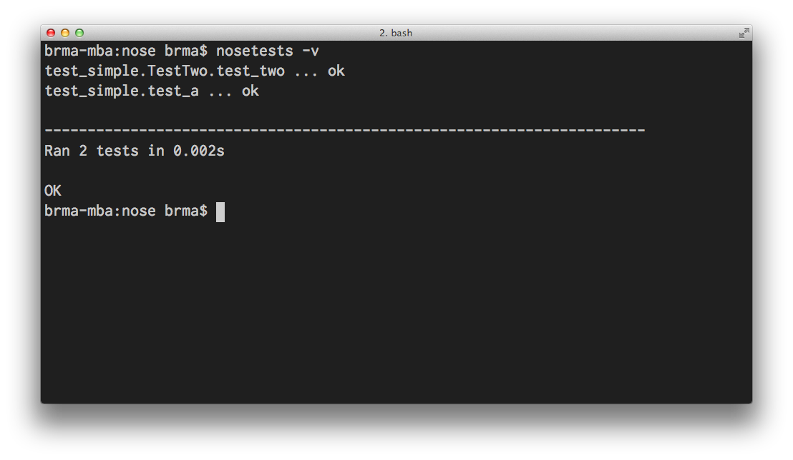
nose
automatic test discovery

Slide 8
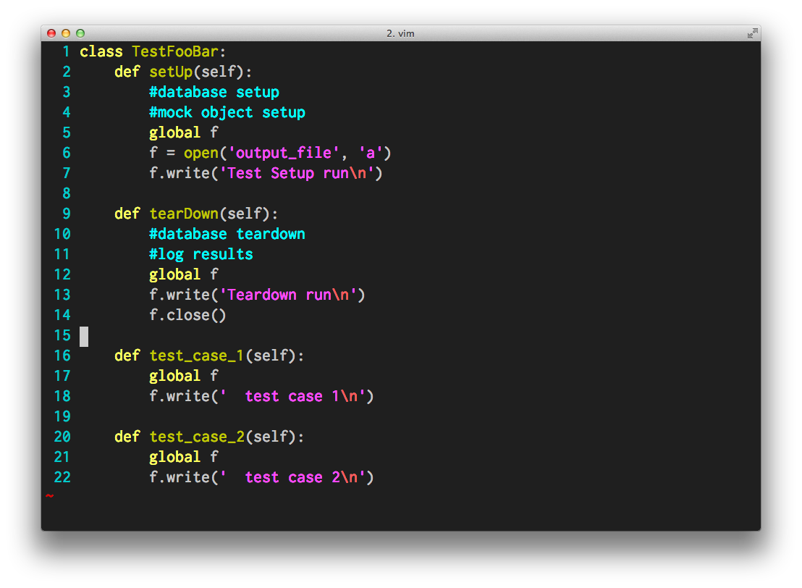
nose
test setup and teardown

Slide 9
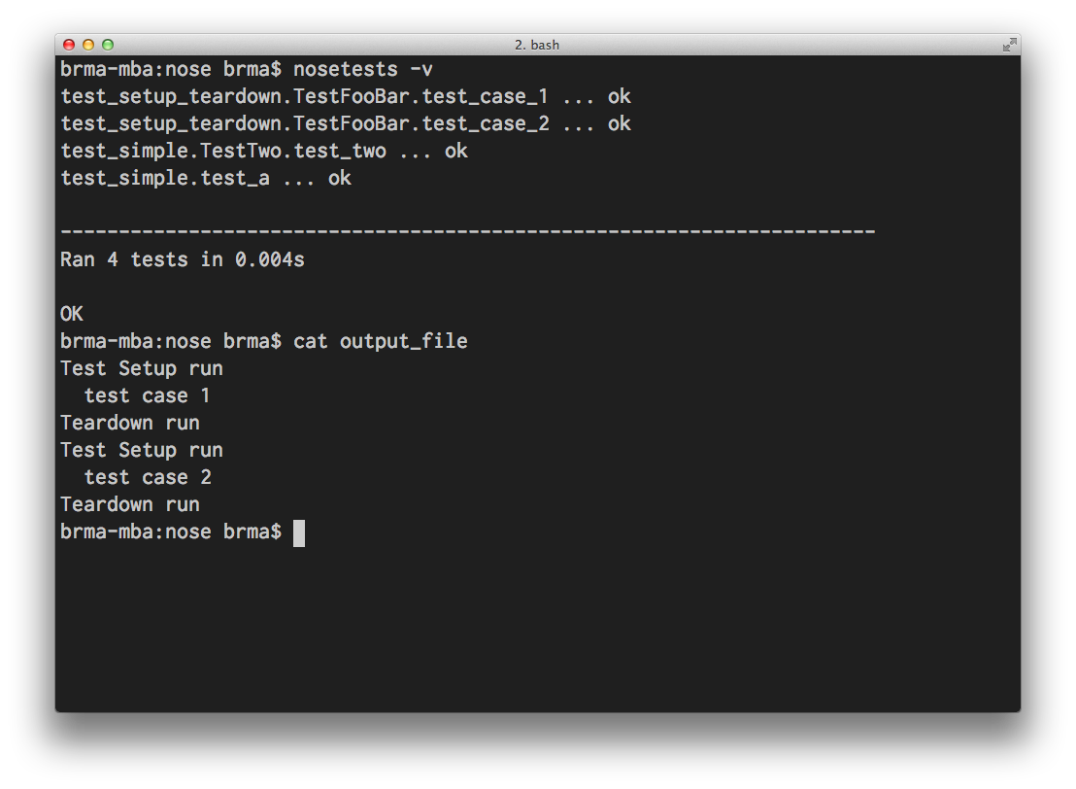
nose

Slide 10
nose-parameterized
pip install nose-parameterized
allows for data driven unit tests.
Nose. It's got test generators. But they kind of suck, because:
They make it difficult to separate the data from the test
They don't work with subclases of unittest.TestCase
They often require a second function
-David Wolever

Slide 11
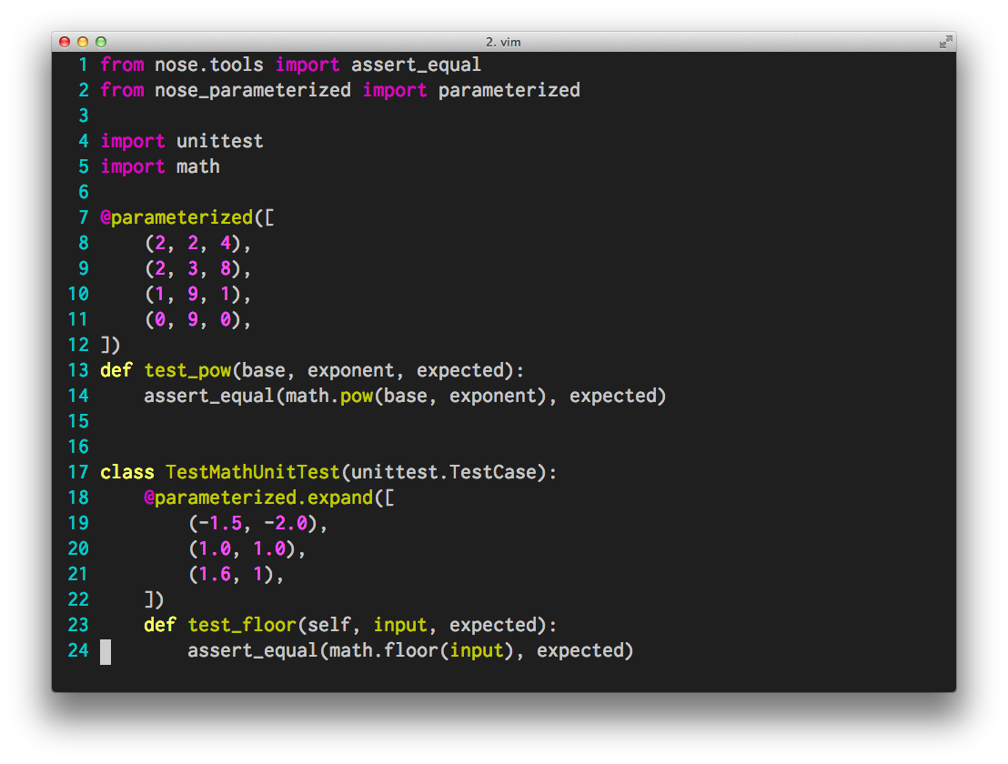
nose-parameterized

Slide 12
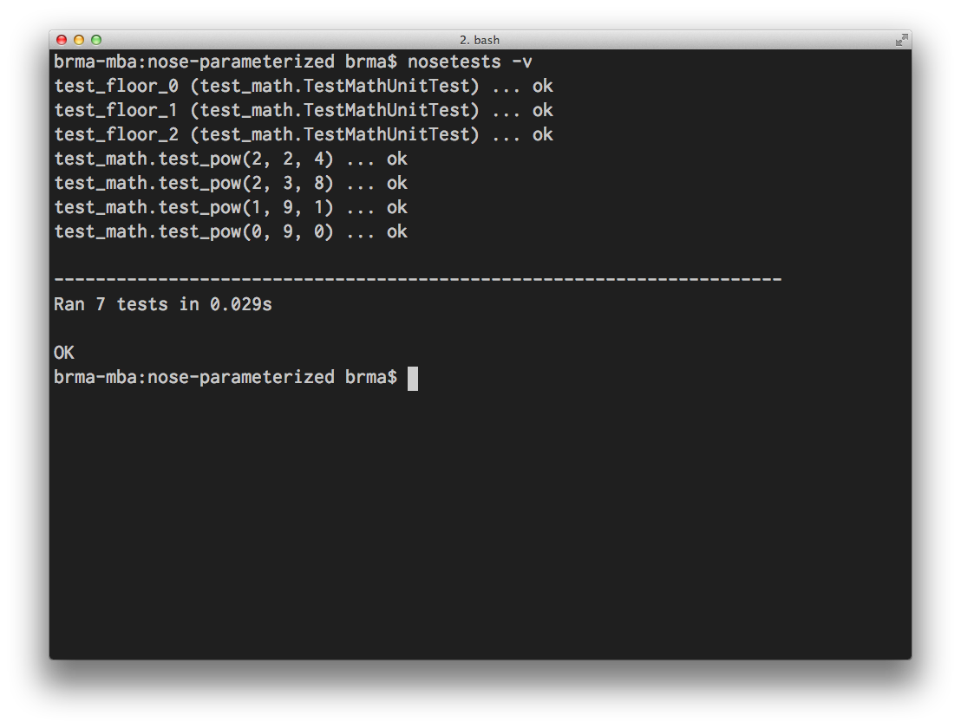
nose-parameterized

Slide 13
nose review
encoder/decoder demo
can be plugged into a continuous integration platform like Jenkins.

Slide 14
lettuce
Behavior Driven Development
TDD via common toolset with non-technical business analysts.
Python’s version of cucumber (ruby)
gherkin used to write tests
pip install lettuce

Slide 15
lettuce
terms
Gherkin – “business readable, domain specific language”
automation
documentation
Feature – describe a distinct feature of the system.
Scenarios – a number of scenarios combine to represent a feature.

Slide 16
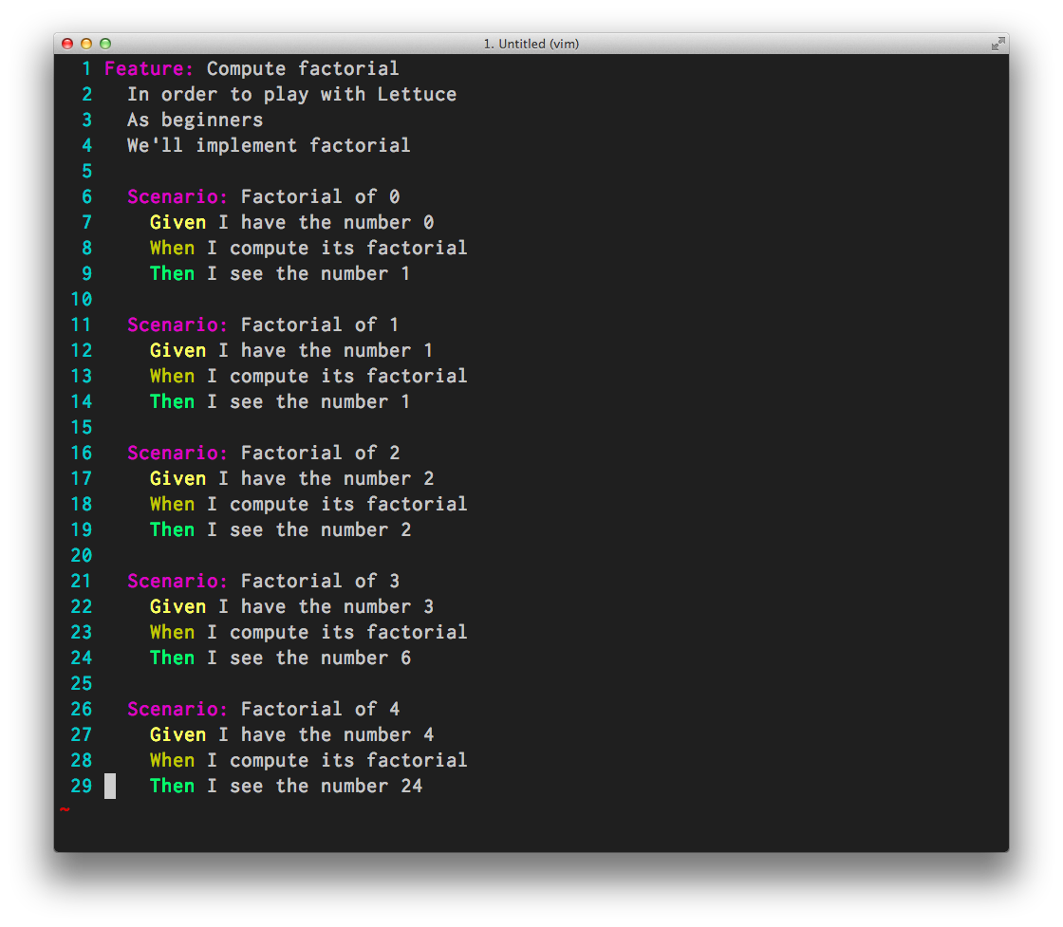
lettuce
Step 1 - write some gherkin

Slide 17
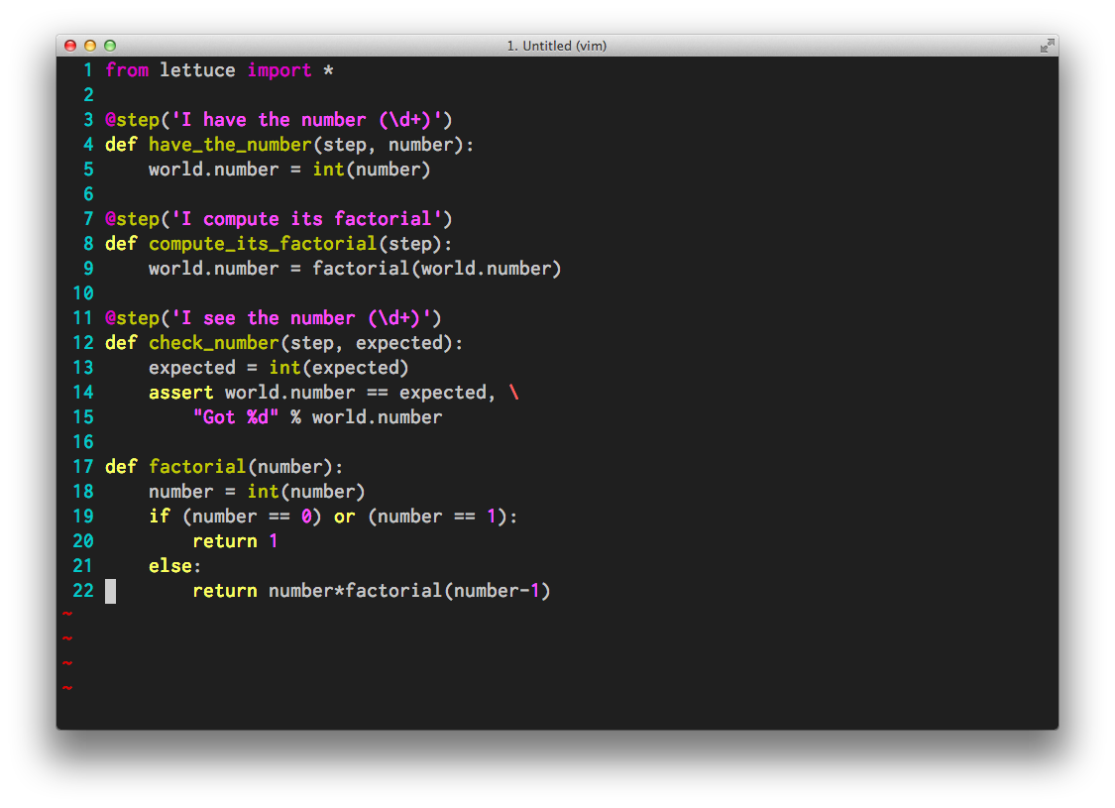
lettuce
Step 2 – write the steps.py code for your gherkin sentences.

Slide 18
lettuce
Step 3 – run your tests.
Step 4 – watch it fail
Step 5 – write code that makes the failing test pass.
Step 6 – goto Step 3

Slide 19
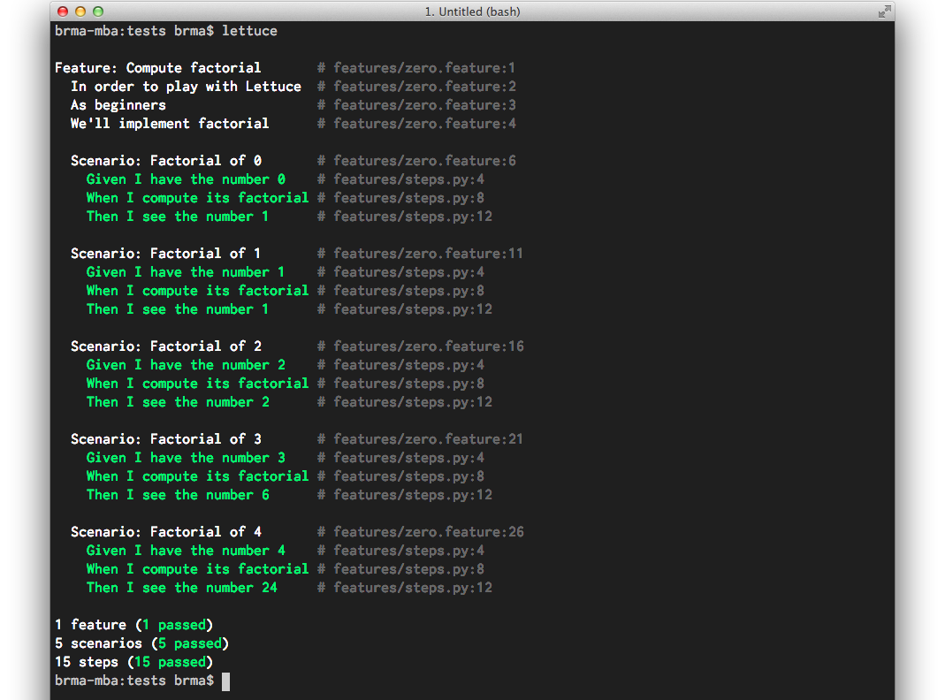
lettuce

Slide 20
lettuce
lettuce makes BDD straightforward.
but is BDD for you?
BDD is TDD in Gherkin
why Gherkin?

Slide 21
nose & lettuce
benefits of execution from the source tree
supports CI
thoughtless execution (automated)
pinpoint broken commit
shorten the feedback loop
saves money!
and now for a quick rant…

Slide 22
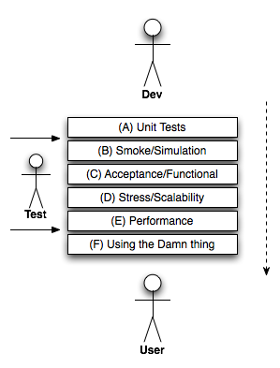
feedback loop
- Jesse Noller

Slide 23

robot
robot framework
acceptance testing framework
keyword driven
Python / Jython / IronPython
open source
large library of built-in keywords
many community plugins
selenium, phantomJS, watir
ssh, http, requests
VmrunLibrary

Slide 24
robot
selenium example:
how does a keyword driven approach differ from “regular” WebDriver scripts?
keyword reuse
easier to maintain
easier to read
lowers technical barrier

Slide 25
robot
installation:
pip install robotframework
pip install robotframework-ride
pip search robotframework
sudo apt-get install python-wxgtk2.8
resources:
http://blog.codecentric.de/en/2012/03/robot-framework-tutorial-overview
http://code.google.com/p/robotframework/

Slide 26
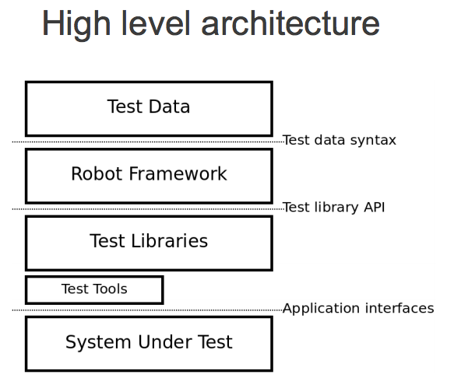
robot

Slide 27
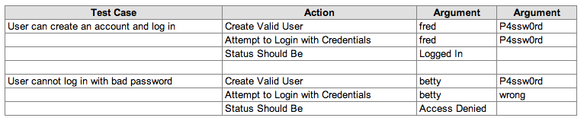
robot
simple test case

Slide 28
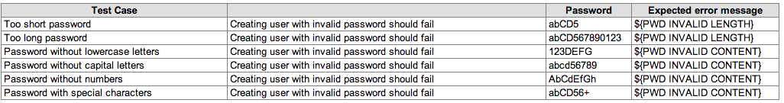
robot
data driven tests

Slide 29
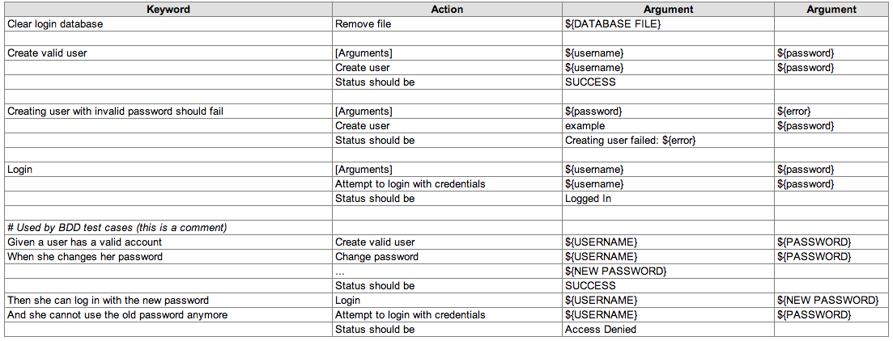
robot
define keywords

Slide 30
robot
let’s see it run
review tagging
review report format
review rebot
mention data-driven suites
demonstrate jenkins integration

Slide 31
multi-mechanize
installation :
pip install multi-mechanize matplotlib numpy
resources:
http://testutils.org/multi-mechanize/
http://www.tracelytics.com/blog/performing-under-pressure-pt-1-load-testing-with-multi-mechanize/

Slide 32
multi-mechanize
why is performance testing a good idea?
only way to test scalability and stability before your users do it for you.
can be used to visualize changes in software.
if automated, it shortens the feedback loop.

Slide 33
multi-mechanize
what does multi-mechanize bring?
report generation
graphs
aggregates statistics
easily scalable
pure python
what do you need to provide?
instrumentation

Slide 34
multi-mechanize
Layout:
---project
\---config.cfg
\---results
\---test_scripts
\---actual_test.py

Slide 35
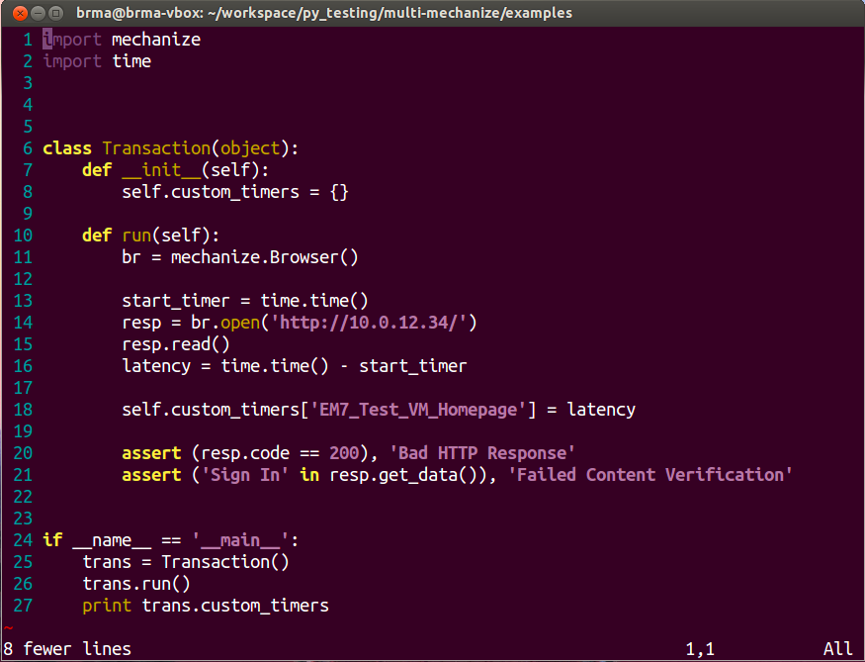
multi-mechanize
first let’s look at a simple script

Slide 36
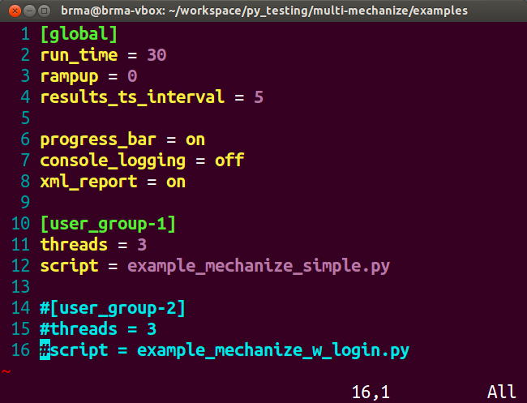
multi-mechanize
setup the config.cfg file

Slide 37
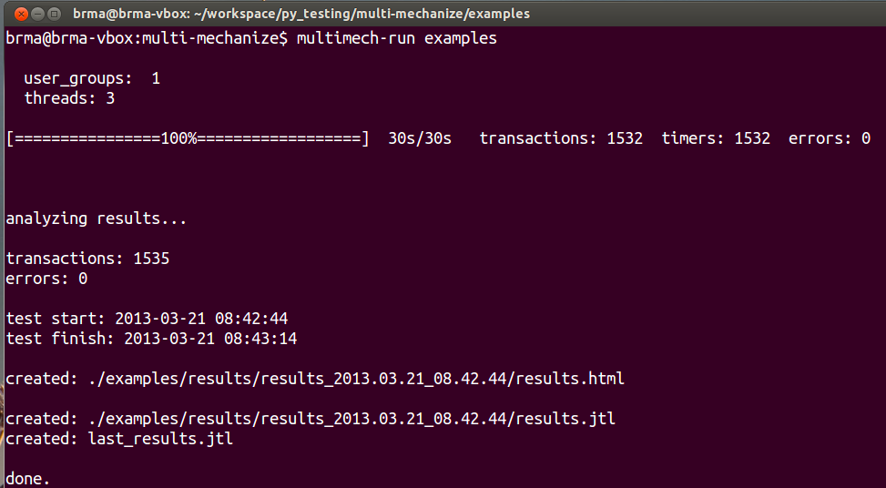
multi-mechanize
how to run it?

Slide 38
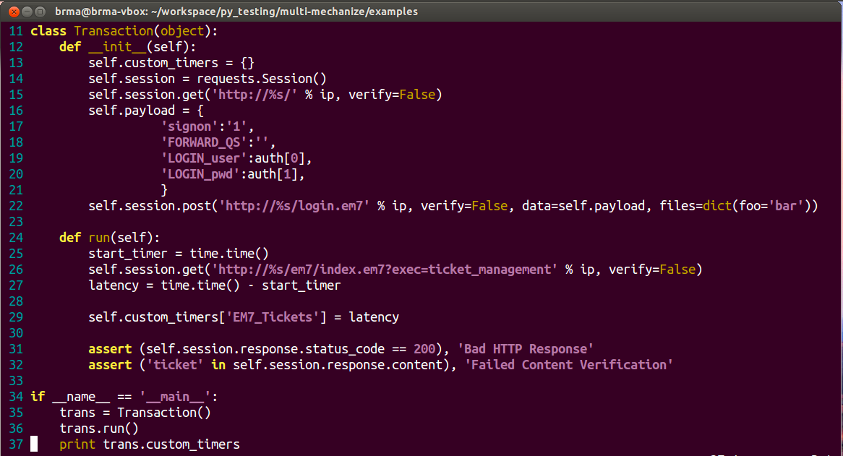
multi-mechanize
session setup

Slide 39
multi-mechanize
results
file://localhost/Users/brma/Dropbox/Work/silo/results_2013.03.21_09.05.31/results.html
jenkins integration
http://glados.qa.sciencelogic.local:8080/job/Performance_Testing/performance/?

Slide 40
questions
?

