Slide 1
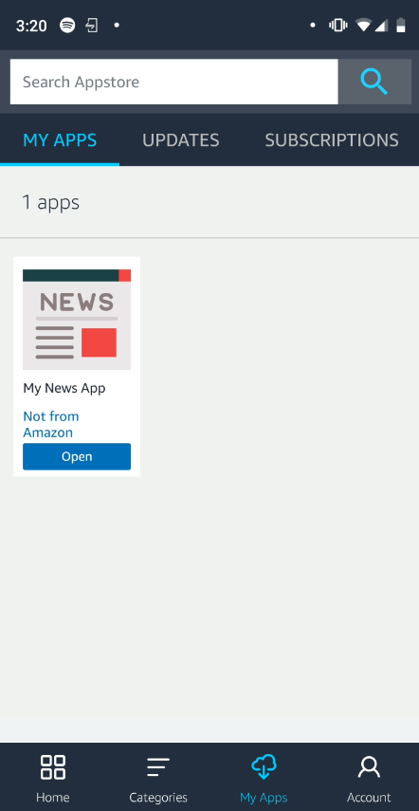
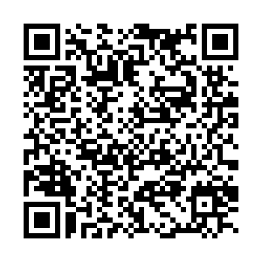
My News App

Slide 2
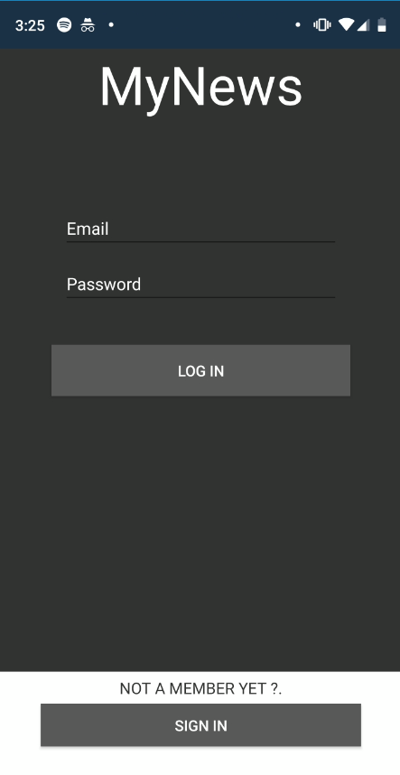
Features
Sign in/out (validation)
Fetches News from created API (https://android-lambton-api.herokuapp.com/news)
Filters News List
Add/Remove to favorites (local storage)
Edit user info
See full piece of news in WebView

Slide 3
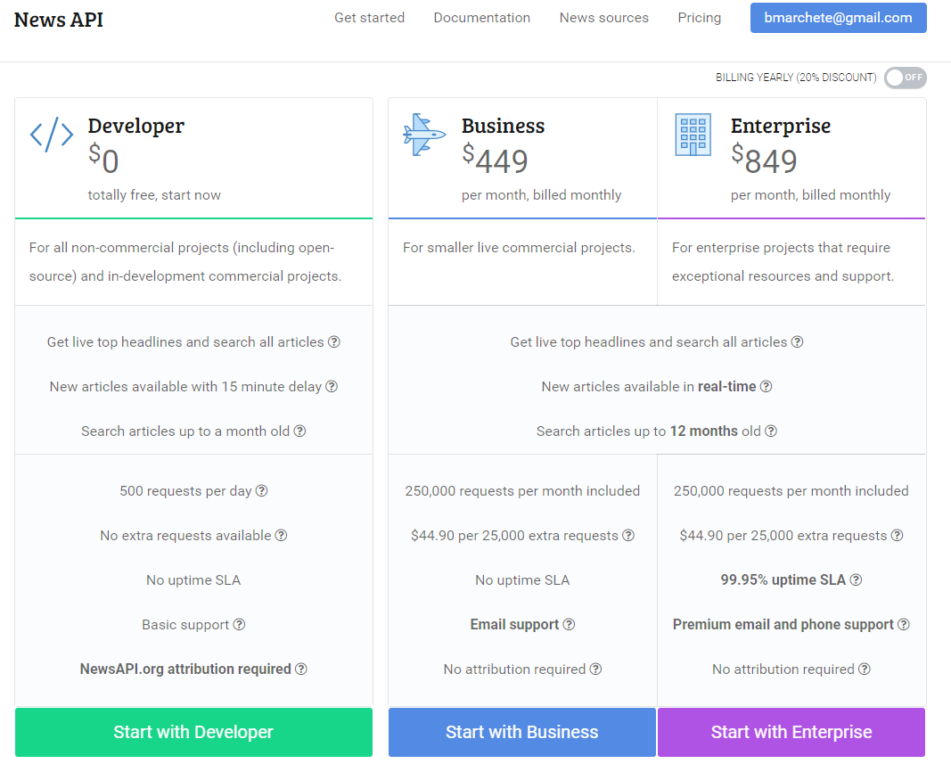
API
Fetchs news from https://newsapi.org/
Avoids exceed max calls to the service (550/day)
Node.js/Express.js
Published on Heroku

Slide 4
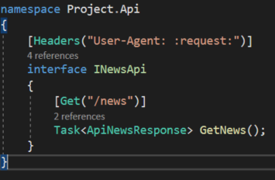
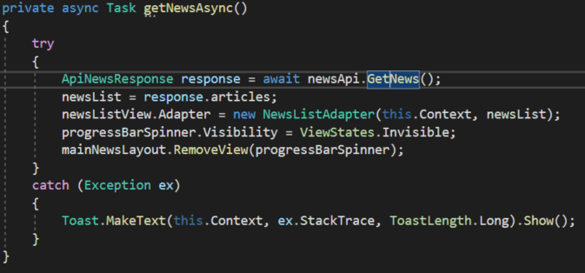
Extra Packages

Slide 5
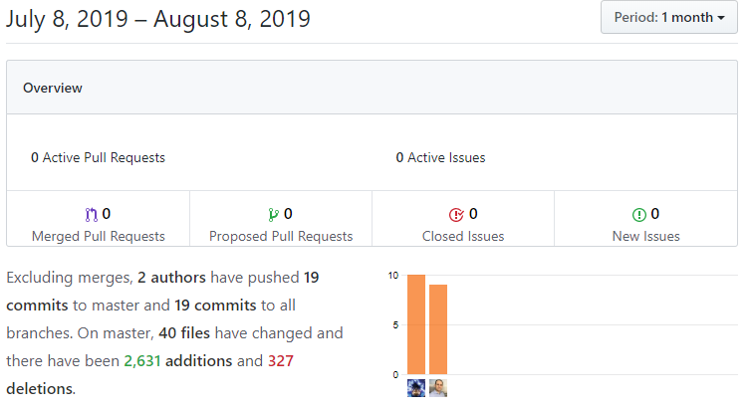
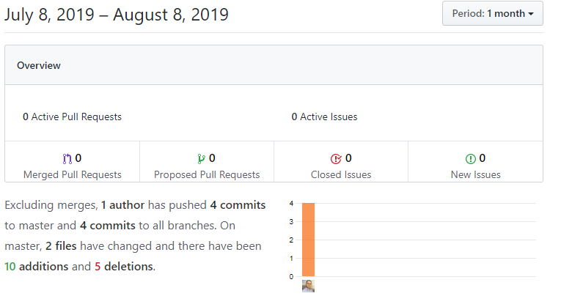
Git Repos
https://github.com/bmarchete/android-lambton-project
https://github.com/bmarchete/android-lambton-project-api

Slide 6
Live Example

