Slide 1
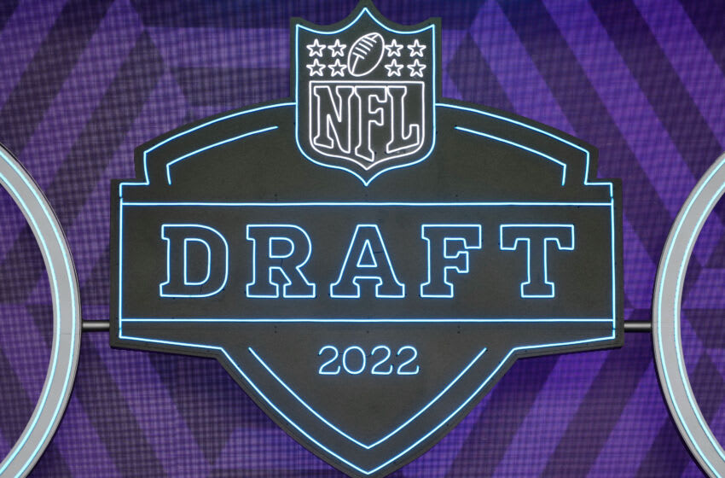
Optimizing the Pro Football Draft:
An Annual Challenge For NFL Front Offices
Benjamin Marlow
DASC 3203
University of Arkansas
May 10, 2022

Slide 2
Background
Every year, the NFL Draft, a nationally televised event held in late April, gives all thirty-two NFL teams the opportunity to select new players into their organization.
There’s always great build up as to how each team and their executive personnel will manage the draft.
Items taken into consideration:
Positional needs on a roster
Draft capital (picks) one owns
Risk tolerance

Slide 3
Motivation
As motivation for this project – we reference the article,
“The 7 Commandments for Optimizing Success in Round 1 of the NFL Draft” by Sheil Kapadia from The Athletic
Pulls from the 2013 research paper – The Loser’s Curse: Decision Making and Market Efficiency in the National Football League Draft, Cade Massey and Richard H. Taler
Don’t swing big on a trade unless it’s for a QB
Look for opportunities to trade back and identify GMs in ‘win now’ mode
https://theathletic.com/1759298/2020/04/21/the-7-commandments-for-optimizing-success-in-round-1-of-the-nfl-draft/

Slide 4
Overview and Purpose
Identify a problem that can be solved using optimization
Formulate an optimization model to solve that problem
Gather data to populate the optimization model
Use an optimization solver in order to perform analysis of the problem.
Purpose: solve the complex nature of the NFL Draft by applying optimization techniques

Slide 5
Define the Problem
Goal: Fit a (linear) least absolute deviations model to the dataset in order to estimate the true value of an NFL team’s set of picks.
Every pick is assigned a value (256 total selections)
Want to limit our sample size
Picks allotted to teams after rd. 6 (#222 or later) not included
Observe no more than a couple teams (have 8 in total)

Slide 6
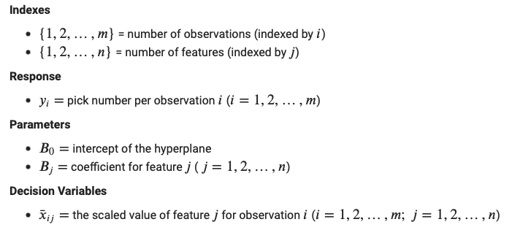
Model Formulation

Slide 7
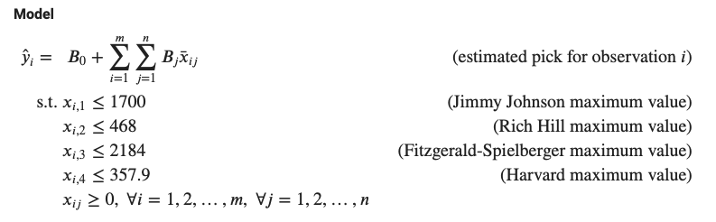
Model Formulation

Slide 8
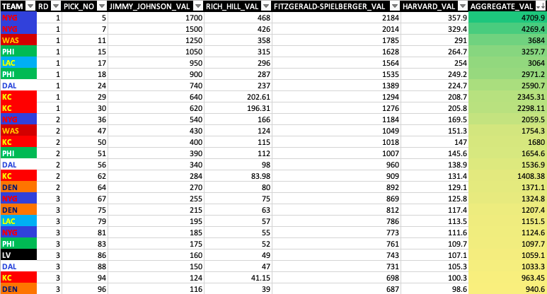
Gather and Synthesize Data

Slide 9
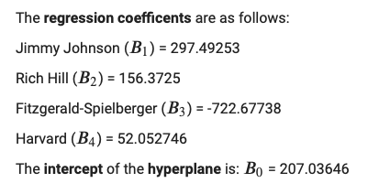
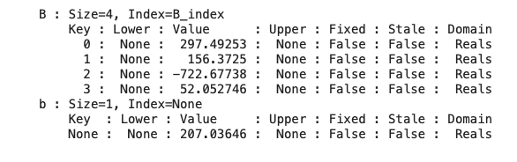
Solve and Analyze the Model

Slide 10
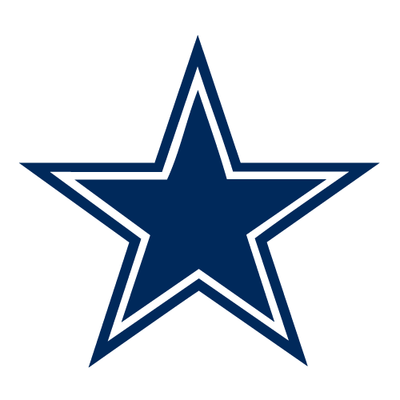
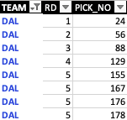
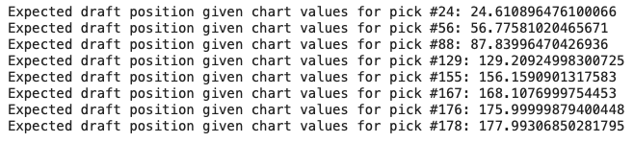
Dallas Cowboys
KEY
Good value
Fair value
Weak value
10

Slide 11
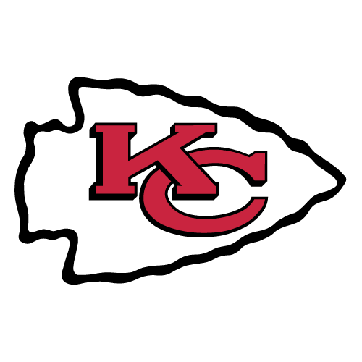
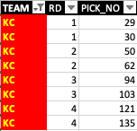
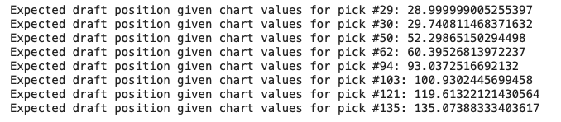
Kansas City Chiefs
KEY
Good value
Fair value
Weak value
11

Slide 12
Wrap-up
There is no such thing as “mastering” the NFL Draft.
Some GMs are more adept at taking advantage of picks than others.
The valuation of each draft slot can serve as a guide for which pick(s) to keep/rid of when making trade offers to other teams.
According to many of the top draft analysts, the Chiefs had one of the better talent hauls in 2022. Our analysis indicates that might have had something to do with the rich value of picks KC owned in the early to middle rounds.
12

