Slide 1
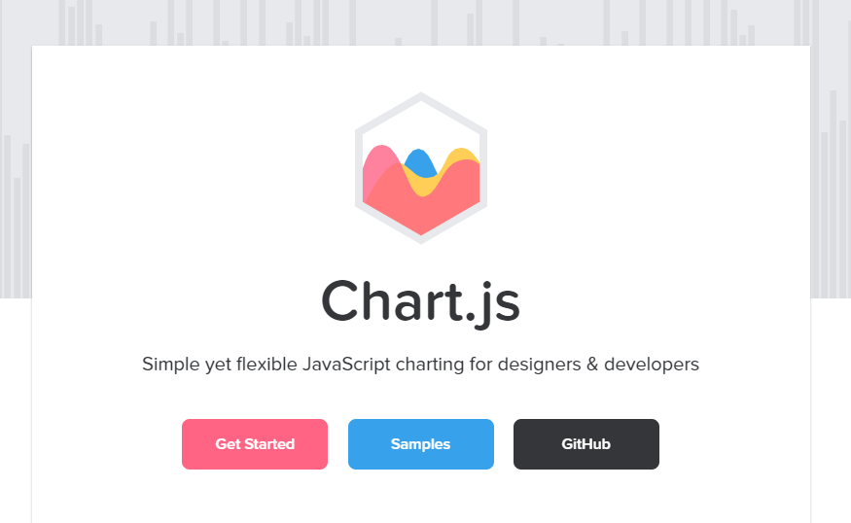
Chart.js: An Introduction
Marmur Tech Report
LA558

Slide 2
What is Chart.js?
Chart.js is an open source chart creation JavaScript Library
Allows the developers to simply and quickly create 8 different types of charts
All charts can be mixed, combined, and animated
Highly responsive, redraws charts for perfect viewing on any device
Bubble
Line
Area
Polar Area
Bar
Doughnut or Pie
Scatter
Radar

Slide 3
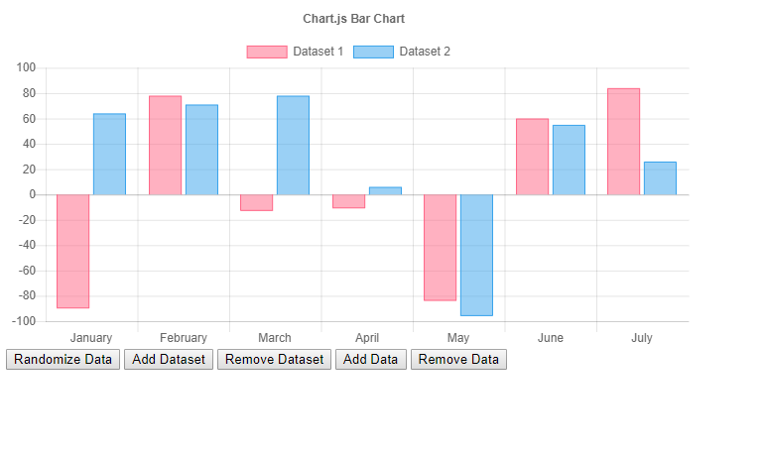
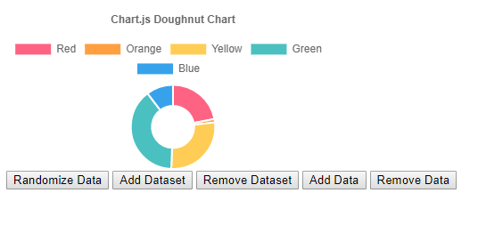
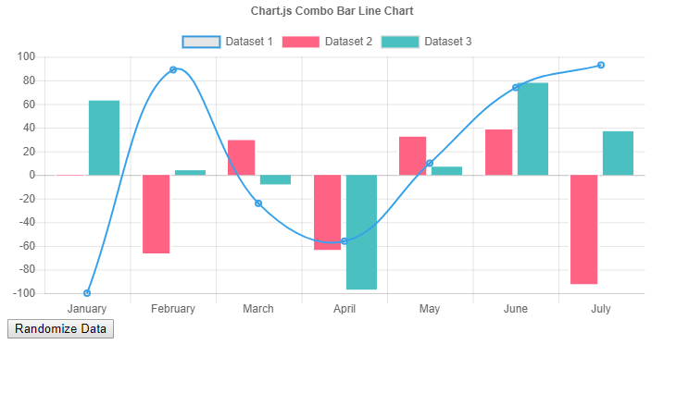
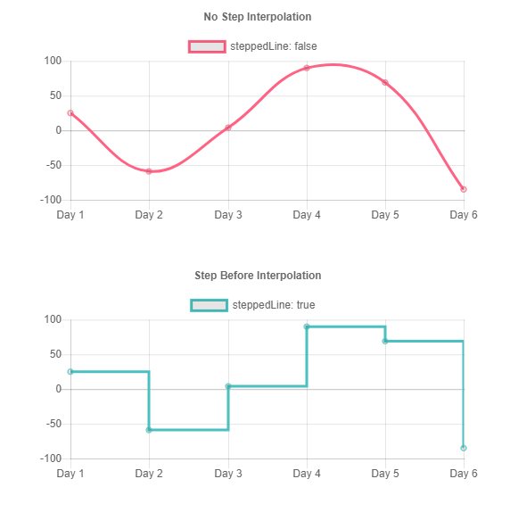
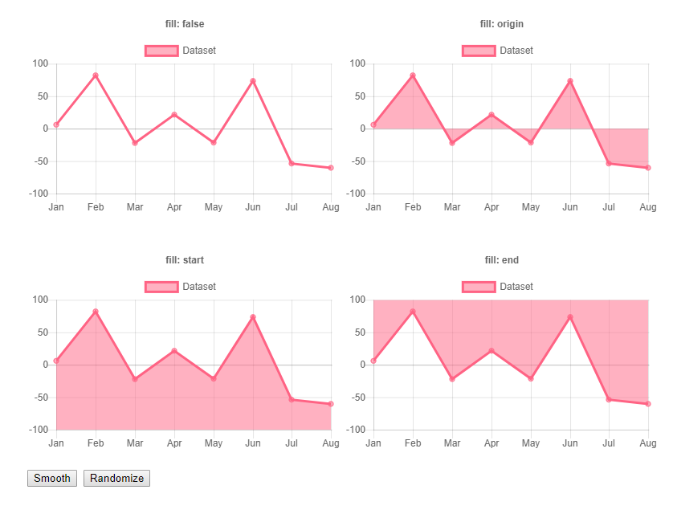
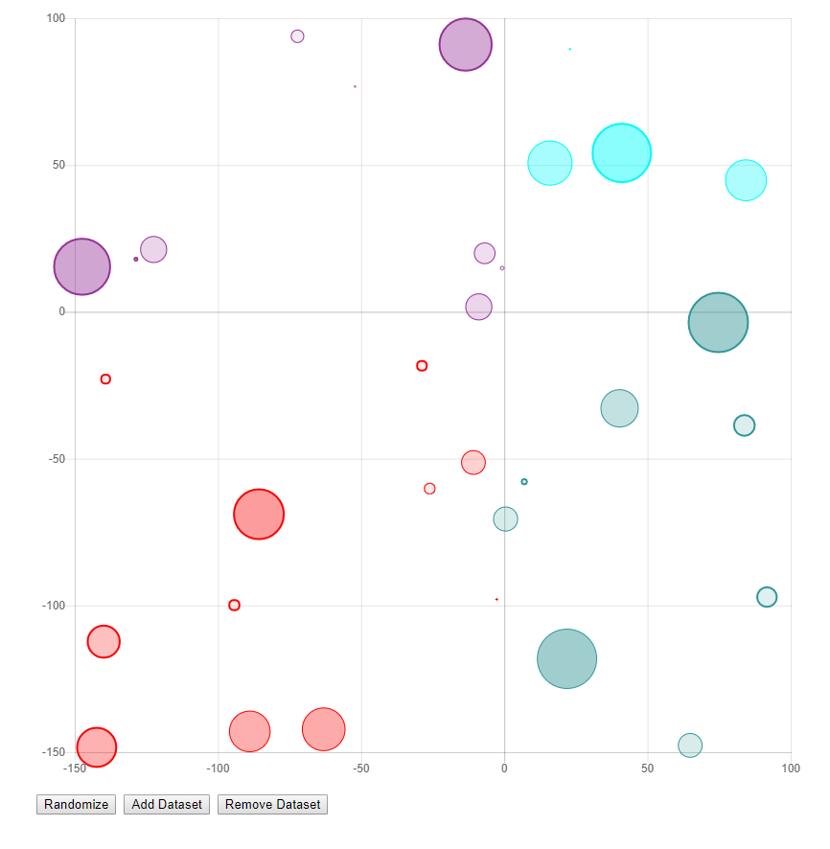
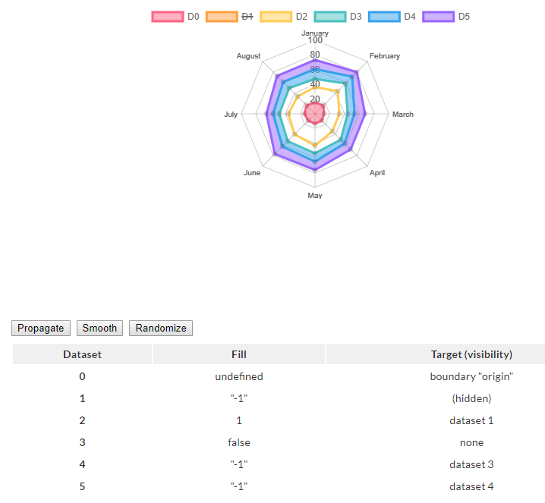
Chart.js Samples

Slide 4
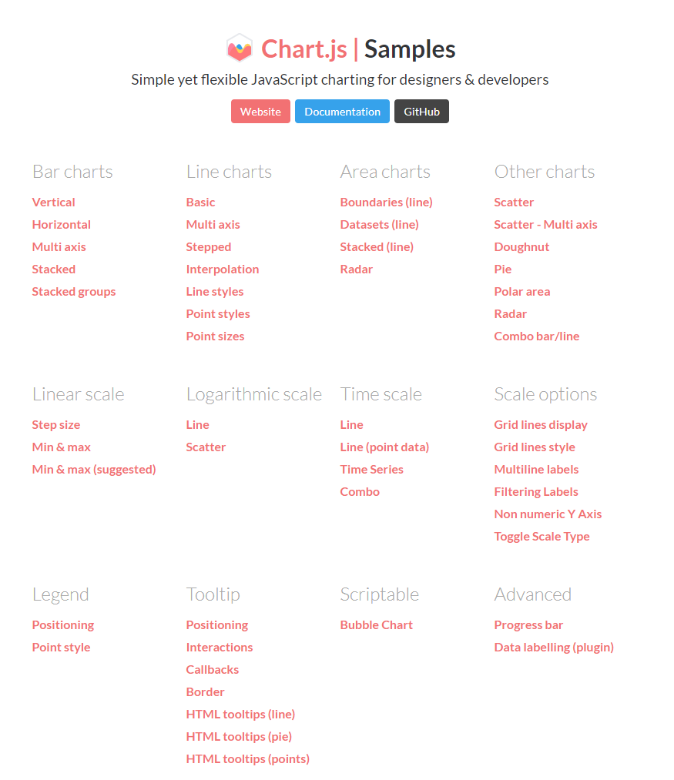
Chart.js Samples
Website provides clear examples of the many different chart options, styles, and the many customizations available within the library

Slide 5
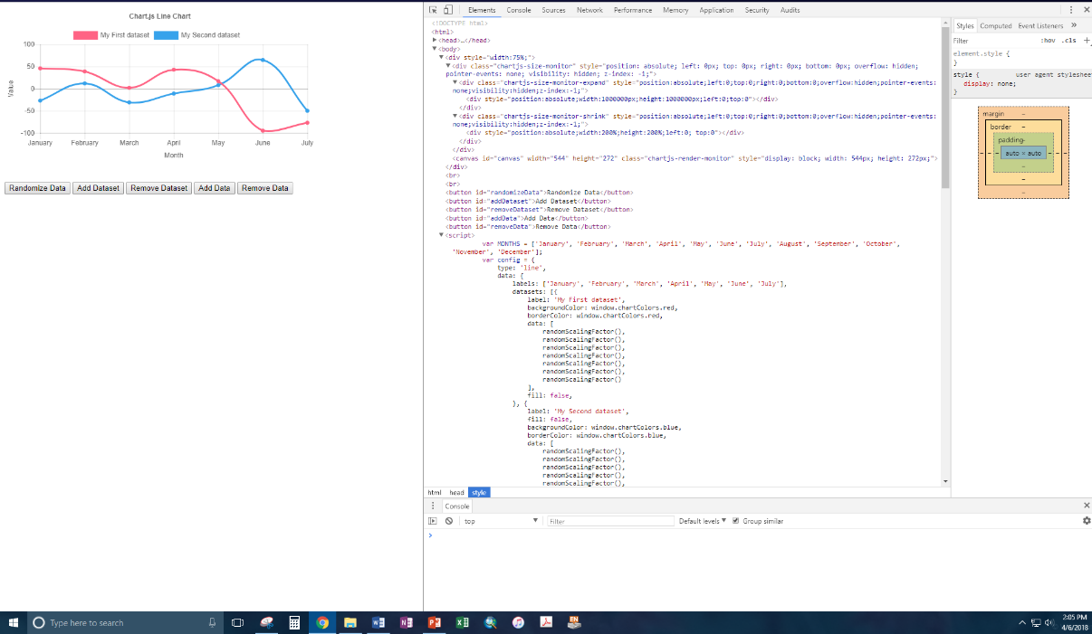
Chart.js Samples
Each sample chart opens in a new window.
Inspecting each sample allows a detailed and complete view of the code.

Slide 6
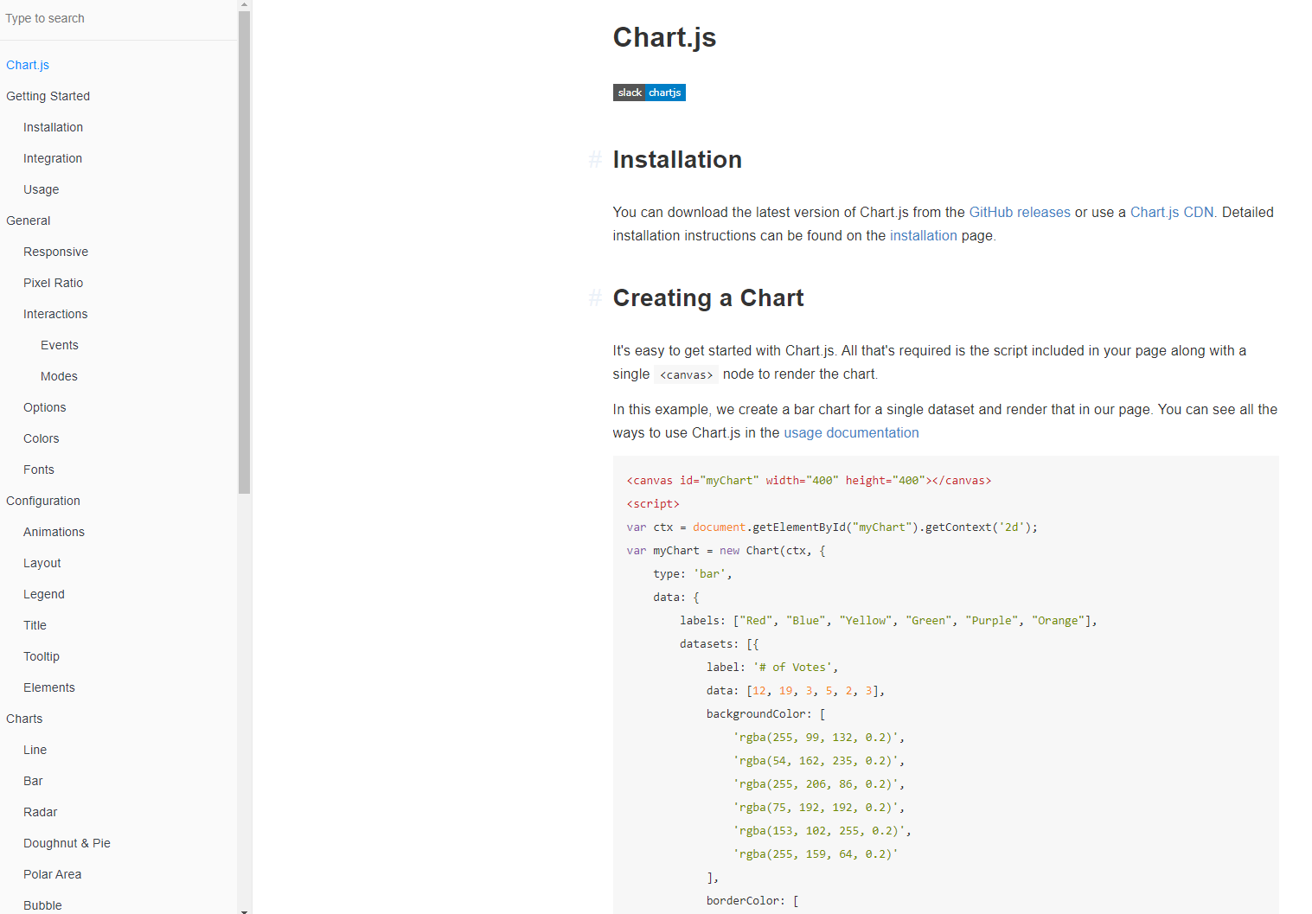
Chart.js and Leaflet
Chart.js’ documentation is very similar to that of Leaflet

Slide 7
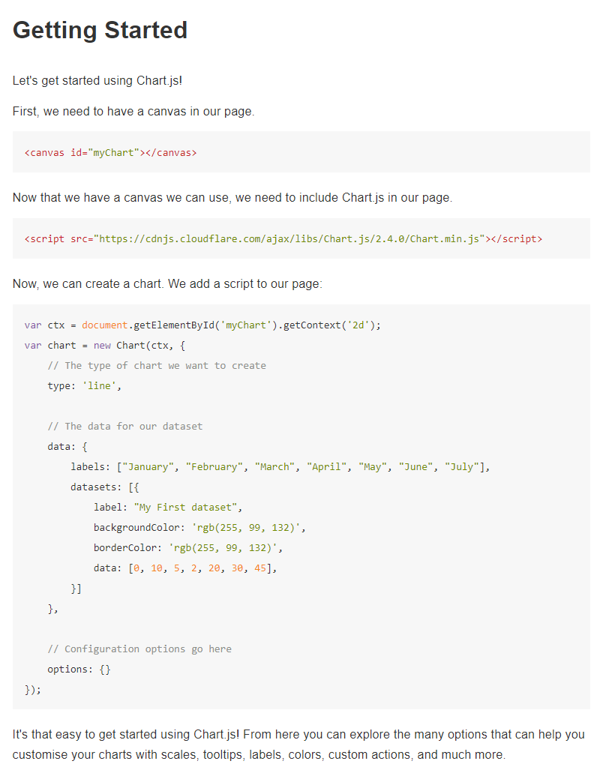
<canvas id="myChart"></canvas>
Getting Started with Chart.js
Creating a chart is simple!
Add this script to add the Chart.js library
Add a canvas tag to the html body
Then create the chart with some simple scripts!
<script src="https://cdnjs.cloudflare.com/ajax/libs/Chart.js/2.4.0/Chart.min.js"></script>

Slide 8
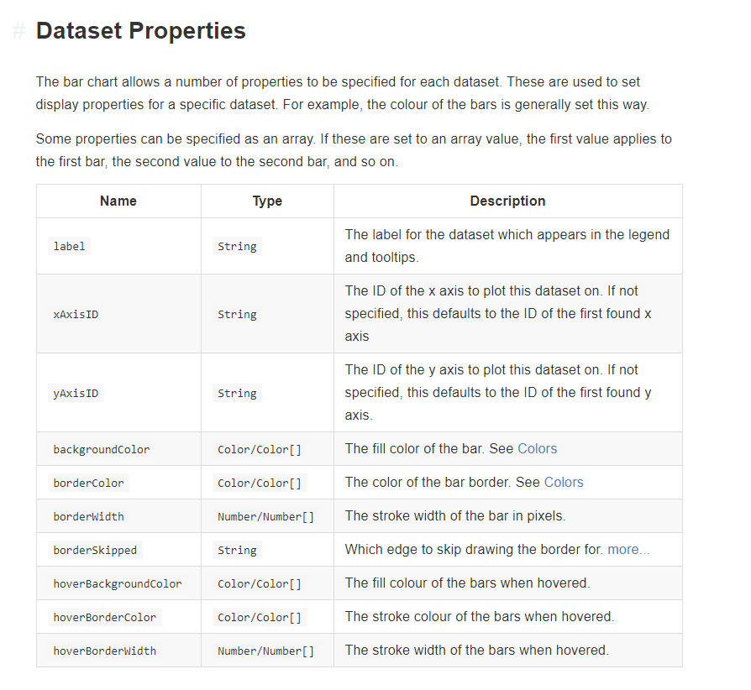
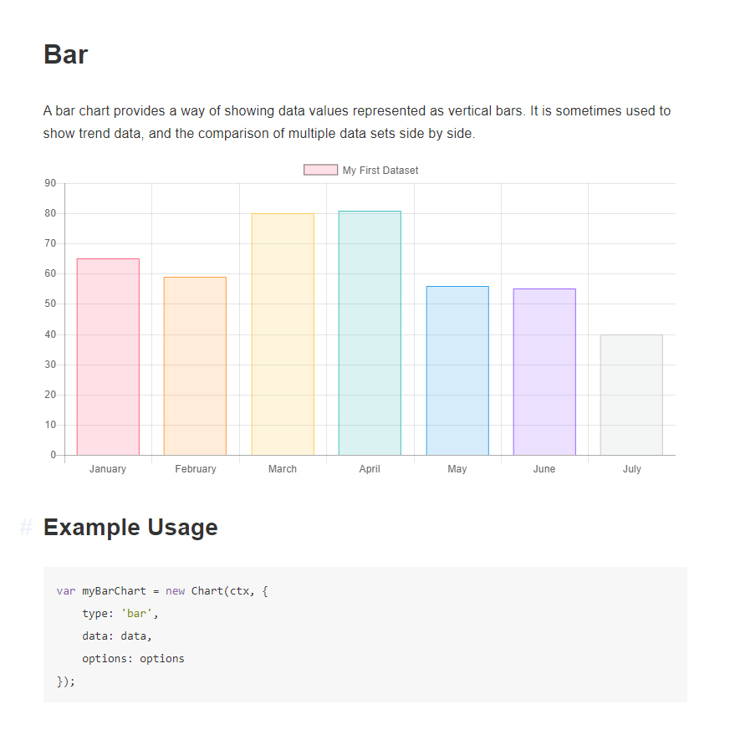
Each chart has full documentation of all its properties and customizations.

Slide 9
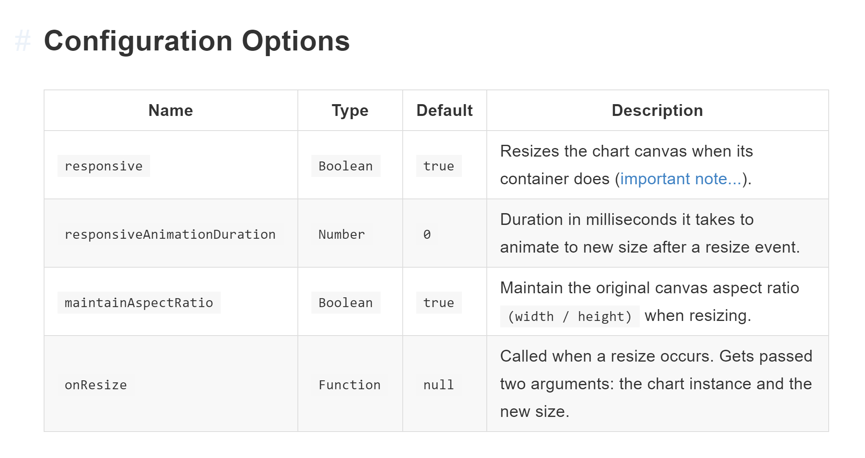
Responsive
Chart.js is designed to be fully responsive, rendering on an display size.
With simple scripts, each chart will automatically redrawn.

Slide 10
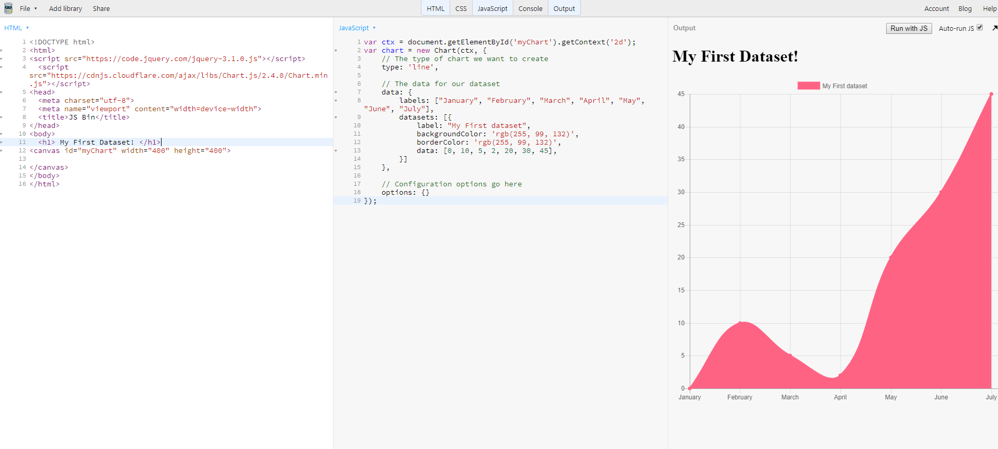
Making your first chart takes minutes! Here’s my first dataset!

