Slide 1






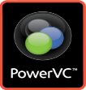








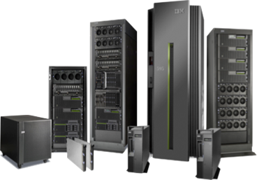


IBM Cloud Automation Manager on IBM Cloud Private
Value Proposition for Enterprise Power Systems & IBM i :
→ Optimize developer’s need for speed with organization’s need for governance
VM Based Apps
VM Based Apps
Other VM Based Apps
Containerized cloud native application CAM is installed into an IBM Cloud Private worker node with a Helm chart Leverages IBM Cloud Private services for enterprise capabilities
IBM Cloud Automation Manager
Deployment & Process Orchestration
Service & Template
Library
Compute & Storage Automation
3rd Party Integrations
Service
Composer
Flow Engine
Openstack Cloud provider
Template Management
Instance Management
Template API
Workload
Terraform
Helm
Service
Public, Private & Hybrid Clouds
IaaS Management
HMC managed
IBM Cloud Private
Multi-cloud
Services
Service catalog
Infrastructure
Data & Analytics Services
Core Services
Kubernetes
Databases
/ Analytics
CAM
IAM
Logging
Audit
API & Data Connect
Encryption & Key Management
Monitoring
Usage
Metering
Event
Tenant Svcs

Slide 2

Need
Provide multiple customers with cost-effective, repeatable, error-free, and timely SAP deployments in the cloud
Solution
Use IBM’s Cloud Automation Manager (CAM) to automate the deployment of SAP HANA and vHANA systems
Deployment times are very long, extremely manual, and error prone. CAM automates most of this work and eliminates errors for multiple successive deployments
CAM can restart the deployment at the point of failure after troubleshooting is completed.
Value
Built, deployed, and provided ongoing management of 8 complex SAP HANA deployments with a 5 person team
Decreased time to deploy a SAP HANA system by 99.6% - reduced time to deploy from 4 weeks to 38 minutes
IBM Cloud Automation Manager
Customer Success Story –
Global Managed Cloud Consultancy
“We reduced the time to build and deploy a vHANA system from 4 weeks to 38 minutes”
2
2
Notes:
Provision cloud infrastructure & application services and in all of your clouds with a common automation framework
Common automation framework to automate deployments in public, private and hybrid clouds

