Slide 1
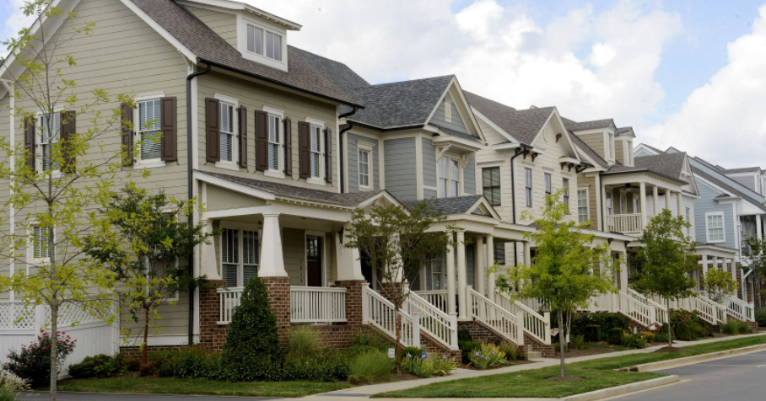
Predicting House Prices with regression
Bhanu Bhattarai
Michael Cook
Jinu Daniel
Rupinder Grewal
Basil Marotical

Slide 2





Team 6
Bhanu Bhattarai
Associate, Project Manager, Commercial Bank, Finance and Business Management
Michael Cook
Trade Lifecycle Associate, Corporate and Investment Bank, Securities Operations
Jinu Daniel
Vice President, Chief Quality Office, Operations Technology
Rupinder Grewal
Vice President, Software Engineer, Retail
Basil Marotical
Vice President, Data Visualization Manager, Finance Data and Insights

Slide 3







The AI Canvas
What task/decision are you examining?
The objective of this model is to predict the market value of a house for the home lending team to verify the house’s appraised value.
Prediction
Judgment
Action
Outcome
The primary measure of the model’s performance will be Root Mean Square Error (RMSE)
The variation of housing prices across different geographical locations
True prediction will reduce risk, increase profitability of the bank.
False Positive will increase risk to the bank while False Negative will have adverse impact on the bank-customer relationship.
In case of high variance between the predicted versus appraised market value of the house, the bank can initiate extra measures to minimize the risk.
Training
Input
Feedback
Specific features of a house such as year built, number of bedrooms/bathrooms, lot area, etc.
Compare predicted house price with the data collected, refine features, and remove the least important features from the dataset to decrease RMSE in the algorithm while operating.
Model needs to be trained with housing data collected from a specific geographical location , over a period of time, and Sales price adjusted for inflation
How will this AI impact on the overall workflow?
This AI model will improve the appraisal process, which will optimize the home lending workflow from loan origination to closing. This will require modification to the business process and staff re-training.
© Agrawal, Gans, Goldfarb 2019

Slide 4
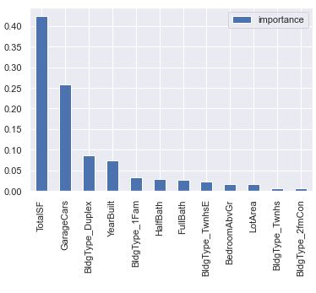
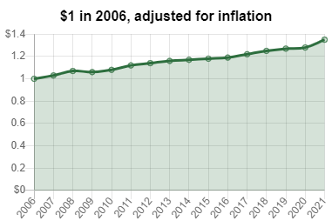
EDA and Preprocessing
Initial Data Analysis
Data was sourced from Ames- IA, Newark- DE, Bear-DE, Wilmington-DE
Model was trained only on Ames- IA which were from the period of 2006-2010
Garage car size, Year Built and Total Square Feet have high correlation with Sales Price
Final columns selected : Lot Area, Total Square feet, Building Type, Year Built, Full Bath, Half Bath, Number of Bedroom, Number of Garage
Inflation Adjustment
$1 in 2006 = $1.4 in 2021 !

Slide 5
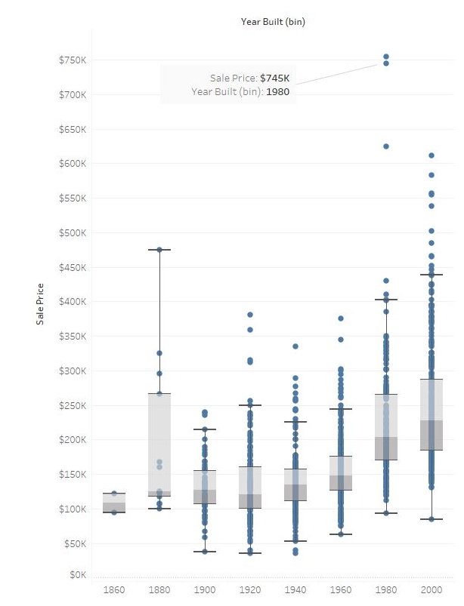
EDA and Preprocessing
Data Cleansing
Out of 19 attributes which had nulls, 4 attributes having more than 70 percent NULLs were dropped
Data Correlation
Slight increase in Lot Area increases Sales Price by a higher margin
Total square footage is highly correlated to Sales Price

Slide 6
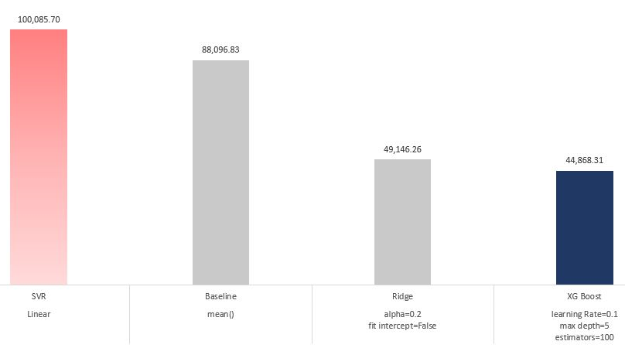
Model Training, Tuning, and Selection
Selected XG Boost as the best performing model based on RMSE
Checked the important features during tuning and removed one of the least important features (House Style) from the dataset which decreased RMSE

Slide 7
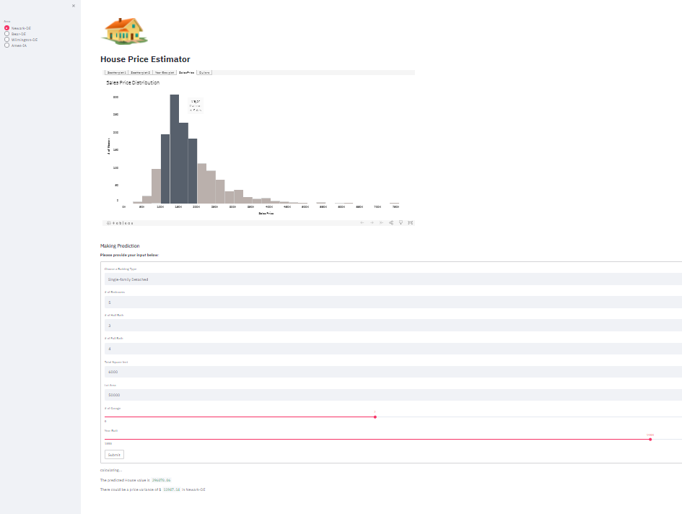
Demo of mL Web app
https://housing-demo-team6.herokuapp.com/

Slide 8
Model Limitations/Generalization issues
The current data source was more specific to one region and was lacking key features such as School District/School Rating, Future Development (Commercial Complex, Highways etc.), Crime rate
Our project shows that it is not possible to train a housing model on only one city and generalize it to others
Real Estate values are highly dependent upon location and geographical region
To build a highly predictive model, multiple geographical regions are needed to train model.
Next Steps:
Interview Real Estate Agents to value the area based on
School District/School Rating
Future Development (Commercial Complex, Highways etc.)
Find proximity to amenities

Slide 9
Appendix
Github:
https://github.com/bmarotical/capstoneTeam6
Dataset:
https://www.kaggle.com/c/house-prices-advanced-regression-techniques
CPI:
https://github.com/datadesk/cpi
RapidApi (datasets):
https://rapidapi.com/datascraper/api/us-real-estate/

