Slide 1
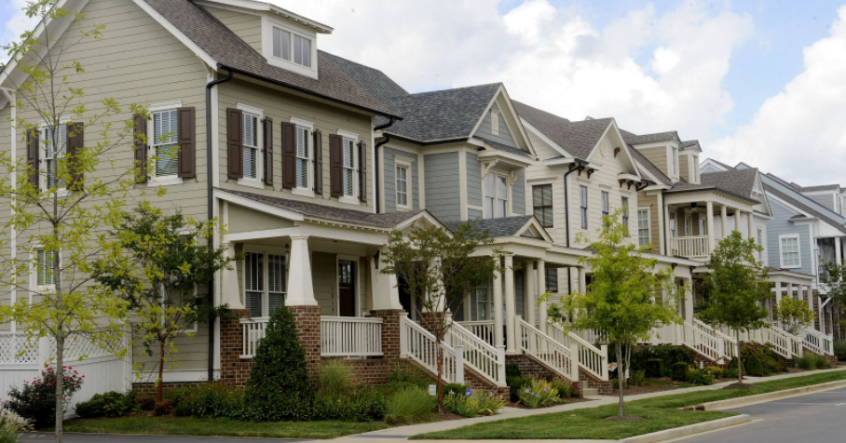
Predicting House Prices with regression
Bhanu Bhattarai
Michael Cook
Jinu Daniel
Gary Grewal
Basil Marotical

Slide 2
Team 6
Bhanu Bhattarai
Michael Cook
Jinu Daniel
Gary Grewal
Basil Marotical

Slide 3
AI Canvas
Task/Decision Being Examined
The objective of this model is to predict the market value of a house for the home lending team to verify against its appraised value
Prediction
The variation of housing prices across different geographic locations
Judgment
True prediction will reduce risk, increase profitability of the bank
False Positive will increase risk to the bank
False Negative will have adverse impact on the bank-customer relationship
Action
In case of high variance between predicted vs. appraised house value, the bank can initiate extra measures to minimize the risk
Outcome
The primary measure of the model’s performance will be its accuracy and R2 scores
Training
Model needs to be trained with housing data collected from a specific geographic location over a period of time
Sales price adjusted for inflation
Input
Specific features of a house such as year built, number of bedrooms/bathrooms, lot area, etc.
Feedback
Retrain and test on new dataset on a given interval to improve performance of the model
How will this AI impact on the overall workflow?
AI model will improve the appraisal process which will optimize the home lending workflow from loan origination to closing
This will require modification to the business process and staff retraining

Slide 4
EDA and Preprocessing
Initial Data Analysis
The dataset contains 1460 rows and 81 columns and has data of houses sold during the period 2006-2010 in the city of Ames, IA.
The dataset has 43 categorical and 38 numerical fields which we can use.
Executed Describe, info() to find the type of data and 19 columns were identified as having NULL values
Out of 19, 4 columns have more than 70 percent NULLs
Garage car size, Year Built and Total Square Feet have high correlation with Sales Price.
In the train data, the oldest house was built in 1872 and newest house in 2010.
Inflation Adjustment
Installed and imported the cpi package (https://www.bls.gov/)
Used Year sold and the current Price to get the Adjusted SalesPrice.
Data Cleansing
Out of 19 which had nulls, 4 columns having more than 70 percent NULLs were dropped
Ran box plot for finding outliers and LotArea greater than 50,000 sq.ft. were eliminated
Data Correlation
Plotted histogram for the columns: LotArea,BldgType,YearBuilt,FullBath,HalfBath,BedroomAbvGr,GarageCars
Relationships of columns with SalesPrice
Smaller increase in LotArea increased SalesPrice by a higher margin
Living Area was linearly related to the SalesPrice.
Total of Basement, 1st and 2nd floor square footage was highly correlated to SalesPrice.

Slide 5
Model Training, Tuning, and Selection
Executed Linear Regression, Ridge and XG Boost to train the Model using GridSearchCV to test multiple parameters.
Identified XG Boost as the best performing model by comparing the results and persisted it to apply on test data.
Model Training, Tuning & Evaluation
Linear regressor, Ridge regressor and XGBoost Regressor were trained with different parameters and below are the best parameter selection for each.
Linear regression:
{'classifier__copy_X': True, 'classifier__fit_intercept': False, 'classifier__normalize': True}
Ridge regressor:
{'clf_RG__alpha': 0.2, 'clf_RG__copy_X': True, 'clf_RG__fit_intercept': False}
XGBoost regressor:
{'clf_XG__learning_rate': 0.1, 'clf_XG__max_depth': 5, 'clf_XG__n_estimators': 100}
Checked the important features during tuning and removed one of the least important feature 'HouseStyle' from the dataset which increased our score.
Final Selection of Model
Following are the scores from Linear Regression, Ridge and XG Boost Regressor
- linear regression score is: 0.7494241357121679
- Ridge regression score is: 0.7459059322291025
- XG Boost Regressor score is: 0.7852363569881567
Based on the above Scores, we selected XG Boost Regressor as our desired model.

Slide 6
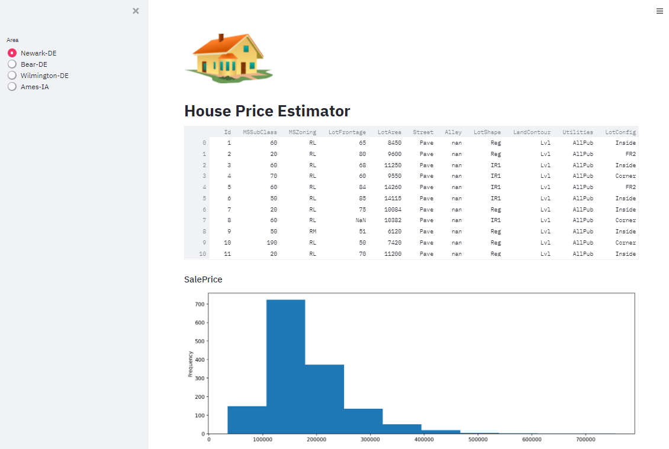

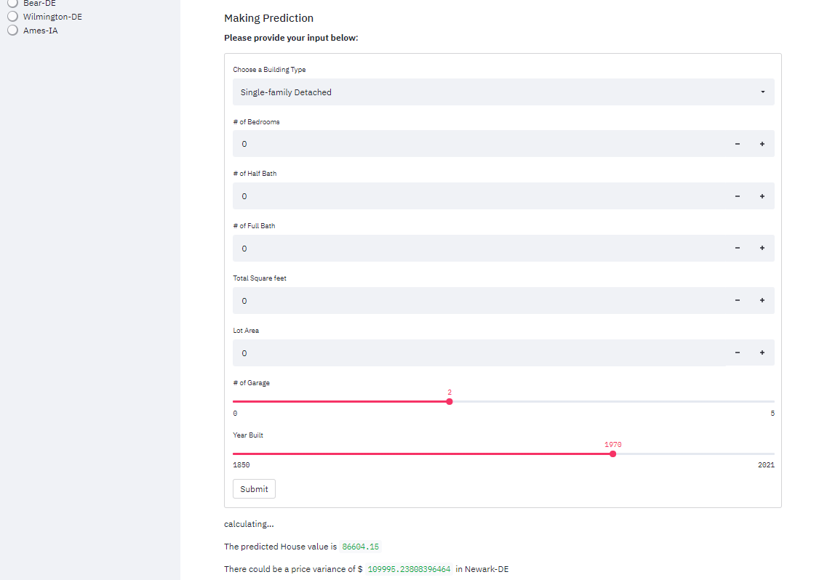
Demo of mL Web app
https://housing-demo-team6.herokuapp.com/

Slide 7
Appendix
Github:
https://github.com/bmarotical/capstoneTeam6

