Slide 1
Why Software?
Why is software as important to security as crypto, access control and protocols?
Virtually all of information security is implemented in software
If your software is subject to attack, your security is broken
Regardless of strength of crypto, access control or protocols
Software is a poor foundation for security

Slide 2
Bad Software
Bad software is everywhere!
NASA Mars Lander (cost $165 million)
Crashed into Mars
Error in converting English and metric units of measure
Denver airport
Buggy baggage handling system
Delayed airport opening by 11 months
Cost of delay exceeded $1 million/day
MV-22 Osprey
Advanced military aircraft
Lives have been lost due to faulty software

Slide 3
Software Issues
“Normal” users
Find bugs and flaws by accident
Hate bad software…
…but must learn to live with it
Must make bad software work
Attackers
Actively look for bugs and flaws
Like bad software…
…and try to make it misbehave
Attack systems thru bad software

Slide 4
Complexity
“Complexity is the enemy of security”, Paul Kocher, Cryptography Research, Inc.
system
Lines of code (LOC)
Netscape | 17,000,000
Space shuttle | 10,000,000
Linux | 1,500,000
Windows XP | 40,000,000
Boeing 777 | 7,000,000
A new car contains several orders of magnitude more LOC than was required to land the Apollo astronauts on the moon

Slide 5
Lines of Code and Bugs
Conservative estimate: 5 bugs/1000 LOC
Do the math
Typical computer: 3,000 exe’s of 10K LOC each
Conservative estimate of 50 bugs/exe
About 150k bugs per computer
30,000 node network has 4.5 billion bugs
Suppose that only 10% of bugs security-critical and only 10% of those remotely exploitable
Then “only” 4.5 million critical security flaws!

Slide 6
Counter-Measurements: Skynet
Fault Intrusion Tolerance
Features
Zero-day detection
Risk Analysis
Graph mining
Degradation under intrusion but maintains correctness
Self-Testing
Introspection
Secure Enclaves as secure anchors
Self-healing

Slide 7
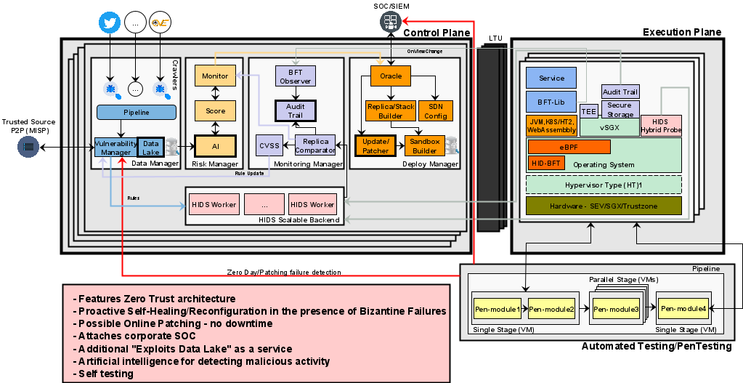
Counter-Measurements: Skynet’s Architecture

