Slide 1
Estimating the proportion of hatchery-origin spawners using parentage-based tagging
by
Richard Hinrichsen, Shawn Narum, Matt Campbell, Mike Ackerman, Craig Steele, Maureen Hess, Bill Young, Barbara Shields, Brian Maschhoff
Funded by: Bonneville Power Administration

Slide 2
Why Estimate Hatchery-Origin Spawners?
These fish originate in hatchery, are released as juveniles, and return to spawn in the wild.
Influx of hatchery spawners affects population dynamics by artificially increasing spawner numbers.
Influences: density dependence, reproductive success.
Genetic effects (Christie et al. 2012).
Mark R. Christie, Melanie L. Marine, Rod A. French, and Michael S. Blouin. 2012. Genetic adaptation to captivity can occur in a single generation. PNAS 109:238-242.

Slide 3
Relative Reproductive Success of Hatchery-born Spawners
Chilcote et al. (2011) found that a naturally spawning population composed entirely of hatchery-origin spawners would have a reproductive performance that is 0.128 of that expected for a population composed entirely of wild-origin spawners.
The study was based on 93 salmon populations in Oregon, Washington, and Idaho, that were known to contain both wild and hatchery fish. Three species were represented: steelhead, coho and chinook.

Slide 4
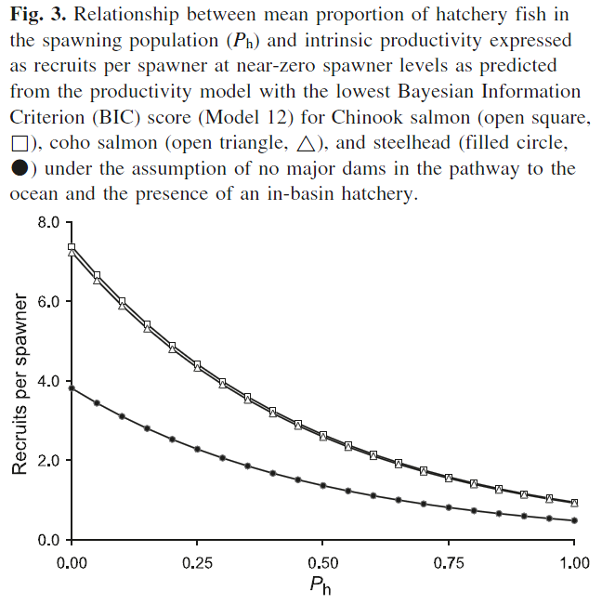
Source: Chilcote et al. (2011) CJFAS

Slide 5
Using CWT To Estimate P_{h}
A fraction of juvenile fish at source hatcheries are visibly marked with a fin clip (adipose or other) or implant elastomer tag.
Furthermore, some juvenile fish are tagged with a coded-wire tag that identifies the hatchery of origin.
Spawning fish are sampled using carcass surveys.

Slide 6
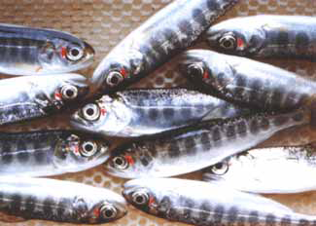
Visible Marks (VM)
Visible Implant Elastomer tags (VIE)
Adipose Fin Clip

Slide 7
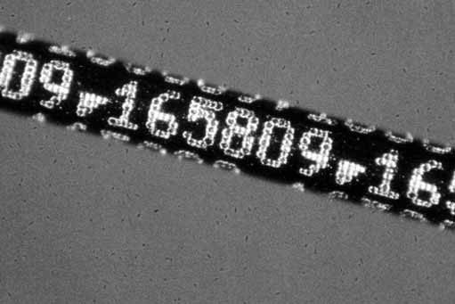
Coded Wire Tags (CWT)
Source: Northwest Marine Technology.
Magnified section of a CWT (1.1 mm long) before insertion into the snout of a juvenile salmon.

Slide 8
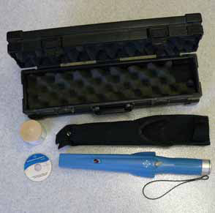
Carcass Survey
Fish with CWT are indentified with a hand-held wand device; snouts sawed off to recover tags.

Slide 9

An Easy Solution
Use constant VM fraction at all source hatcheries! For example, λ = 0.25. In that case,
$\hat{H}$is an estimate of the total number of hatchery-origin spawners on the spawning grounds.

Slide 10
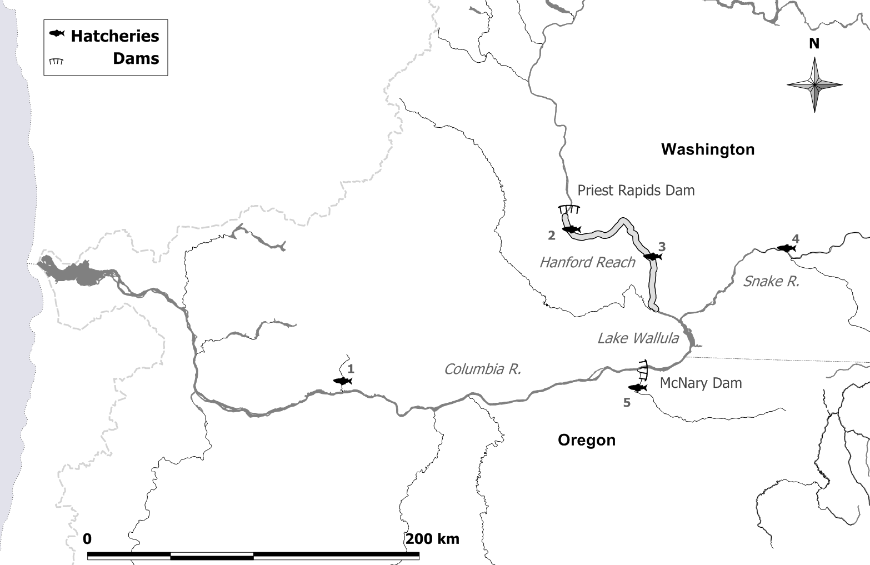
HANFORD REACH EXAMPLE
Priest Rapids H
Lyons Ferry H
Ringold Springs H
Little White Salmon NFH
Umatilla H
Source: Hinrichsen, Sharma & Fisher (2012) TAFS:

Slide 11
Visible marking and coded-wire tagging at source hatcheries that provide spawner inputs to Hanford Reach spawning grounds. Total number of spawning ground carcasses sampled in 2010 was 9,791 and the sample rate was 0.11252. Of carcasses sampled, 23 were VM and CWT at a hatchery and 308 were VM only.
Hatchery | Brood year | VM & CWT | VM only | CWT only | Not VM & not CWT | VM fraction, λ | CWT fraction, φ | # tags in sample
Little White Salmon NF | 2005 | 448,145 | 1,354,029 | 0 | 0 | 1.00 | 0.25 | 1
Priest Rapids | 2005 | 199,445 | 1,628,614 | 0 | 5,048,231 | 0.27 | 0.11 | 3
 | 2007 | 202,568 | 813 | 0 | 4,344,925 | 0.04 | 1.00 | 7
Ringold Springs | 2006 | 222,706 | 0 | 0 | 3,179,824 | 0.07 | 1.00 | 2
 | 2007 | 221,951 | 2,230,190 | 0 | 645,308 | 0.79 | 0.09 | 7
Lyons Ferry | 2006 | 231,534 | 1,673 | 220,350 | 6,076 | 0.51 | 0.99 | 1
Umatilla | 2007 | 279,480 | 0 | 0 | 0 | 1.00 | 1.00 | 2
Total Numbers Released

Slide 12
VM or CWT In 2010 Hanford Reach Carcass Survey

Slide 13
Simplified Method of Moments Estimator
x_{1,i} is the number of carcasses sampled that were VM and CWT at hatchery i.
θ_{i} is the sample rate
λ_{i} is the VM fraction at source hatchery i.
φ_{i} is the CWT fraction at source hatchery i

Slide 14
Method of Moments For both VM&CWT and VM only
VM&CWT equations
VM only equation

Slide 15
Proportions of Hatchery-Origin Spawners (Hatchery-specific)
GLSE
var(GLSE)
var(SMME)

Slide 16
Proportion of Total Hatchery-Origin Spawners
GLSE
var(GLSE)
var(SMME)

Slide 17
CV of the GLSE and SMME relative to tagged fraction, φ. Number of hatcheries = 2; True spawning population = 1000; true value of p = 0.5; sample rate = 0.20; H₁ = H₂; VM fraction of one hatchery is 1.0, and the other is 0.5.

Slide 18
Estimates of hatchery inputs to Hanford Reach spawning grounds in 2010. Standard errors of estimates in parentheses.
 |  | Hatchery contribution to spawning population |  |  |  |  | Proportion of hatchery fish in total spawning population
Source Hatchery | Brood year | GLSE |  | SMME |  |  | GLSE |  | SMME
Little White Salmon | 2005 | 45.1 | (39.5) | 35.7 | (35.2) |  | 0.0005 | (0.0005) | 0.0004 | (0.0004)
Priest Rapids | 2005 | 2100.4 | (738.3) | 919.2 | (529.9) |  | 0.0241 | (0.0085) | 0.0106 | (0.0061)
 | 2007 | 1397.2 | (526.7) | 1396.8 | (526.6) |  | 0.0161 | (0.0061) | 0.0161 | (0.0061)
Ringold Springs | 2006 | 271.6 | (191.3) | 271.6 | (191.3) |  | 0.0031 | (0.0022) | 0.0031 | (0.0022)
 | 2007 | 2818.4 | (289.6) | 868.2 | (326.8) |  | 0.0324 | (0.0033) | 0.0100 | (0.0038)
Lyons Ferry | 2006 | 17.7 | (17.1) | 17.6 | (17.1) |  | 0.0002 | (0.0002) | 0.0002 | (0.0002)
Umatilla | 2007 | 17.8 | (11.8) | 17.8 | (11.8) |  | 0.0002 | (0.0001) | 0.0002 | (0.0001)
 | Total | 6668.1 | (788.9) | 3527.0 | (838.6) |  | 0.0766 | (0.0090) | 0.0405 | (0.0096)

Slide 19
Ambiguity in hatchery of origin
Hatchery #1
Hatchery #2
Hatchery #3
S p a w n i n g G r o u n d s
CWT
CWT
CWT
SAMPLE

Slide 20
Parentage-Based Tagging
Parentage-based tagging (PBT) instead of CWT
Single Nucleotide Polymorphisms (SNPs) used to determine parents and therefore, hatchery of origin and brood year.
Increased tagging fractions can solve problem of ambiguity in determining hatchery of origin.

Slide 21
Parentage-Based Tagging (PBT)
Genotype hatchery broodstock with SNPs and record genotypes in a data base of parents.
Sample carcasses on spawning grounds.
Determine if carcass genotype comes from parents in data base (is tagged) (Anderson 2010).
Use tag to determine release group.
Anderson, E.C. 2010. Computational algorithms and user-friendly software for parentage-based tagging of Pacific salmonids. SWFSC Final Report 10 March 2010.
Notes:
Clearer if broken down into steps.

Slide 22
Tag Loss
Data from the South Fork Salmon show that 29 of 218 samples failed to genotype.
Culprit: carcass decay.
PBT tagging fraction for the McCall spawn year 2008 and spawn year 2009 broodstock were 97.61% and 96.43%, respectively.
The tagging rate is estimated for each hatchery by squaring the proportion of successfully genotyped broodstock.
Accounting for tag loss, the effective tagging fraction was approximately 0.97 x (218-29)/218 = 0.84.

Slide 23
Sensitivity Analysis
VM 25% all releases
VM 100% all releases

Slide 24
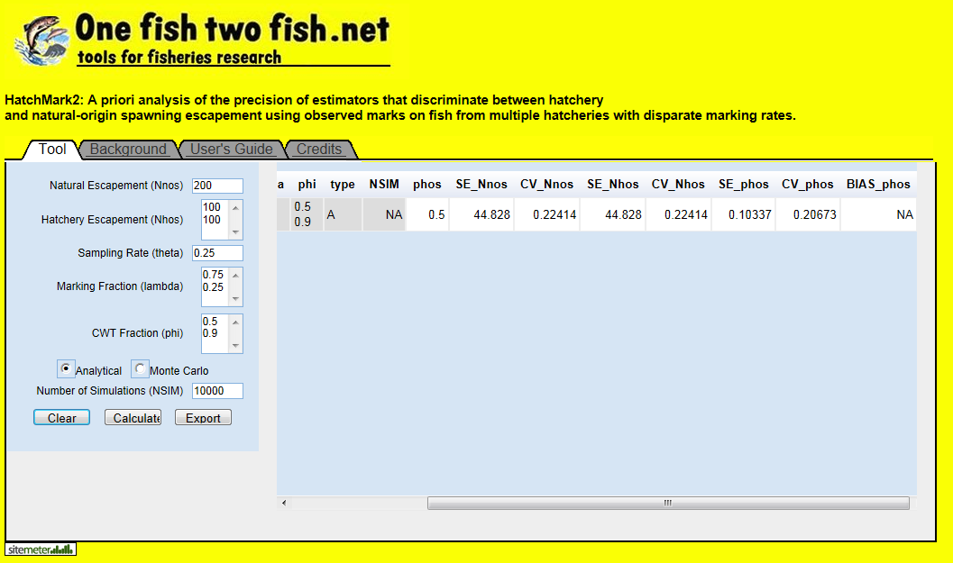
Please Visit Us!

Slide 25
Conclusions
When marking fractions at all source hatcheries are equal, estimation is simple. However, when marking fractions vary widely, estimation is complex and precision may decrease.
Small tagging fractions can lead to ambiguity in estimation of proportion of hatchery-origin spawners and loss of precision;
In the Hanford Reach example, very few (23) carcasses tested positive for a CWT.
PBT has the potential to increase numbers of tagged carcasses and thereby increase precision of estimates of the proportion of hatchery-origin spawners.

