Slide 1
Amazon Web Services
Brian Mason
Netapp

Slide 2
Agenda
Overview of Services
Walk through some Use Cases
Programming to AWS
Questions

Slide 3

Truly Dizzying Collection of Services
EC2
Lambda
S3
Storage Gateway
Glacier
Cloud Front
RDS
Dynamo DB
ElastiCache
Redhsift
VPC
Direct Donnect
Route53
Directory Ser4vices
Identity Y Access Managment
Trusted Advisor
Cloud Trail
Config
Cloud Watch
Elastic Beanstalk
OpsWork
Cloud Formation
Cloud Deploy
EMR
Knesis
Data Pipeline
SQS
SWF
AppStream
SES
Cloud Search
Congnito
Mobile Analystics
Workspaces
WorkDocs
WorkMail

Slide 4

Grouping of Services
Compute
Storage
Database
Networking
Administration & Security
Deployment & Management
Analytics
Application Services
Mobile Services
Enterprise Application

Slide 5
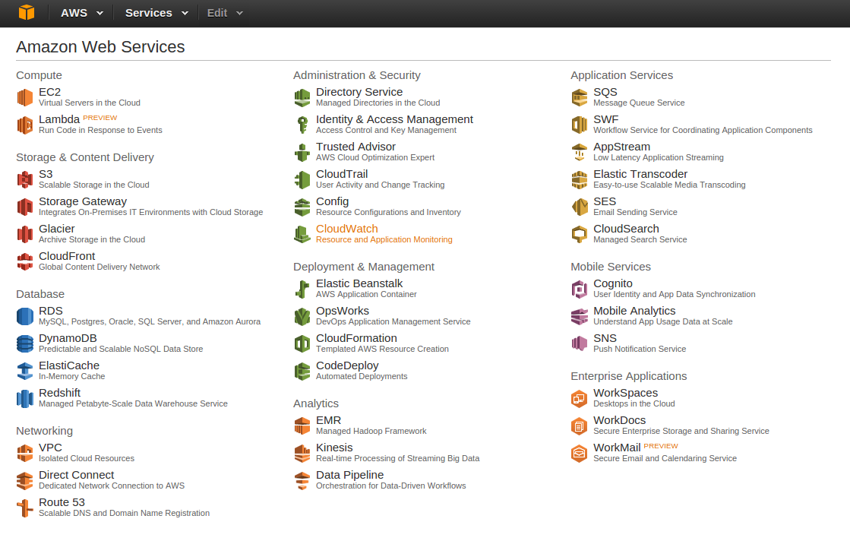

Slide 6
Use Case 1
User wants a scale out service
Has drank the AWS Kool-aid
Image Processing Service
Has following Components
  Web Front End
  REST API
  Processing Nodes
  Meta Data storage
  Image Storage

Slide 7




Document Store
For Meta Data
400K size recs
Dynamo DB
EC2 Node
EC2 Node
EC2 Node
Object Store
Large Objects
S3
Simple Queue Service
EC2 Node
Web Server
EC2 Node
Web Server
EC2 Node
Web Server
Simple Notification Service
Route 53 Round Robin DNS
Async Messages
Client

Slide 8
Use Case 2
User wants scale out services
User Likes AWS
NO WAY DO WE TRUST IT WITH OUR DATA

Slide 9
Amazon
Co-Location
“Near Amazon”
EC2
AWS
Direct Connect
Simple Queue Service
Standard NAS
Or ISCSI Block
EC2
Such as
Netapp Storage
(Shameless Company Plug)
Route 53 Round Robin DNS

Slide 10
Use Case 3
Archival Data Storage
S3 Store – Object Store Online
Glacier – Object Store Offline / cold

Slide 11
Archival Storage Options
S3
Glacier
AWS Import
REST Interface
FedEx
Hard drives

Slide 12
Programming to AWS
Services expose Web API
  Most use REST
  Still a couple lurking SOAP API
Amazon has SDKs!!
  Java, Ruby, .niet, PHP and Java script
  Java sdk is comprehensive and EASY
Java SDK goes beyond REST API
  Java Beans <-> DynmoDB for example

Slide 13
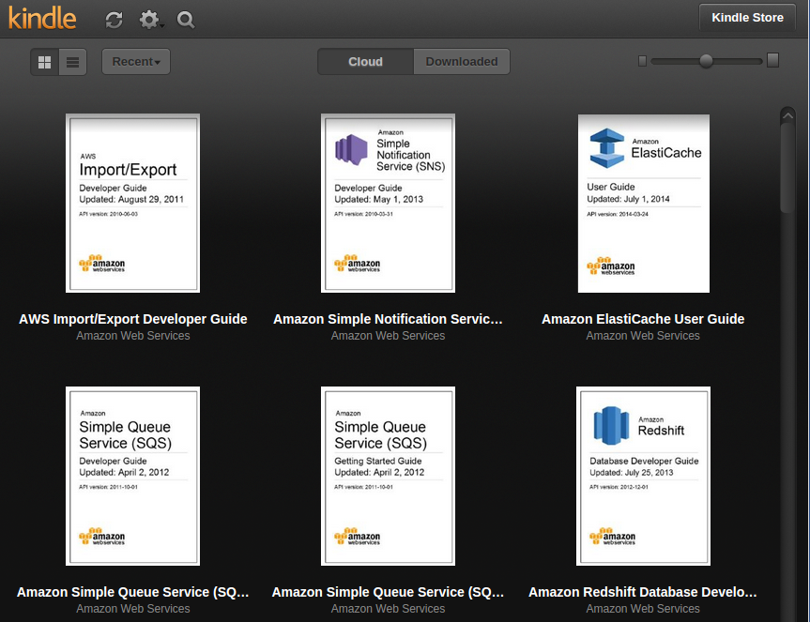
Well Documented (Kindle, PDF, HTML, Javadoc...)

Slide 14
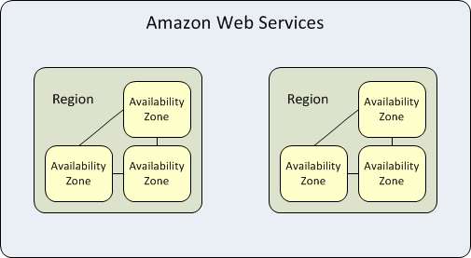
Regions and Availability Zones
http://docs.aws.amazon.com/AWSEC2/latest/UserGuide/using-regions-availability-zones.html

Slide 15
AWS Regions
US East -N Virgina (us-east-1)
US West -Oregon (us-west-2)
US West - N California (us-west-1)
EU -Ireland (eu-west-1)
EU – Frankfurt (eu-central-1)
Asia Pacific -Singapore (ap-southeast-1)
Asia Pacific -Tokyo (ap-northeast-1)
Asia Pacific -Sydney (ap-southeast-2)
South America - San Paulo (sa-east-1)

Slide 16
Java SDK
SDK has clients for each service
They use a common pattern and authentication
Isolates REST and SOAP APIs from user
Has some value add above the Web APIs

Slide 17
Code Example
ProfileCredentialsProvider pcp;
pcp=new ProfileCredentialsProvider();
AWSCredentials credentials = pcp.getCredentials();
AmazonDynamoDBClient client;
client = new AmazonDynamoDBClient(pcp);
client.setRegion(Region.getRegion(Regions.US_WEST_2))
DynamoDB dynamoDB = new DynamoDB(client);
Table arrayTable = dynamoDB.getTable("arrays");

Slide 18
Q&A?

