Slide 1
HAML Working Group
2024-12-12T17:00:00+01:00

Slide 2
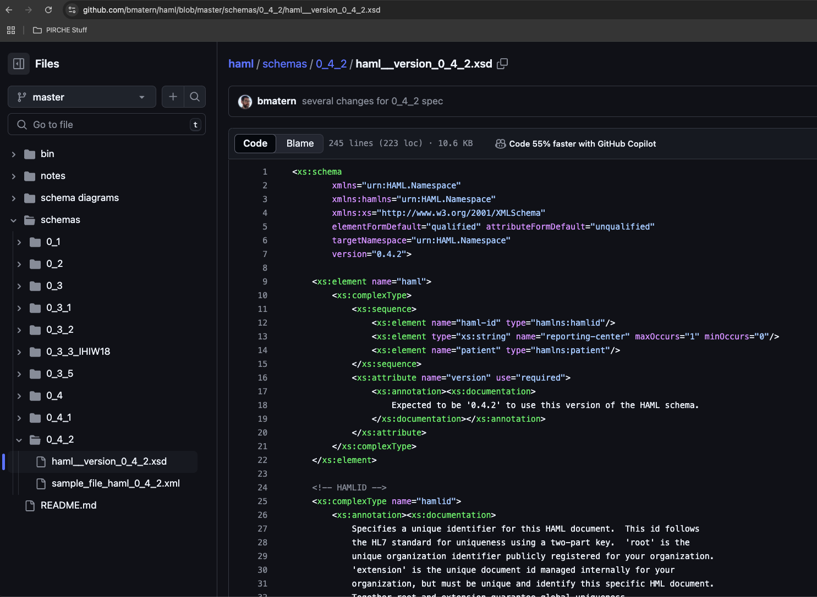
Current HAML Spec (v 0.4.2)
https://github.com/bmatern/haml (Latest)

Slide 3
Where we left off
What has changed in the spec
Roadmap moving forward

Slide 4
What is still Missing from v0_4_1?
Several parameters from previous haml versions
  Order Number
  Test ID? For replicate tests on the same sample.
  Lot number / kits / Manufacturer etc.
  Software IDs Document/sample/reporting center. Test ID.
  For SampleID and TestID - what is the namespace of who assigned the sample IDs
  https://hl7.org/fhir/datatypes.html#Identifier
    Define a nested definition for IDs. The parent IDs can “inherit” the generic ID definition ( inspired by FHIR)
Other Assays besides Single Antigen Bead:
  CDC Panel (Cells)
  Flow-Panel
Clarity in Override Reasons – structure these
Date Formats
Formulas
  Standardize how co communicate how the adjusted mfi is calculated (free-form is best option so far)
HL7 FHIR
Can we flag a specificity/bead as “self” or “nonself”
  Annotation field / Exclusion mark
Divider! This is a way that machines sorta self-calibrate so that different machines can be comparable

Slide 5
Goals from 2024.11.18 meeting:
Fill in the v0_4_1 gaps, for a v0_4_2 xml and xsd (Ben)
Harden the Format, Strengthen the XSD
  Define what things are required, be precise about cardinality
  More precision on data types & Dates
  Documentation & Comments within the xsd
Define scope (add cell assays?)
PLString – examples and detailed description (check GLString for inspiration)
Write a implementation guide / healthcare guideline through FHIR
  Dig up Bob Milius’ work and define path to FHIR (David Wroe?)
Real-world use-cases. (IHIW is biggest example so far)
  Do you want to use this spec in one of your routines or research projects?
  What TOOLS are needed for public adoption?
    Converters & Validators
Manuscripts
  PLString communication: Eric S.- nomenclature, minimal character sets ~+{}
  Eventually - publish 1.0 spec with manuscript
  MIRING (quality checklists)
Long term: Hackathon with antibody analysis vendors to tell them what to do and how to do it

Slide 6
Meeting minutes/notes 2024.11.18
Order of operations:
Vet with Users and manufacturers
1.0 spec comes after that.
PLString -
define anchor residues in the Peptide String? Regular expression for peptides
Serological specificity within a plstring
What if we don’t know the peptide? Modifications and such?
Extensions - “reserved characters” for future things
For now: Focus on the easy cases. Beads and things.
Modification to proposed nomenclature for peptides
DQB1*05:01~{PEPTIDE}~DQA1*01:01
DQB1*05:01~DQA1*01:01
A*01:01~{PEP}
Define example namespaces for epitopes/antigens/ambiguities
DPB1 “unnacceptable epitopes” , Eplets, Cregs, PIRCHES, alleles, serology, DPB1, MAC Codes
Show how to show which system is used (website or DOI)
“Serotype list string”, “Eplet String”
Need to add a “Conclusion” which is a different idea than assay level interpretation
the targeted eplets go into here
Define eplet nomenclature.
What is the use/purpose of this haml document? SOT….SCT? Platelets?
Different interpretations for different contexts? Is this in the context of a patient/donor pair?
Allow generic reporting, and in interpretation
Specify what the report is intended for. Is this meant for SOT or is it meant for “Research” or SCT etc.
“Interpretation” should be flexible and handle MULTIPLE interpretation blocks:
“Assay interpretation” -
“Clinical Interpretation”
Could include a field of use in here
In the context of transfusion we have these unnacceptables…
Serum ID for positive and negative controls - these are in the csv export I think but no place in HAML
Next Steps
Martin - Collaborations & Datasets? set up a message creation and such with some collabs he has in mind
Loren and Nick csv of antibody exports from one lambda
Eventually re-convert IHIW stuff
1-2 meetings in 2025 before prague
Next meeting right before xmas.
Dec 9th or 16th same time?
Doodle poll is out https://doodle.com/meeting/organize/id/eEGDQXmb

Slide 7
What has changed since last meeting
Script to automatically validate a xml against a schema (XmlValidation.py)
Added a version tag to the HAML spec
Rename “results” back to “solid-phase-panel”?
added several parameters to solid-phase-panel
  <lot-number>12345</lot-number>
  <kit-manufacturer>One_Lambda</kit-manufacturer>
  <kit-version>LS1A04</kit-version>
  <interpretation-software>HLA_Fusion</interpretation-software>
  <interpretation-software-version>4.1</interpretation-software-version>
bead-classification, added a restriction: Positive/Negative/Borderline/Undetermined
<patient-id> and <sample-id>
<reporting-center>
question: Bead classification - was this assigned by a human or algorithm?

Slide 8
Roadmap
Goal | When? | Who? | Comments
Update Schema with Missing fields (that we’re aware of) |  | Ben
PLString Examples
PLString Communication/Paper |  | Eric? Ben
Align with FHIR concepts | DASH 16: January 22-24
Apply HAML in UseCases / Datasets, Develop Tools and Validators |  | Martin?
Reconvert IHIW data
Vet with Users and manufacturers
Version 1.0 Spec |  | Ben
Version 1.0 Manuscript |  | Ben
FHIR Implementation Guide
Other Assays besides Single Antigen Bead( CDC Panel, Flow-Panel)
MIRING-like quality checklist

Slide 9
Next workgroup meeting(s)
One more in mid-January or No?
DASH 16 (January 22-24)
  Ben = Remote / Online

