Slide 1
HAML discussion
DASH 15 Utrecht
Oct 10&11 2024

Slide 2
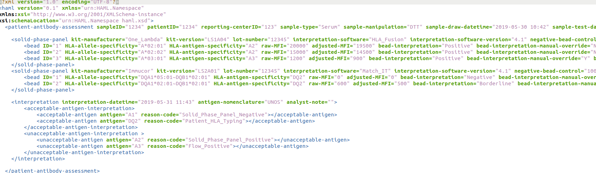
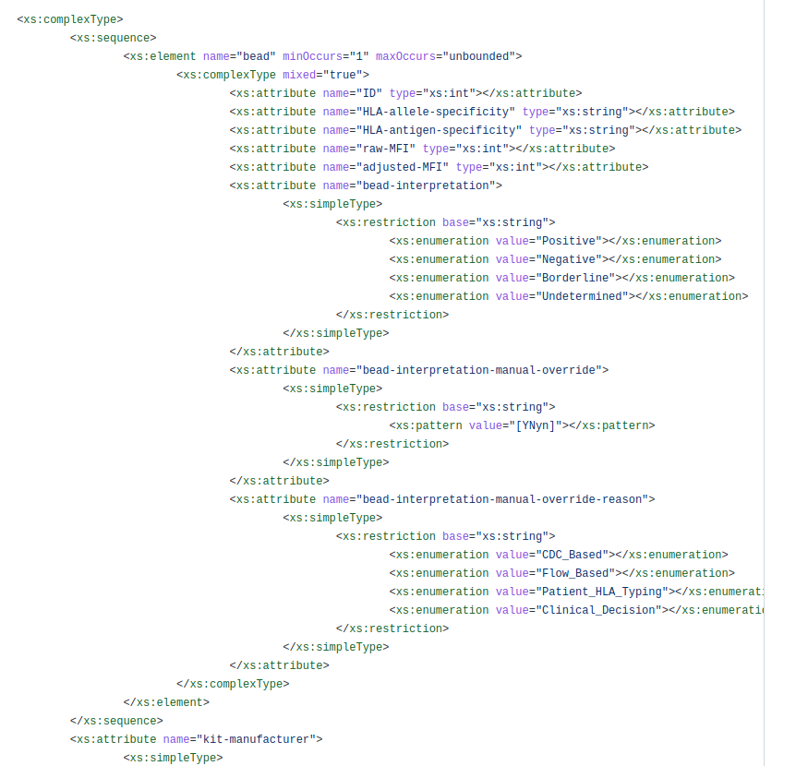
Current HAML Spec
https://github.com/lgragert/haml
Haml__version_0_3.xsd = “workshop version” Focused on Single Antigen Bead Assays

Slide 3
What is Missing?
Negative/Positive control SAMPLES for “calibrating” the machine/run
Specificity - Phenotype list string?
Sample - level Cumulative interpretation
What are the positive antibodies in this sample?
Order Number? Test ID? For replicate tests on the same sample.
For SampleID and TestID - what is the namespace of who assigned the sample IDs https://hl7.org/fhir/datatypes.html#Identifier Look to FHIR for inspiration
Smarter Structure - be sure
Identifiers. Document/sample/reporting center. Test ID. Define a nested definition for IDs. The parent IDs can “inherit” the generic ID definition ( inspired by FHIR)
“Acceptables and Unnacceptable”
“Determinants”: Antigens / Alleles / etc. Broad / Split. Heterodimers? Epitopes?
CDC Panel (Cells)
Flow-Panel
Clarity in Override Reasons
Date Formats
Formulas
(Distinguishing Raw vs Adjusted MFI)
HL7 FHIR
Can we flag a specificity/bead as “self” or “nonself”
Annotation field / Exclusion mark
Divider! This is a way that machines sorta self-calibrate so that different machines can be comparable

Slide 4
What did we do
Looked at the previous standard
Redefined the HAML with a patient-focused structure.
Looked at options for controls
Bead positive negative controls
Positive & negative serum controls
Discussed the divisor
How to report the calibration constants which actually change the “raw” data
Separate the ideas of Bead values, and interpretation
Bead-specific interpretation and assay interpretation
Raw MFI and adjusted MFI
Formula for calculating it (free form text)
Discuss PLString
Separate concept with overlapping ideas with GL String

Slide 5
Other things Things
Harden the Format,
Define what things are,precise cardinality
Strengthen the XSD
Make it a healthcare through FHIR
Write a implementation guide.

Slide 6
Thanks to the contributions from the interesting folks in this discussion (no particular order)
Loren Gragert
Gottfried Fischer
Eric Spierings
Ben Matern
Nick Brown
Bram Gerritsen
Kazutoyo Osoegawa
Joost van Averbeke
Zhihong He
Dirk Koppenaal
David Wroe
Martin Maiers

Slide 7
Conclusions & followup
PLString communication: Eric - include nomenclature, minimal character sets ~+{}
Fill in the v0_4 XML example, fill in the gaps; eventually make a XSD to accommodate: Ben (commit github today, improve “asap”) Pass around to the team
Dig up Bob Milius’ work and define path to FHIR (David Wroe)
Eventually - publish 1.0 spec with manuscript
We haven’t talked about cell assays…. “MIRING”ish rule-set: (Lots of people might have opinions on this) Another manuscript probably
Hackathon with antibody vendors to tell them what to do (Physicians control the world)

