Slide 1
DASH16
2025-01-22

Slide 2
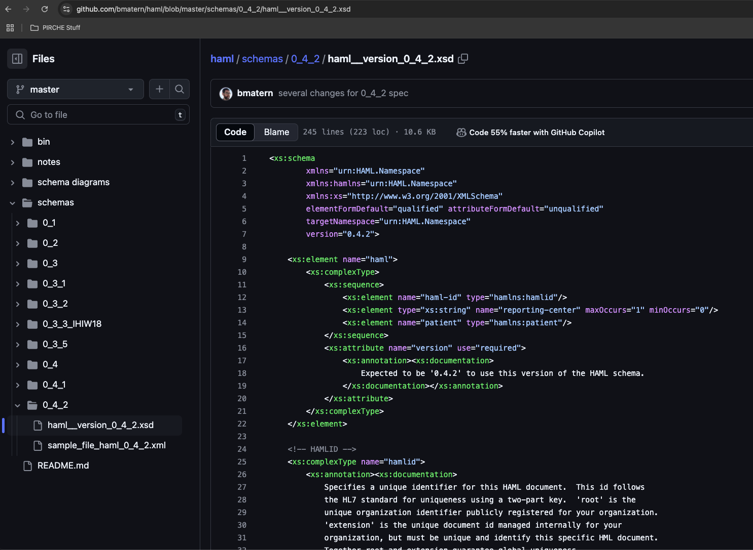
Current HAML Spec (v 0.4.3)
https://github.com/bmatern/haml (Latest)

Slide 3
Goals from 2024.11.18 meeting:
Define scope (add cell assays?)
PLString – examples and detailed description (check GLString for inspiration)
Write a implementation guide / healthcare guideline through FHIR
Dig up Bob Milius’ work and define path to FHIR (David Wroe?)
Real-world use-cases. (IHIW is biggest example so far)
Do you want to use this spec in one of your routines or research projects?
What TOOLS are needed for public adoption?
Converters & Validators
Manuscripts
PLString communication: Eric S.- nomenclature, minimal character sets ~+{}
Eventually - publish 1.0 spec with manuscript
MIRING (quality checklists)
Long term: Hackathon with antibody analysis vendors to tell them what to do and how to do it

Slide 4
What has changed since last meeting (v0_4_3)
Re-shuffled the <bead> structure
(<raw-data>, <converted-data>, <bead-info> live under each bead)
Question: “positive-control-serum-raw-MFI is “raw-data” or “converted-data”?
<Sample-date> and <assay-date>
Either “date” or “datetime” are acceptable.
<document-context>
Freeform field describing the purpose of this haml document (SOT, Platelets, etc..?)
<classification-entity>
Multiple humans or machines can interpret a bead result.
<positive/negative-serum-id>
CSV files contained ids pointing to the pos/neg control serum. This can be included in HAML
Filling in Documentation and Cardinality things.

Slide 5
Roadmap
Goal | When? | Who? | Comments
Update Schema with Missing fields (that we’re aware of) | Before DASH 16 | Ben
PLString Examples | January – pre DASH | Eric & Ben
PLString Communication/Paper | January – pre DASH | Eric & Ben
Align with FHIR concepts | DASH 16: January 22-24 | David Wroe? Ben send him a msg
Apply HAML in UseCases / Datasets, Develop Tools and Validators | Proof of Concept Before EFI Prague | Martin? | Eurotransplant – Come up with a use case for this (SOT) NMDP – Examle for a SCT Penn – AB data for SRTR outcomes, Tx that meet acceptable mismatches, DSA outcome
Reconvert IHIW data | Q3 2025
Vet with Users and Manufacturers / Vendors | Prague EFI May 12 DASH 17 Prague
Version 1.0 Spec |  | Ben
Version 1.0 Manuscript |  | Ben
FHIR Implementation Guide |  | David Wroe?
Other Assays besides Single Antigen Bead( CDC Panel, Flow-Panel)
MIRING-like quality checklist

Slide 6
DASH Goals
Fill in documentation for each element and describe the contents of each field.
Fix cardinality of elements
Create sample files to identify gaps and issues.
Identify missing elements
from previous HAML revisions
From Antibody CSV files and maybe IHIW needs?
FHIR experts? Look for issues.
For SampleID and TestID - what is the namespace of who assigned the sample IDs https://hl7.org/fhir/datatypes.html#Identifier
Define a nested definition for IDs. The parent IDs can “inherit” the generic ID definition ( inspired by FHIR)
Can we flag a specificity/bead as “self” or “nonself”
Annotation field / Exclusion mark
I propose: Skip cell assays for now, scope is big enough with SAB panels
CDC Panel (Cells)
Flow-Panel
PLString (Eric Spierings?)
DQB1*05:01~{PEPTIDE}~DQA1*01:01
DQB1*05:01~DQA1*01:01
A*01:01~{PEP}

Slide 7
DASH 16 Discussion Notes
“Plate”
which plate was it run on?
- because if there is contamination there can be info on which plate it was run on.
could be multiple kits on one plate
(Maybe this is as easy as putting a plate ID somewhere)
plstring
Suggest: alpha first then beta second
- Maybe - force a single nomenclature system / namespace in a single plstring
Which namespace - which nomenclature system can be used? This is a good thing to add. Ben: Suggest a field for this
Ben & Martin: followup with David Wroe
Use cases - Start with research and upload
- Can we include cPRA? Or enough info to create it?
- Some batch thing from CareDx into matilda, we could use this as a tool for that.
Loren:
<requisition-reason> instead of <document-context>
- What does FHIR do?
Update HAML Converter? Yes but that will affect reporting on the 18th Database. Ben can help accommodate that.
Maybe William and Livia and Ben are interested in the HAML converter tool
William and Livia demonstrated a good first pass of the modified converter. When it seems to consistently create schema-compliant hamls for both vendors, we can try updating the lambda functions for the 18th database.
William:
I have a comment regarding version 0.4.3: I think plstrings should be capped at 1 per specificity (positive, questionnable, and negative). There can be more than one interpretation, but only one conclusion per interpretation.
Important: Document incremental changes from 0.4.3 to 0.4.4 etc, maybe a sort of “patch notes”
ben.matern
I think that can work; as long as it's acceptable to have multiple nomenclatures in a single PLString,
Maybe someone wants to specify specific alleles as "positive", and might also specify an antigen at the same time Question:
The number system 1,2,4,8, positive or negative or weak,
Keep both fields and both are optional
TODO: Think about where it’s appropriate to store the HAML spec repository. Should that be in NMDP Bioinformatics?

