Slide 1
HAML Working Group
2024-11-18T16:00:00+01:00

Slide 2
HAML Working Group
What have we done so far?
What needs to be done moving forward?

Slide 3
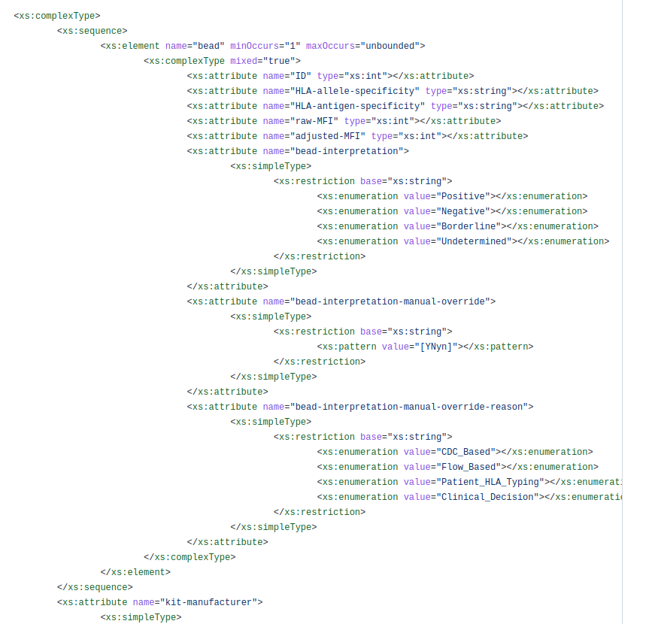
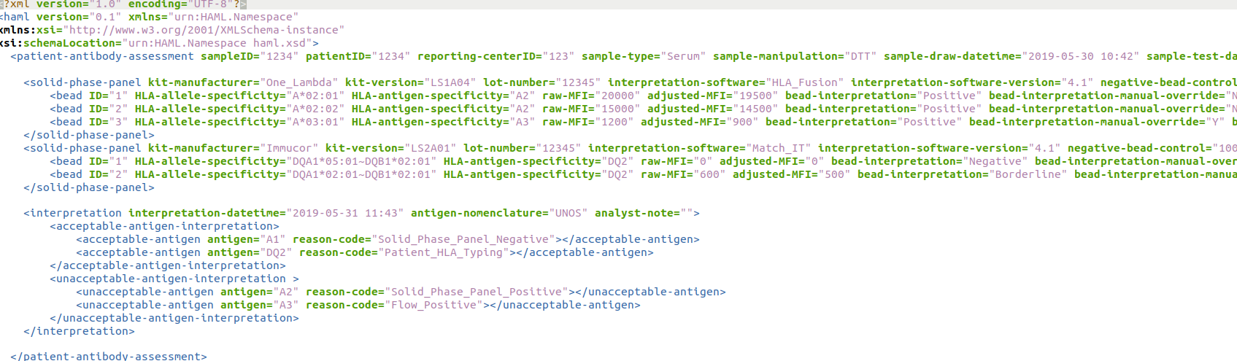
HAML?
HLA Antibody Markup Language
XML-based format for antibody assay results.
Inspired by HML
Developed during DASH hackathons

Slide 4
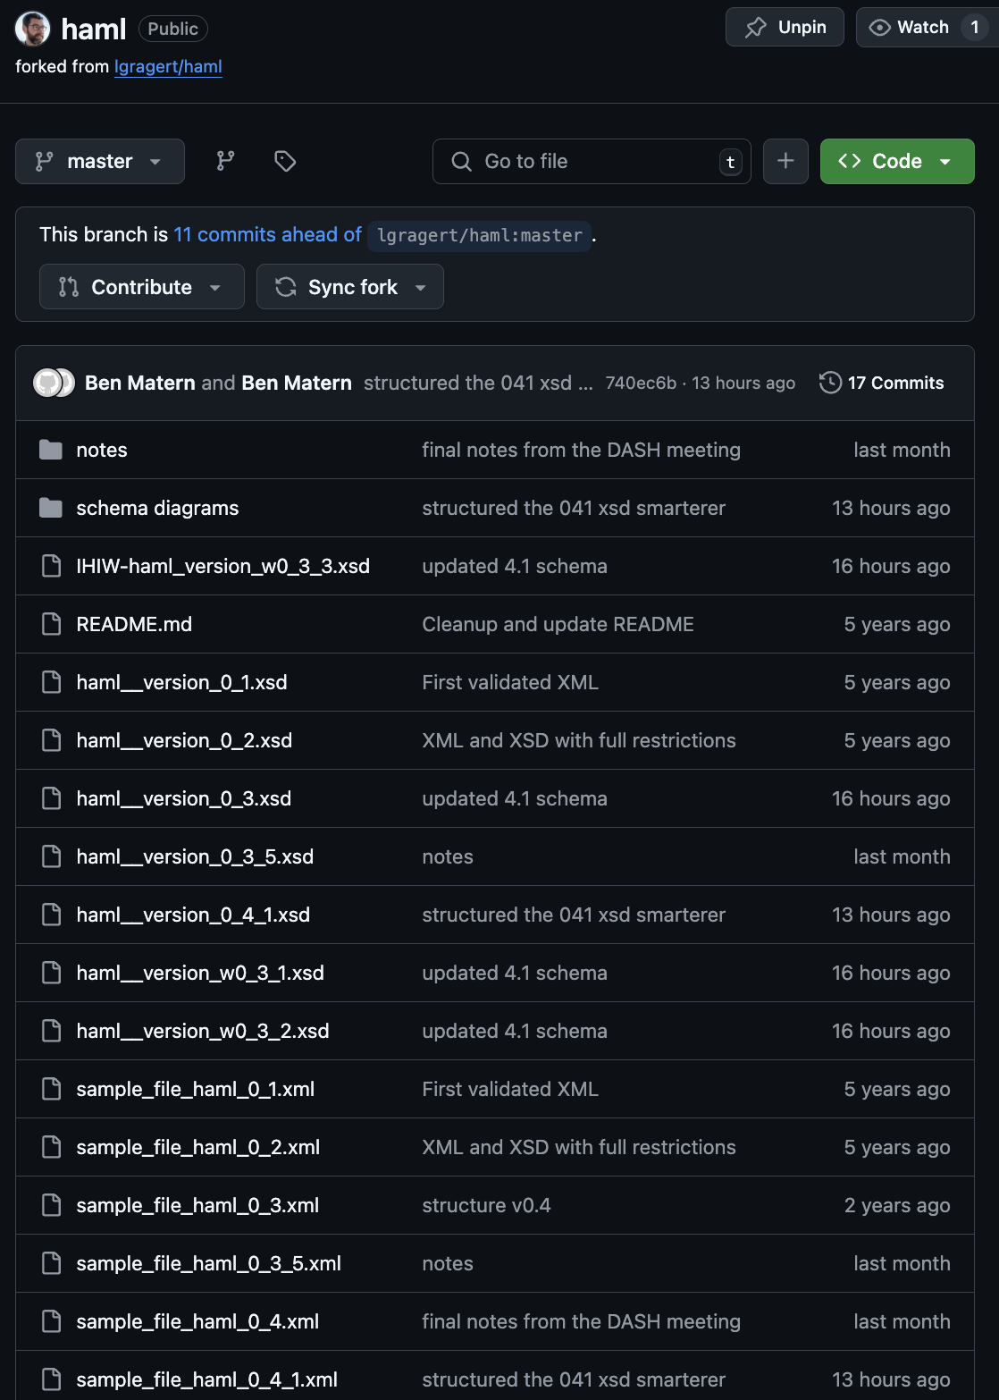
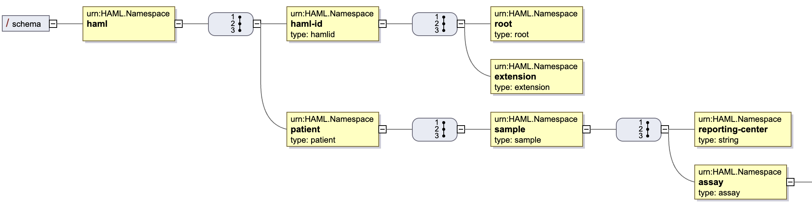
Current HAML Spec
https://github.com/lgragert/haml
https://github.com/bmatern/haml (Latest)
IHIW-haml_version_w0_3_3.xsd = IHIW schema (Single Antigen Bead Assays)
sample_file_haml_0_4.xml = Developed during Utrecht DASH 15
“schema diagrams”

Slide 5
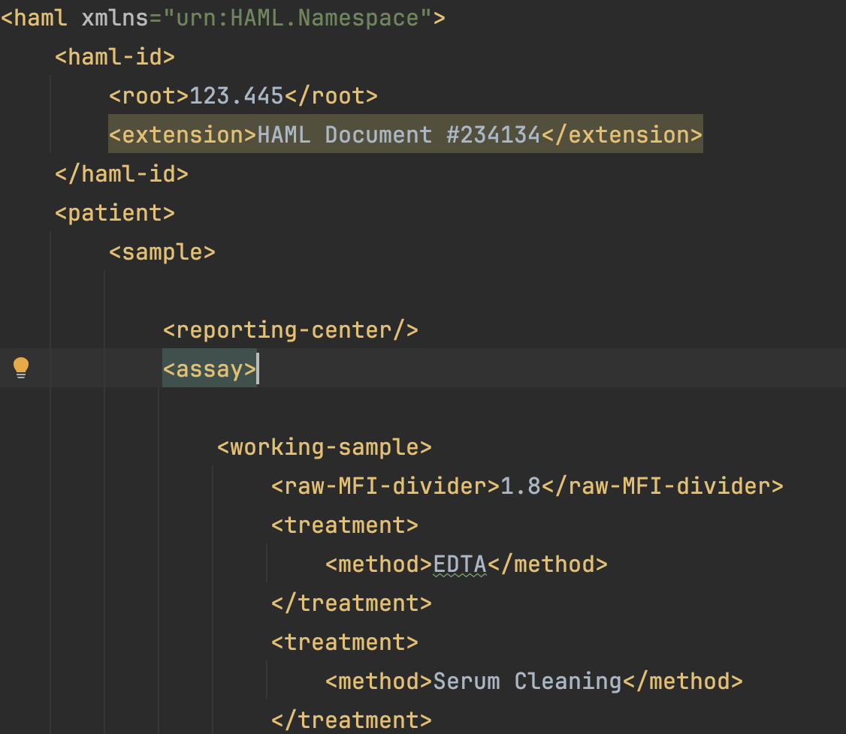
DASH 15 sample (sample_file_haml_0_4.xml)
Ground-up rebuild of the data structure/format
Start at the level of the “Patient” (Not the assay)
No attributes, only elements (Because FHIR)
Sample = blood drawn from a ”patient”
Working Sample = Test tube that is prepared/treated/diluted
Serological / Phenotype nomenclature
PLString nomenclature
How to handle Control MFIs (At the “bead” level) :
Bead positive negative controls
Positive & negative serum controls
Discussed the divisor (calibration constants which actually change the “raw” data)
Interpretations:
Bead level (positive/negative beads)
Sample level (acceptable / unnacceptable specificities)
Assay level: (Reject assay because ….)

Slide 6
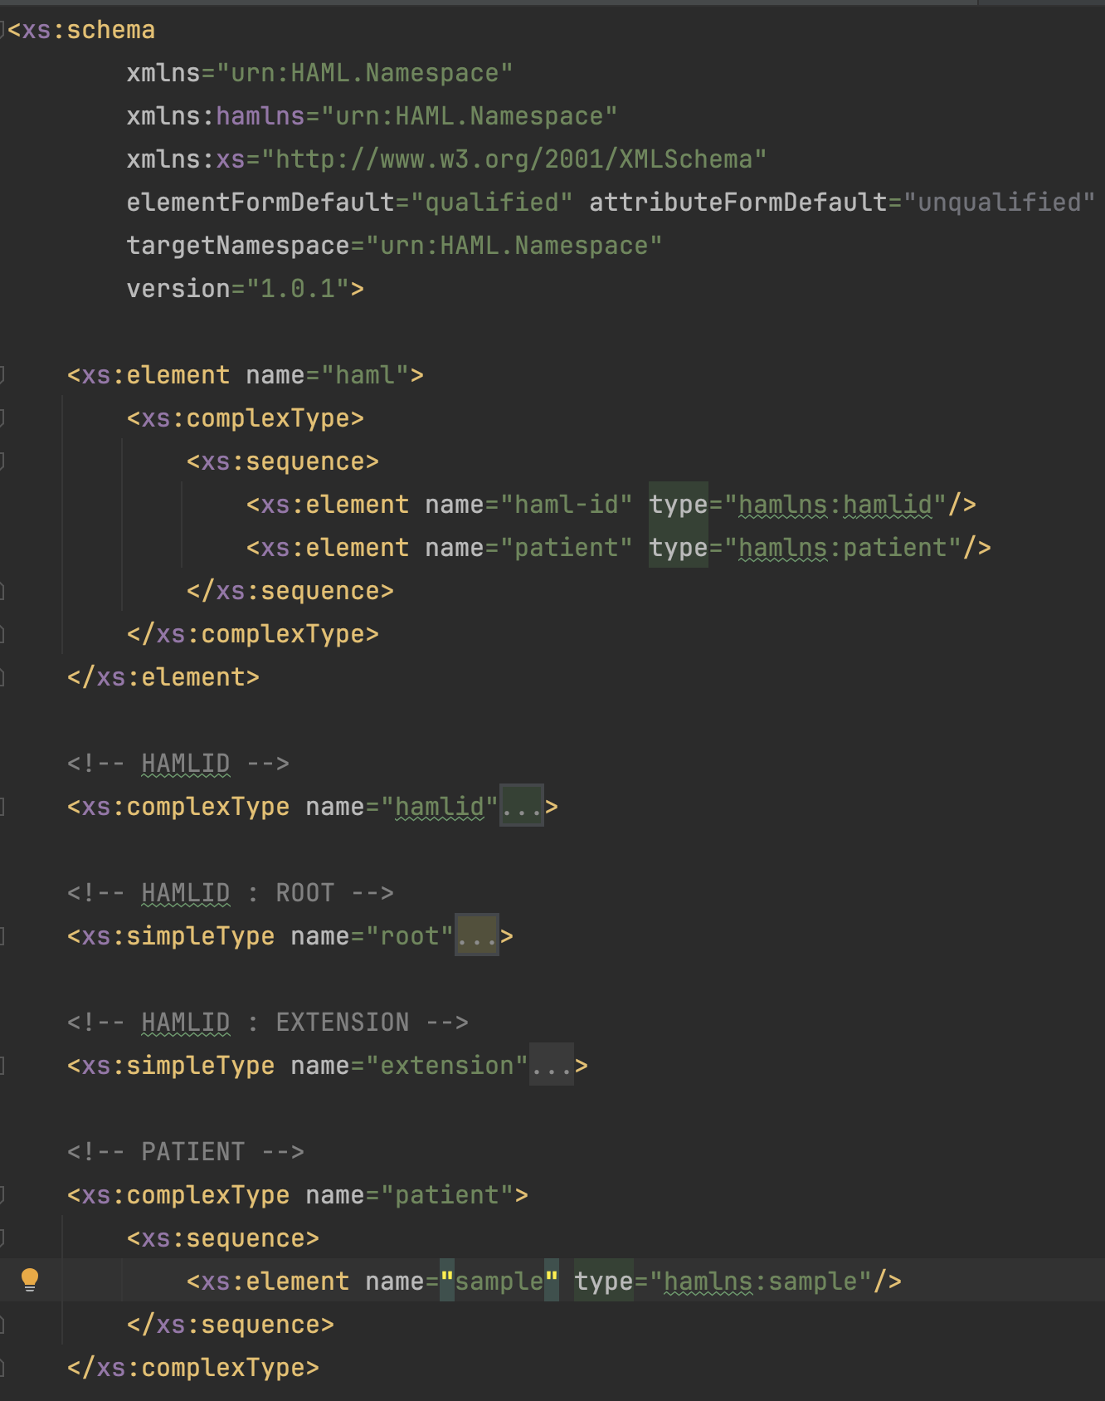
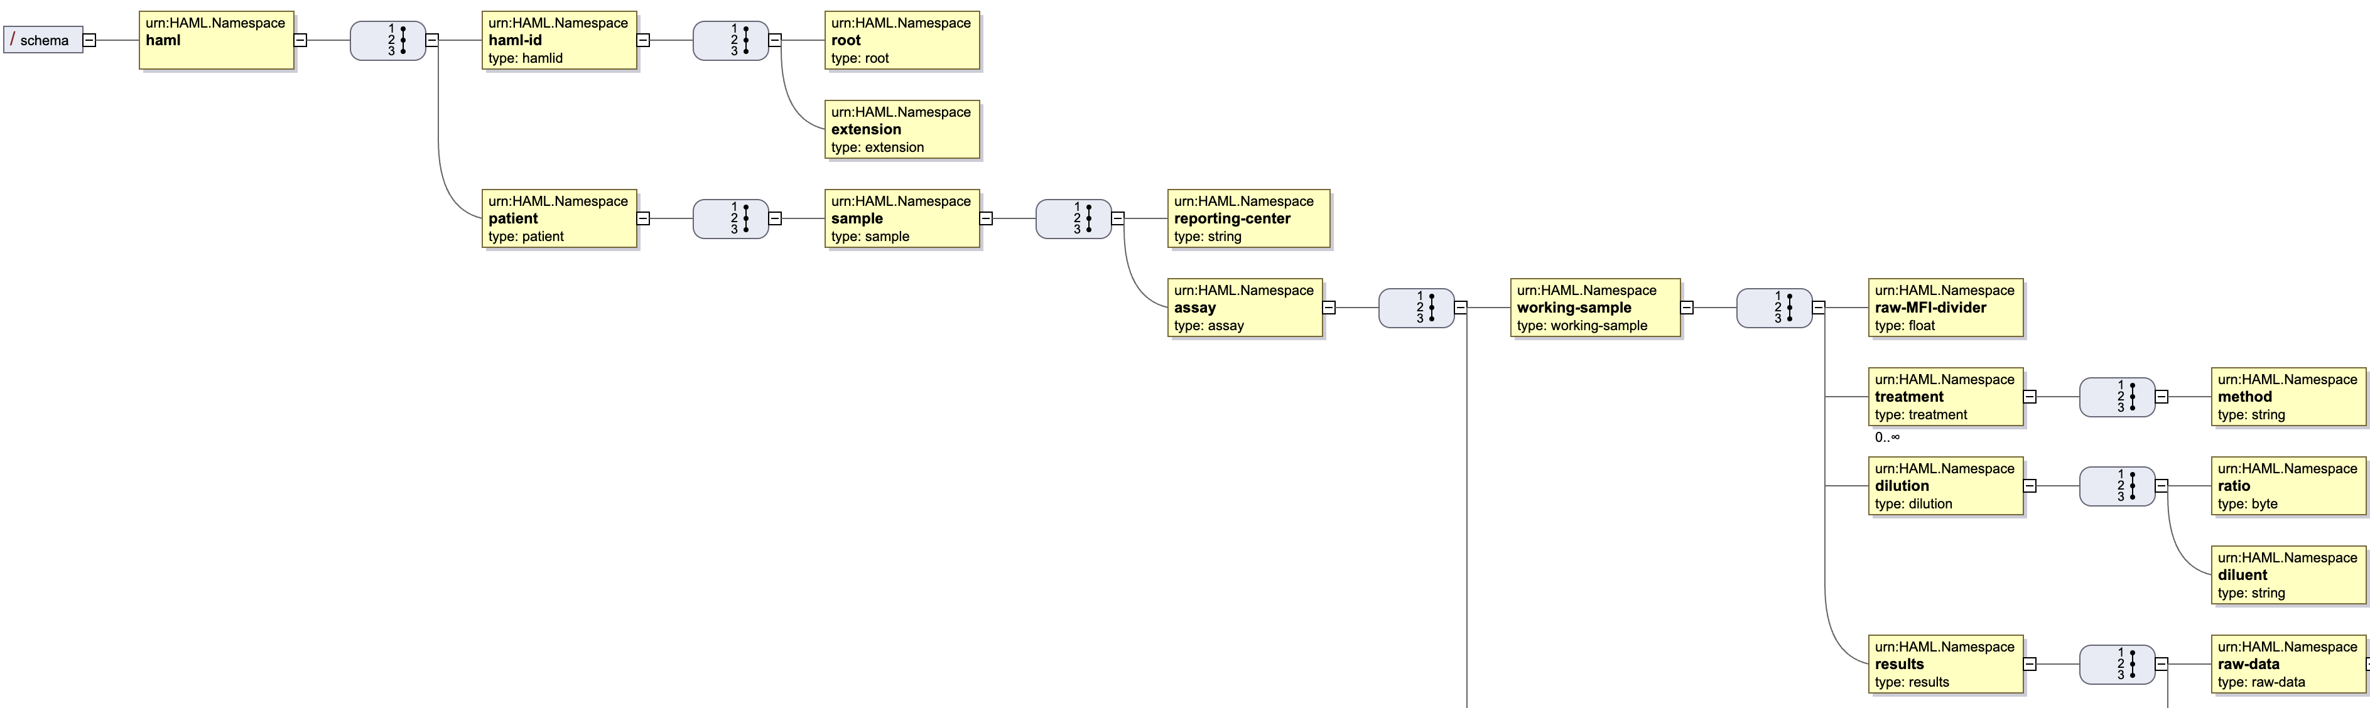
haml__version_0_4_1.xsd (Schema) haml__version_0_4_1.svg (Diagram)

Slide 7
What is still Missing from v0_4_1?
Several parameters from previous haml versions
Order Number
Test ID? For replicate tests on the same sample.
Lot number / kits / Manufacturer etc.
Software IDs Document/sample/reporting center. Test ID.
For SampleID and TestID - what is the namespace of who assigned the sample IDs https://hl7.org/fhir/datatypes.html#Identifier
Define a nested definition for IDs. The parent IDs can “inherit” the generic ID definition ( inspired by FHIR)
Other Assays besides Single Antigen Bead:
CDC Panel (Cells)
Flow-Panel
Clarity in Override Reasons – structure these
Date Formats
Formulas
Standardize how co communicate how the adjusted mfi is calculated (free-form is best option so far)
HL7 FHIR
Can we flag a specificity/bead as “self” or “nonself”
Annotation field / Exclusion mark
Divider! This is a way that machines sorta self-calibrate so that different machines can be comparable

Slide 8
PLString
Phenotype List String
(Phenotypes on a bead/cell. Not Genotypes on a chromosome.)
Inspired by GLString
Re-use ~ as a “physically linked” heterodimer
A*01:01{PEPTIDE} DQB1*05:01~DQA1*01:01{PEPTIDE} DRB1*01:01{PEPTIDE} A*01:01{PEPTIDE} ^ DQB1*05:01~DQA1*01:01{PEPTIDE}

Slide 9
Roadmap, Moving Forward:
Fill in the v0_4_1 gaps, for a v0_4_2 xml and xsd (Ben)
Harden the Format, Strengthen the XSD
Define what things are required, be precise about cardinality
More precision on data types & Dates
Documentation & Comments within the xsd
Define scope (add cell assays?)
PLString – examples and detailed description (check GLString for inspiration)
Write a implementation guide / healthcare guideline through FHIR
Dig up Bob Milius’ work and define path to FHIR (David Wroe?)
Real-world use-cases. (IHIW is biggest example so far)
Do you want to use this spec in one of your routines or research projects?
What TOOLS are needed for public adoption?
Converters & Validators
Manuscripts
PLString communication: Eric S.- nomenclature, minimal character sets ~+{}
Eventually - publish 1.0 spec with manuscript
MIRING (quality checklists)
Long term: Hackathon with antibody analysis vendors to tell them what to do and how to do it

Slide 10
Tools & Links
https://github.com/bmatern/haml
https://sourceforge.net/projects/xsdvi/
Java-based schema diagram generator
java -jar dist/lib/xsdvi.jar /Users/ben/github/haml/haml__version_0_4_1.xsd
https://www.freeformatter.com/xsd-generator.html
Generate a naïve xsd schema from an xml document
https://www.liquid-technologies.com/online-xsd-validator
Check if a sample xml is valid against an xsd

Slide 11
Thanks to the contributions from the interesting folks in this discussion (no particular order)
Loren Gragert
Gottfried Fischer
Eric Spierings
Ben Matern
Nick Brown
Bram Gerritsen
Kazutoyo Osoegawa
Joost van Averbeke
Zhihong He
Dirk Koppenaal
David Wroe
Martin Maiers

Slide 12
Meeting minutes/notes
Order of operations:
Vet with Users and manufacturers
1.0 spec comes after that.
PLString -
define anchor residues in the Peptide String? Regular expression for peptides
Serological specificity within a plstring
What if we don’t know the peptide? Modifications and such?
Extensions - “reserved characters” for future things
For now: Focus on the easy cases. Beads and things.
Modification to proposed nomenclature for peptides
DQB1*05:01~{PEPTIDE}~DQA1*01:01
DQB1*05:01~DQA1*01:01
A*01:01~{PEP}
Define example namespaces for epitopes/antigens/ambiguities
DPB1 “unnacceptable epitopes” , Eplets, Cregs, PIRCHES, alleles, serology, DPB1, MAC Codes
Show how to show which system is used (website or DOI)
“Serotype list string”, “Eplet String”
Need to add a “Conclusion” which is a different idea than assay level interpretation
the targeted eplets go into here
Define eplet nomenclature.
What is the use/purpose of this haml document? SOT….SCT? Platelets?
Different interpretations for different contexts? Is this in the context of a patient/donor pair?
Allow generic reporting, and in interpretation
Specify what the report is intended for. Is this meant for SOT or is it meant for “Research” or SCT etc.
“Interpretation” should be flexible and handle MULTIPLE interpretation blocks:
“Assay interpretation” -
“Clinical Interpretation”
Could include a field of use in here
In the context of transfusion we have these unnacceptables…
Serum ID for positive and negative controls - these are in the csv export I think but no place in HAML
Next Steps
Martin - Collaborations & Datasets? set up a message creation and such with some collabs he has in mind
Loren and Nick csv of antibody exports from one lambda
Eventually re-convert IHIW stuff
1-2 meetings in 2025 before prague
Next meeting right before xmas.
Dec 9th or 16th same time?
Doodle poll is out https://doodle.com/meeting/organize/id/eEGDQXmb

