Slide 1
HAML Working Group
2024-11-18T16:00:00+01:00

Slide 2
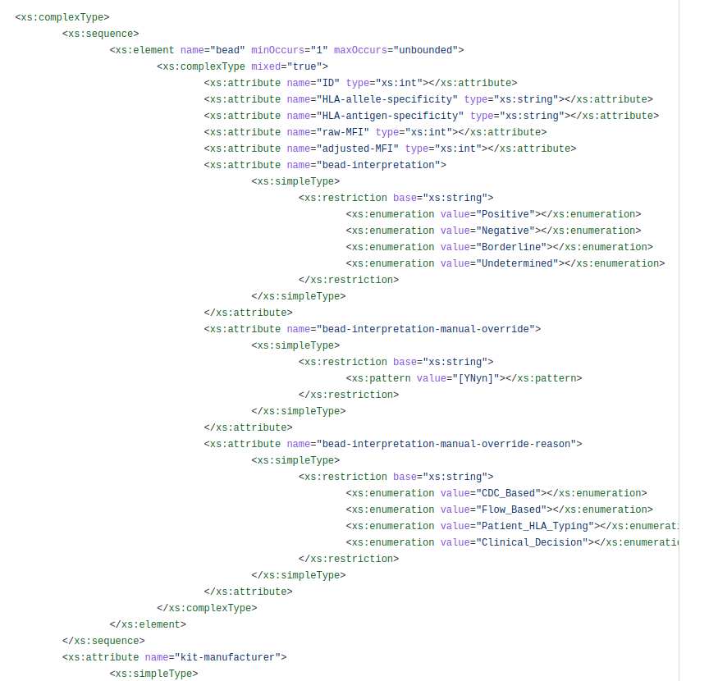
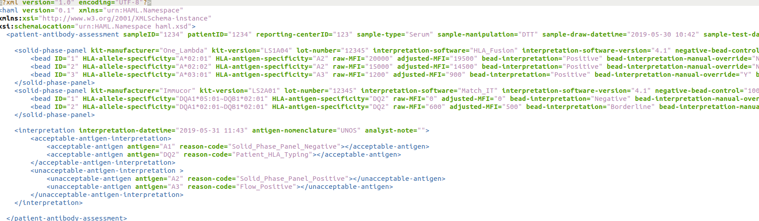
HAML?
HLA Antibody Markup Language
  XML-based format for antibody assay results.
Inspired by HML
Developed during DASH hackathons

Slide 3
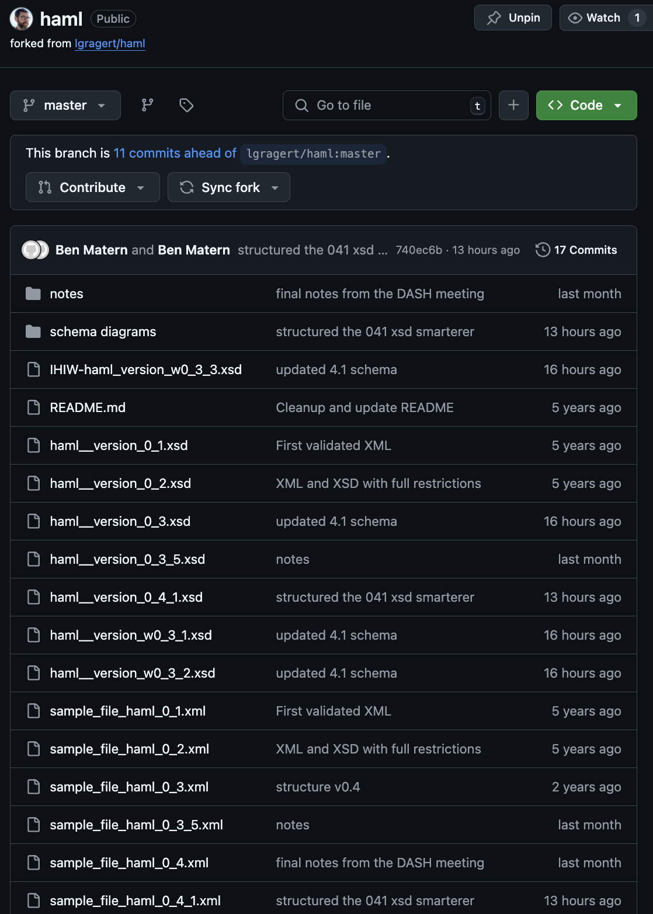
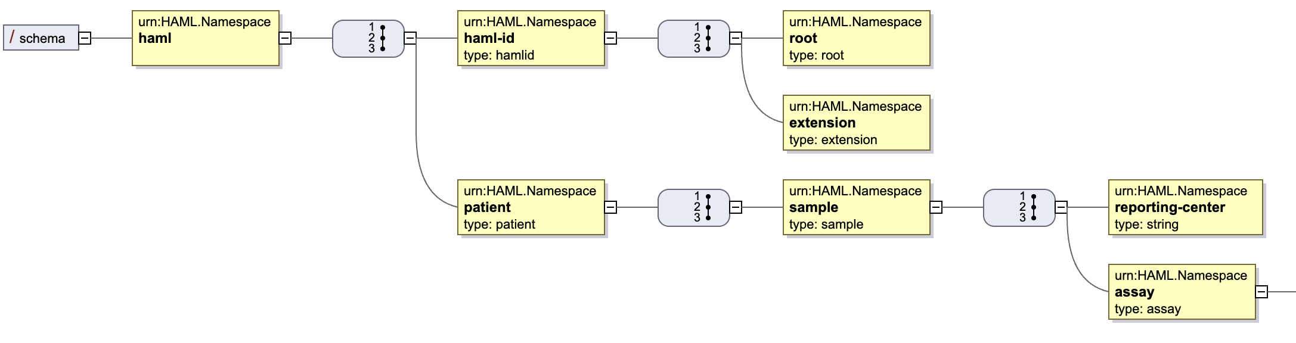
Current HAML Spec
https://github.com/lgragert/haml
https://github.com/bmatern/haml (Latest)
    IHIW-haml_version_w0_3_3.xsd
    = IHIW schema
    (Single Antigen Bead Assays)
    sample_file_haml_0_4.xml
    = Developed during Utrecht DASH 15
    “schema diagrams”

Slide 4
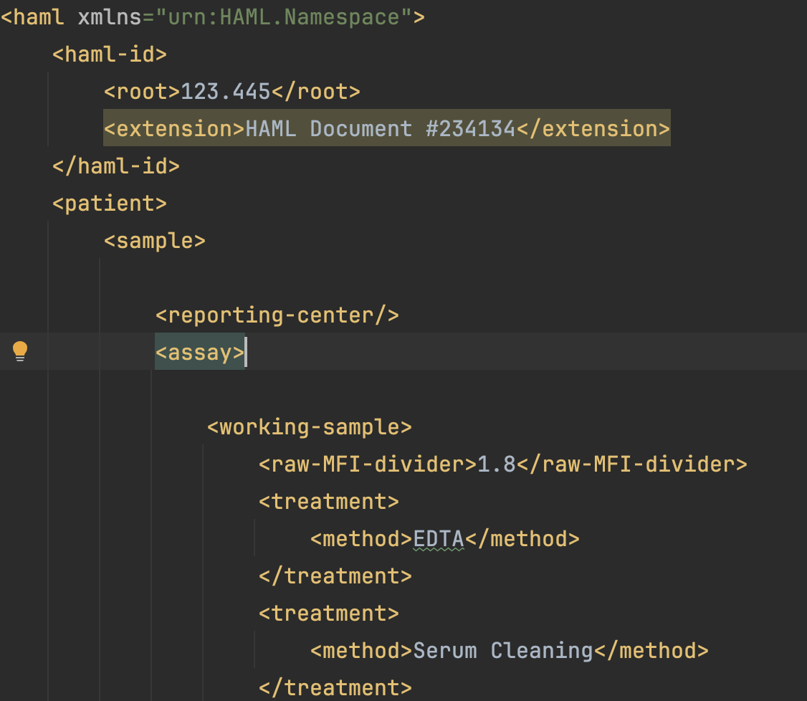
DASH 15 sample (sample_file_haml_0_4.xml)
Ground-up rebuild of the data structure/format
Start at the level of the “Patient” (Not the assay)
No attributes, only elements (Because FHIR)
Sample = blood drawn from a ”patient”
Working Sample = Test tube that is prepared/treated/diluted
Serological / Phenotype nomenclature
  PLString nomenclature
How to handle Control MFIs (At the “bead” level) :
  Bead positive negative controls
  Positive & negative serum controls
  Discussed the divisor (calibration constants which
  actually change the “raw” data)
Interpretations:
  Bead level (positive/negative beads)
  Sample level (acceptable / unnacceptable specificities)
  Assay level: (Reject assay because ….)

Slide 5
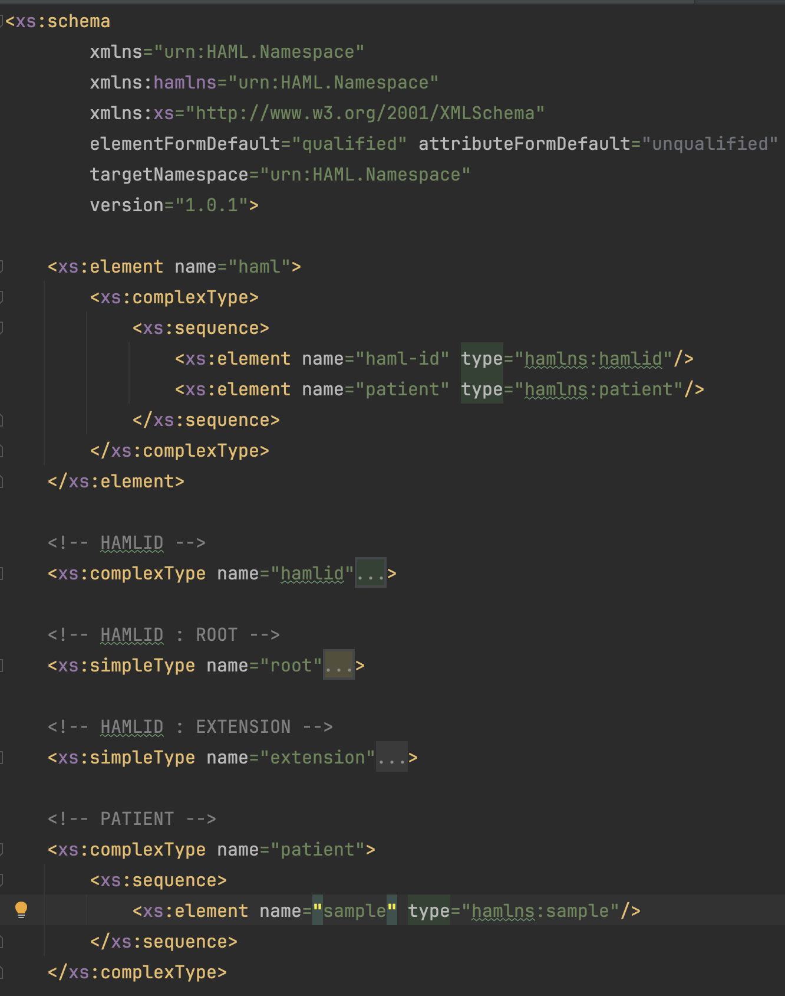
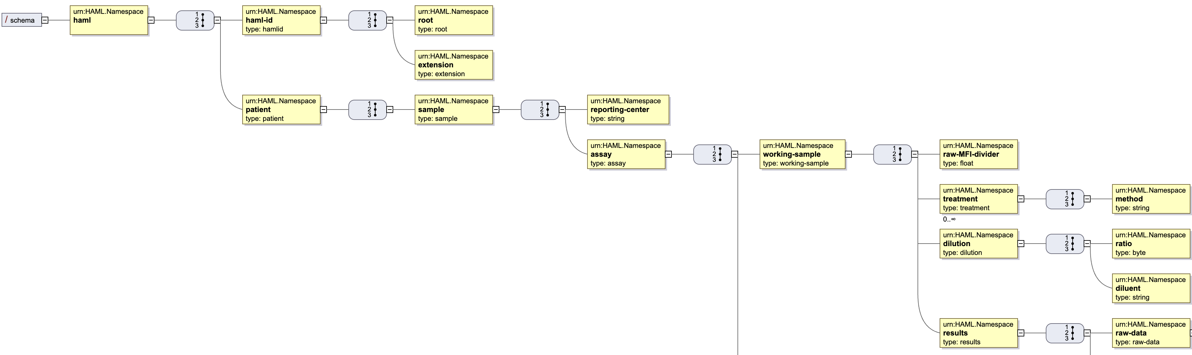
haml__version_0_4_1.xsd (Schema) haml__version_0_4_1.svg (Diagram)

Slide 6
What is still Missing from v0_4_1?
Several parameters from previous haml versions
  Order Number
  Test ID? For replicate tests on the same sample.
  Lot number / kits / Manufacturer etc.
  Software IDs Document/sample/reporting center. Test ID.
  For SampleID and TestID - what is the namespace of who assigned the sample IDs
  https://hl7.org/fhir/datatypes.html#Identifier
    Define a nested definition for IDs. The parent IDs can “inherit” the generic ID definition ( inspired by FHIR)
Other Assays besides Single Antigen Bead:
  CDC Panel (Cells)
  Flow-Panel
Clarity in Override Reasons – structure these
Date Formats
Formulas
  Standardize how co communicate how the adjusted mfi is calculated (free-form is best option so far)
HL7 FHIR
Can we flag a specificity/bead as “self” or “nonself”
  Annotation field / Exclusion mark
Divider! This is a way that machines sorta self-calibrate so that different machines can be comparable

Slide 7
PLString
Phenotype List String
  (Phenotypes on a bead/cell. Not Genotypes on a chromosome.)
Inspired by GLString
  Re-use ~ as a “physically linked” heterodimer
A*01:01{PEPTIDE}
DQB1*05:01~DQA1*01:01{PEPTIDE}
DRB1*01:01{PEPTIDE}
A*01:01{PEPTIDE} ^ DQB1*05:01~DQA1*01:01{PEPTIDE}

Slide 8
Roadmap, Moving Forward:
Fill in the v0_4_1 gaps, for a v0_4_2 xml and xsd (Ben)
Harden the Format, Strengthen the XSD
  Define what things are required, be precise about cardinality
  More precision on data types & Dates
Define scope (add cell assays?)
Make it a healthcare guideline through FHIR
  Write a implementation guide.
  Dig up Bob Milius’ work and define path to FHIR (David Wroe?)
Real-world use-cases. (IHIW is biggest example so far)
  Do you want to use this spec in one of your routines or research projects?
  What TOOLS are needed for public adoption?
    Converters & Validators
Manuscripts
  PLString communication: Eric S.- nomenclature, minimal character sets ~+{}
  Eventually - publish 1.0 spec with manuscript
  MIRING (quality checklists)
Long term: Hackathon with antibody vendors to tell them what to do and how to do it

Slide 9
Tools & Links
https://github.com/bmatern/haml
https://sourceforge.net/projects/xsdvi/
  Java-based schema diagram generator
  java -jar dist/lib/xsdvi.jar /Users/ben/github/haml/haml__version_0_4_1.xsd
https://www.freeformatter.com/xsd-generator.html
  Generate a naïve xsd schema from an xml document
https://www.liquid-technologies.com/online-xsd-validator
  Check if a sample xml is valid against an xsd

Slide 10
Thanks to the contributions from the interesting folks in this discussion
(no particular order)
Loren Gragert
Gottfried Fischer
Eric Spierings
Ben Matern
Nick Brown
Bram Gerritsen
Kazutoyo Osoegawa
Joost van Averbeke
Zhihong He
Dirk Koppenaal
David Wroe
Martin Maiers

