Slide 1
In-ear EEG Auditory Steady State Response Analysis
Integrated Systems Laboratory (ETH Zürich)
Benedetta Mazzoni b.mazzoni@unibo.it
Andrea Cossettini cossettini.andrea@iis.ee.ethz.ch
Simone Benatti simone.benatti@unimore.it

Slide 2
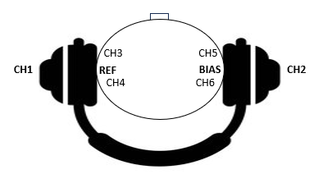
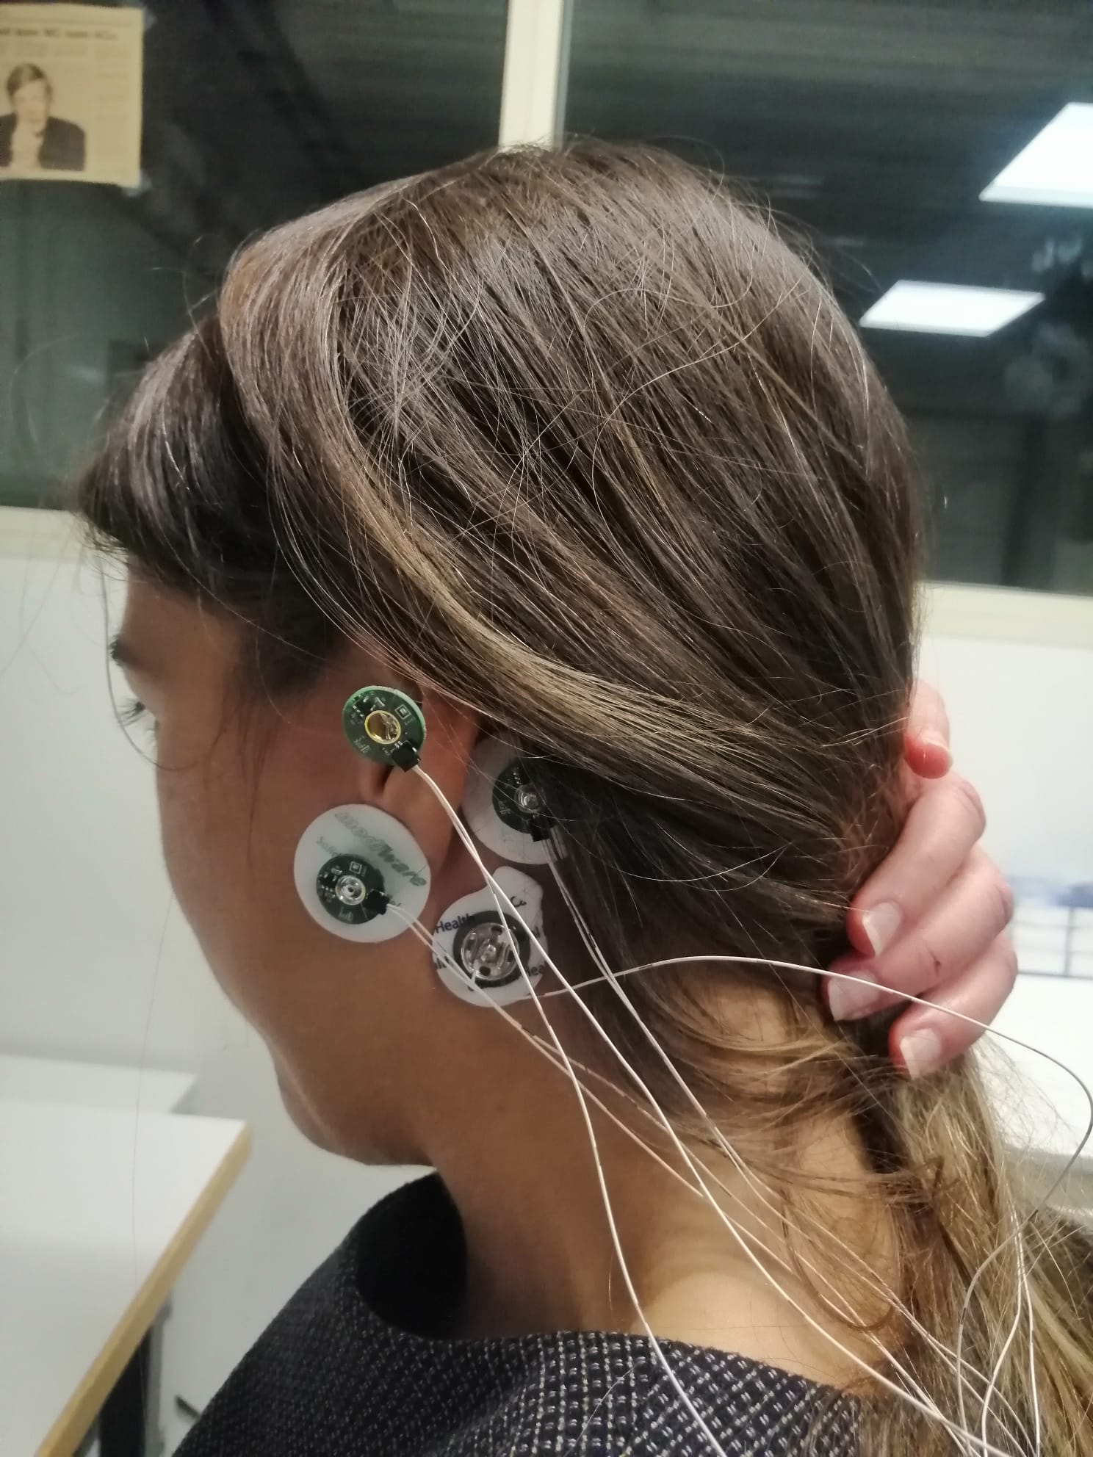
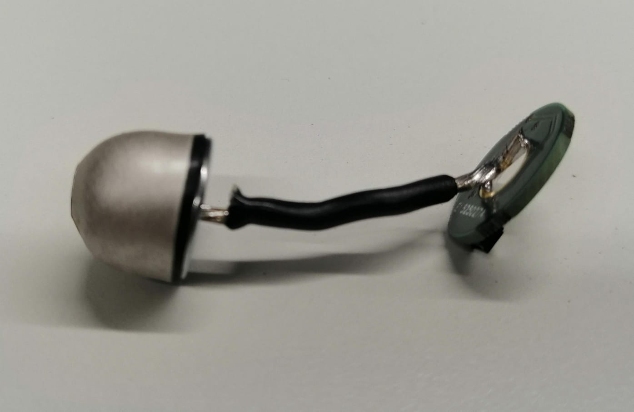
Setup description (1)
Naison
Stimuli (for ASSR)
Over-the-head or bone-conduction headphones
Electrodes
earEEG electrodes: fabricated by Dätwyler Schweiz AG
headphones
Channel | Location | Type
CH1 | In-ear (left) | Ear-EEG electrode + active buffering
CH2 | In-ear (right) | Ear-EEG electrode + active buffering
CH3 | front of the ear (left) | Wet electrode + active buffering
CH4 | back of the ear (left) | Wet electrode + active buffering
CH5 | front of the ear (right) | Wet electrode + active buffering
CH6 | back of the ear (right) | Wet electrode + active buffering
REF | Mastoid (left) | Wet electrode + active buffering
BIAS | Mastoid (right) | Wet electrode
Electrodes configuration on a test subject
Ear-EEG electrode fabricated by Dätwyler Schweiz AG and connected to an active buffering PCB

Slide 3
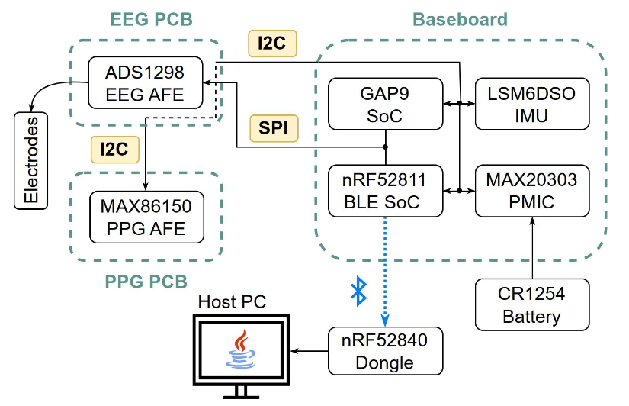
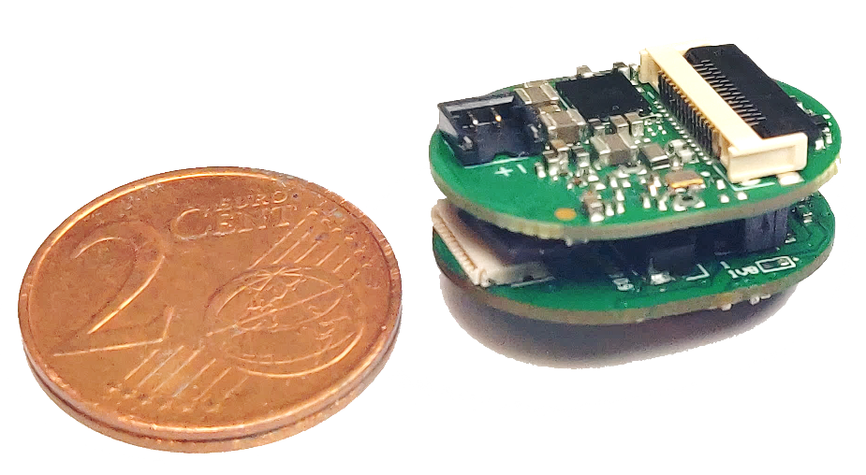
Setup description (2)
Data acquisition platform
BioGAP (https://arxiv.org/abs/2307.01619)
PULP-based computing platform (GAP9)
TOPS capabilities, 10 RISC-V cores, state-of-the-art performance for tinyML
Nordic nRF52 for BLE connectivity
Can be flexibly connected to a large variety of sensor interfaces
ADC for biopotentials (ADS1298, 8 ExG channels, 24 bit resolution)

Slide 4
Validation measurements: Alpha waves
Protocol
Subject alternating eyes open and eyes closed with 10-second intervals
Goal
Analyze the power of alpha waves within the frequency range of 7 to 13 Hz
Data processing
Filtering: band-pass, Butterworth (order 10, cutoff: f₁=0.5 Hz, f₂= 40 Hz)
Filtering: notch, order 2, at 50 Hz
Spectrogram computation: 1024-samples windows (2 seconds) with 768-samples (1.5 seconds) overlap

Slide 5
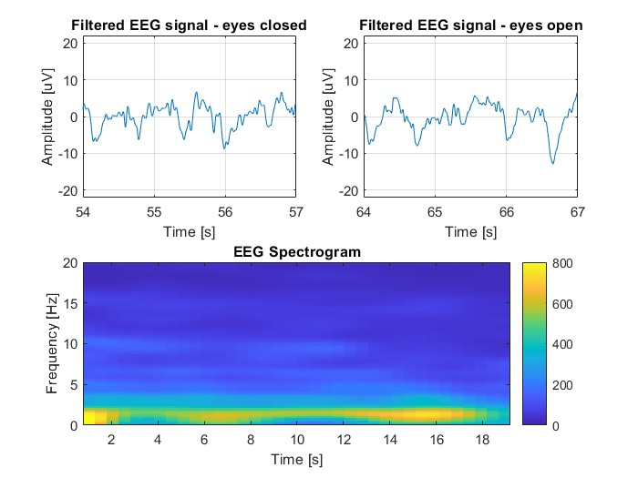
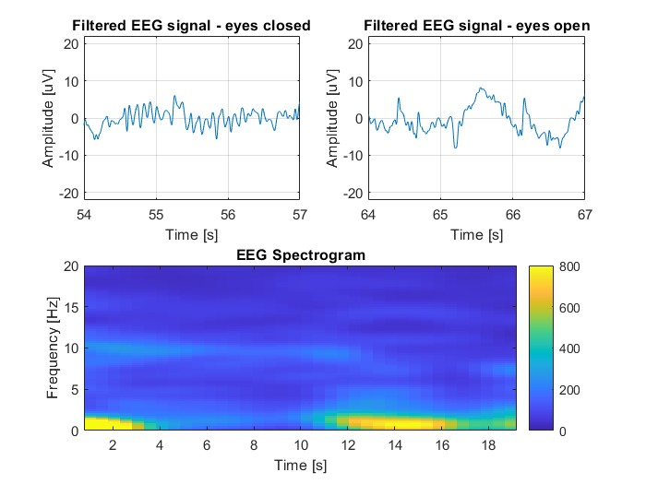
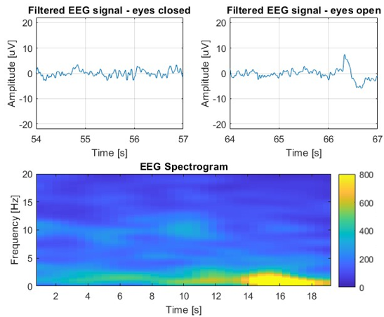
Validation measurements: Alpha waves
Results (Subject A)
Left channels
Alpha activity visible in the 7-13 Hz range
eyes closed
eyes open
eyes closed
eyes open
eyes closed
eyes open
Channel 1 in-ear
Channel 3
Channel 4

Slide 6
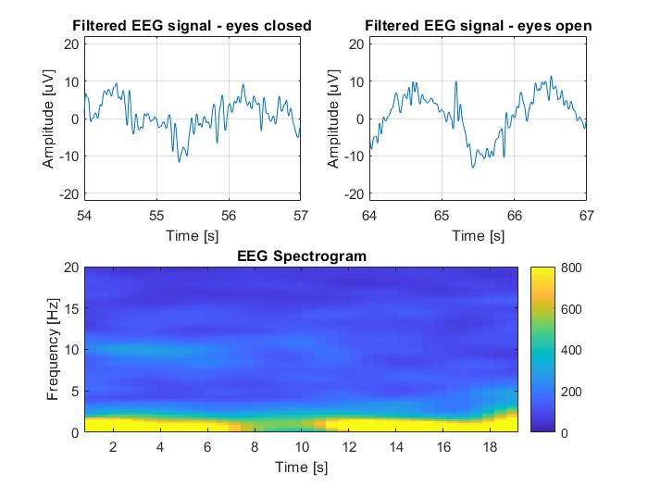
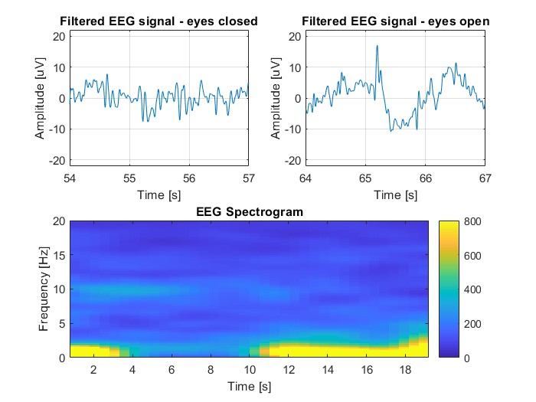
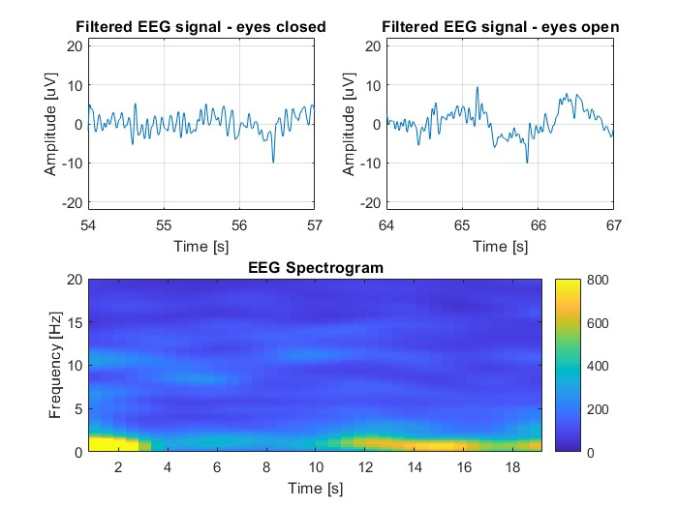
Validation measurements: Alpha waves
Results (Subject A)
Right channels
Alpha activity visible in the 7-13 Hz range
eyes closed
eyes open
eyes closed
eyes open
eyes closed
eyes open
Channel 2 in-ear
Channel 5
Channel 6

Slide 7
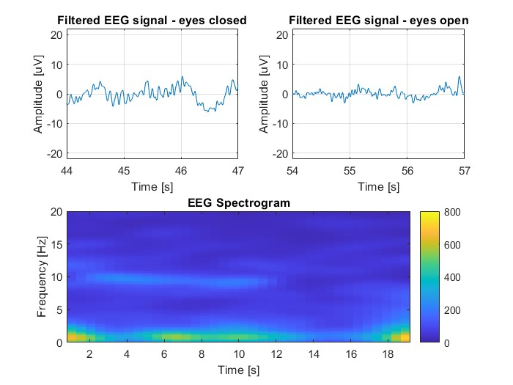
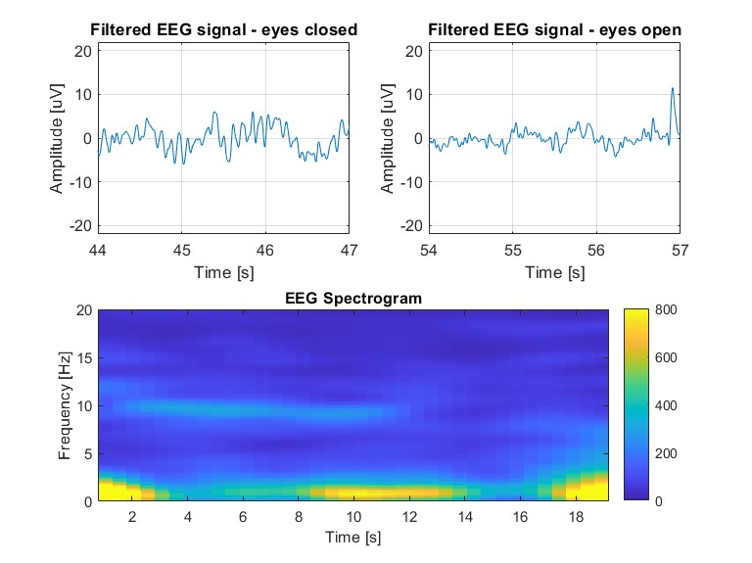
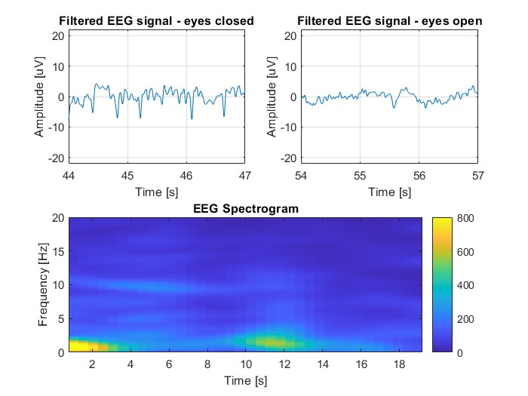
Validation measurements: Alpha waves
Results (Subject B)
Left channels
Alpha activity visible in the 7-13 Hz range
eyes closed
eyes open
eyes closed
eyes open
eyes closed
eyes open
Channel 1 in-ear
Channel 3
Channel 4

Slide 8
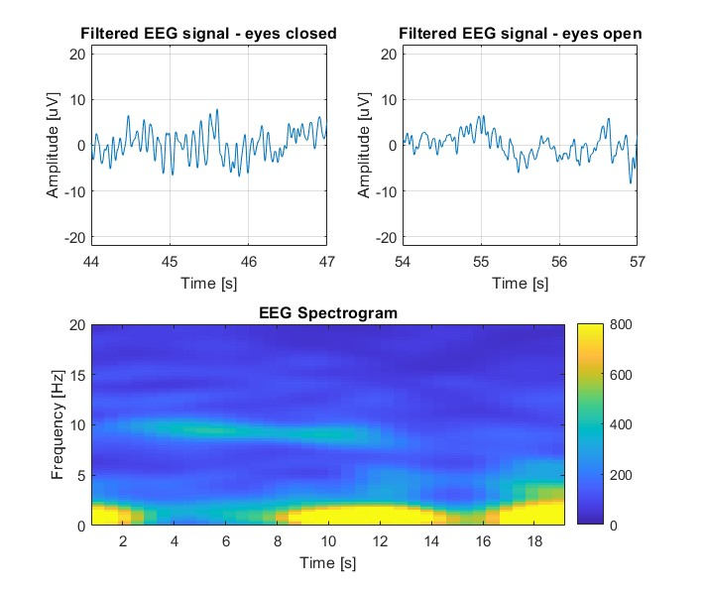
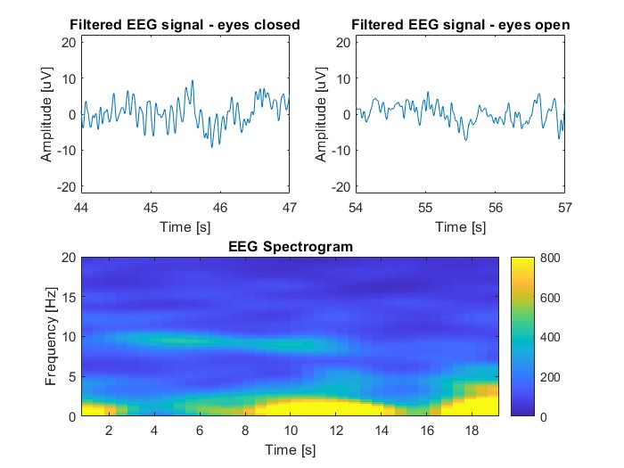
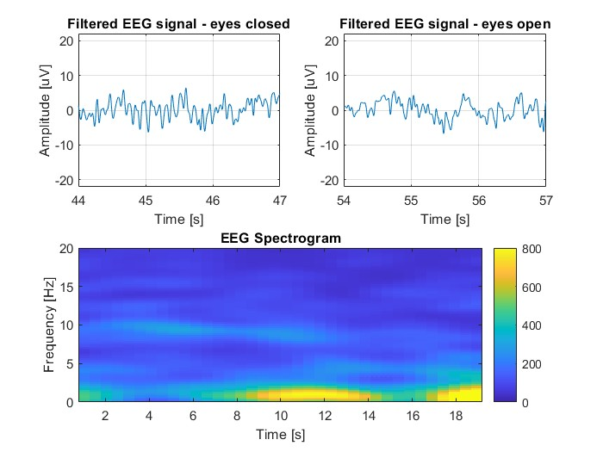
Validation measurements: Alpha waves
Results (Subject B)
Right channels
Alpha activity visible in the 7-13 Hz range
eyes closed
eyes open
eyes closed
eyes open
eyes closed
eyes open
Channel 2 in-ear
Channel 5
Channel 6

Slide 9
ASSR: protocol
Protocol description
5 healthy volunteers
Subjects wear the electrodes and the headphones. During acquisitions, they are allowed to read
Auditory stimulus from the headphones:
sinusoidal tone with a carrier at 4 kHz and AM modulated [1][2] (we test 80 Hz and 88 Hz)
Intensity: 65 dB SPL (sound pressure level)
Duration: 15 minutes (similar to [3])
BioGAP sampling frequency: 500 Hz
[1] Kubota, Toshinori, et al. "Detecting the recruitment phenomenon in adults using 80-Hz auditory steady-state response." Auris Nasus Larynx 46.5 (2019)
[2] Herdman AT, Lins O, Van Roon P, Stapells DR, Scherg M, Picton TW. Intracerebral sources of human auditory steady-state responses. Brain Topogr. 2002.
[3] C. B. Christensen, T. Lunner, J. M. Harte, M. L. Rank and P. Kidmose, "Chirp-Evoked Auditory Steady-State Response: The Effect of Repetition Rate," in IEEE Transactions on Biomedical Engineering, vol. 69, no. 2, pp. 689-699, Feb. 2022.

Slide 10
ASSR: data processing
Signal processing pipeline
Filtering: band-pass, Butterworth, order = 10, cutoff 30 – 180 Hz
Filtering: notch, at 50 Hz (PLI) and 100 Hz (2nd harmonic of PLI): order = 2, quality factor = 100
Power Spectral Density (PSD) analysis using WELCH Method:
Windowing = 5 sec
Discrete Fourier Transform (DFT) of the periodgram
Squared magnitude, yelding power spectrum estimates for each segment
Averaging of the individual power spectra (to reduce noise floor)
Result: array of power measurements vs. frequency «bin» (Power/Freq) estimated at frequency intervals.
Automatic peak detection (peak of the response at the AM frequency 80 Hz)
Automatic Signal-to-Noise Ratio (SNR) estimation

Slide 11
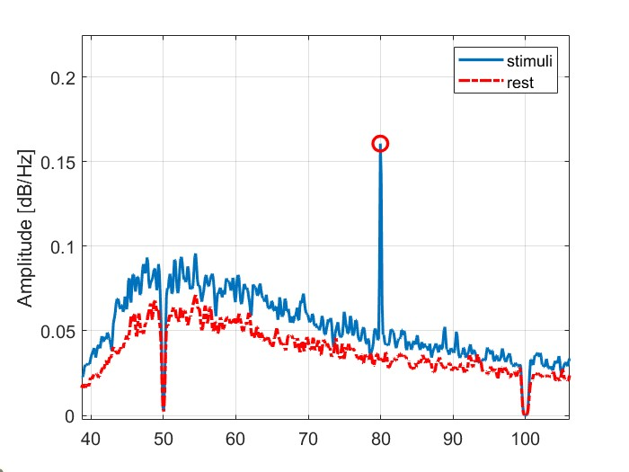
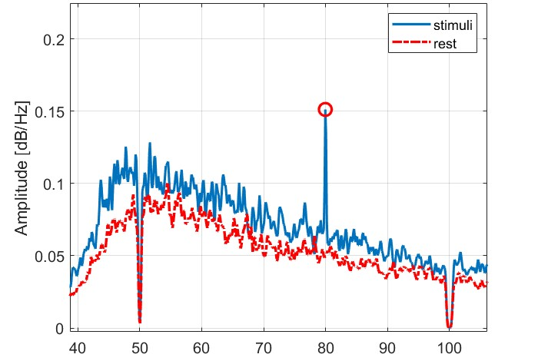
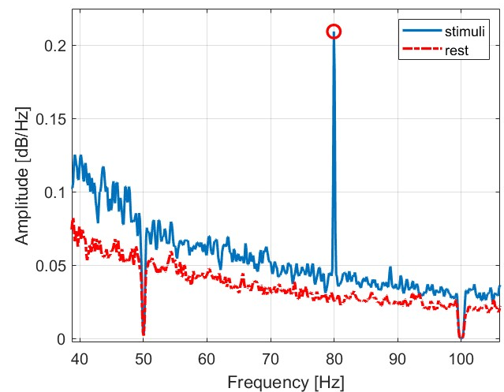
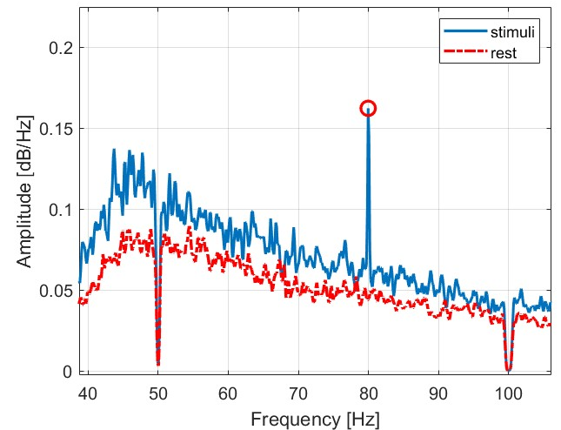
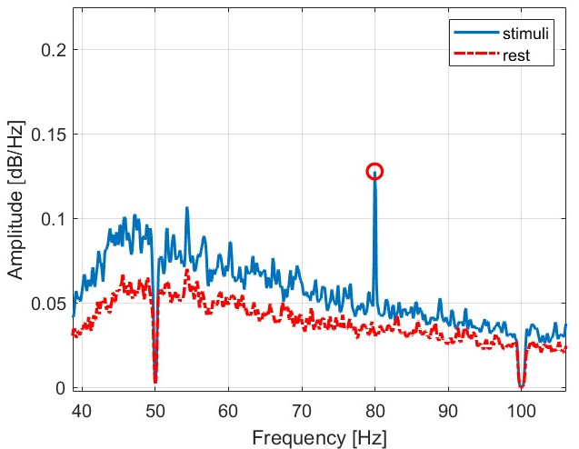
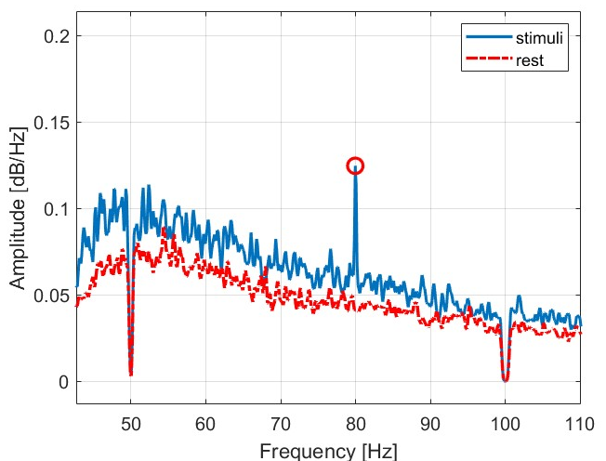
Results: 80 Hz AM
Power spectra
Signal strongly visible in all channels

Slide 12
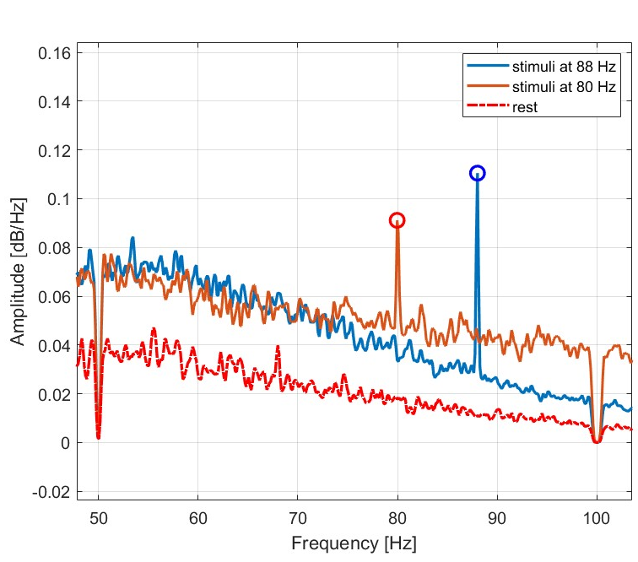
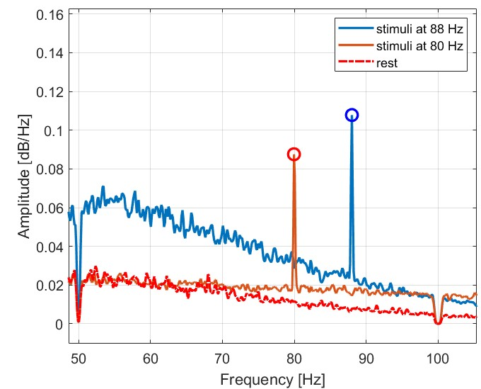
Results: 80 Hz vs 88 Hz AM stimuli
Power spectra comparison
Signal strongly visible in both cases (in-ear channels)

Slide 13
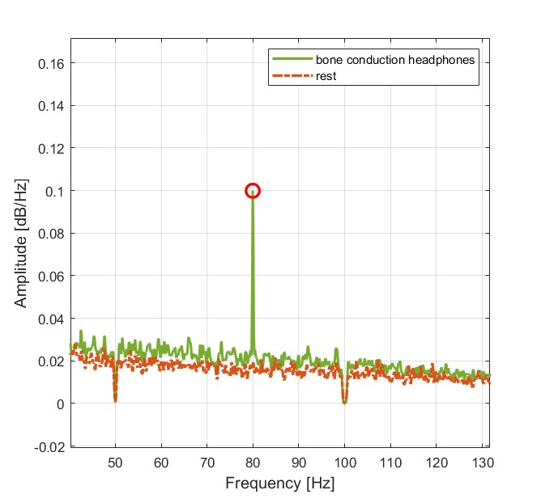
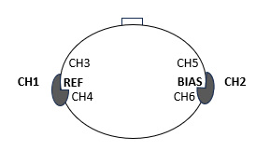
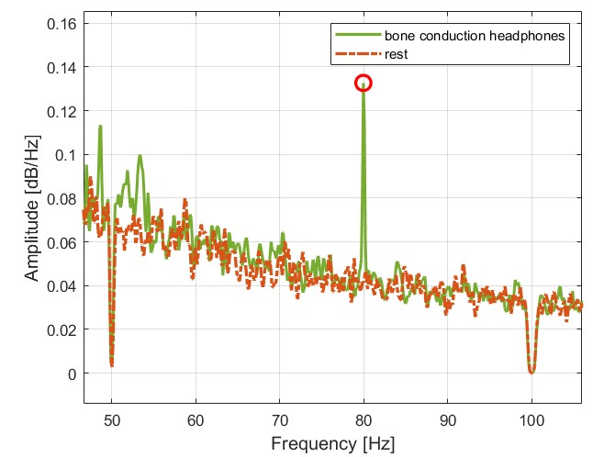
Results: over-the-ear vs bone-conduction headphones
Power spectra comparison
Signal strongly visible in both cases (in-ear channels)

