Slide 1
In-ear EEG Auditory Steady State Response Analysis
Integrated Systems Laboratory (ETH Zürich)
Benedetta Mazzoni b.mazzoni@unibo.it
Andrea Cossettini cossettini.andrea@iis.ee.ethz.ch
Simone Benatti simone.benatti@unimore.it

Slide 2
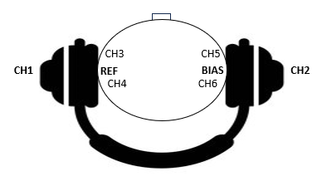
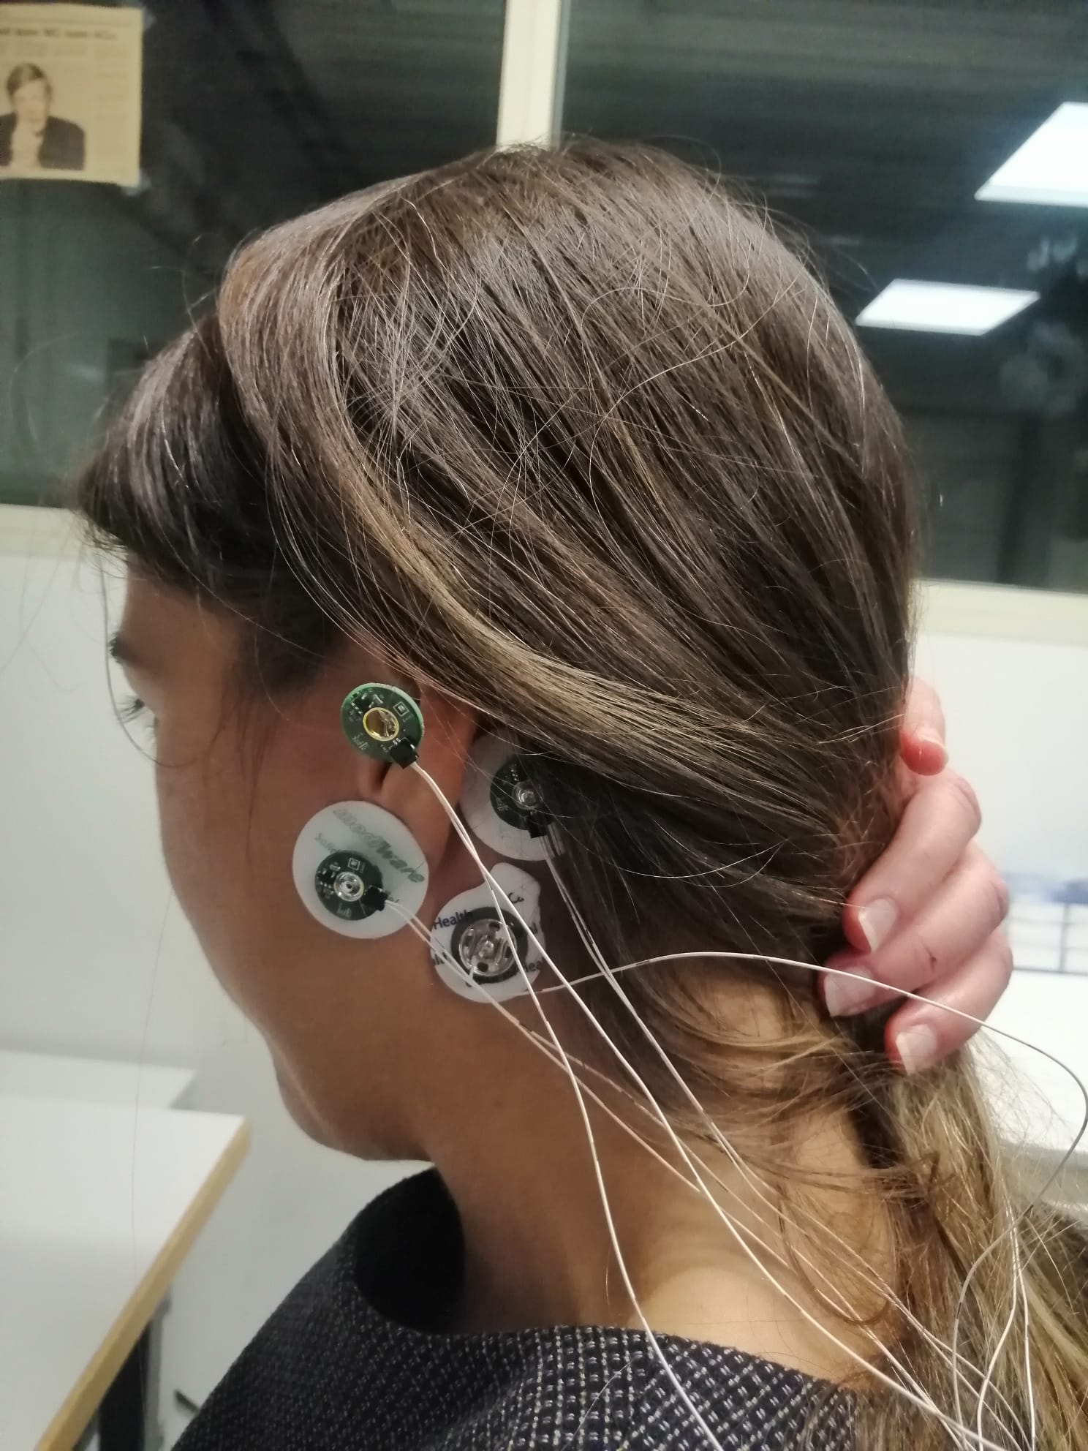
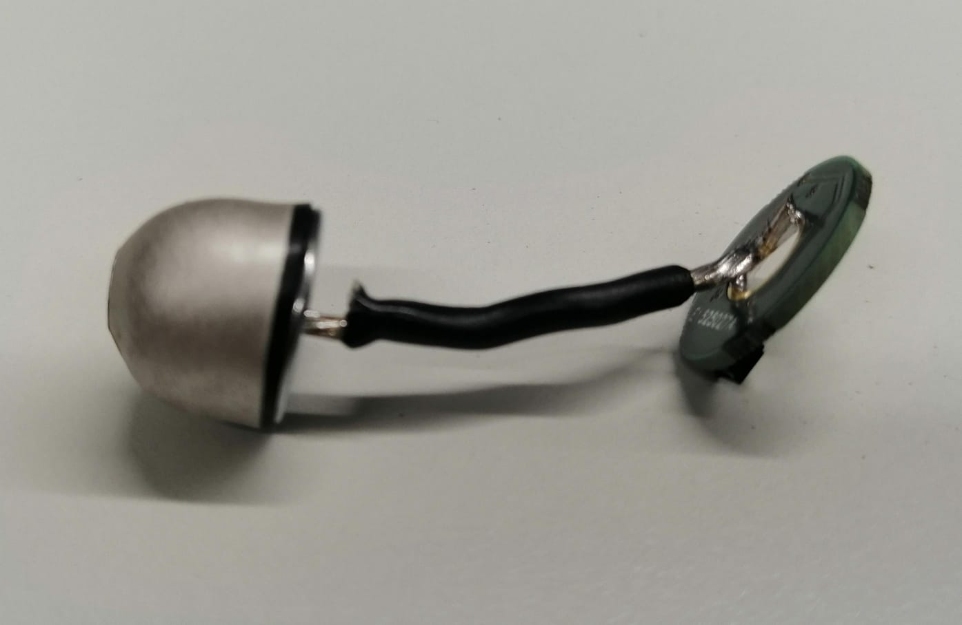
Setup description (1)
Naison
Stimuli (for ASSR)
Over-the-head or bone-conduction headphones
Electrodes
earEEG electrodes: fabricated by Dätwyler Schweiz AG
headphones
Channel | Location | Type
CH1 | In-ear (left) | Ear-EEG electrode + active buffering
CH2 | In-ear (right) | Ear-EEG electrode + active buffering
CH3 | front of the ear (left) | Wet electrode + active buffering
CH4 | back of the ear (left) | Wet electrode + active buffering
CH5 | front of the ear (right) | Wet electrode + active buffering
CH6 | back of the ear (right) | Wet electrode + active buffering
REF | Mastoid (left) | Wet electrode + active buffering
BIAS | Mastoid (right) | Wet electrode
Electrodes configuration on a test subject
Ear-EEG electrode fabricated by Dätwyler Schweiz AG and connected to an active buffering PCB

Slide 3
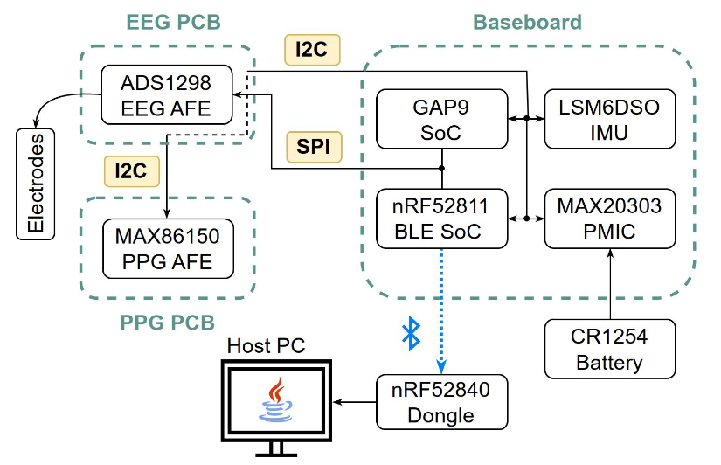
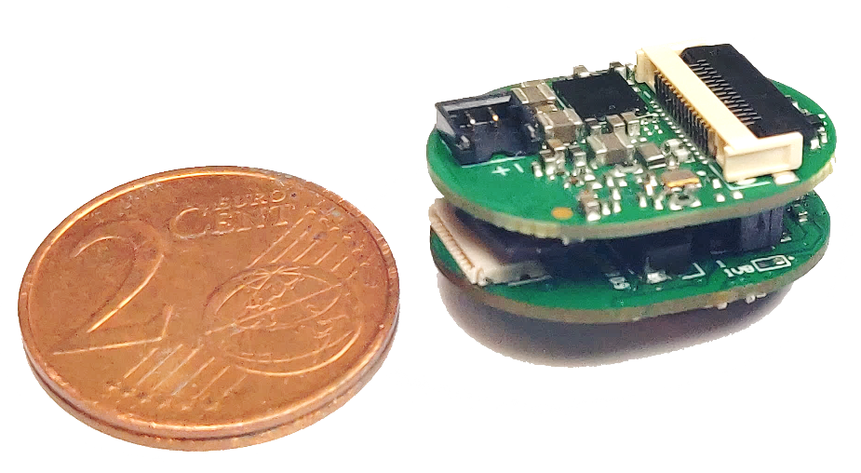
Setup description (2)
Data acquisition platform
BioGAP (https://arxiv.org/abs/2307.01619)
PULP-based computing platform (GAP9)
TOPS capabilities, 10 RISC-V cores, state-of-the-art performance for tinyML
Nordic nRF52 for BLE connectivity
Can be flexibly connected to a large variety of sensor interfaces
ADC for biopotentials (ADS1298, 8 ExG channels, 24 bit resolution)

Slide 4
Validation measurements: Alpha waves
Protocol
Subject alternating eyes open and eyes closed with 10-second intervals
Goal
Analyze the power of alpha waves within the frequency range of 7 to 13 Hz
Data processing
Filtering: band-pass, Butterworth (order 10, cutoff: f₁=0.5 Hz, f₂= 40 Hz)
Filtering: notch, order 2, at 50 Hz
Spectrogram computation: 1024-samples windows (2 seconds) with 768-samples (1.5 seconds) overlap

Slide 5
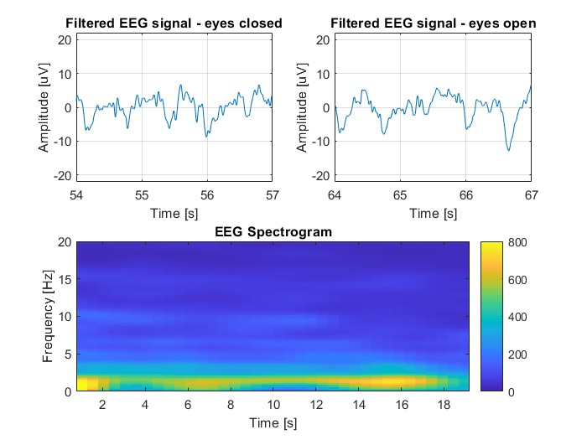
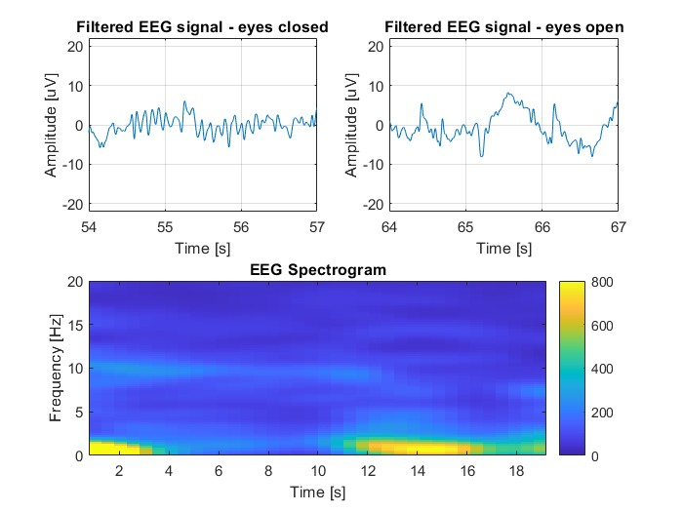
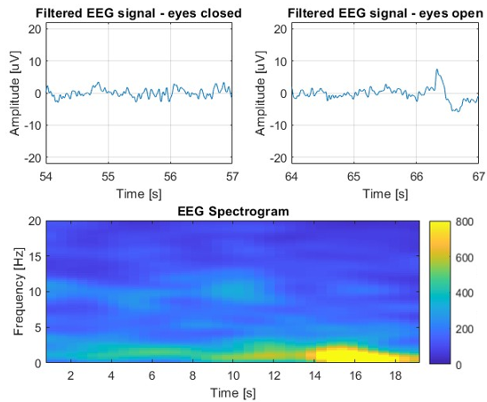
Validation measurements: Alpha waves
Results (Subject A)
Left channels
Alpha activity visible in the 7-13 Hz range
eyes closed
eyes open
eyes closed
eyes open
eyes closed
eyes open
Channel 1 in-ear
Channel 3
Channel 4

Slide 6
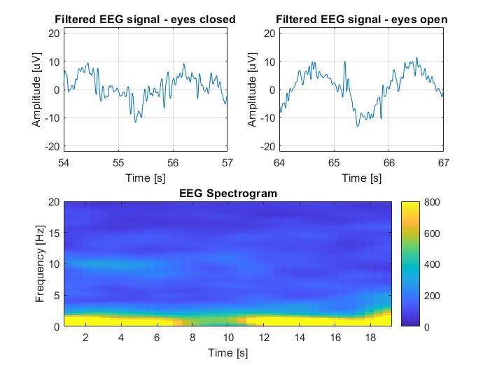
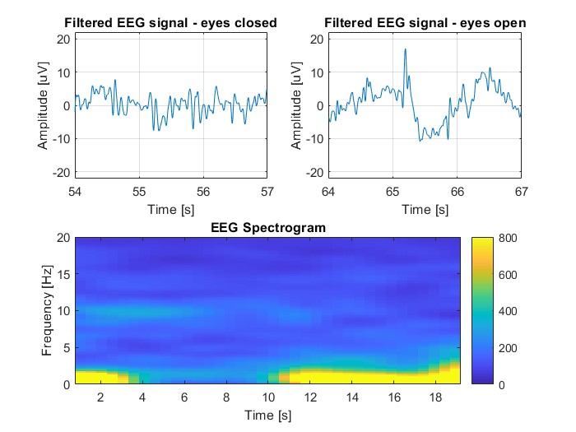
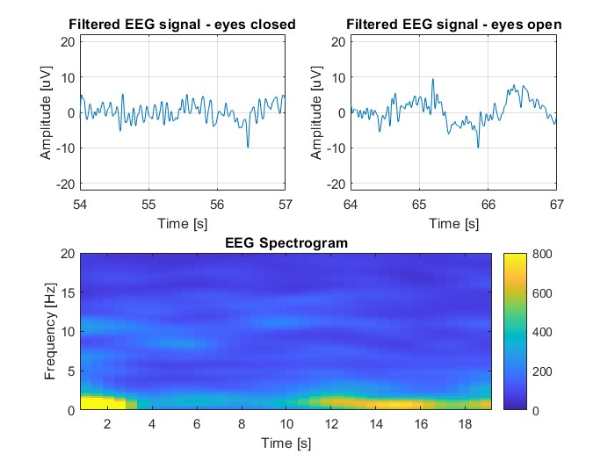
Validation measurements: Alpha waves
Results (Subject A)
Right channels
Alpha activity visible in the 7-13 Hz range
eyes closed
eyes open
eyes closed
eyes open
eyes closed
eyes open
Channel 2 in-ear
Channel 5
Channel 6

Slide 7
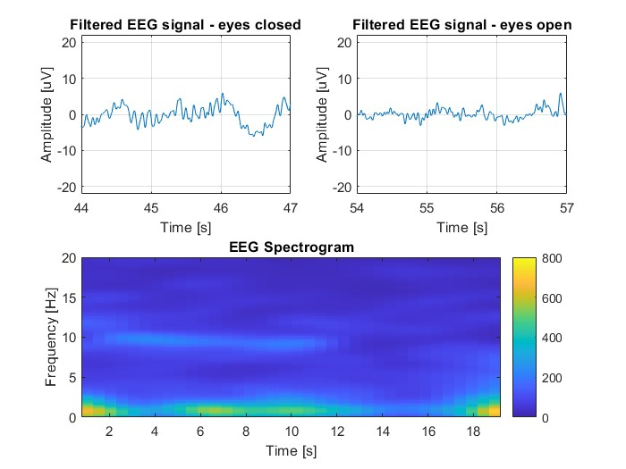
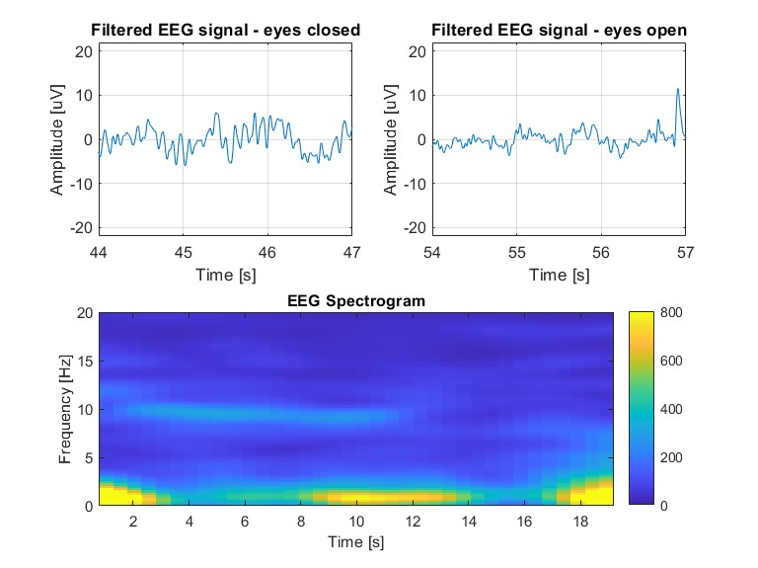
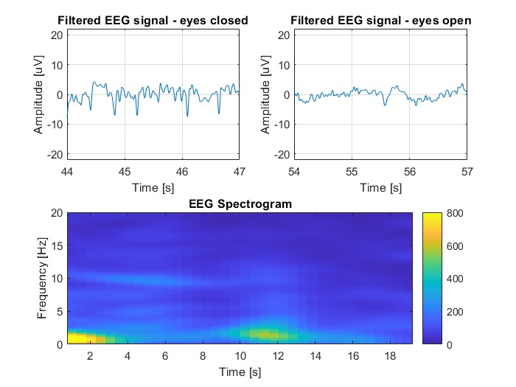
Validation measurements: Alpha waves
Results (Subject B)
Left channels
Alpha activity visible in the 7-13 Hz range
eyes closed
eyes open
eyes closed
eyes open
eyes closed
eyes open
Channel 1 in-ear
Channel 3
Channel 4

Slide 8
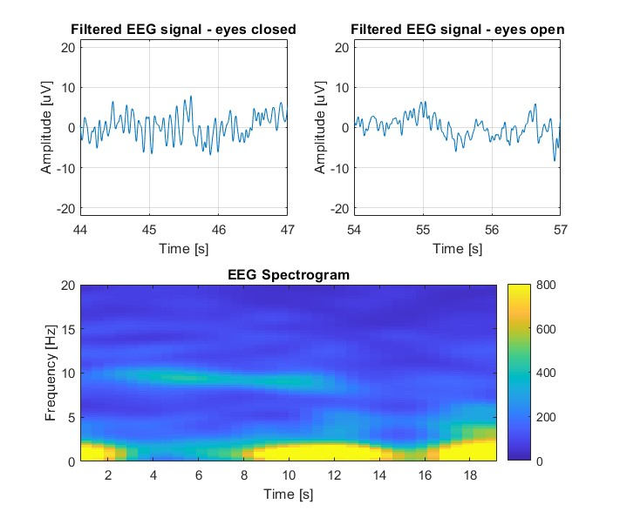
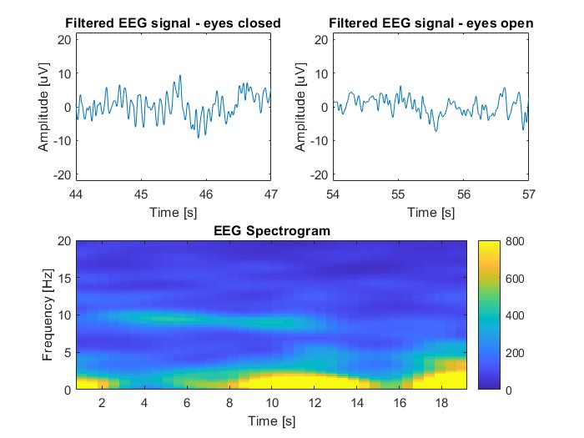
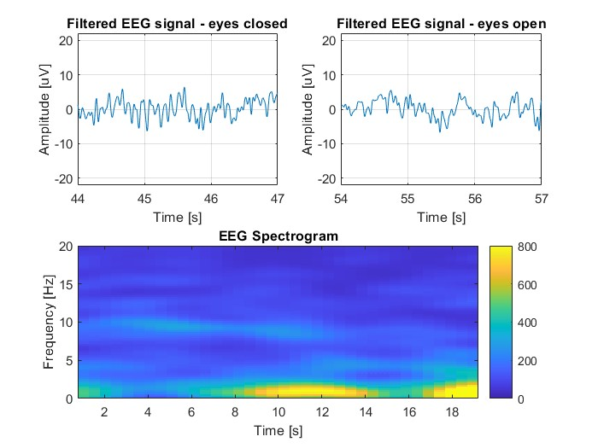
Validation measurements: Alpha waves
Results (Subject B)
Right channels
Alpha activity visible in the 7-13 Hz range
eyes closed
eyes open
eyes closed
eyes open
eyes closed
eyes open
Channel 2 in-ear
Channel 5
Channel 6

Slide 9
ASSR: protocol
Protocol description
5 healthy volunteers
Subjects wear the electrodes and the headphones. During acquisitions, they are allowed to read
Auditory stimulus from the headphones:
sinusoidal tone with a carrier at 4 kHz and AM modulated [1][2] (we test 80 Hz and 88 Hz)
Intensity: 65 dB SPL (sound pressure level)
Duration: 15 minutes (similar to [3])
BioGAP sampling frequency: 500 Hz
[1] Kubota, Toshinori, et al. "Detecting the recruitment phenomenon in adults using 80-Hz auditory steady-state response." Auris Nasus Larynx 46.5 (2019)
[2] Herdman AT, Lins O, Van Roon P, Stapells DR, Scherg M, Picton TW. Intracerebral sources of human auditory steady-state responses. Brain Topogr. 2002.
[3] C. B. Christensen, T. Lunner, J. M. Harte, M. L. Rank and P. Kidmose, "Chirp-Evoked Auditory Steady-State Response: The Effect of Repetition Rate," in IEEE Transactions on Biomedical Engineering, vol. 69, no. 2, pp. 689-699, Feb. 2022.

Slide 10
ASSR: data processing
Signal processing pipeline
Filtering: band-pass, Butterworth, order = 10, cutoff 30 – 180 Hz
Filtering: notch, at 50 Hz (PLI) and 100 Hz (2nd harmonic of PLI): order = 2, quality factor = 100
Power Spectral Density (PSD) analysis using WELCH Method:
Windowing = 5 sec
Discrete Fourier Transform (DFT) of the periodgram
Squared magnitude, yelding power spectrum estimates for each segment
Averaging of the individual power spectra (to reduce noise floor)
Result: array of power measurements vs. frequency «bin» (Power/Freq) estimated at frequency intervals.
Automatic peak detection (peak of the response at the AM frequency 80 Hz)
Automatic Signal-to-Noise Ratio (SNR) estimation

Slide 11
ASSR: data processing
Signal processing pipeline
ANALYSIS of the SNR change over time
Consider the noise component as the signal acquired during periods of rest, without any auditory stimulation.
Averaged PSD over multiple windows of 60 s: AV_{s1}, ..AV_{si} and AV_{n1}, …AV_{ni} are the mean values of the signal with stimulation and the mean values of the noise signal, respectively.
Calculate the mean of the noise component across all windows: NOISE_{TOT} = mean(AV_{n1},.. AV_{ni}) => Analysis of the noise change over time.
Compute the SNR as the ratio between the AV_{si} values and NOISE_{TOT} : AV_{s1} / NOISE_{TOT}, …, AV_{si} /NOISE_{TOT}
Compute the SNR considering the cumulative average:
AV_{s1} / NOISE_{TOT}, mean(AV_{s1} , AV_{s2}) / NOISE_{TOT} , …, mean(AV_{s1} , AV_{s2}, …, AV_{si} ) / NOISE_{TOT}

Slide 12
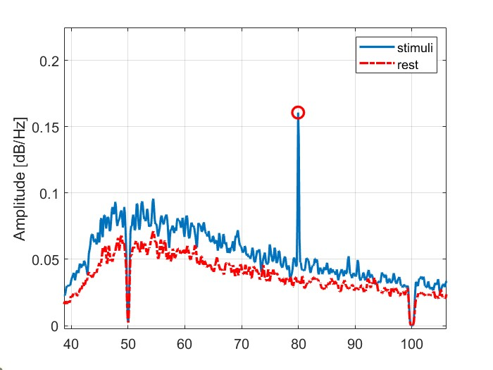
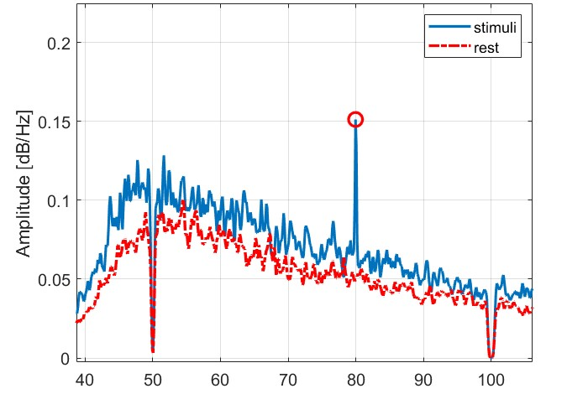
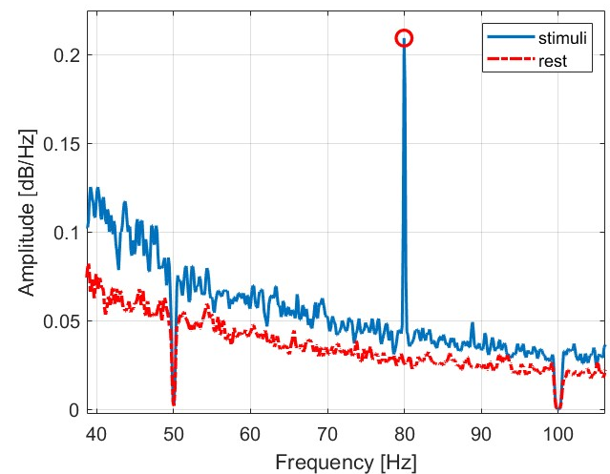
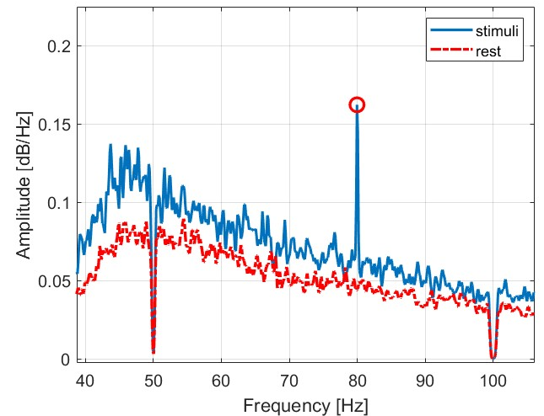
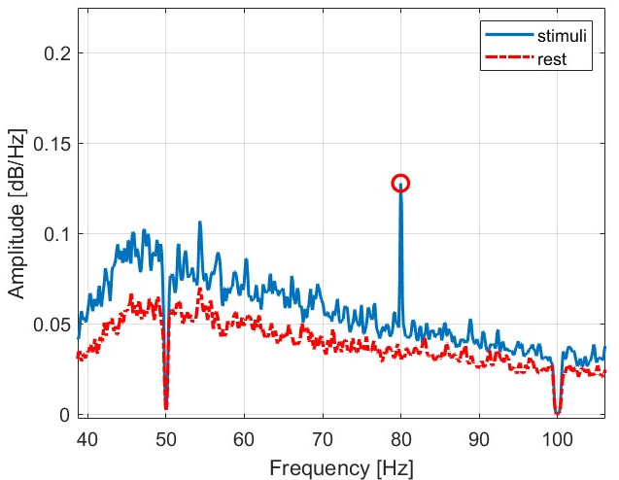
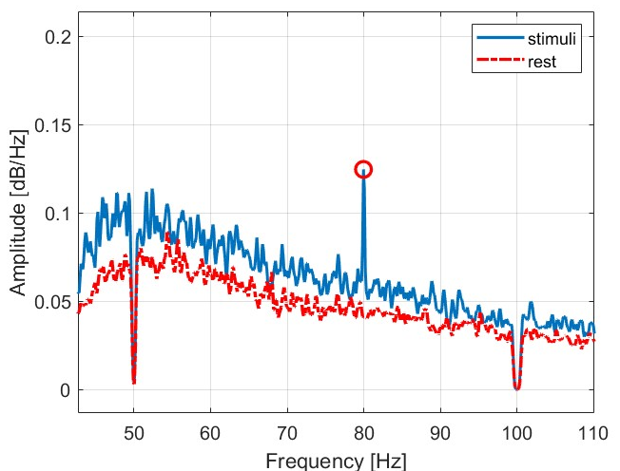
Results: 80 Hz AM
Power spectra
Signal strongly visible in all channels

Slide 13
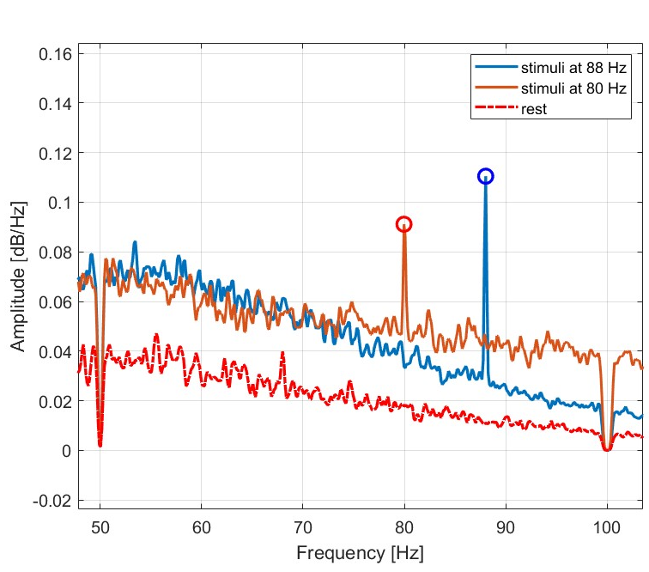
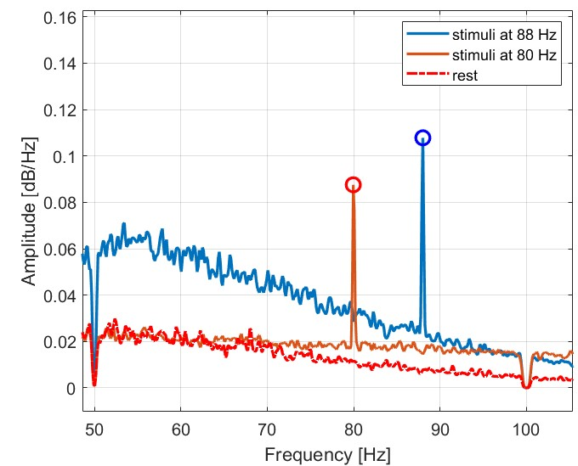
Results: 80 Hz vs 88 Hz AM stimuli
Power spectra comparison
Signal strongly visible in both cases (in-ear channels)

Slide 14
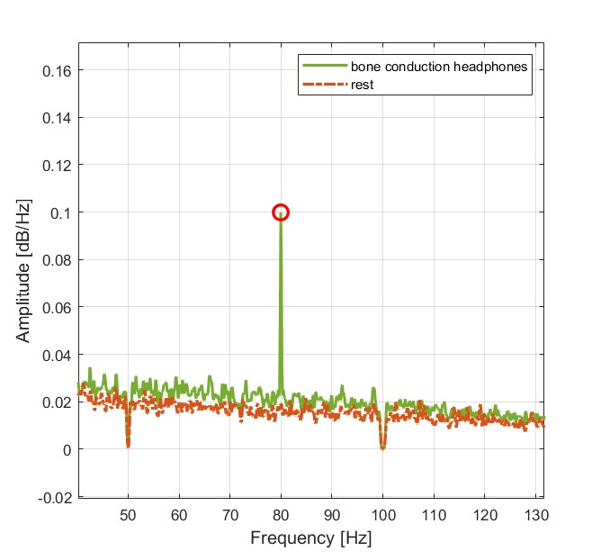
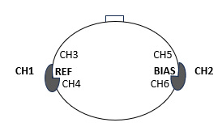
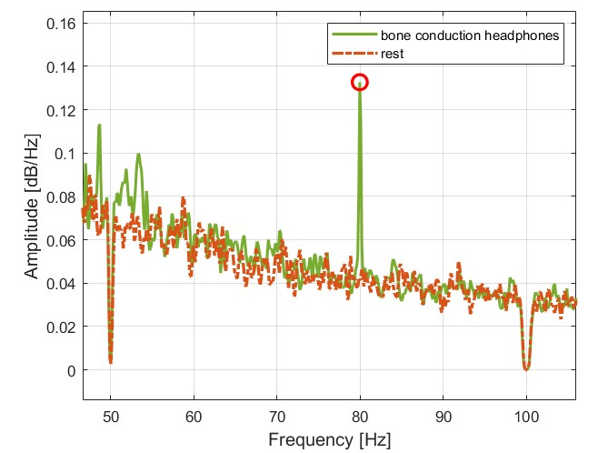
Results: over-the-ear vs bone-conduction headphones
Power spectra comparison
Signal strongly visible in both cases (in-ear channels)

Slide 15
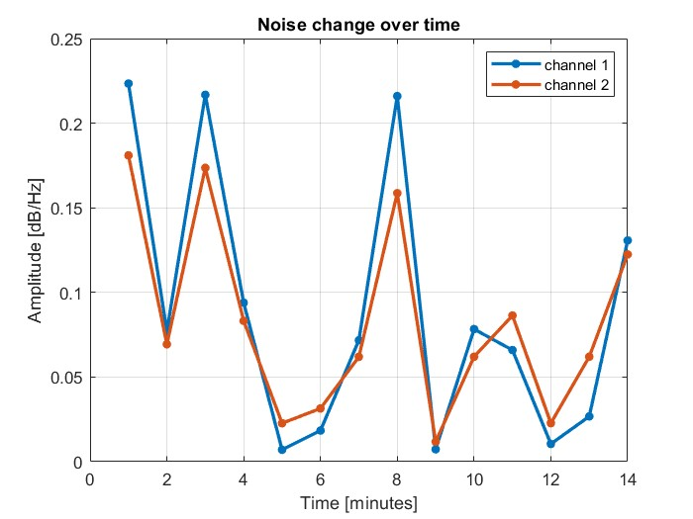
Results: NOISE trend
How does the NOISE change over time?
The noise signal (in-ear channels) exhibits considerable variability, yet the values consistently remain at low levels

Slide 16
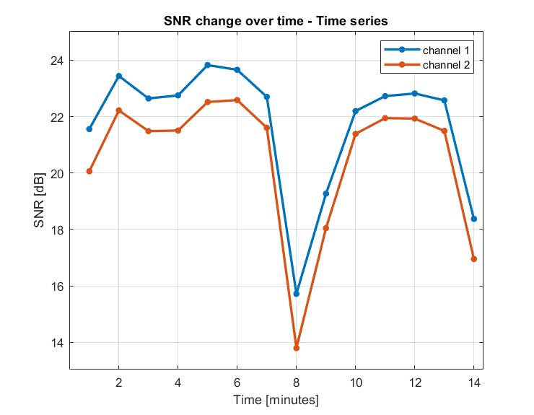
Results: SNR vs time
How does the SNR change over time?
Increase from 1 min to 5 min experiment duration, followed by a subsequent decrease in trend
Still, short durations (e.g., 5 minutes) are sufficient to detect the response

Slide 17
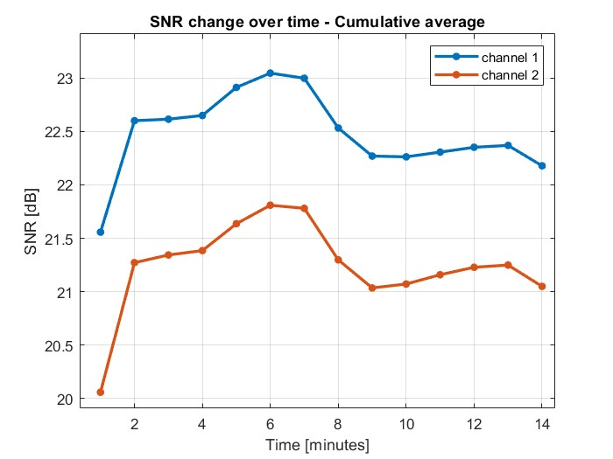
Results: SNR vs time
How does the SNR change over time?
Considering the cumulative average, increase from 1 min to 6 min experiment duration, followed by a subsequent decrease in trend
Still, short durations (e.g., 5 minutes) are sufficient to detect the response

