Slide 1
Elements

Slide 2
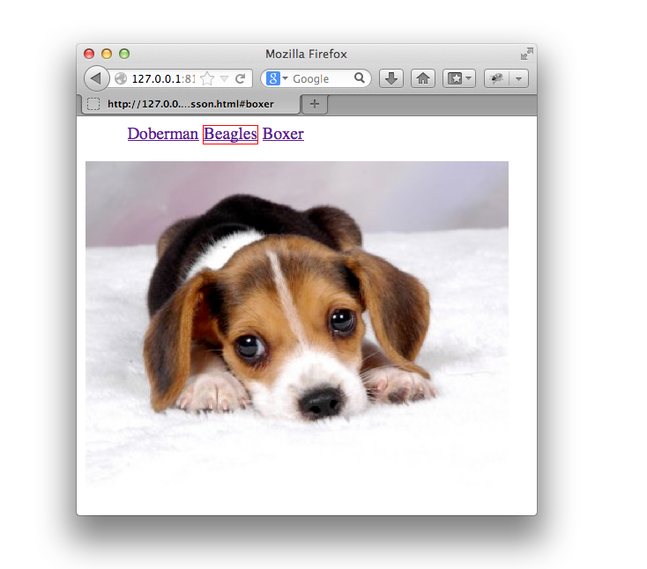
The Goal

Slide 3
The Setup
<ul id="breeds">
<li><a href="#doberman">Doberman</a></li>
<li><a href="#beagles">Beagles</a></li>
<li><a href="#boxer">Boxer</a></li>
</ul>
<div id="doberman">
<img src="doberman.jpg" width="400px"/>
</div>
<div id="beagles">
<img src="beagle.jpg"/>
</div>
<div id="boxer">
<img src="boxer.jpg" width="400px"/>
</div>

Slide 4
The Setup
$ = function(selector) { /*...*/ };
$.extend($.prototype, {
html: function(string) { /*...*/ },
val: function(value) { /*...*/ },
text: function(string) { /*...*/ },
find: function(el) { /*...*/ },
next: function() { /*...*/ },
prev: function() { /*...*/ },
parent: function() { /*...*/ },
children: function() { /*...*/ },
attr: function(attr, val) { /*...*/ },
css: function(style, val) { /*...*/ },
width: function() { /*...*/ },
hide: function() { /*...*/ },
show: function() { /*...*/ }
});

Slide 5
Finding

Slide 6
from the Document
We’re provided a simple API to find elements
within a document.
document.getElementById( id )
document.getElementsByTagName( tag )
document.getElementsByClassName( className )
document.querySelector( selector )
document.querySelectorAll( selector )

Slide 7
from the Document
document.getElementById( id )
document.getElementById('breeds') //-> HTMLUListElement
<ul id="breeds">
<li><a href="#doberman">Doberman</a></li>
<li><a href="#beagles">Beagles</a></li>
<li><a href="#boxer">Boxer</a></li>
</ul>

Slide 8
from the Document
document.getElementsByTagName( tag )
document.getElementsByTagName('li')
//-> [HTMLIElement, HTMLLIElement, HTMLLIElement]
<ul id="breeds">
<li><a href="#doberman">Doberman</a></li>
<li><a href="#beagles">Beagles</a></li>
<li><a href="#boxer">Boxer</a></li>
</ul>

Slide 9
from the Document
document.getElementsByClassName( className )
document.getElementsByClassName('contact')
//-> [HTMLDivElement]
<html>
<head></head>
<body>
<h1 id="greet">Hello World</h1>
<div class="contact">
<label>Age</label>
<input name="age"/>
</div>
<label>For</label>
<input name="user"/>
</body>
</html>

Slide 10
from the Document
document.querySelectorAll( selector )
document.querySelectorAll('#doberman img')
//-> [HTMLImageElement]
<div id="doberman">
<img src="doberman.jpg" width="400px"/>
</div>

Slide 11
Exercise
Create a function named ‘$’ that takes a selector as an argument, selects elements from the DOM, and returns an array-like object:
var breeds = new $('#breeds');
breeds.length //-> 1;
breeds[0] //-> $[ ul#breeds ]
hint:
make an “array-like” object, set length to 0, add items with:
[].push.apply(this, items)
Notes:
TODO! this is showing .html()

Slide 12
Exercise
Add an html method to get/set the innerHTML of an element(s).
var dogs = new $('#breeds li');
dogs.html('<div>All Dogs</div>').html()
//-> '<div>All Dogs</div>'
hint:
html() should be “chainable”, returning the original $ instance when setting.
Notes:
$.extend($.prototype,{
html: function( newHtml ){
if( arguments.length ) {
return $.each(this, function(i, node){
node.innerHTML = newHtml;
});
} else {
return this[0].innerHTML;
}
}
})

Slide 13
Exercise
Add an val method to get/set the value of an element.
<input type="text" value="some text">
$('input').val() //-> 'some text'
$('input').val('new text');
Notes:
$.each({
val: "value",
html: "innerHTML"
}, function(funcName, propName){
$.prototype[funcName] = function(newValue) {
if( arguments.length ) {
// set
return $.each(this, function(i, element){
element[propName] = newValue;
});
} else {
// get
return this[0][propName];
}
};
});

Slide 14
Exercise
Remove the need to call new when using our jQuery object.
var dogs = $('#breeds li');
dogs.html('<div>Go To Heaven</div>').html()
//-> '<div>Go To Heaven</div>'
Notes:
$ = function(selector) {
if(! (this instanceof $) ) {
return new $(selector);
}
var elements;
if( typeof selector === "string") {
elements = document.querySelectorAll(selector);
} else if($.isArray(selector)) {
elements = selector;
}
this.length = 0;
[].push.apply(this, elements);
};

Slide 15
Exercise
Add an text method to get/set the text of an element.
$('ul').text()
//-> '
// Doberman
// Beagles
// Boxer
// ‘
$('ul li:first-child').text('TEETH!').text() //-> 'TEETH!'
hint:
To set, clear html and append document.createTextNode( text ).
To get, iterate through each child if child.nodeType === 3, read and accumulate child.nodeValue.
Notes:
$.extend($.prototype,{
text: function(newText){
if( arguments.length ){
this.html("");
return $.each(this, function(i, element){
var textNode = document.createTextNode( newText );
element.appendChild( textNode );
});
} else {
return getText(this[0].childNodes);
}
}
});

Slide 16
from an Element
Elements have the same query methods as document.
element.getElementById( id )
element.getElementsByTagName( tag )
element.getElementsByClassName( className )
element.querySelector( selector )
element.querySelectorAll( selector )
document.getElementById('#breeds')
.querySelectorAll('li a');

Slide 17
Exercise
Add a find method that returns items within the current elements:
var dogImages = $('div').find('img');
hint:
Have $ also accept an array of nodes.
Use el.querySelectorAll('img').
Notes:
find: function(selector){
var els = [];
$.each(this, function(i, el){
els.push.apply(els, el.querySelectorAll(selector))
})
return $(els);
}

Slide 18
Traversing
Notes:
TODO: move .find into here.

Slide 19
from an Element
<ul>
<li> … </li>
<li>
Text Node
<a href="">Link</a>
<span></span>
<li>
<li> … </li>
</ul>
element.childNodes
element.firstChild
element.lastChild
element.nextSibling
element.previousSibling
element.parentNode
element.children
Notes:
TODO: fix animations

Slide 20
Exercise
Add the next method to $:
$('#doberman').next() //-> $[ div#beagles ]
$('#doberman').next().next() //-> $[ div#boxer ]
$('#doberman').next().next().next() //-> $[]
$('#doberman, #beagles').next() //-> $[ div#beagles,
div#boxer ]
hint:
Make sure you check for text nodes.
Notes:
$.prototype.next = function() {
var collection = [];
this.each(function(index, element) {
var sibling = element.nextSibling;
while (sibling) {
if (sibling && sibling.nodeType === 1) {
collection.push(sibling);
}
sibling = sibling.nextSibling;
}
});
return $(collection);
};

Slide 21
Exercise
Add the prev method to $:
$('#doberman').prev() //-> $[ ul#breeds ]
hint:
Make sure you check for text nodes.
Notes:
$.prototype.prev = function() {
var collection = [];
this.each(function(index, element) {
var sibling = element.previousSibling;
while (sibling) {
if (sibling && sibling.nodeType === 1) {
collection.push(sibling);
}
sibling = sibling.previousSibling;
}
});
return $(collection);
};

Slide 22
Exercise
Add the parent method to $:
$('#breeds').parent() //-> $[ HTMLBodyElement ]
Notes:
parent: function(){
var els = [];
$.each(this, function(i, el){
els.push(el.parentNode)
})
return $(els);
}

Slide 23
Exercise
Add the children method to $:
$('#breeds').children() //-> $[ li, li, li ]
Notes:
children: function(){
var els = [];
$.each(this, function(i, el){
els.push.apply(els, el.children)
})
return $(els);
}

Slide 24
Exercise
Add a private helper method makeTraverser to $ and reimplement find,next, prev, parent, children:
children: makeTraverser(function() {
return this.children;
});
parent: makeTraverser(function() {
return this.parentNode;
});
hint:
Look at the similarities of each method and refactor the similar code out into its own method.
Notes:
children: function(){
var els = [];
$.each(this, function(i, el){
els.push.apply(els, el.children)
})
return $(els);
}

Slide 25
Attributes and Properties

Slide 26
get/set Element properties
element.getAttribute( attributeName )
element.setAttribute( attributeName , value )
element.removeAttribute( attributeName )
element.id
element.className
anchor.href
input.type

Slide 27
Exercise
Add an attr method to $ that gets/sets attributes:
$('ul li a').attr('class', 'active');
$('ul li a').attr('href') //-> '#Doberman'
Notes:
attr: function(attrName, value){
if(arguments.length == 2){
return $.each(this, function(i, element){
element.setAttribute(attrName, value)
})
} else {
return this[0] && this[0].getAttribute(attrName);
}
}

Slide 28
Styles

Slide 29
How styles are applied
HTML
<li>
<a href="#Doberman">Doberman</a>
</li>
JS
var doberman = $('li')[0];
doberman.style.display
document.defaultView
.getComputedStyle(doberman)
.getPropertyValue('display') //-> ’inline-block'
doberman.style.display = 'none';
CSS
li {
display: inline-block;
}
//-> ''
Notes:
The next exercise is going to be implementing jQuery’s `css` method. jQuery’s CSS method is used to read and write the styles applied to an element.
Before attempting that, it’s worth reviewing how styles get applied to elements.
For example, I have a food’s element
And some CSS that adds padding to the food’s element.
If I read that div’s paddingTop value with JavaScript, what will it return?
It returns an empty string. This is because the style object doesn’t provide the current style value of an element, instead it ONLY provides a way to set the element’s style values.
To read the actual, computed value, you use this craziness ..
This reads from the CSS in the page and from the element’s style value.
The element’s style value acts as an “overwrite”.

Slide 30
Exercise
Add an css method to $ that gets/sets styles:
$('div').css('padding', '20px')
.css('padding-bottom') //-> '20px'
hint:
document.defaultView.getComputedStyle( el )
.getPropertyValue( prop )
Notes:
css: function(cssPropName, value){
if(arguments.length == 2){
return $.each(this, function(i, element){
element.style[cssPropName] = value
})
} else {
return this[0] &&
document
.defaultView
.getComputedStyle( this[0] )
.getPropertyValue( cssPropName );
}
}

Slide 31
Element Styles
<div style="height: 300px"> … </div>
div.style.height; //-> 300px
document
.defaultView
.getComputedStyle( div, null )
.getPropertyValue('paddingTop'); //-> 5px

Slide 32
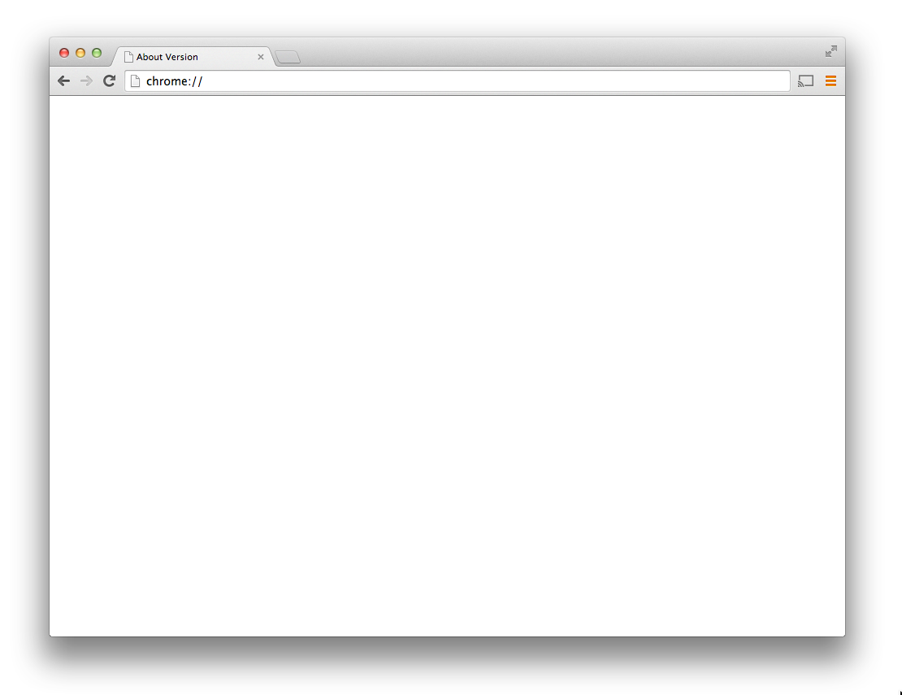
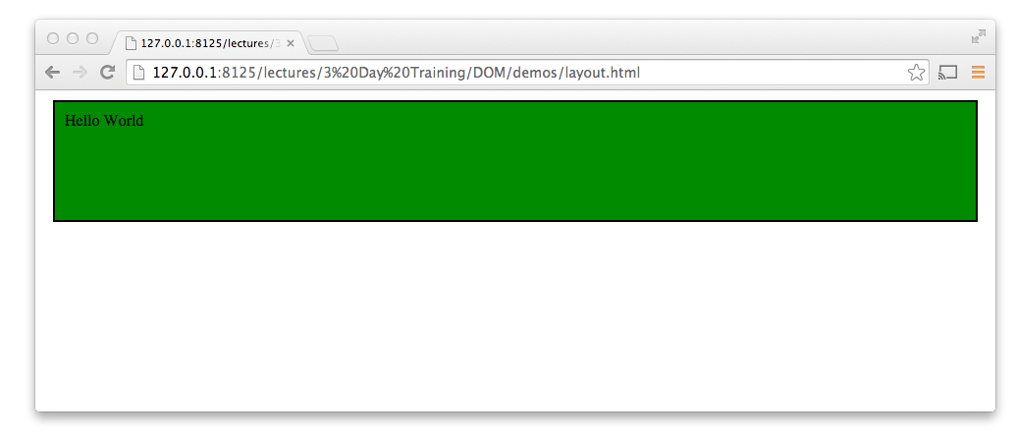
DOM Layout and Positioning
<body>
<div>
Hello World
</div>
</body>
div {
height: 100px;
padding: 10px;
border: 2px;
margin: 10px;
}
=
div.offsetTop
div.offsetWidth
div.offsetParent
div.getBoundingClientRect()
Notes:
So now that we understand CSS, and how those properties are computed, it’s important to understand how
the interplay of:
the structure of the DOM
some of those CSS properties, especially display
the window’s dimensions
result in the layout of the page. Specifically the positions and dimensions of elements.
Once layout has occurred, the DOM allows you to read this information.
Understanding is VERY useful in creating JavaScript widgets that behave correctly no matter how they are styled. For example, a slider that can
be moved around no matter how big or small it’s container or its containers margin, padding or border gets.

Slide 33
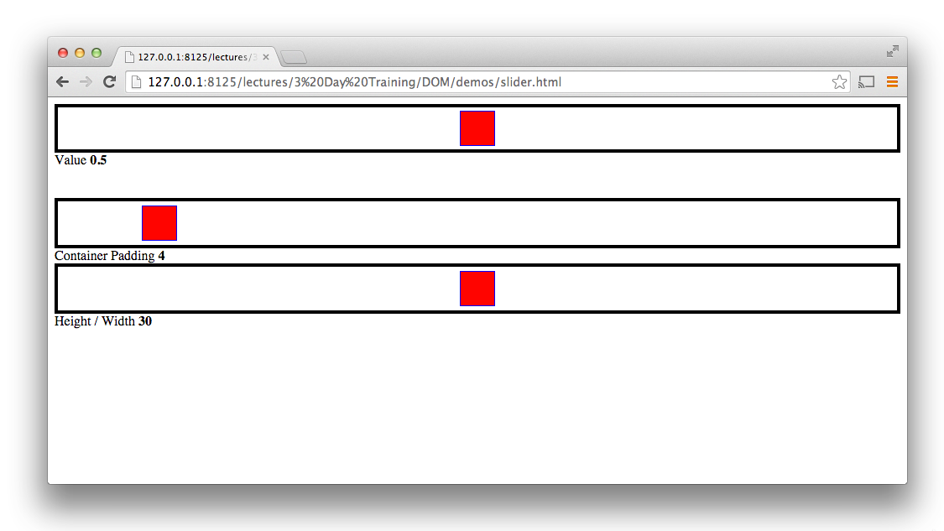
Slider Demo

Slide 34

Layout
<body>
<div>
Hello World!
I am a sentence.
</div>
</body>
<body>
<div>
Hello World! I am a sentence.
body {
margin: 8px;
}
div {
box-sizing: content-box;
margin: 10px 20px;
}
Notes:
https://developer.mozilla.org/en-US/docs/Web/CSS/display
https://developer.mozilla.org/en-US/docs/Web/CSS/box-sizing
content-box

Slide 35
Layout
<body>
<div>
Hello World!
I am a sentence.
</div>
</body>
<div>
Hello World! I am a sentence.
Hello World! I am a sentence.
<div>
body {
margin: 8px;
}
div {
box-sizing: content-box;
background-color: green;
margin: 10px 20px;
}
Notes:
https://developer.mozilla.org/en-US/docs/Web/CSS/display
https://developer.mozilla.org/en-US/docs/Web/CSS/box-sizing
content-box

Slide 36
Layout
<body>
<div>
Hello World!
I am a sentence.
</div>
</body>
<body>
<div>
Hello World! I am a sentence.
Hello World! I am a sentence.
<body>
<div>
body {
margin: 8px;
}
div {
box-sizing: content-box;
background-color: green;
margin: 10px 20px;
}
Notes:
https://developer.mozilla.org/en-US/docs/Web/CSS/display
https://developer.mozilla.org/en-US/docs/Web/CSS/box-sizing
content-box

Slide 37
Layout
<body>
<div>
Hello World
</div>
</body>
body {
margin: 8px;
}
div {
box-sizing: content-box;
margin: 10px 2px;
}
Notes:
https://developer.mozilla.org/en-US/docs/Web/CSS/display
https://developer.mozilla.org/en-US/docs/Web/CSS/box-sizing
content-box

Slide 38
Layout
<body>
<div>
Hello World
</div>
</body>
Hello World
Hello World
body {
margin: 8px;
}
div {
box-sizing: content-box;
width: 30px; height: 30px;
padding: 4px;
border: solid 4px black;
margin: 10px 3px;
}
padding
border
margin
Notes:
https://developer.mozilla.org/en-US/docs/Web/CSS/display
https://developer.mozilla.org/en-US/docs/Web/CSS/box-sizing
content-box

Slide 39
offsetParent
offsetTop
offsetLeft
width: 100px
height: 100px
padding: 10px
border 2px
margin: 10px;
Hello World
clientHeight
offsetHeight
clientWidth
offsetWidth
Notes:
I start with a body element,
- W/ FF, the body has an 8px margin. This keeps all content 8px away from the body.
Add in a div element.
Now lets say I give it a height and a width
And some padding
And a border

Slide 40
offsetParent
offsetParent is the closest positioned parent, not necessarily the direct parent.
position: relative
position: relative

Slide 41
CSS > Position
Set and get positions
$("div").offset() $("div").scrollTop()
$("div").position() $("div").scrollLeft()
Notes:
41

Slide 42
CSS > Height/Width
padding
border
Set and get height and width
height/width
innerHeight/innerWidth
outerHeight/outerWidth
Notes:
Outer methods take boolean param includeMargin
42

Slide 43
offset()
Here we have a offset method that traverses our offsetParents, calculating our total offset, relative to the document.
offset: function() {
var offset = this[0].getBoundingClientRect();
return {
top: offset.top,
left: offset.left
};
}
Notes:
Old way of doing it

Slide 44
Exercise
Add a width method that returns the width of an element:
$('#breeds').width() //-> 1109
hint:
Use the css() method and don’t forget about padding and borders.
Notes:
width: function(){
var offsetWidth = this[0].offsetWidth,
paddingLeft= parseInt( this.css("padding-left") ),
paddingRight = parseInt( this.css("padding-right") ),
borderRight = parseInt( this.css("border-right-width") ),
borderLeft = parseInt( this.css("border-left-width") );
return offsetWidth - paddingLeft - paddingRight - borderRight - borderLeft;

Slide 45
Exercise
Add show and hide methods to $:
$('#breeds').hide();
$('#breeds').show();
hint:
Use your css() method.
Notes:
$.prototype.next = function() {
var collection = [];
this.each(function(index, element) {
var sibling = element.nextSibling;
while (sibling) {
if (sibling && sibling.nodeType === 1) {
collection.push(sibling);
}
sibling = sibling.nextSibling;
}
});
};

