Slide 1
Events
Notes:
I think the key to JavaScript is really understanding what’s going on in memory. And the key to understanding what’s going on in memory is understanding
what JS’s basic data types look like in memory and how JS’s operators are used to manipulate those data structures.

Slide 2
What We’ll Learn
Listening to Events
Types and Actions
Event Data
Propagation and Delegation

Slide 3
Listening to Events

Slide 4
Event API
//Register an event on any DOM element
element.addEventListener(eventType, handler[, useCapture]);
//Remove a handler after registered
element.removeEventListener(eventType, handler[, useCapture]);

Slide 5
Registering handlers
Register a function to be called when an event occurs on a specified element.
document.getElementById('breeds')
.addEventListener('click', function(ev) {
this; //-> element with id "breeds"
}, false);

Slide 6
Removing handlers
Removing a handler requires a reference to the handler registered.
var breeds = document.getElementById('breeds');
//register a simple handler
breeds.addEventListener('click', function(ev) {
console.log('clicked!');
}, false);
//removing a handler that looks identical
breeds.removeEventListener('click', function(ev) {
console.log('clicked!');
}, false);

Slide 7
Removing handlers
Removing a handler requires a reference to the handler registered.
//instead, keep a reference to our handler
var handler = function(ev) {
console.log('clicked!');
},
breeds = document.getElementById('breeds');
//register a simple handler
breeds.addEventListener('click', handler, false);
//and remove the registration
breeds.removeEventListener('click', handler, false);

Slide 8
Exercise
Add bind/unbind methods to $:
$('#age').bind('click', function(ev) {});
$('#age').unbind('click');

Slide 9
Basic Event Handling
Within an event handler, we are given an event object to interact:
var handler = function(ev) {
if(ev.currentTarget === ev.target) {
console.log('target!')
}
ev.preventDefault();
ev.stopPropagation();
},
document.getElementById('breeds')
.addEventListener('click', handler, false);

Slide 10
Types and Actions

Slide 11
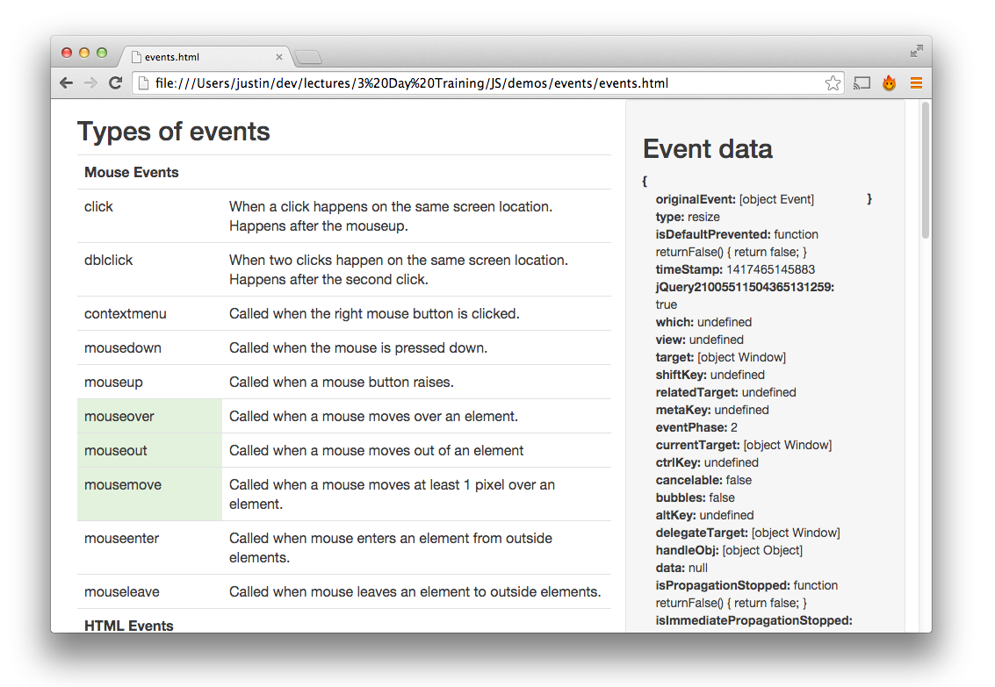
Demo
Notes:
js/demo/events/events.html

Slide 12
Default Actions
Event | Default Action
submit | Sends a post request with form data
click | On an anchor element, sets the window.location to the element's href attribute
mousedown | Selects text
contextmenu | Opens the browser’s context menu
keydown/keypress | Text is written into an input or tab to the next tabindex

Slide 13
Stopping actions
event.preventDefault() will stop the default action from being executed.
var click_handler = function(ev) {
//stops window.location from being set
ev.preventDefault();
};

Slide 14
Basic Event Data
Notes:
js/demo/events.html

Slide 15
Event Data
breeds.addEventListener('click', function(ev) {
//click, keypress, etc
ev.type;
//element event was invoked on
ev.target;
//current element in propagation
ev.currentTarget;
ev.timestamp;
ev.bubbles;
ev.cancelable;
ev.eventPhase;
}, false);
Notes:
All events

Slide 16
Mouse Events
breeds.addEventListener('click', function(ev) {
//true if modifier was pressed
ev.altKey;
ev.ctrlKey;
ev.metaKey;
ev.shiftKey;
//which button was pressed
ev.button;
//secondary target element, such as a mouseover
ev.relatedTarget;
}, false);

Slide 17
Key Events
breeds.addEventListener('click', function(ev) {
//numeric key code
ev.keyCode;
//character representation of key pressed
ev.charCode;
}, false);

Slide 18
Propagation and Delegation
Notes:
js/demo/events.html

Slide 19
Event Propagation
Events are dispatched through the DOM over three phases:
Capture
Target
Bubble
Notes:
Reference:
http://www.w3.org/TR/DOM-Level-3-Events/#dom-event-architecture

Slide 20
Event Propagation
window
Bubble Phase
document
Capture Phase
body
div
a
Target Phase
Notes:
Reference:
http://www.w3.org/TR/DOM-Level-3-Events/#dom-event-architecture

Slide 21
Stopping Propagation
event.stopPropagation() will stop the event from being triggered on subsequent elements.
var handler = function(ev) {
//stops clicks from passing to the next element
//in the hierarchy
ev.stopPropagation();
//Note: this sample would stop bubbling
};
Notes:
Reference:
http://www.w3.org/TR/DOM-Level-3-Events/#dom-event-architecture

Slide 22
stopImmediatePropagation
event.stopImmediatePropagation() will stop the event from being triggered on subsequent handlers.
element.addEventListener('click', function(ev) {
ev.stopImmediatePropagation();
console.log('I will be called');
});
element.addEventListener('click', function(ev) {
console.log('I will not be called');
});
Notes:
IE9+
Reference:
http://www.w3.org/TR/DOM-Level-3-Events/#dom-event-architecture

Slide 23
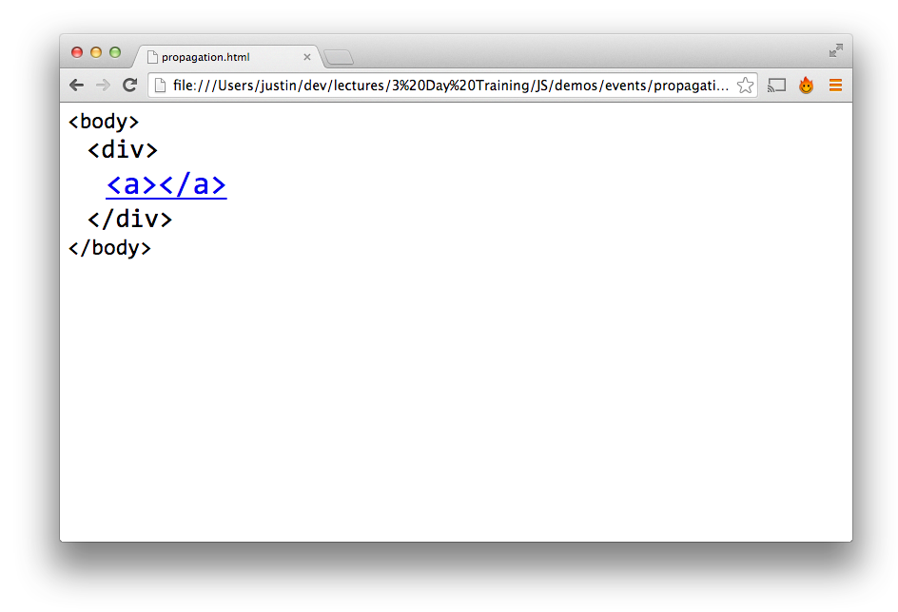
Demo
Notes:
js/demo/events/propagation.html

Slide 24
Event Delegation
window
document
Register a handler on a parent element check the target
body
div
a
Notes:
Talking point: register an event on the “div” as opposed to “a” itself
Reference:
http://www.w3.org/TR/DOM-Level-3-Events/#dom-event-architecture

Slide 25
Event Delegation
Register a handler on a parent element and do work if target element is the right type.
document.body.addEventListener("click",
function(ev){
if(ev.target.nodeName === "A") {
console.log("clicked on an anchor!");
// do stuff!
}
}, false);
Notes:
Reference:
http://www.w3.org/TR/DOM-Level-3-Events/#dom-event-architecture

Slide 26
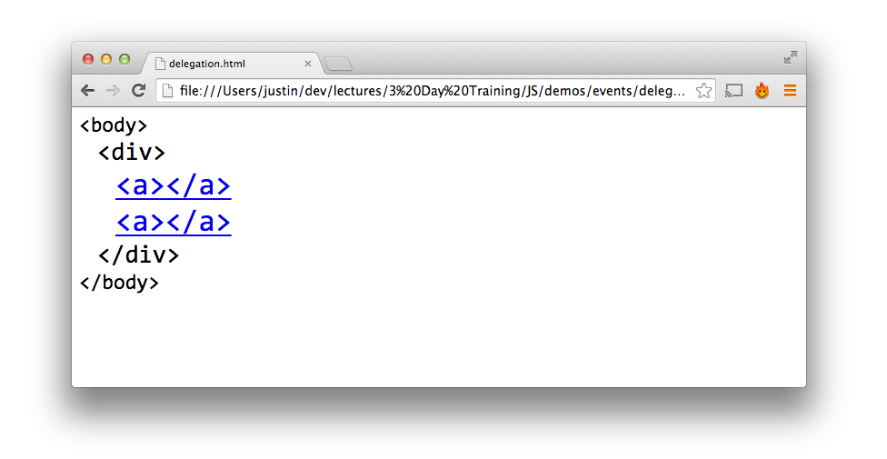
Delegation
Notes:
js/demo/events/propagation.html

Slide 27
Advantages?
Future elements already set up
Performance

Slide 28
Event Delegation with jQuery
Register a handler to listen for “a” clicks on the parent div.
$('body').on('click','div', function() {
console.log('Here I am!');
});

Slide 29
$('body').on('click','div',…
window
1. Now that the event has triggered the handler, loop from target to currentTarget to find matches for the selector.
document
2. The first node will be the target <a>. <a> does not match our selector "div", so check with <a>’s parentNode.
body
3. <div> matches our selector, so invoke the handler.
div
4. Once currentTarget is reached, continue bubbling
a
>
Here I am!
>
Notes:
So jQuery makes this work similar to the following.
jQuery listens to “click” events on the body.
When the anchor is clicked on, the event captures and bubbles to the body.
Once that happens, the delegation code is going to loop from the target anchor element to the current target “body” element, to look for elements that match the selector.

Slide 30
Event Delegation with jQuery
To check the selector of a DOM element, we will use a $.fn.has() helper method.
has: function(selector) {
var elements = [];
$.each(this, function(i, el) {
if(el.matches(selector)) {
elements.push(el);
}
});
return $( elements );
}
Note: Be sure to check out the answer key for a browser compatible version of this method.

Slide 31
Event Delegation with jQuery
A simple $.fn.on() function.
on: function(eventType, selector, handler) {
return this.bind(eventType, function( ev ){
var cur = ev.target;
do {
if ($([ cur ]).has(selector).length) {
handler.call(cur, ev);
}
cur = cur.parentNode;
} while (cur && cur !== ev.currentTarget);
});
},
Note: Be sure to check out the answer key for a version that handles a corresponding off().

Slide 32
Gotchas
Order of dispatching events per element isn’t the same cross browser
To remove an event, need reference to the original function
Mouseover an internal element causes a mouseout on the containing element.
mouse out
OUT

Slide 33

Gotchas
You can also register event handlers with the DOM 0/DOM 1 approaches:
DOM 0:
<a href="javascript://" onclick="alert('hello!')">Click</a>
DOM 1:
document.querySelector('a').onclick = function() {
alert('hello!');
};
But don't.

Slide 34
Exercise
has() reduces a jQuery collection based on a selector
Add $.prototype.has() method to $
//returns a $ collection
$('li').has('.dogs');

Slide 35
Exercise
Attach a handler to one or more events for all elements that match the selector, now or in the future, based on a specific set of root elements.
Add $.prototype.on() method to $
$('ul').delegate('click', 'li', function(el) {});

