Slide 1
Tabs

Slide 2
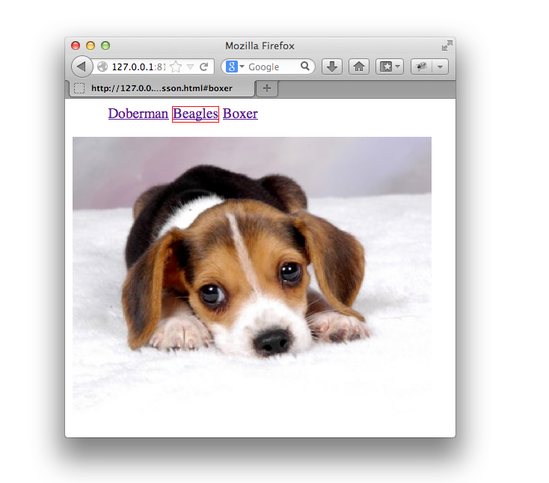
The Goal

Slide 3
The Setup
<ul id="breeds">
<li><a href="#doberman">Doberman</a></li>
<li><a href="#beagles">Beagles</a></li>
<li><a href="#boxer">Boxer</a></li>
</ul>
<div id="doberman">
<img src="doberman.jpg" width="400px"/>
</div>
<div id="beagles">
<img src="beagle.jpg"/>
</div>
<div id="boxer">
<img src="boxer.jpg" width="400px"/>
</div>

Slide 4
The Setup
$.extend($.prototype, {
fn: null,
addClass: function(class) { /*...*/ },
removeClass: function(class) { /*...*/ },
tabs: function() { /*...*/ }
});
$.fn.tabs = function() { /*...*/ };

Slide 5
Exercise
Add a property to $ called fn that is equivalent to $.prototype:
$.fn === $.prototype //-> true
Notes:
$.fn = $.prototype;

Slide 6
CSS Classes

Slide 7
Exercise
Add addClass and removeClass methods to $ that accepts a string and either adds or removes a class from an element:
$('#breeds li:first-child').addClass('active');
$('#breeds li:first-child').removeClass('active');
hint:
This RegEx might help:
new RegExp("(^| )"+className+"($| )");
Notes:
addClass: function(className){
var classTest = new RegExp("(^| )"+className+"($| )");
$.each(this,function(i, element){
if(! classTest.test(element.className) ) {
element.className = element.className + " "+className
}
})
}

Slide 8
Exercise
Add tabs method to $ that shows an li’s content and adds `active` to the li’s className:
Notes:
$.fn.tabs = function(){
this.attr('class', 'tabs');
return this.each(function(i, element) {
var active;
var activate = function(li){
if(active){
active.removeClass("active");
$(active.find("a").attr("href")).hide();
}
li = $(li);
li.addClass('active');
$( li.find("a").attr("href") ).show();
active = li;
};
element = $(element);
activate( element.find("li:first") );
element.find('a').bind('click', function(event) {
activate( $(this).parent() );
event.preventDefault();
});
});
};

