Slide 1
Basic JS
Notes:
I think the key to JavaScript is really understanding what’s going on in memory. And the key to understanding what’s going on in memory is understanding
what JS’s basic data types look like in memory and how JS’s operators are used to manipulate those data structures.

Slide 2
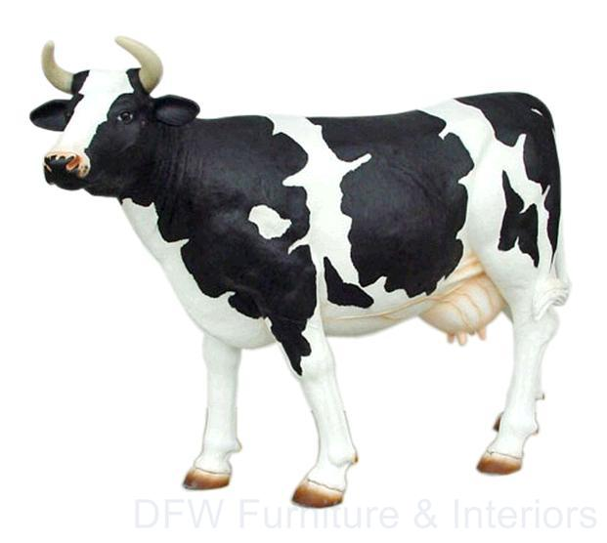
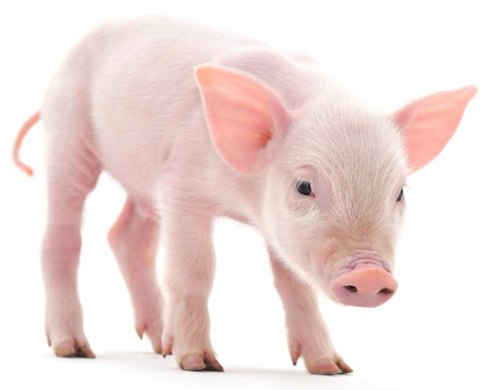

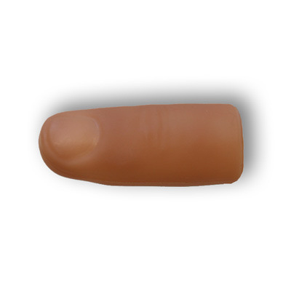

JavaScript and the DOM
var, primitives, and objects
functions and closures
this, and prototypes
Notes:
feel / hood / sausage
abstraction to diagram what’s going on, something you can use to teach new JS developers.
Fortunately there’s just a few things to get right.
Before we begin … this is a training!
None of Us / All of us
Level of skill

Slide 3
document.getElementById('dog’)

Slide 4



A dynamic, weakly typed, prototype-based language with first-class functions.
A document format based on SGML used to describe the elements of a hypertext document.
A language-neutral interface that allows programs to dynamically access and update the content, structure and style of documents.
Notes:
a set of standards, a variety of SGML, used to tag the elements of ahypertext document

Slide 5
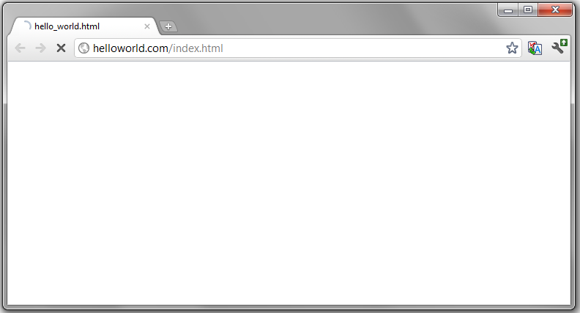
What Happens?
GET http://helloworld.com/index.html
<html>
<head>
<script type='text/javascript'>
alert('hello world');
</script>
</head>
<body>
<h1>Hello World</h1>
</body>
</html>

Slide 6

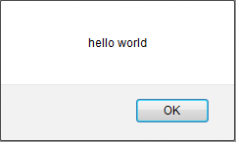
GET http://helloworld.com/index.html
Server
Hello World
"<html>\n<head><script … "
DOM
<html>
<head>
<script type='text/javascript'>
documentElement
head
script
Tokenize: alert, (, "hello world", ), ;
Parse:
[{ "value": "(", "arity": "binary",
"first": {"value": "alert"},
"second": [{ "value": "hello world"}]
}]
Run:
- lookup alert
- call with "hello world"
JS
DOM
documentElement
</script></head>
<body><h1>Hello World</h1></body>
</html>
head
body
script
h1
Notes:
Request is made
Response is HTML
DOM is built
Immediately starts parsing response
Finds Script Tag, stop parsing, hand over to JS
JS
tokenizes JS
Runs statement by statement
Calls alert
Alert waits until ‘OK’ is clicked
JS finishes
Parsing continues
H1 is parsed, and displayed
Douglas crockford

Slide 7
JavaScript is ...
a dynamic, weakly typed, prototype-based language with first-class functions.
JavaScript != Java
JavaScript == A real programming language
JavaScript == ECMAScript == JScript
JavaScript != Document Object Model

Slide 8
JS is Dynamic
Compilation and execution happen together.
var propMap = {
val: "value", html: "innerHTML"
};
for(var fnName in propMap){
$.prototype[fnName] = (function(prop){
return function(){
return this[prop];
}
})(propMap[fnName]);
}
Notes:
Remove boilerplate code
Change objects and classes on the fly
Create more “lightweight” objects
Less Code

Slide 9
JS is Weakly Typed
Type associated with value, not variable.
var a = 1;
a = "one";
a = [1];
a = {one: 1};

Slide 10
JS has 1st Class Functions
Treat like any object
var square = function(x){ return x*x },
mult = function(f1, f2){
return function(n){
return f1(n)*f2(n);
}
},
bigF = mult(square, square),
value = bigF(2); // 16
CREATE
RETURN
ARG

Slide 11
JS is Prototype Based
Prototype looks up inherited and shared properties.
has_hair
has_spine
toString
Chordate
Object
Animal
Object
Animal
p
proto
proto
prototype
prototype
prototype
Mammal
Chordate
Animal
Notes:
most misunderstood
OO and need to share functionality
Classes pair method and class. Animal <-> eat
In JS, you have functions that pretend to be methods.
The final key attribute to JS is that it is prototype based. And this is likely one of the most misunderstood parts of JavaScript.
JavaScript, like most languages, is an object-oriented language. And you often need to share functionality across objects.
In Class based languages, you have a strong paring of methods and a Class. An animal has an “eat” method. The eat method belongs to Animal.
In JS, you really have functions that pretend to be methods via a proto property. Alexis is going to talk about this.

Slide 12
Summary
JS Representation of HTML and browser.
Dynamic, weakly typed, prototype-based language with first-class functions and some data types.

