Slide 1
jQuery Functional Utils
Notes:
I think the key to JavaScript is really understanding what’s going on in memory. And the key to understanding what’s going on in memory is understanding
what JS’s basic data types look like in memory and how JS’s operators are used to manipulate those data structures.

Slide 2
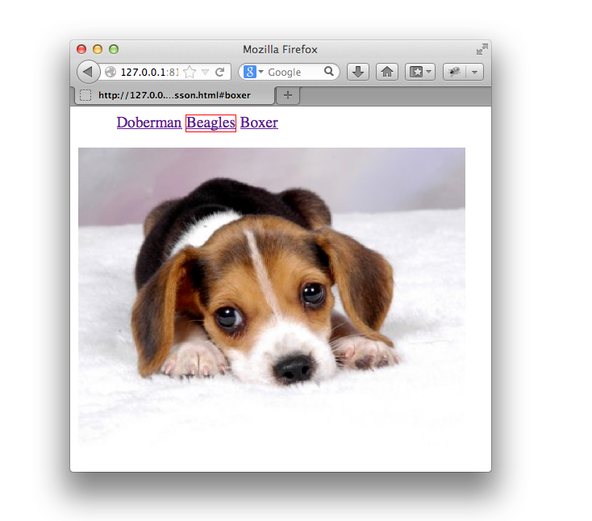
The Goal

Slide 3
The Setup
<ul id="breeds">
<li><a href="#doberman">Doberman</a></li>
<li><a href="#beagles">Beagles</a></li>
<li><a href="#boxer">Boxer</a></li>
</ul>
<div id="doberman">
<img src="doberman.jpg" width="400px"/>
</div>
<div id="beagles">
<img src="beagle.jpg"/>
</div>
<div id="boxer">
<img src="boxer.jpg" width="400px"/>
</div>

Slide 4
The Setup
$ = function(selector) { /*...*/ };
$.extend = function(target, object) { /*...*/ };
$.extend($, {
isArray: function(array) { /*...*/ },
each: function(arr, callback) { /*...*/ },
makeArray: function(arr) { /*...*/ },
proxy: function(fn, context) { /*...*/ }
});

Slide 5
$.extend( target, object ) -> target
Merge the contents of two or more objects together into the first
object.
var target = {first: 'Justin'},
object = {last: 'Meyer'};
var result = $.extend(target, object);
equal(result, target);
deepEqual(result, {first: 'Justin', last: 'Meyer'});

Slide 6
Setting Lots of Properties
$.isArray = function(array) { /*...*/ };
$.each = function(arr, callback) { /*...*/ };
$.makeArray = function(arr) { /*...*/ };
$.proxy = function(fn, context) { /*...*/ };
$.prototype.text = function( text ) { /*...*/ };
$.prototype.html = function( html ) { /*...*/ };
Notes:
most misunderstood
OO and need to share functionality
Classes pair method and class. Animal <-> eat
In JS, you have functions that pretend to be methods.
The final key attribute to JS is that it is prototype based. And this is likely one of the most misunderstood parts of JavaScript.
JavaScript, like most languages, is an object-oriented language. And you often need to share functionality across objects.
In Class based languages, you have a strong paring of methods and a Class. An animal has an “eat” method. The eat method belongs to Animal.
In JS, you really have functions that pretend to be methods via a proto property. Alexis is going to talk about this.

Slide 7
Setting Lots of Properties
$.extend($,{
isArray: function(array) { /*...*/ },
each: function(arr, callback) { /*...*/ },
makeArray: function(arr) { /*...*/ },
proxy: function(fn, context) { /*...*/ }
});
$.extend($.prototype, {
text: function(html) { /*...*/ },
html: function(text) { /*...*/ }
});

Slide 8
Extending Default Values
var move = function(el, options) {
$(el).offset({left: options.from || 0});
setTimeout(function() {
$(el).offset({left: options.to || 100});
}, options.time || 1000);
};
var div = document.getElementById('beagles');
move(div, {to: 10, from: 0, time: 1000});

Slide 9
Extending Default Values
var move = function(el, options) {
options = $.extend({
time: 1000,
from: 0,
to: 100
}, options);
$(el).offset({left: options.from});
setTimeout(function() {
$(el).offset({left: options.to});
}, options.time);
};

Slide 10
Exercise
Implement $.extend
test:
var target = {first: 'Justin'},
object = {last: 'Meyer'};
var result = $.extend(target, object);
equal(result, target);
deepEqual(result, {first: 'Justin', last: 'Meyer'});
Notes:
Things to mention:
- deep copy with jQuery
- hasOwnProperty
- multiple merge object args
$.extend = function(target, object) {
for (var prop in object) {
if (!target.hasOwnProperty(prop)) {
Object.defineProperty(target, prop, {value: object[prop]});
}
}
return target;
}

Slide 11
Type Checking

Slide 12
Checking types in JavaScript
Conventional typing checking works just as we expected…
typeof [].length === 'number'; //-> true
[] instanceof Array; //-> true
[].constructor === Array; //-> true
Notes:
Should talk about what edge cases each one of these fail in.
http://javascriptweblog.wordpress.com/2011/08/08/fixing-the-javascript-typeof-operator/

Slide 13
Except when it doesn’t…
var iframe = document.createElement('iframe');
document.body.appendChild(iframe);
var _Array =
window.frames[window.frames.length-1].Array;
var arr = new _Array(1,2,3); // [1,2,3]
typeof arr; //-> 'object'
arr instanceof Array; //-> false
arr.constructor === Array; //-> false

Slide 14
String comparison to the rescue
Array objects created within one iframe share NOTHING with array’s created within another iframe.
So, to cover all of our basis’ and edge cases:
var obj = [];
Object.prototype.toString.call(obj) ===
'[object Array]'; //-> true
Notes:
From the ECMA-262 specification:
Object.prototype.toString( )
When the toString method is called, the following steps are taken:
1. Get the [[Class]] property of this object.
2. Compute a string value by concatenating the three strings “[object ", Result (1), and "]“.
3. Return Result (2)
http://perfectionkills.com/instanceof-considered-harmful-or-how-to-write-a-robust-isarray/

Slide 15
$.isArray( obj ) -> target
Determine whether the argument is an array.
$.isArray([]) == true;
$.isArray(arguments) == false;
var iframe = document.createElement('iframe');
document.body.appendChild(iframe);
var _Array = iframe.contentWindow.Array;
$.isArray(new _Array()) == true;

Slide 16
Exercise
Implement $.isArray
test:
$.isArray([]) == true;
$.isArray(arguments) == false;
var iframe = document.createElement('iframe');
document.body.appendChild(iframe);
var _Array = iframe.contentWindow.Array;
$.isArray(new _Array()) == true;
hint: Object.prototype.toString.call
Notes:
$.isArray = function( obj ){
return Object.prototype.toString.call(obj) === "[object Array]";
}

Slide 17
isArrayLike( obj ) -> target
Determine whether the argument is LIKE an array.
isArrayLike(['a', 'b', 'c']) == true;
isArrayLike(arguments) == true;
var divs = document.getElementsByTagName('div');
isArrayLike(divs) == true;
var lis = document.getElementsByTagName('li');
isArrayLike(lis) == true;

Slide 18
Duck Typing
“If it walks like a duck and swims like a duck and
quacks like a duck, I call that bird a duck.”
Duck typing is concerned with those properties that are used on the object rather than the type of the object itself.
An object that is like an Array has the following characteristics:
arguments.length;
arguments[0];
Notes:
The name refers to the “duck test”.
A length property, and access to a specific item in the collection

Slide 19
Exercise
Implement isArrayLike
test:
isArrayLike(['a','b', 'c']) == true;
isArrayLike(arguments) == true;
var divs = document.getElementsByTagName('div');
isArrayLike(divs) == true;
var lis = document.getElementsByTagName('li');
isArrayLike(lis) == true;
hint: typeof obj.length === ‘number’
‘in’ operator on obj.length - 1
Notes:
$.isArrayLike = function(collection) {
return (collection.length && collection[collection.length – 1]);
}

Slide 20
Is something is an array?
$.extend($, {
isArrayLike: function( obj ){ /*...*/ },
each: function( collection, callback ) {
if( $.isArrayLike(collection) ) {
// Loop through array's items.
} else {
// Loop through object's properties
}
}
});
Notes:
ISN’T $.extend in this code missing the target?
most misunderstood
OO and need to share functionality
Classes pair method and class. Animal <-> eat
In JS, you have functions that pretend to be methods.
The final key attribute to JS is that it is prototype based. And this is likely one of the most misunderstood parts of JavaScript.
JavaScript, like most languages, is an object-oriented language. And you often need to share functionality across objects.
In Class based languages, you have a strong paring of methods and a Class. An animal has an “eat” method. The eat method belongs to Animal.
In JS, you really have functions that pretend to be methods via a proto property. Alexis is going to talk about this.

Slide 21
$.each( obj , cb(index, value) ) -> obj
Iterate over arrays or objects.
var collection = ['a', 'b', 'c'];
$.each(collection, function(index, item) {
console.log(item + ' is at index ' + index);
});
collection = {foo: 'bar', zed: 'ted'};
res = $.each(collection, function(prop, value){
console.log('prop: ' + prop + ', value: ' + value);
});

Slide 22
Exercise
Implement $.each
test:
var collection = ['a','b'];
var res = $.each(collection,function(index, value) {
if( index === 0 ) equal(value, 'a');
else if( index === 1 ) equal(value, 'b');
else ok(false);
});
collection == res;
collection = {foo: 'bar', zed: 'ted'};
res = $.each(collection, function(prop, value){
if( prop === 'foo' ) equal(value, 'bar');
else if( prop === 'zed' ) equal(value, 'ted');
else ok(false);
});
collection == res;
Notes:
TODO: talk about what we are going to do about the okay function
$.each = function(collection, cb){
if( $.isArrayLike( collection) ) {
for(var i=0; i < collection.length; i++){
if( cb.call(this, i, collection[i]) === false) {
break;
}
}
} else {
for(var prop in collection) {
if(collection.hasOwnProperty(prop)) {
if( cb.call(this, prop, collection[prop]) === false) {
break;
}
}
}
}
return collection;

Slide 23
$.makeArray( obj ) -> array
Convert an array-like object into a true JavaScript array.
$.makeArray( document.body.childNodes );
$.makeArray( document.getElementsByTagName('*') );
$.makeArray( arguments );
$.makeArray( $('li') );

Slide 24
Exercise
Implement $.makeArray
test:
var childNodes = document.body.childNodes;
ok(! $.isArray(childNodes) );
var childArray = $.makeArray(childNodes);
ok( $.isArray(childArray) );
equal(childArray.length, childNodes.length);
for(var i =0; i < childArray.length; i++){
equal(childArray[i], childNodes[i]);
}
Notes:
$.makeArray = function(arr){
if($.isArray(arr)) {
return arr;
}
var array = [];
for(var i =0; i < arr.length; i++) {
array[i] = arr[i]
}
return array;
}

Slide 25
$.proxy( fn, context ) -> function
Takes a function and returns a new one that calls the
original with a particular context.
var dog = {
name: 'fido',
speak: function(){
console.log( this.name + ' says woof'); }
};
var speakProxy = $.proxy(dog.speak, dog);
setTimeout(speakProxy, 1000);

Slide 26
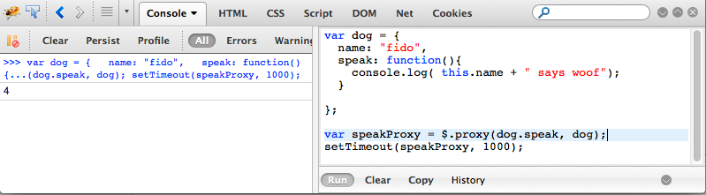
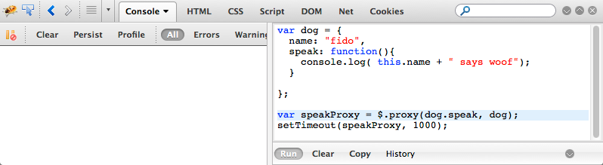
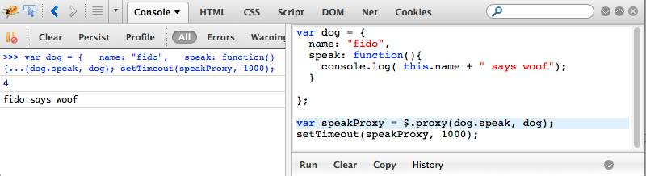

Slide 27
Exercise
Implement $.proxy
test:
var dog = {
name: 'fido',
speak: function(words){
return this.name + ' says ' + words;
}
};
var speakProxy = $.proxy(dog.speak, dog);
speakProxy('woof!') == 'fido says woof!';
Notes:
$.proxy = function(fn, context){
return function(){
return fn.apply(context, arguments);
}
}

