Slide 1
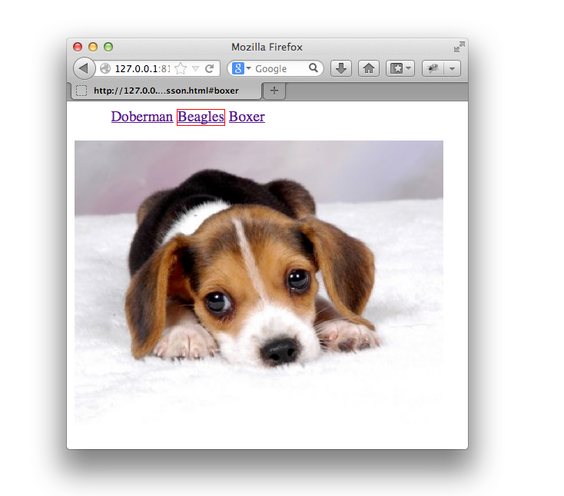
JavaScript, the DOM and jQuery

Slide 2
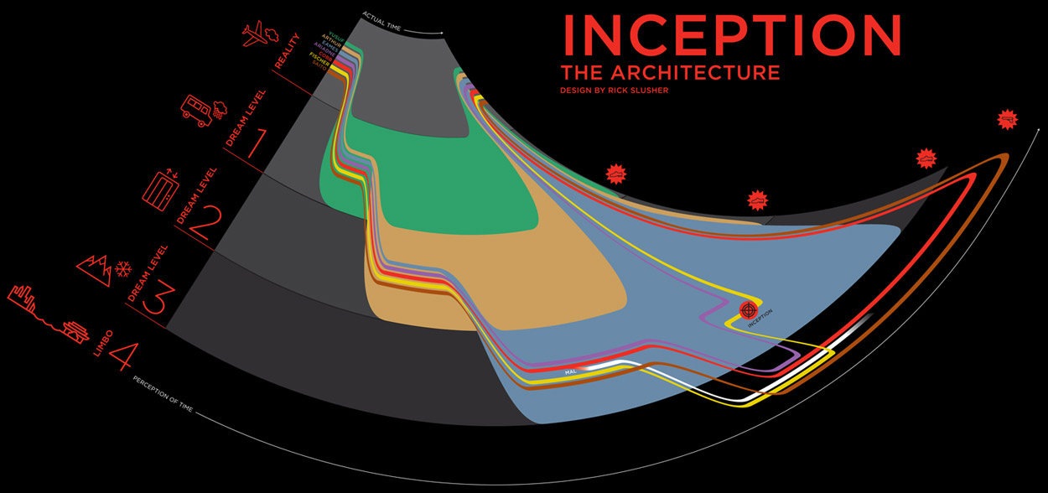

Slide 3
Agenda
Day 1: JS
Basic JS
Types Operators and Primitives
Comparisons
Lunch
Closures
Context
Prototypes
jQuery Functional Utils
Day 2: DOM + jQuery
Finding Elements
Traversing Elements
Element Attributes and Properties
Lunch
Element Styles and Positioning
Events
Build a Tabs Widget

Slide 4



@bitovi
bitovi.com
@justinbmeyer
@alexisabril
github.com/justinbmeyer
github.com/alexisabril

Slide 5
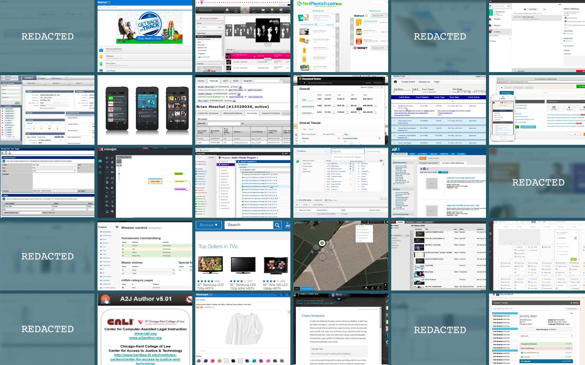
Notes:
In the last 7 years, I’ve either worked on directly or overseen 30 different JavaScript projects for about 20 companies:
- big companies and small companies
- teams of 2 and teams of 30
- for apps that target IE6 to mobile, phonegap and node webkit
- I’ve even used other open source projects

Slide 6






Our entire suite of products in one package. Everything you need
Complex apps quick and simple
Utilities you wish jQuery supported
Dependency management
Functional testing
Sophisticated documentation

Slide 7


