Slide 1

BMBI Product Overview
Features and Future Roadmap

Slide 2
Advantages
No need of paying any licensing for Reporting Tools
No need to spend on hosting and cloud service providers as BMBI is available as SaaS
No need of hiring professionals for Building Reports and Dashboards
No upfront costing, as we provide monthly subscription schemes. Hence its pay as you use
We enable the Business Users and the Domains Experts to build Reports and Dashboards
We let our customers focus on domain not on technology

Slide 3
Capabilities
Build a data store online by uploading excel spreadsheets
Build interactive dashboards and reports without any coding and scripting effort
Build a data store online on top of existing data base systems
Publish and Access Dashboards from anywhere including mobile devices
Browse, Explore and Analyze data online with tools like Pivot Tables, Pivot Charts and Plots
Download Reports and Dashboards in the form of Spread Sheets and Images

Slide 4
Can Create a cube from Excel Data

Slide 5
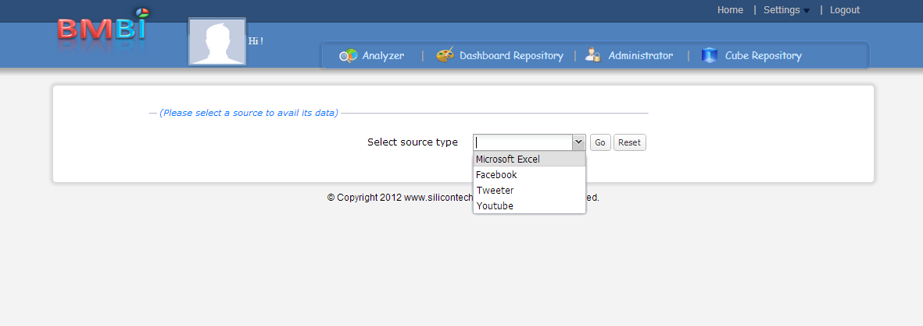
Features: Build Data Store using excel spread sheets
Microsoft Excel to be selected. Facebook, Twitter and YouTube integration is in progress at the moment

Slide 6
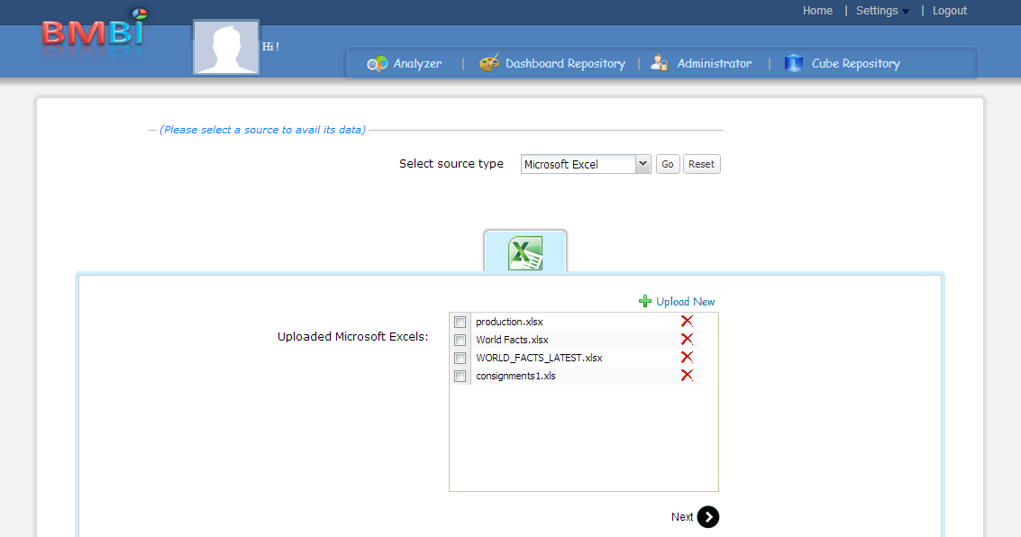
Features: Build Data Store using excel spread sheets …cont
Need to click here to upload a new excel document
Shown here are the excel sheets already uploaded

Slide 7
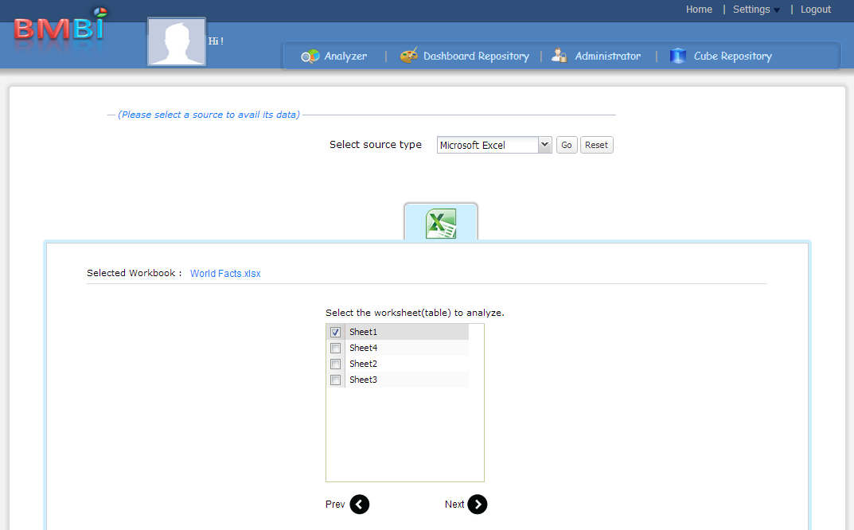
Features: Build Data Store using excel spread sheets …cont
Shown here are the excel workbooks available in the uploaded excel document

Slide 8
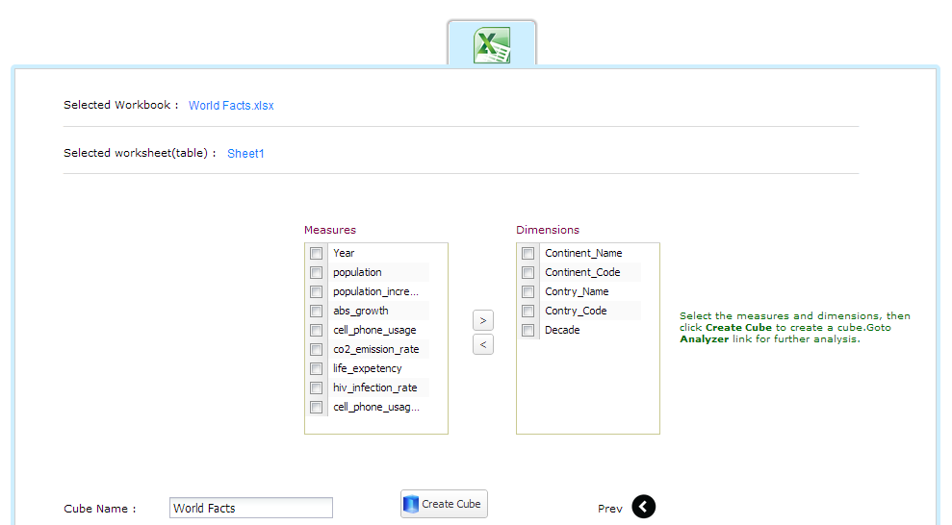
Features: Build Data Store using excel spread sheets …cont
All the columns are automatically discovered as measures and dimensions. Alterations can still be done

Slide 9
Can Create a cube from Data Available in any Relational Data Base System ( Oracle, PostGres, MySQL)

Slide 10
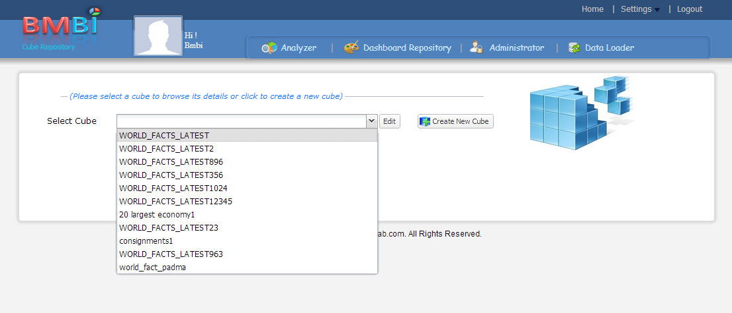
Features: Build Data Store using a relational data base system
A new cube can be created by clicking here.
Shown here are the already available cubes. Any one of them can be selected for editing

Slide 11
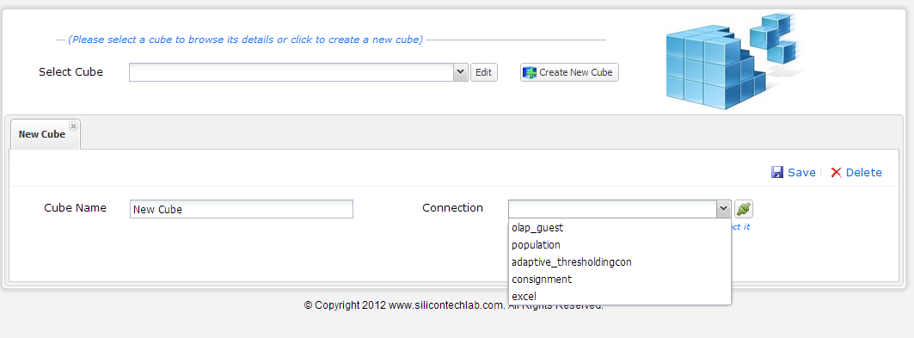
Features: Build Data Store using a relational data base system
Shown here are the already available connections to different relational data base systems. These connections can be created by the administrator in the admin portal

Slide 12
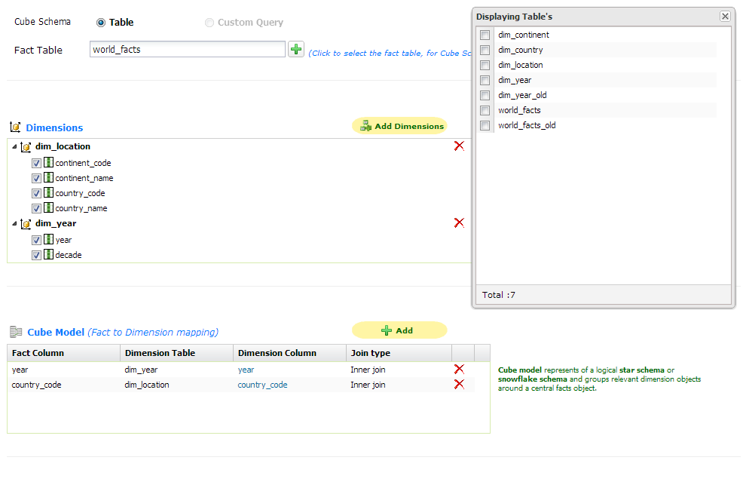
Features: Build Data Store using a relational data base system
Shown here are the available tables in the database. Selected table will be considered as the Fact table
Dimension Tables can be identified in a similar fashion
Mappings between Dimensions and the Facts

Slide 13
Can Browse, Explore and Analyze any of the available cubes

Slide 14
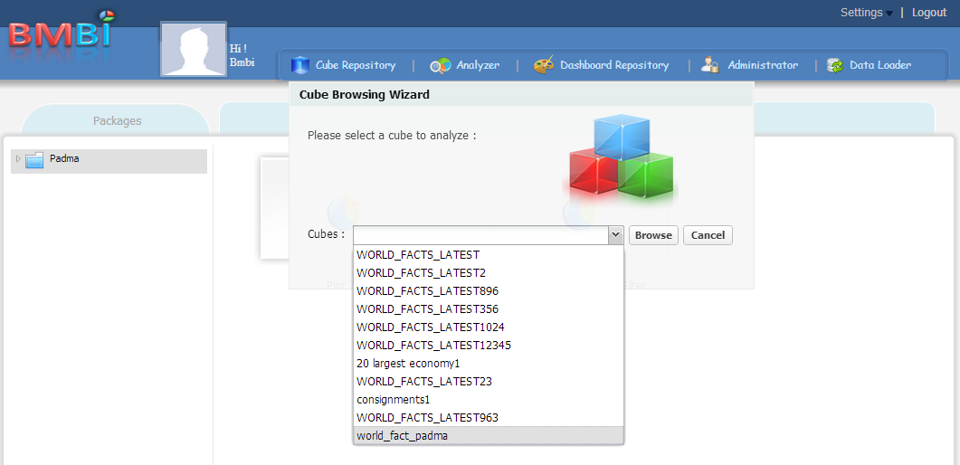
Features: Browse, Explore and Analyze Data Online
All cubes available till date. Any one of them can be selected for analysis

Slide 15
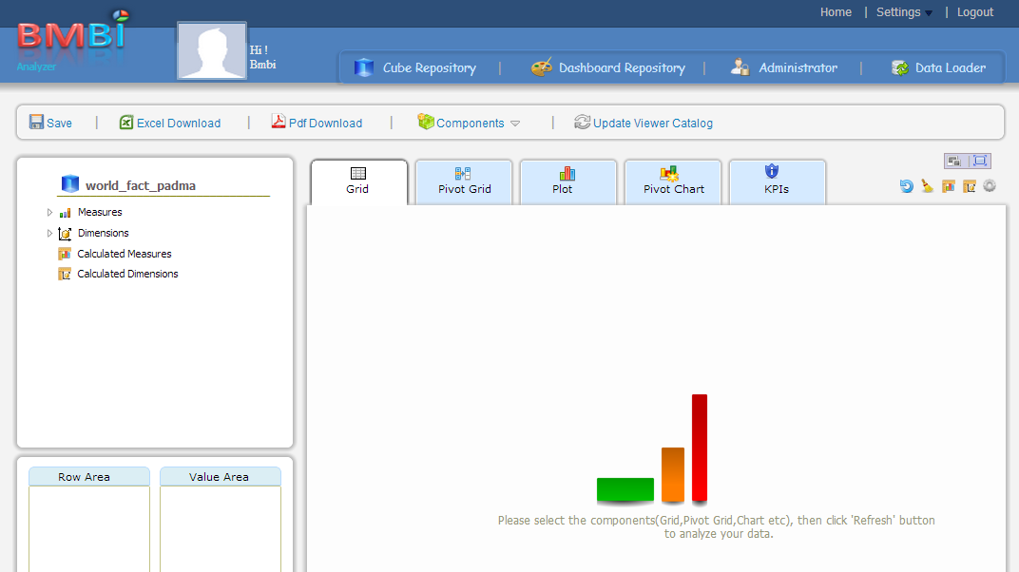
Features: Browse, Explore and Analyze Data Online cont…
Available widgets for analysis
Dimensions and Measures available in the selected cube

Slide 16
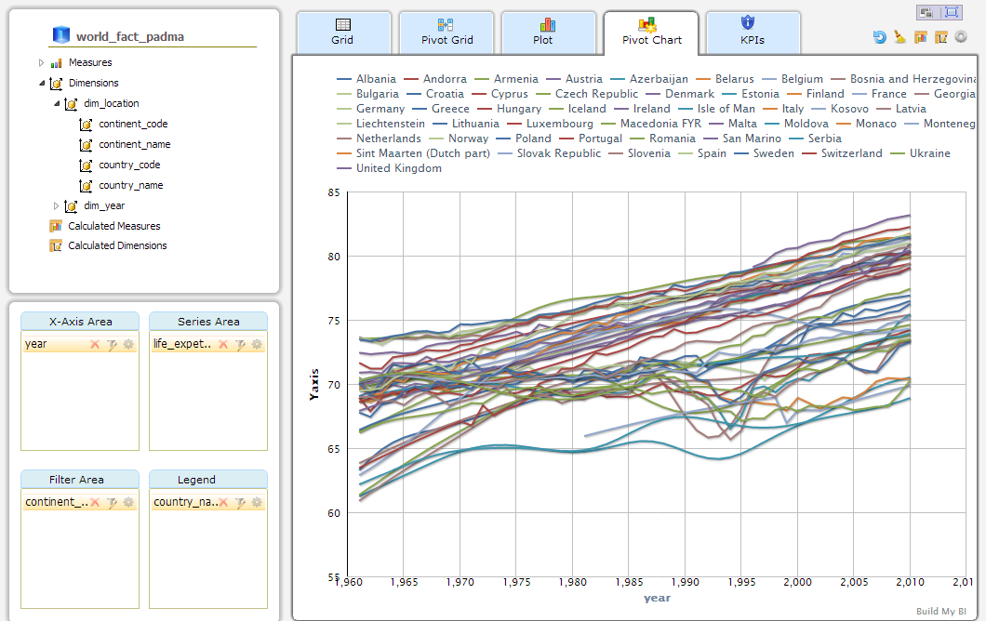
Features: Browse, Explore and Analyze Data Online cont…
Shown here are the curves of life expectancy for all countries in Europe

Slide 17
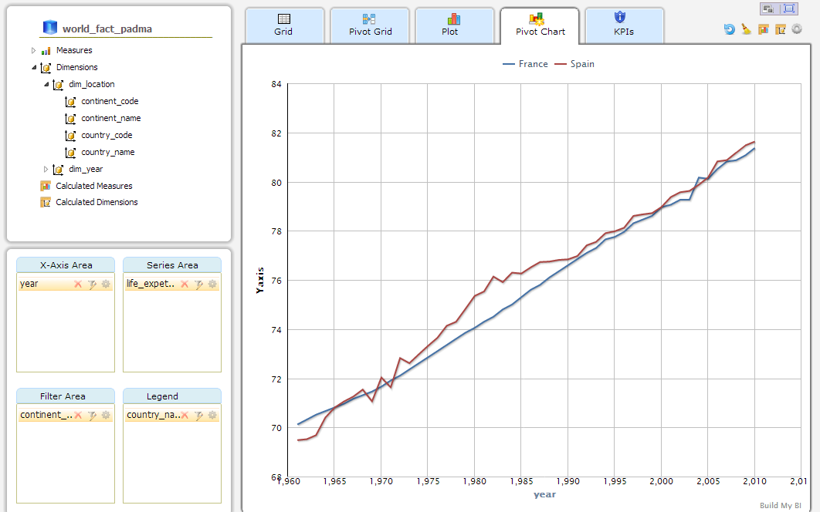
Features: Browse, Explore and Analyze Data Online cont…
Comparison of life expectancy for France and Spain only. This has been achieved by applying filters

Slide 18
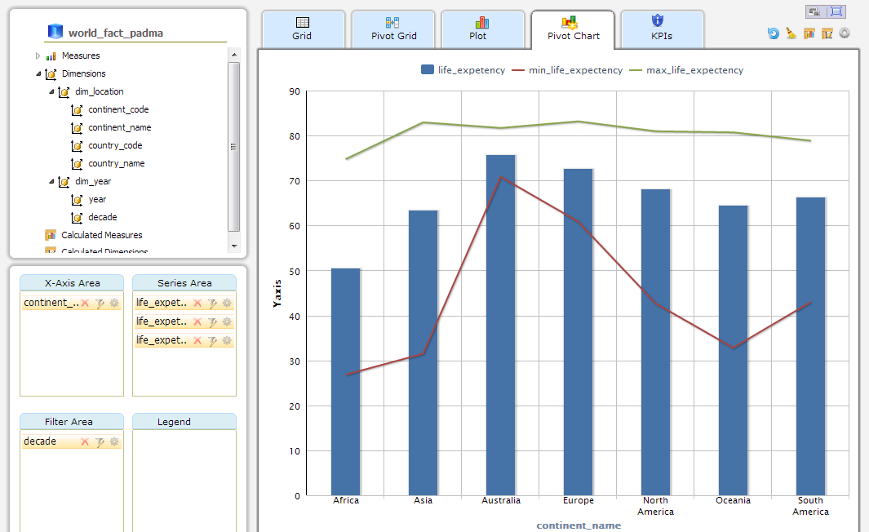
Features: Browse, Explore and Analyze Data Online cont…
Bringing multiple measures into the realm of analysis

Slide 19
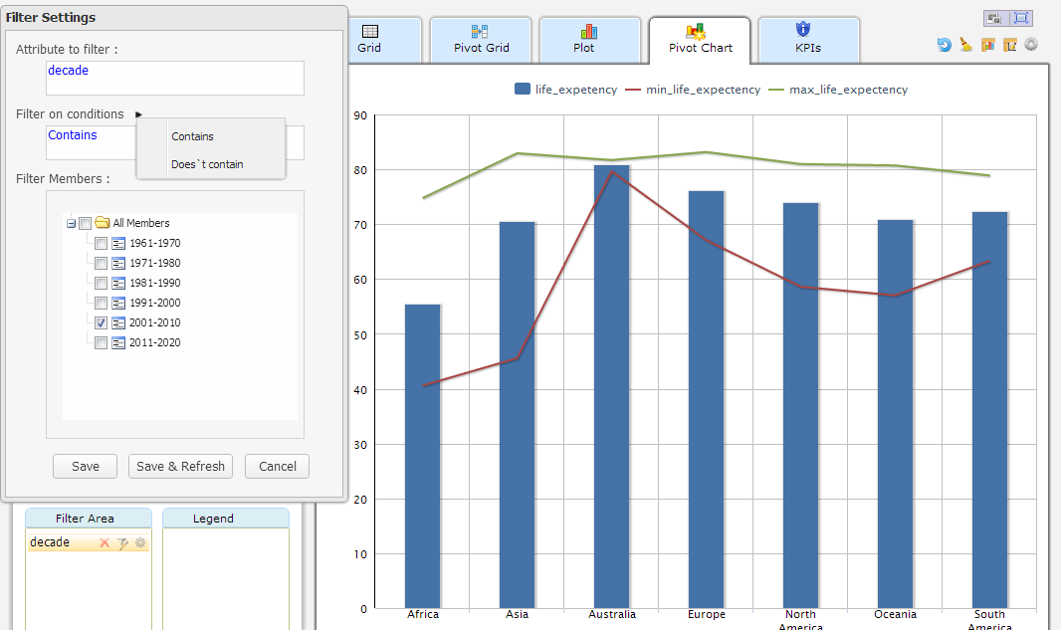
Features: Browse, Explore and Analyze Data Online cont…
Application of Filters

Slide 20
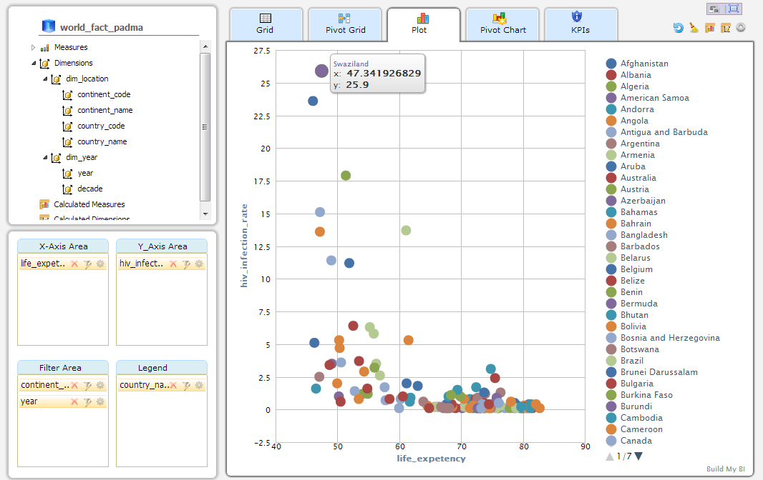
Features: Browse, Explore and Analyze Data Online cont…
Analysis using a scatter chart showing the relationship between HIV and Life Expectancy

Slide 21
Building and Publishing a Dashboard Online

Slide 22
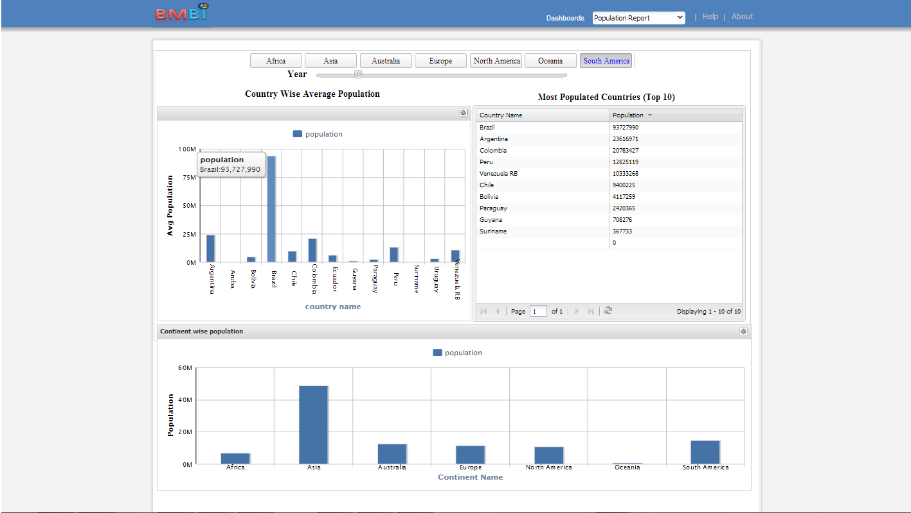
Features: Browse, Explore and Analyze Data Online cont…
One of the sample dashboards which has already been published

Slide 23
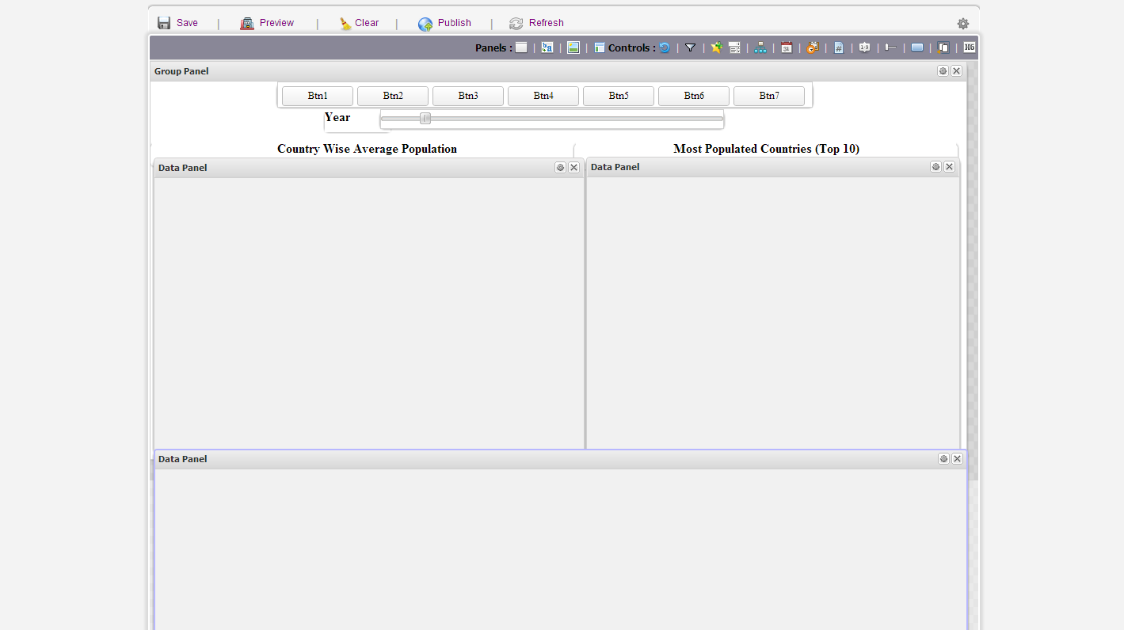
Features: Browse, Explore and Analyze Data Online cont…
Widgets available for building a dashboards.
Designer for creating a dashboard.

Slide 24
BMBI Technology Stack
EXTJS
Java Script Widget Library
Sencha Touch
Java Script Widget Library for Mobile Devices
High Charts
Charting Library
D3
For Charting and Visualization of Big Data
Charting Library
Fusion Charts
Front End Stack
Tomcat
Web Server
JDBC
Database Connectivity
Servlets
Backend Development
JSON
Data Interchanging Format
Connection Pooling
DBCP
Server Stack
Bigdata Technologies
Cloud Technologies
Data Base Technologies
Hadoop (Hbase)
Hadoop (MapReduce)
MongoDB
Postgres
Amazon Web Services
Elastic MapReduce
MySQL
Oracle

Slide 25
Comparisons
 | Pentaho (CE) | MSBI | Tableau | BMBI
Excel Data Upload | NO | NO | YES | YES
RDBMS Support | YES | YES | YES | YES
Online Analysis | NO | NO | NO | YES
Dashboard/ Report Designer | NO | YES | YES | YES
Role Based Access Control Mechanism | NO | YES | YES | YES
Web Pivot Tables and Pivot Charts | NO | YES | YES | YES
Designed for Business Users | NO | NO | YES | YES
Available as SaaS | NO | NO | NO | YES

Slide 26
Roadmap
Feature | Status | Release Date | Remarks
HBASE Support | In Progress | 30th April
MongoDB Support | Planned | 30th June
Hadoop MapReduce Integration | Planned | 30th June
Twitter Analytics | Planned | 30th June
Support for Custom Web Feeds | Planned | 30th June

Slide 27
Thank You

