Slide 1
Students Performance On Exams
By: Brandon Boyle

Slide 2
Intro
Data set from Kaggle (Students Performance on Exams)
8 columns and 1000 data entries
Math, reading, and writing scores
Gender, race/ethnicity, parental level of education, lunch, test preparation course

Slide 3
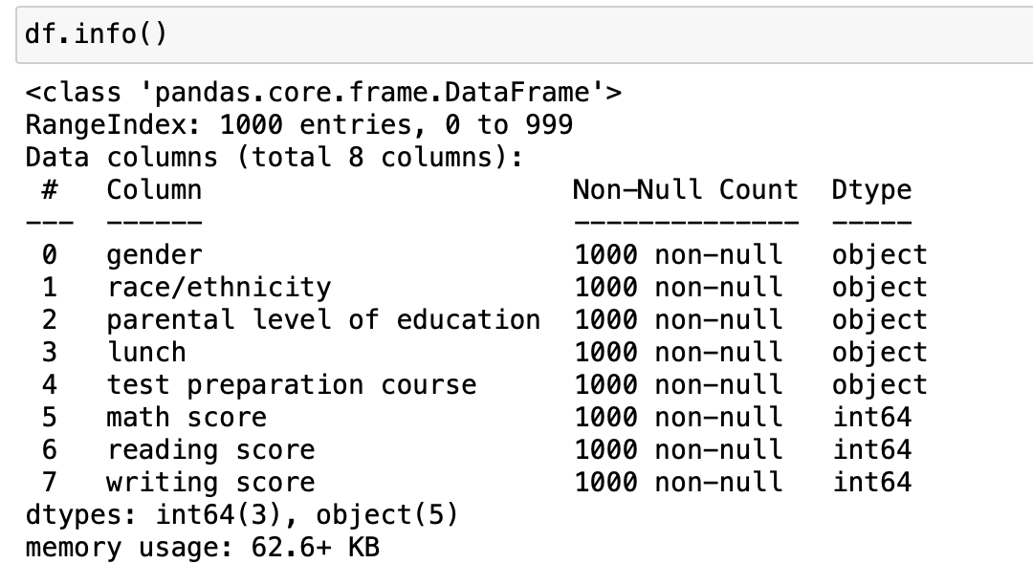
Variables

Slide 4
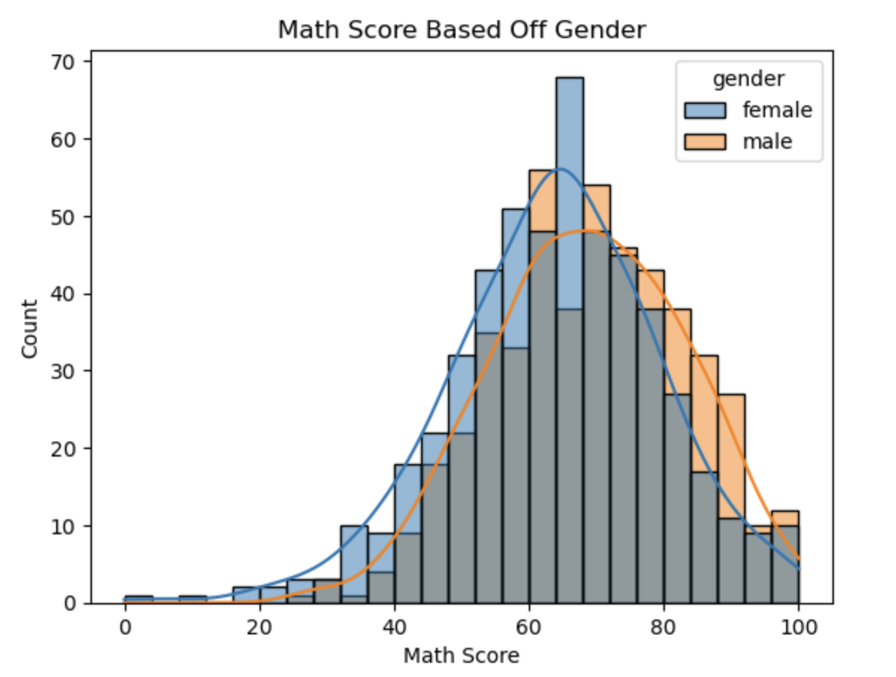
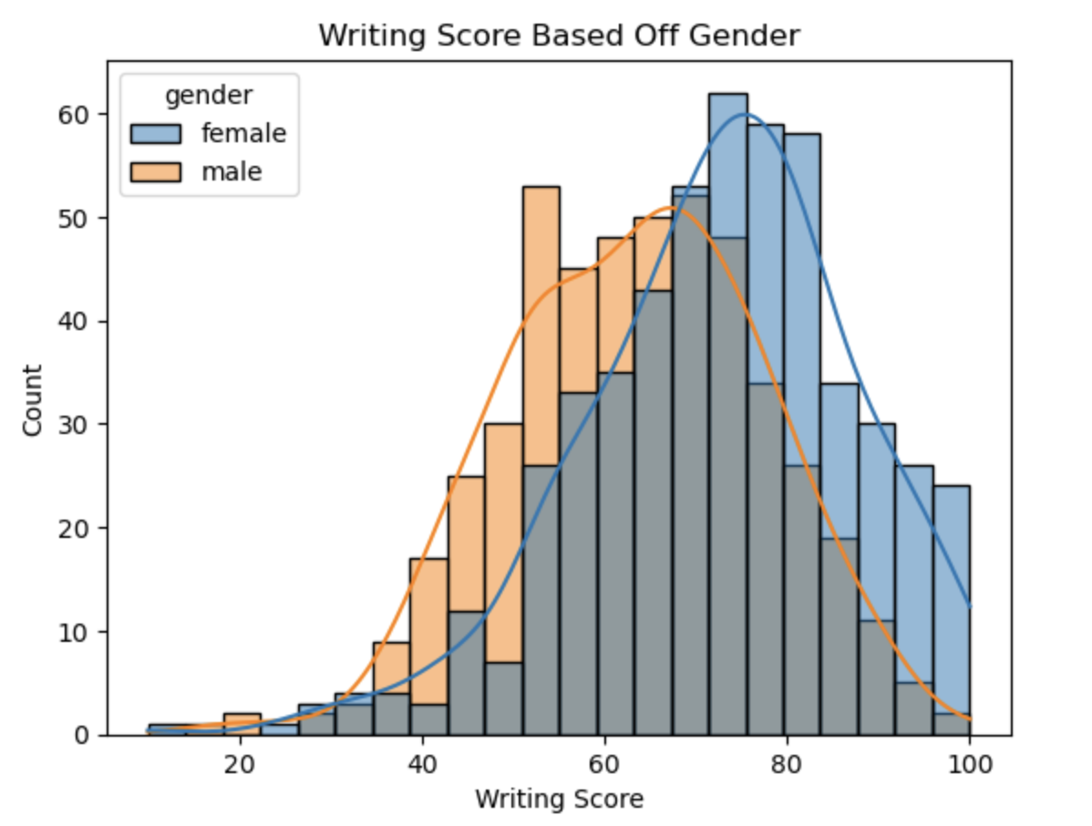
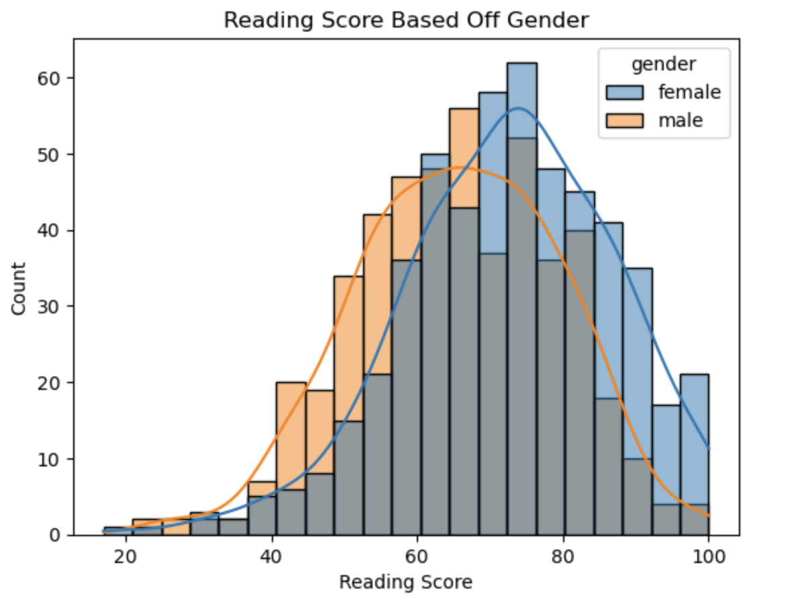
Graphs

Slide 5
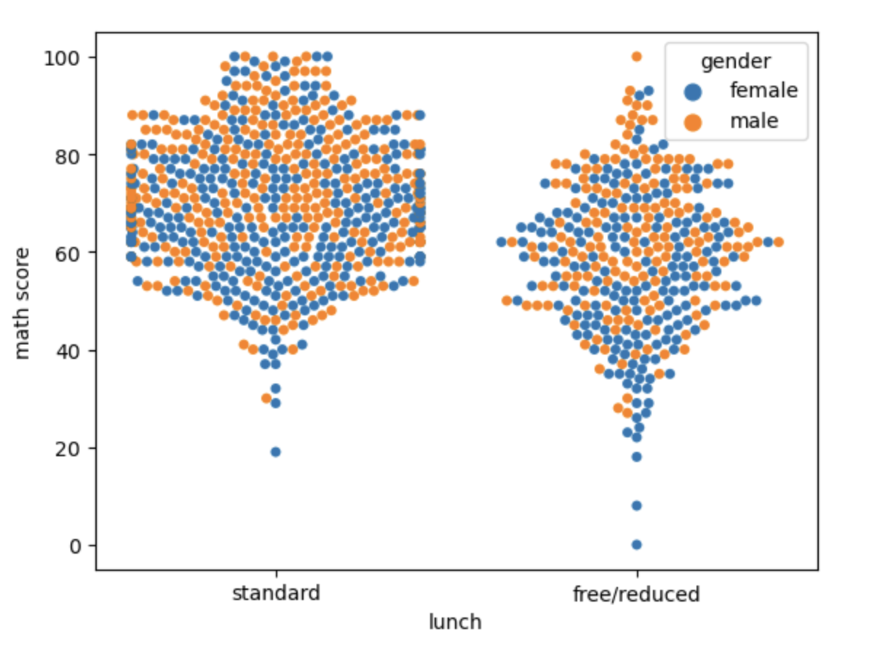
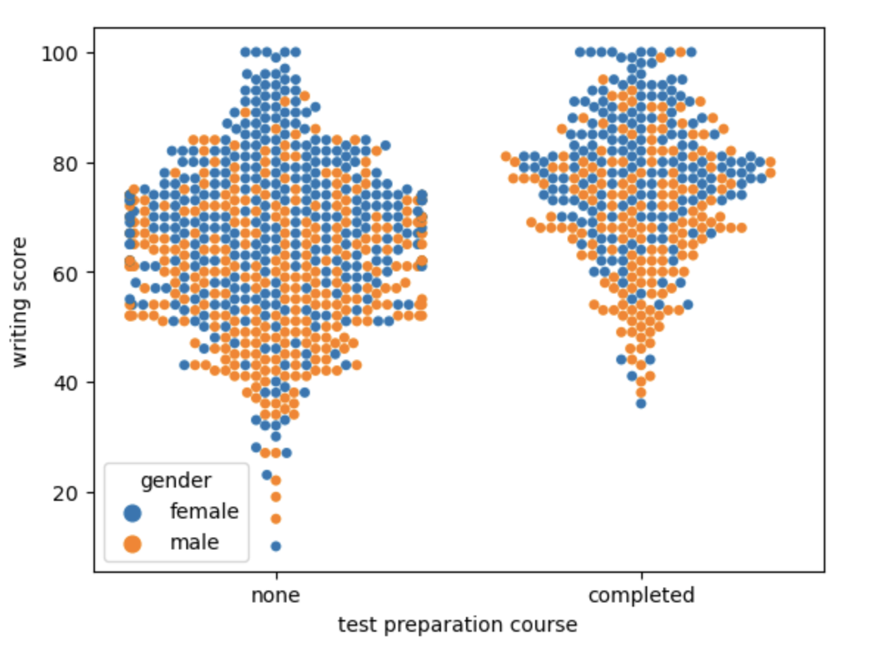
Graphs
Swarm Plot of math test scores based off the two lunch options - color based on gender
Swarm Plot of writing scores based of test preparation – color based on gender

Slide 6
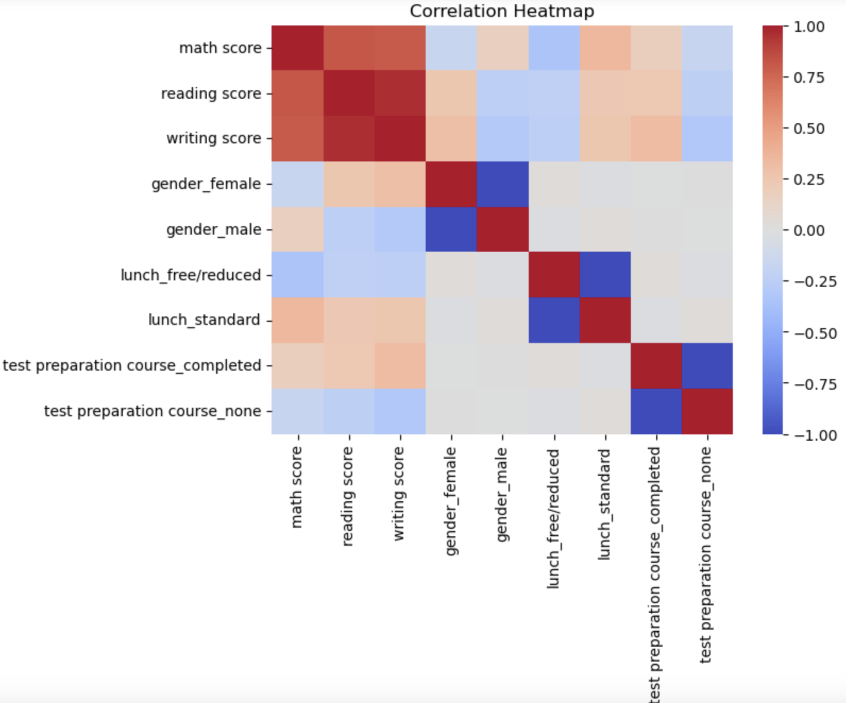
Correlation Heatmap

Slide 7
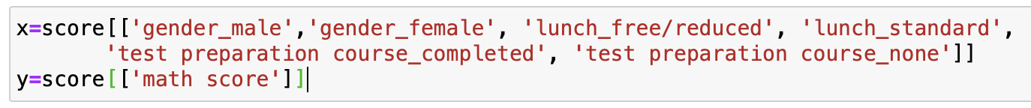
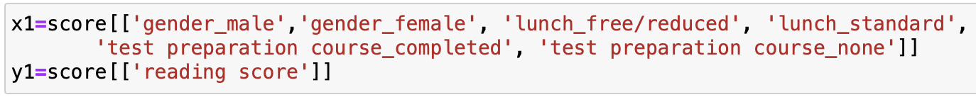
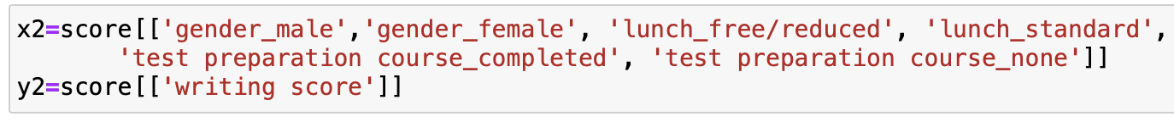
Splitting The Data
3 models
20% data split
All with the same x value, just different y value

Slide 8
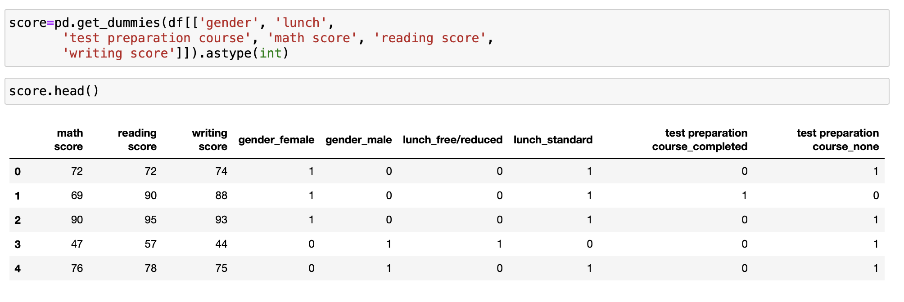
Predicting Scores

Slide 9
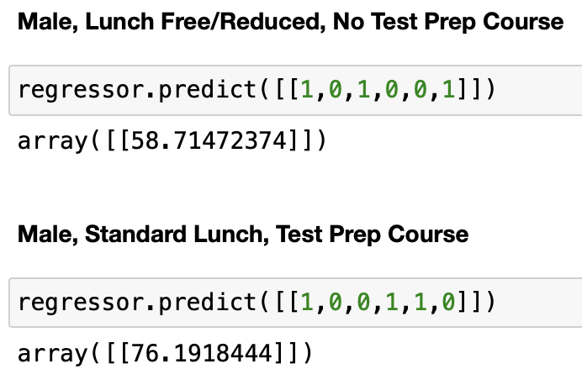
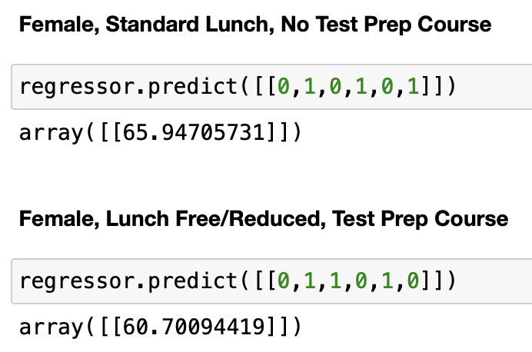
Math Scores

Slide 10
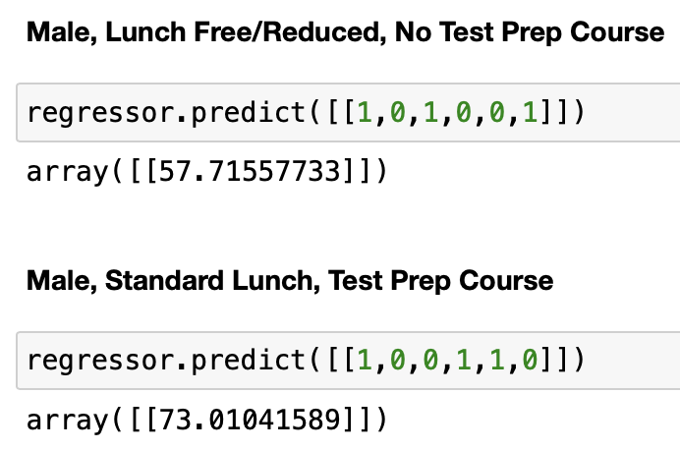
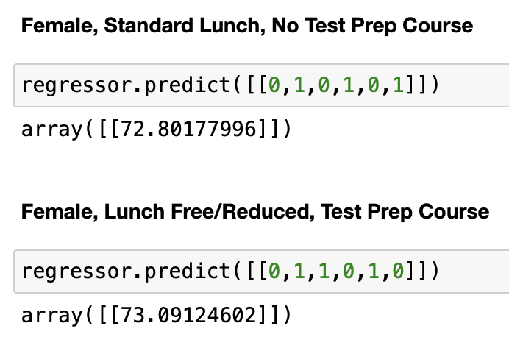
Reading Scores

Slide 11
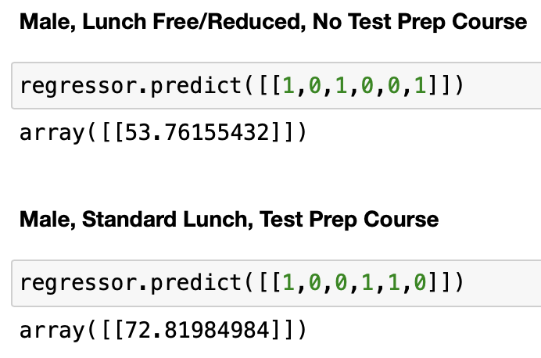
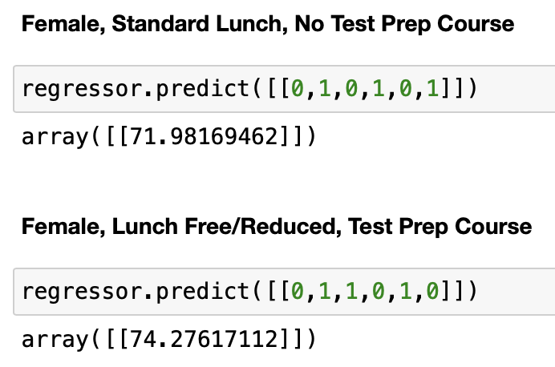
Writing Scores

Slide 12
Problems Faced
Trial and error with a couple data sets
Wasn’t able to perform MLR or Logistical Regression
Variables like race and parents education were not of value

Slide 13
Conclusion
Answered the questions I had at the start
Is lunch beneficial?
Does a test prep course help?
Wish there were more variables – sleep, time spent studying, distractions, etc.

