Slide 1
Project 2: Encryption/ Decryption
By: Bryan Burkhardt

Slide 2
Languages used
C++
Get User Input.
Create an Array.
Call Encryption or Decryption Function.
Inline Assembly
Encryption Function.
Decryption Function.

Slide 3
Encryption/Decryption method 1 Summary:
Uses an even/odd system of encryption/decryption using ASCII values.
Encryption:
Even: Adds 4 to ASCII value of given character.
Odd: Adds 2 to ASCII value of given character.
Decryption:
Even: Subtracts 4 from ASCII value of given character.
Odd: Subtracts 2 from ASCII value of given character.

Slide 4
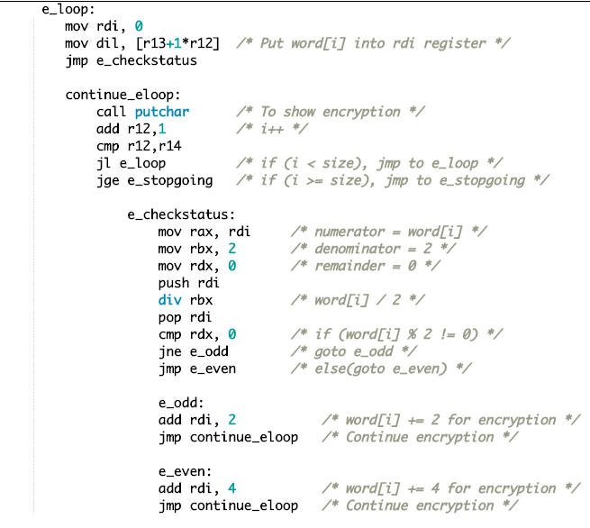
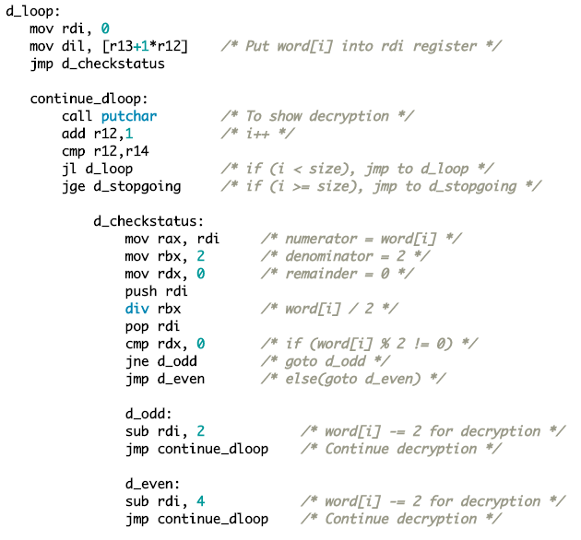
Encryption/Decryption method 1 Code:
Encryption:
Decryption:

Slide 5
Encryption/Decryption method 2 Summary:
Uses a mod base 3 system of encryption/decryption using ASCII values.
Encryption:
( word[i] % 3 ) == 1; Adds 3 to ASCII value of word[i]
( word[i] % 3 ) == 2; Adds 9 to ASCII value of word[i]
( word[i] % 3 ) == 0; Adds 15 to ASCII value of word[i]
Decryption:
( word[i] % 3 ) == 1; Subtracts 3 from ASCII value of word[i]
( word[i] % 3 ) == 2; Subtracts 9 from ASCII value of word[i]
( word[i] % 3 ) == 0; Subtracts 15 from ASCII value of word[i]

Slide 6
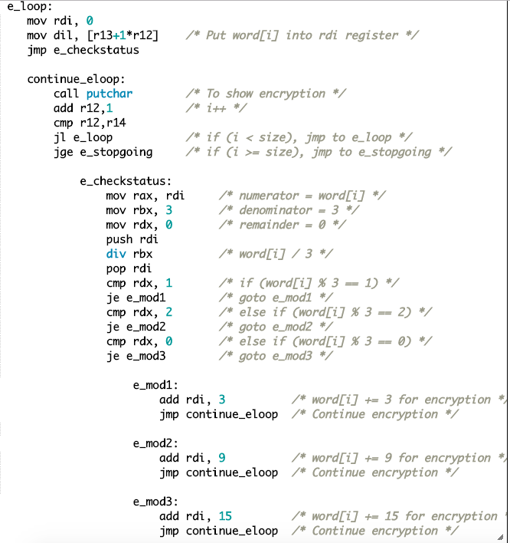
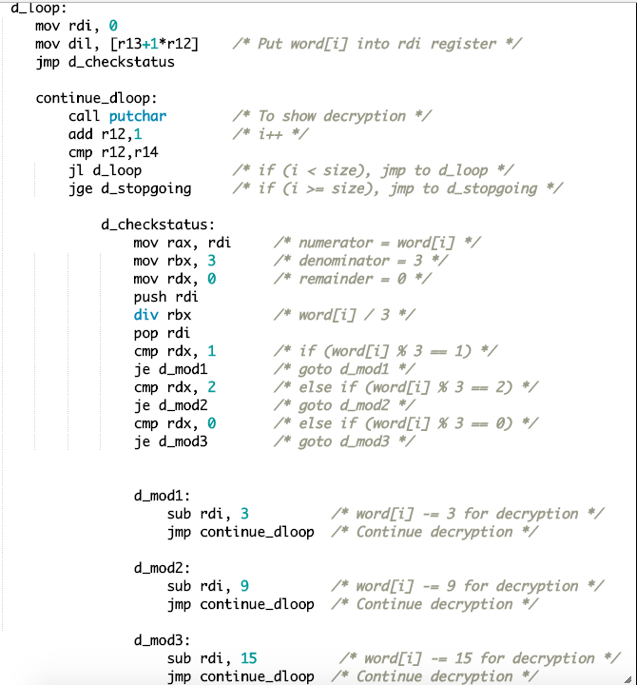
Encryption/Decryption method 2 Code:
Encryption:
Decryption:

Slide 7
Demo

Slide 8
Questions?

