Slide 1


Big data & hpcc
Notes:
NOTE:
To change the image on this slide, select the picture and delete it Then click the Pictures icon in the placeholder to insert your own image

Slide 2
Housekeeping
All materials are uploaded in GitHub:
https://github.com/hpccsystems-solutions-lab/BigData-Workshop
Some slides include additional information and are for students to study on their own.
The HPCC cluster used for this workshop,will be available for a week.
Students can use Play cluster later: http://play.hpccsystems.com:8010/
Contents in repo is subjected to minor changes during workshop, please always use the latest copy.
Its strongly suggested to try and review/finish TODOs part after workshop.

Slide 3
Objective
Setting up CloudIDE
Setting up VsCode

Slide 4
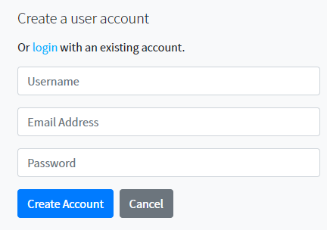
CloudIDE
CloudIDE is our cloud-based IDE which developers can simply login and start coding.
ECL Cloud IDE (hpccsystems.com)
Select Register
Enter required information
Username: FirstName_LastNameInitial
Select Create Account
A confirmation email is sent
Confirm the account

Slide 5
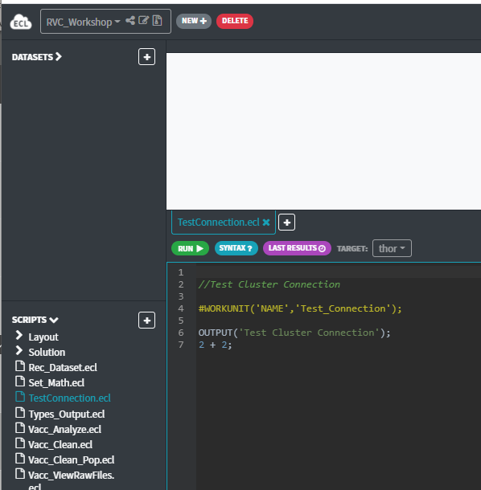
ECL CloudIDE
Once logged in please click on the following:
https://ide.hpccsystems.com/workspaces/share/c7b858bc-244e-467d-b229-2e2c48cc5762

Slide 6

VSCode
Clone or copy the repo in your local machine:
https://github.com/hpccsystems-solutions-lab/BigData-Workshop
Open VSCode
Extension installation: search for ECL Language
Install the plugin
Select File/Open Folder
Select SourceCode folder from BigData-Workshop

Slide 7
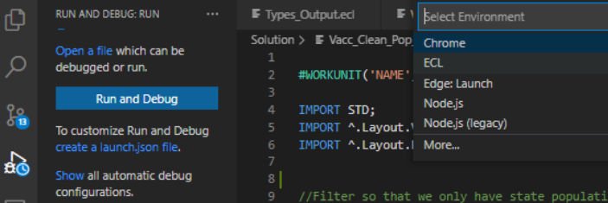

VSCode
Once plugin is installed and you have SourceCode open, select Run/Debug from left panel.
3
Now you have the default lunch.json
Loaded.
From Github copy the content of json file.
Update “user”
1
2
Json: https://raw.githubusercontent.com/hpccsystems-solutions-lab/BigData-Workshop/main/launch.json?token=AGG25XI46SJE7H4ASBUDRPTASBEWS

Slide 8
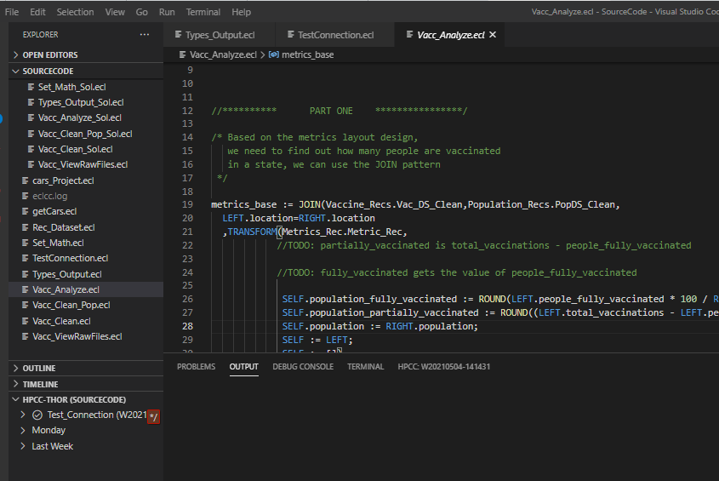
VSCode
Once you have source code open you should see:

Slide 9
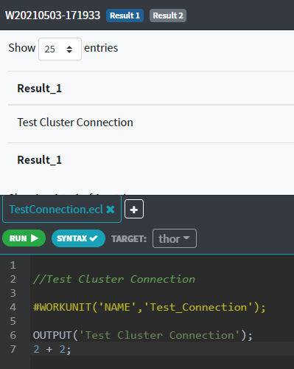
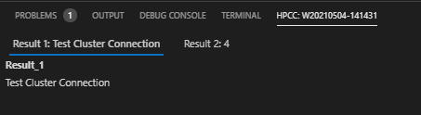
Test Connection Cloud IDE & VSCode
Please run TestConnection to make sure everything is working.
Results can be viewed in both platform:
Select Thor

Slide 10
ECL watch

Slide 11
Objective
File Types
ECL WatchPage
WUID
Files
Queries
Cluster Information
Hands-on

Slide 12
File Type Definitions
Physical File
Any file types that is stored on a disk.
Logical File
logical files appear to be the same as physical files,
but the underlying representation could be either physical files or distributed files.
Super File
Managed list of subfiles (Logical Files) treated as a single logical entity.

Slide 13
ECL Watch
Browser-based interface that provides admin control over a cluster
Monitor cluster status
Job information
View Data Profile
Schedule and reschedule periodic tasks
Manage data
Maintain Roxie queries
Security management
Default URL
ECL Watch: http(s)://hostname:8010
Roxie Page: http(s)://hostname:8002

Slide 14
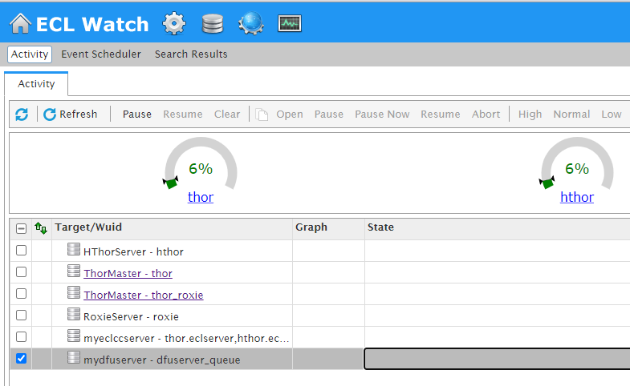
View Workunits
View Files
Published Queries
Cluster Information
Clusters Usage
Clusters Name

Slide 15
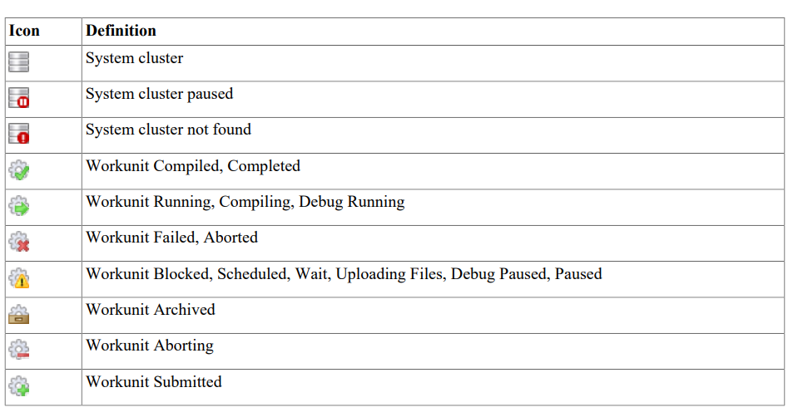
Watch Page Icons

Slide 16
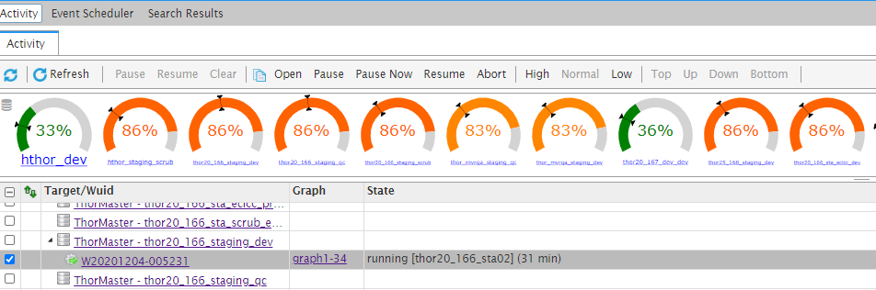
Cluster & Job Options
Cluster Actions
WU Actions
Queuing Option
Priorities

Slide 17
Cluster & Job Options
Cluster Options
Allows to work on selected cluster job queue
Pause: Pause the cluster’s job queue
current running job will complete
Resume: Resume a paused job any waiting job will resume action
Clear: Remove all WUID from a queue selected jobs are set to abort,
all jobs need to be resubmitted later
WUID Options
Clear: Remove all WUID from a queue
Open: Open the job page
Pause: Pause the job after completing
the current subgraph
Pause Now: Interrupts the current subgraph
Resume: Resume a paused job
Abort: Kill a job
Note: User can use these options for ANY jobs, so be careful!

Slide 18
Cluster & Job Options
Priority Options
User can set priorities to jobs
High
Normal
Low
Queue Options
change the position of a job in the queue
Top
Down
Up
Bottom
Note: User can use these options for ANY jobs, so be careful!

Slide 19
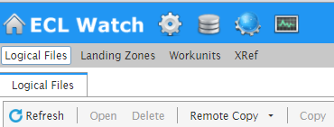
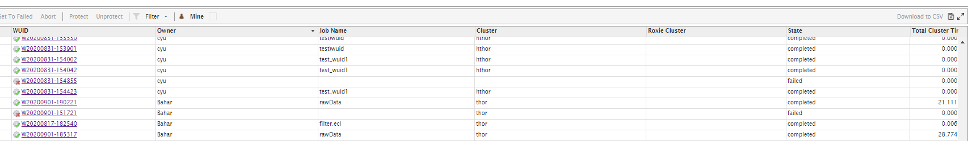
Workunits (WUID / WU)
Workunits displays:
Workunit ID
Owner
Job Name
Cluster job ran on
Job state (Compile, execute, complete, fail)
Total run time
Each workunit provides details such as:
Job information
ECL code
Outputs
Job workflow
Further action items
Publish the job
WUID

Slide 20
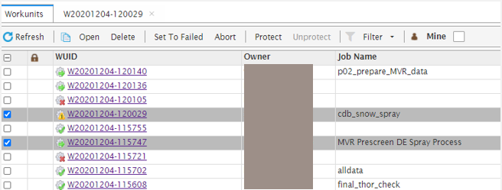
Workunits (WUID / WU)
Open to open the selected workunit(s)
Delete to delete selected workunit(s)
Set to Failed to set the state of the selected workunit(s)
Abort to stop a selected workunit that is running and abort the job
Protect to lock the selected workunit(s). This prevents it from archiving by the Sasha server
Unprotect to unlock the selected locked workunit(s)

Slide 21
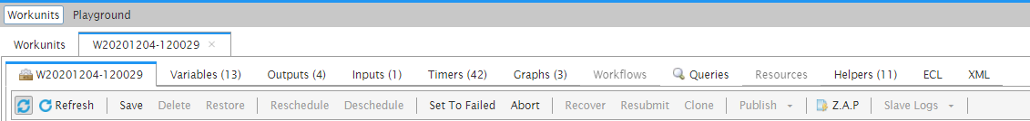
Workunits (WUID / WU) Details
ID Display job information.
Variables Saves any changes to the workunit.
Outputs Display job result(s).
Inputs Display source files.
Timers Display WU timings.
Graphs Graph generated by job.
Workflow Only exists if you have an attribute scheduled. There are multiple workflows when your code contains more than one WHEN statement.
Queries Only appear in the workunit details if the work unit is a published query.
Resources
Helpers Displays several helpful elements of a WU.
XML, Logs, C++, etc.
ECL Displays code.
XML Workunits XML record as stored in Dali..

Slide 22
Workunits (WUID / WU) Details
Refresh Redisplays the workunit details.
Save Saves any changes to the workunit.
Delete Deletes the workunit.
Restore Restores an archived workunit. (Workunits are archived by Sasha).
Reschedule Reschedules a workunit which has been descheduled.
Deschedule Stops the scheduled workunit from running.
Set To Failed Changes the workunit state to failed.
Abort Stops a running workunit and aborts the job.
Recover Resubmits the workunit without resetting the workflow. This resumes processing from the same point in the process where it ended previously.
Resubmit This resets the workflow and starts it over from the beginning.
Publish To publish a query.
Clone Creates a new copy of the workunit. The new workunit is now owned by the user who cloned it.
Publish Publishes the workunit as a published query.
Z.A.P. Packages up workunit and system information into a Zip file that can be shared.
Slave Logs Download the logs for the specified Thor cluster.
What is ZAP and Save Logs useful for?
For troubleshooting and bug reporting.

Slide 23
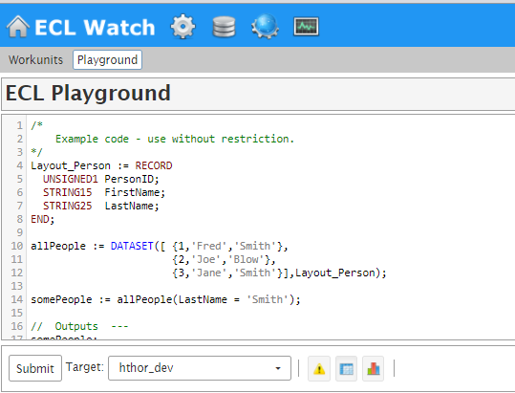
Playground
Playground is equipped with preloaded sample code for practicing and testing purposes.
User can create a new code
Modify current code

Slide 24

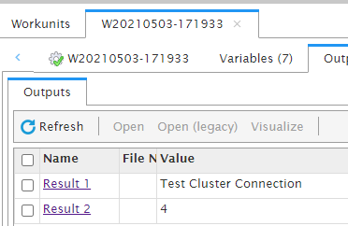
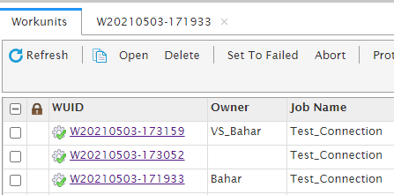
Let’s Get Real
//Lets view the result of TestConnection in WatchPage
//Open the link below explore first, then look for your WUID
http://40.76.26.67:8010/#/stub/Main

Slide 25
Files
File
File contains followings:
Logical Files
Landing Zone
Workunits
Xref

Slide 26
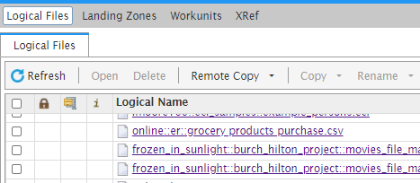
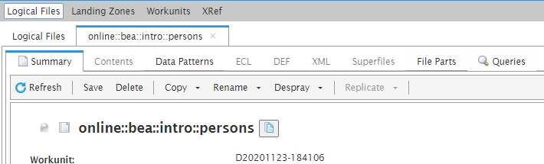
Files
Logical Files
Access to all logical files on the cluster
Selecting a logical file will give user detailed information and action options to take

Slide 27
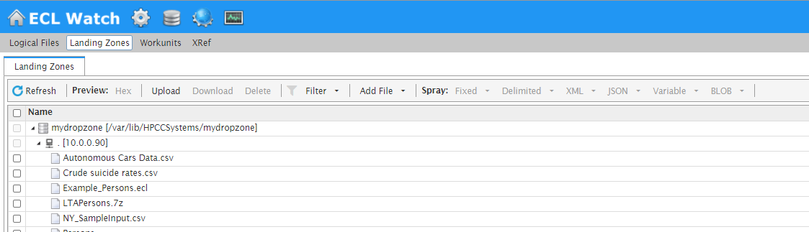
Files
Landing Zones
Upload, download files
Spray, de-spray files
View/modify file information
Supported File Types
Fixed, flat files
Delimited, CSV files
JSON
Variable
BLOB

Slide 28
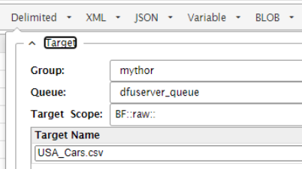
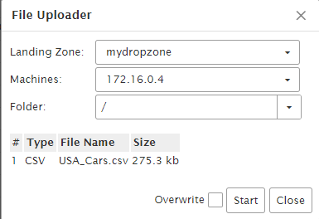
Let’s Get Real
//Let’s work with USA_Cars.csv file
//Download the file from:
https://github.com/hpccsystems-solutions-lab/BigData-Workshop/tree/main/Files
//Add your initial to file name: YourInitial_USA_Cars.csv
//Upload and Spray the file

Slide 29
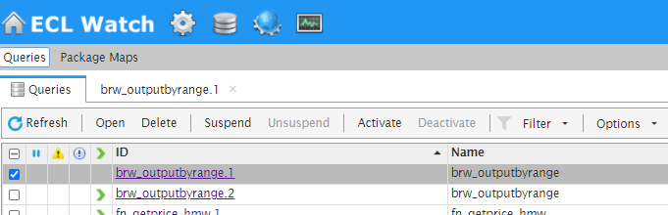
Published Queries
Published Queries
The Queries page lists published queries for each target cluster.
Can see the published queries
You can also perform some actions on the selected queries.
View query
Query details
Graphs
Status
Logical files
Workunit information
Change status of a query

Slide 30
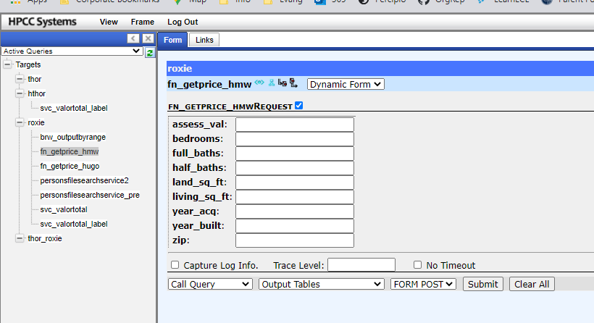
Roxie Interface

Slide 31
Operations
Operations
The Operations link provides access to several components useful for the day-to-day operation of your system, and some system administration access as well.

Slide 32
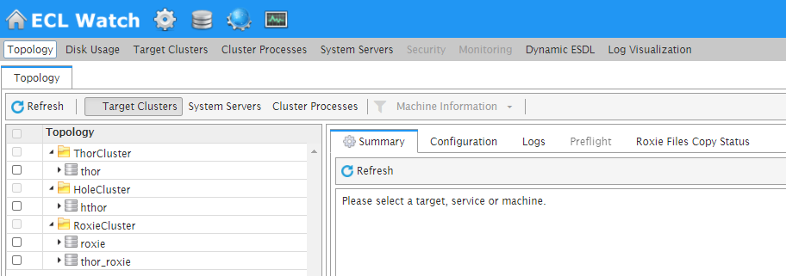
Operations
Topology provides a visual tree display with information about your clusters, services, and nodes.
Disk Usage provides information about the available space on your system, and what is using that space.
Target Clusters provides machine information on the clusters you have set up on your machine.
Cluster Processes/System Servers/Security These tabs provides more information about the specific topology for the selected clusters. They are helpful in certifying that your system is up and running properly.
Monitoring configurable monitoring system for clusters to send out alerts and notifications.
Dynamic ESDL displays the available ESP Services. You can explore the DESDL services and ESDL bindings, also known as service configurations.
Log Visualization integration with ECL Watch using ELK (ElasticSearch, Logstash and Kibana) help identify, track and predict important events and trends on HPCC Systems clusters, by spotting interesting patterns and giving you visual clues which are easier to interpret than reading through the log file itself.

Slide 33
ECL Basics

Slide 34
Objective
ECL vs SQL
House keeping
Data Types
Output
Hands-on

Slide 35
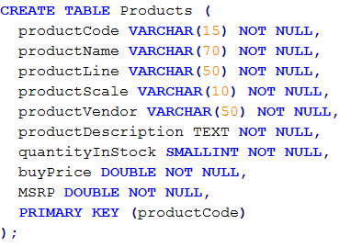
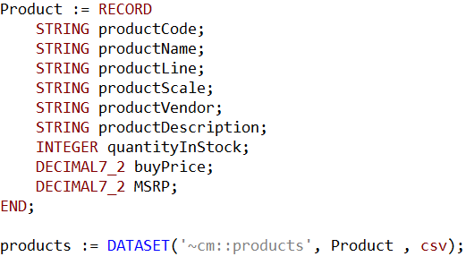
SQL vs. ECL (table and dataset)
SQL
ECL

Slide 36





SQL vs. ECL (sort, count, group)

Slide 37
ECL
ECL is a language design to query/manipulate massive data and is used for ETL (Extract, Transform, Load) and data visualization.
Extract
Reading data from different type of datasets
Transform
Formatting/converting data to needed shape, so it can be used
Load
Writing dataset to it’s target location
Source
Extract
Transfer
Load
Destination

Slide 38
Statement Types
Two Statement Types
Definition
Assign an expression to an attribute
Action
Does something that affects the outside world, such as OUTPUT
Plot Twist
You can define an attribute as an action

Slide 39
House Keeping
Declarative Lang
Not case-sensitive
White space is ignored
Formatting is recommended
// This is a single line comment
/* A block comment */
Object.Property syntax is used to qualify definition scope and disambiguate field references within datasets:
ModuleName.Definition //reference a definition from another module/folder
Dataset.Field //reference a field in a dataset or record set

Slide 40
House Keeping Cont
Definition assignment is :=
Semicolon terminator: num := 12;
Equality test is = valOne = valTwo
Attributes can be defined only once
Only those definitions that contribute to a result are compiled and used
There are no loops. TRANSFORM and PROJECT is used instead
Everything is 1-based index, except Thor slave numbers that start with 0

Slide 41
Common Data Types
Character
STRING[n]
UTF8: unicode character string
UNICODE[_locale][n]: A UTF-16 encoded unicode character string of n characters
Other
BOOLEAN
SET OF <type>
RECORD
DATASET
Numeric
INTEGER[n]: An n-byte integer value. Valid values for n are: 1, 2, 3, 4, 5, 6, 7,or 8
UNSIGNED[n]:
REAL[n]: An n-byte standard IEEE floating point value.
DECIMAL<n>[_y]: A packed decimal value of n total digits. DECIMAL6_3

Slide 42

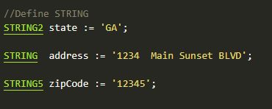


STRING
A character string of n bytes, space padded (not null-terminated)
The upper size limit for any STRING value is 4GB.
attribName The name by which the variable will be invoked
[n] Optional, if omitted, the string is variable length to the size needed to contain the result of the cast or passed parameter.
What happens if define following?

Slide 43

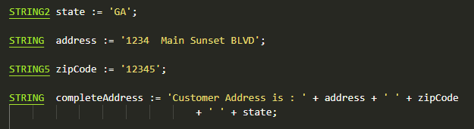
STRING Concatenation
Concatenation can happen using +
It doesn’t change the format of strings being added
attribName The name by which the variable will be invoked
str1 … str_n Values to be added in sequence

Slide 44

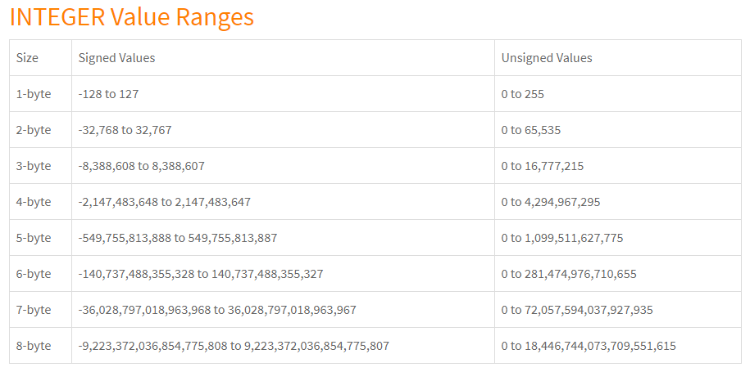
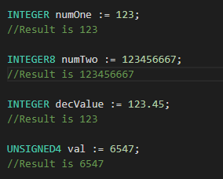
INTEGER
n byte integer value.
Valid values for n are: 1, 2, 3, 4, 5, 6, 7,or 8. If n is not specified for the INTEGER
Default is 8-bytes.
[UNSIGNED] Optional, if omitted the integer is signed.
attribName The name by which the variable will be invoked

Slide 45

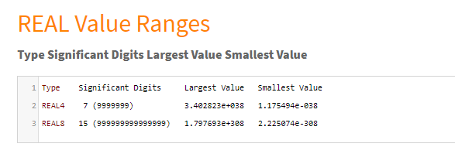
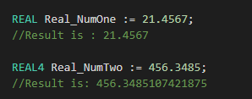
REAL
An n byte standard IEEE floating point value.
Valid values are 4 or 8.
[n]: Optional, if omitted, REAL is a double-precision floating-point value (8-bytes).
attribName: The name by which the variable will be invoked
456.3485107421875 has to do with how computers represent floating points:
https://www.microsoft.com/en-us/microsoft-365/blog/2008/04/10/understanding-floating-point-precision-aka-why-does-excel-give-me-seemingly-wrong-answers/

Slide 46


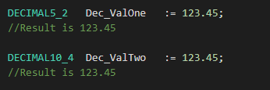

DECIMAL
A packed decimal value of n total digits.
If you have a fixed precision, use decimal instead of real.
N Total digits. Max is 32 leading total.
[_y] Optional, defines the number of decimal places in the value
y <= n
[UNSIGNED] Optional, if omitted the rightmost nibble holds the sign
attribName The name by which the variable will be invoked
How about?
MOD operation with coercion applied. So: 123.45 % 99.9 = (DECIMAL3_1)23.5.

Slide 47
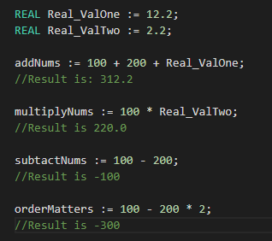
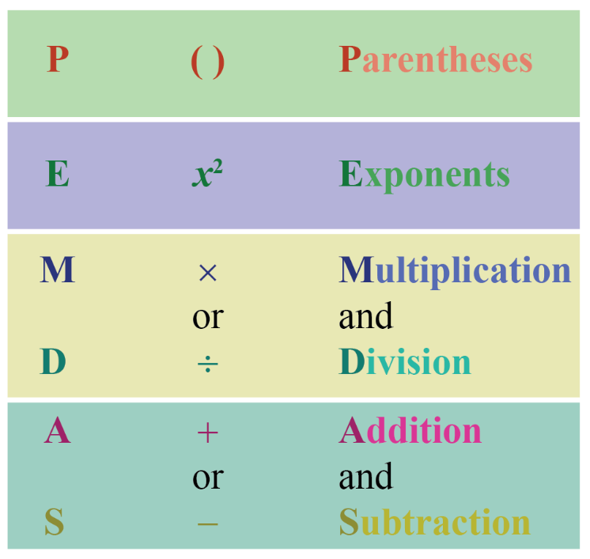
Math on Variables
Simple Math Operations
+
-
/
*
Order of Operation matters

Slide 48
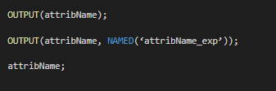
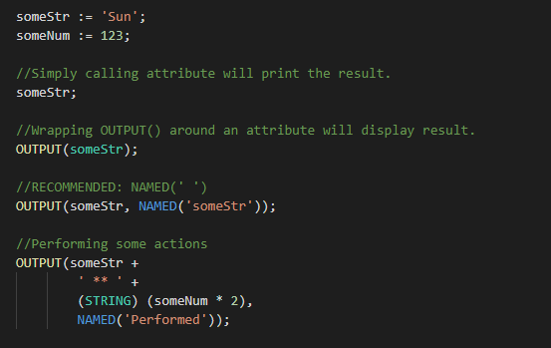
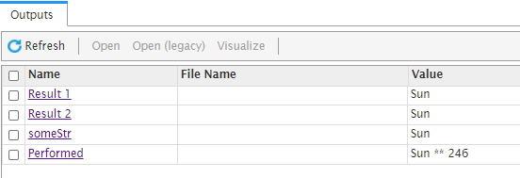
Simple OUTPUT
Used to display result.
OUTPUT Optional, recommended.
NAMED Optional, recommended.

Slide 49
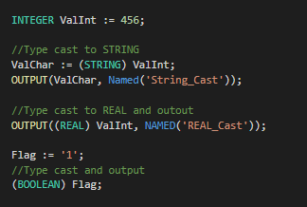


Type Casting

Slide 50
Let’s Get Real
// Open Types_Output.ecl
// Let’s work on TODOs
WU Name

Slide 51
Data Structure & validation

Slide 52
Objective
Data Structure
ECL:
Record layout
Dataset
CHOOSEN
SORT
Filter
DEDUP
SET
Math functions
Hands-on

Slide 53
Data Structure
Data structure is about data management, storage format, retrieving and processing it.
A collection of data types which are stored and organized for further usage.
Benefits
Increased efficiency
Easy modification
Easy access to data

Slide 54

RECORD
Linear representation of file’s record structure.
Defines the layout of fields.
Defines fields types
Defines the order of fields
It can include child record.
A dataset within dataset

Slide 55
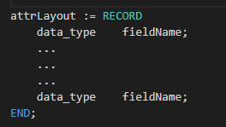
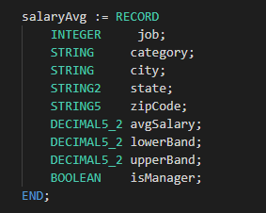
RECORD Structure
attrLayout The name by which the record will be invoked
RECORD Required
data_type Data type of the field (string, integer, Boolean, …)
Fieldname The name by which the field will be invoked
END Indicates the end of record layout

Slide 56
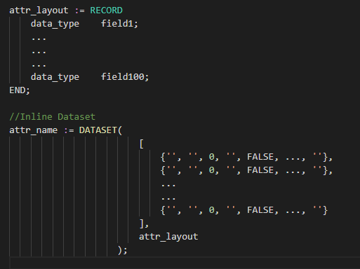
DATASET - Inline
Creates a temporary dataset in memory.
Dataset is only available at run time, unless it’s saved in a file.
Data is created manually.
Will result in a logical/Thor file.
attr_name Dataset name
DATASET Required
attr_layout Record structure the dataset is using
Smaller datasets
Defining an dataset within another functionality
- At the end it’s users choice!
Where can it be used?

Slide 57
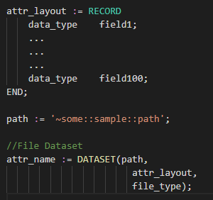
DATASET - Files
attr_name Dataset name
DATASET Required
path
Physical address of file, where file is stored on disk.
~ Not including the cluster the file is on
attr_layout Record structure the dataset is using
file_type Type of file (XML, CSV, logical,…)

Slide 58
Dataset File Types
FLAT Native file type for Thor; also used for fixed-length raw records
CSV Any kind of delimited data, including CSV-encoded data
JSON Data stored as a series of JSON objects
XML Data stored as a series of XML documents
PIPE Data obtained dynamically via process calls

Slide 59
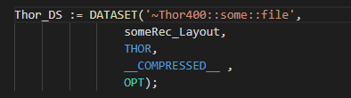
Dataset File Types – Flat Files
Thor/Flat/ logical files
Fixed length file
A few Options
__COMPRESSED__ | Specifies that file is compressed
__GROUPED__ | Specifies that dataset has been grouped, using GROUP function
UNSORTED | Specifies that file is unsorted
PRELOAD | Brings the dataset into memory and keeps it there so it can use it, without going back to storage every time.
ENCRYPT | Specifies that file is encrypted using ENCRYPT option.
OPT | Specifies that if file doesn’t exists return an empty dataset instead of an error

Slide 60
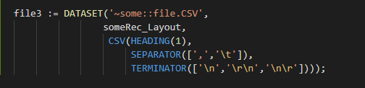
Dataset File Types – CSV Files
To read CSV(Comma Separated Values)
To read variable-length record files with defined record delimiter
Default input is in ASCII format with any UNICODE fields in UTF8 format.
A few Options
HEADING(n) | The number of header records in the file. Default is zero.
SEPARATOR | The field delimiter. Default is a comma (',')
TERMINATOR | The record delimiter. Default is a line feed ('\n')
QUOTE | The string quote character used. Default is a single quote ('\'')
ESCAPE | The string escape character used to indicate the next character. Default is the escape character(‘\’)
MAXLENGTH(size) | Maximum record length in the file in bytes
__COMPRESSED__ | Specifies that the file is compressed

Slide 61
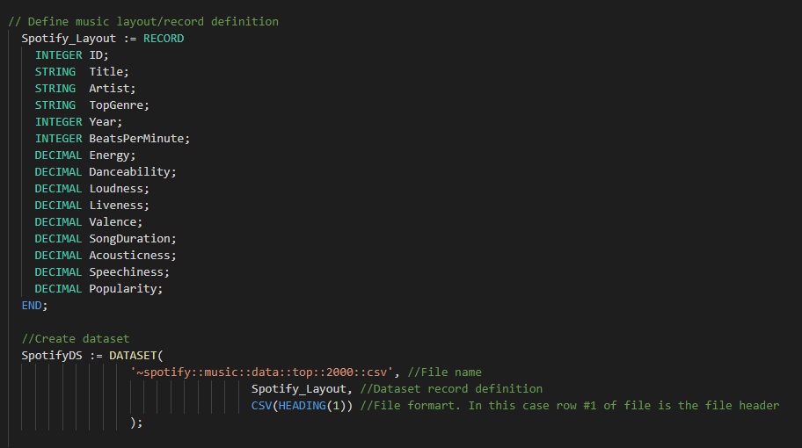
DATASET - Files

Slide 62


CHOOSEN Function
Let’s you display a certain number of rows.
Beginning with the record at the defined row number
attr_name The name by which the function will be invoked
CHOOSEN ECL Keyword, required
dataset_name The dataset to perform action on
n number of records to return
Start_position Optional, to indicate which row to start with. Default is row 1

Slide 63
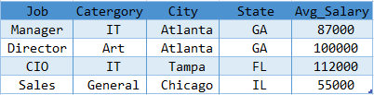
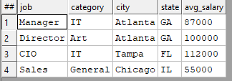
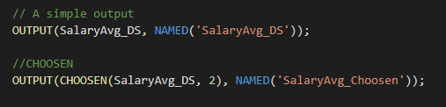

CHOOSEN

Slide 64
Let’s Get Real
// Let’s review & work on Rec_Dataset.ecl:
// We will be working with PART ONE:
CHOOSEN
OUTPUT
WU Name

Slide 65
SORT Function
Ascending or descending sort
attr_name The name by which the function will be invoked
SORT ECL Keyword, required
dataset_name The dataset to perform action on
- sorts descendingly
field(s) field or fields to sort on

Slide 66
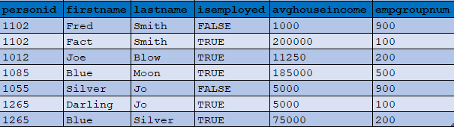



SORT

Slide 67

FILTER
Choosing a smaller part of dataset
It’s recommended to filter down to the desire dataset before any processing
If filtering on STRING value, it is case sensitive
attr_name The name by which the function will be invoked
dataset_name The dataset to perform action on
Filtering conditions field and required filtering conditions

Slide 68


FILTER
All records within dataset will be evaluated
If boolean_expression evaluates to TRUE for a particular record, it will be included in the result
Comparison Operators
=
<> or !=
<
>
<=
>=
<=>
Logical Operators
AND
OR
NOT or ~

Slide 69




FILTER

Slide 70

DEDUP Function
Removes duplicates from a dataset based on the defined conditions
Returns a unique dataset.
Dataset should be sorted, unless ALL is specified.
Dataset Dataset to process
condition A comma-delimited list of expressions or key fields in the dataset that defines "duplicate" records

Slide 71




DEDUP

Slide 72
Let’s Get Real
// Let’s review & work on Rec_Dataset.ecl:
// We will be working with PART TWO:
Filter
SORT
WU Name

Slide 73


SET OF
An array of data elements
Elements have the same data type
Not distributed, so it has to fit into memory
Indexing start from 1
SET OF Required
<dataType> Element's type
attr_name The name by which the operation will be invoked
elem1, elemN Input values

Slide 74



SET Function
Convert values from a field in a dataset to a SET OF
Similar to subset and IN in SQL
Doesn’t remove duplicate values
Doesn’t order the list
attr_name The name by which the function will be invoked
SET ECL keyword, required
dataset_name input dataset
field_name field/column of dataset that will be converted to SET OF

Slide 75


IN – NOT IN Operators
It’s an operator
A collection of OR conditions
Search a SET to check for result
It can be used on a dataset field

Slide 76


BETWEEN Operator
It’s an operator for range check.
Same as <= and >=
attr_name The name by which the operation will be invoked
seek_val The value to be checked. Can be a dataset field
BETWEEN Required
NOT Optional
Low_val Low value in the range
AND Required
high_val High value in the range

Slide 77


Math Functions
COUNT
Returns the total count of a set or a field in a dataset
SUM
Returns the total value from a set or a field in a dataset
attr_name The name by which the function will be invoked
MAX/MIN Required
setValues Input set
dataset_name Input dataset
field_name Field/column of dataset to be checked

Slide 78


Math Functions
MAX
Returns the maximum value from a set or a field in a dataset
MIN
Returns the minimum value from a set or a field in a dataset

Slide 79


Math Functions
AVE
Returns the average value from a set or a field in a dataset
Truncate
Returns the integer portion of real value

Slide 80


Math Functions
ROUND
Returns the rounded real value by using standard arithmetic rounding.
attr_name The name by which the function will be invoked
ROUND Required
Value Real value to be rounded
Decimals Optional, an integer specifying the number of decimal places to be rounded

Slide 81



Slide 82
Let’s Get Real
// Let’s review & work on Set_Math.ecl:
// We will be working with:
Set
Math functions
BETWEEN operator
WU Name

Slide 83
Function, module, & import

Slide 84
Objective
Introduction to Code Structures
ECL:
IMPORT
Function
EMBED
Module
Hands-on

Slide 85

IMPORT
Makes EXPORT definitions within a module available for use.
Module_list: A comma-delimited list of folders or module files in the repository.
$: Makes all definitions in the current folder available.
^: Can be used as shorthand for the container of the current folder.
AS <alias>: To create a local short name for the module
*: Makes everything in that folder available
FROM: Specifies the folder name being imported
Language: The external programming language

Slide 86



IMPORT Statements
Alias

Slide 87

IMPORT

Slide 88

EMBED
Lets you add code written in certain other languages to ECL.
Similar to a FUNCTION structure
Supported lang: SQL, C++, Python, R, etc.
resulttype ECL returned value; required
funcname Function name
parameterlist A comma separated list of the parameters to pass to the function.
EMBED/ENDEMBED Required

Slide 89


EMBED

Slide 90
Code Structures
Code structures are about organizing logic so that it is easy to read and maintain code. ECL encapsulates logic using two main constructs:
Function is typically used to represent fine grained and reusable logic. Examples: String To Date, Date To String are functions that are used to manipulate a Date
Module is typically used to represent multiple functions and their dependencies as a group. Examples: A Date module contains String To Date, Date To String…
Benefits:
Increased Readability
Increase Reuse (if it is used in the context of declarative programming)
Encourages Modular Design (if it is used in the context of declarative programming)

Slide 91
MODULE
Is a container that allows you to group related definitions. The parameters passed to the module are shared by all the related members definitions.
Your file name should be exactly the same as Module name.
Variable Scope
Local definitions are visible only up to an EXPORT or SHARED
SHARED definitions are visible through module.
EXPORT definitions are visible within and outside of a module .

Slide 92

Module
EXPORT Optional, indicates that this module is available outside of this file.
moduleName The name of the function
MODULE Required
param_data_type Data type of each parameter (string, integer, Boolean, …)
END Indicates the end of module
SHARED The attribute or function can be accessed within the module
EXPORT The attribute or function can be accessed from outside of the module as well as with the module

Slide 93



MODULE

Slide 94


Module Example

Slide 95

Let’s Get Real
// Let’s review & work on Layout/Population and Vaccine files:
// Let’s start by looking at field types, format and field definitions, and data dictionary
WU Name

Slide 96


Let’s Get Real
// Now let’s see the data for each field using ViewRawFiles
WU Name

Slide 97


FUNCTION
retValueType Optional return value data type
functionName The name of the function
FUNCTION Required
param_data_type Data type of each parameter (string, integer, …)
Code Placeholder for ECL code
END Indicates the end of function

Slide 98



FUNCTION

Slide 99

One Line FUNCTION
If not much code for a function, then a short version of function can be used.
FUNCTION, RETURN and END keywords are omitted.

Slide 100
Data enrichment

Slide 101
Objective
Data Cleansing
Data Transformation
ECL:
IF
MAP
TRANSFORM
PROJECT
Hands-on

Slide 102
Data Validation
It is often a good idea to test specific values within records for validity
What you do with the results is a different matter
Recommendation: Mark the record as having problems, but don’t delete it
Validation is usually fast and easy
Define a new record structure with new fields containing test results
BOOLEAN values with descriptive names
Include a final “is this valid” BOOLEAN field that summarizes all tests
This makes it easy to filter the records
All of the above can be done in one pass, using the PROJECT() function

Slide 103
Data Cleansing
Data Cleansing is the process of fixing or removing incorrect, corrupted, incorrectly formatted, duplicate, or incomplete data within a dataset.
Part of Data Validation process
Used upon receiving raw data and structuring the data
Also used when combining multiple datasets (in case of duplication, or incomplete data)
Data Cleansing Techniques
Removing duplicates
Removing irrelevant data
Fix structural errors/inconsistent data: “N/A” vs “Not Available”
Handling missing data

Slide 104
Data Transformation
Data Transformation is the process of converting data from one format or structure into another
Changing the shape/format of data
Part of Data Validation and Data Cleansing processes
Also used when combining multiple datasets (in case of duplication, or incomplete data)
Examples
Address cleaning: breaking one line address to different fields
Converting all SSN or DOB to a business approved format
Adding leading 0 or blanks to make all values in a field unified
Can you think of other examples?

Slide 105

IF Function
IF function evaluates the expression to generate a Boolean result.
Both the true-result and false-result must be the same type
attr_name The name by which the function will be invoked
IF Required
expression Boolean expression to be check for True or False
true_result Result value or action if expression is True
false_result May be omitted only if true_result is an action

Slide 106
MAP Function
Evaluates the list of Boolean expressions and returns the value associated with the first true expression.
If none of them match, the else-value is returned.
All return value and else_value values must be of the same type
All expressions must reference the same level of dataset scoping
Therefore, all expressions must either reference fields in the same dataset or the existence of a set of related child records
The expressions are typically evaluated in the order in which they appear, but if all the return values are scalar, the code optimizer may change that order.

Slide 107

MAP Function
attr_name The name by which the function will be invoked
MAP Requied
Expression1…N Boolean expression
=> “Result in” operator
Else_value Optional ,if all other possible return values are actions, otherwise required.

Slide 108

MAP Function

Slide 109
TRANSFORM Function
Specifies exactly how each field in an output record receives its value.
The result of a call to a TRANSFORM is one record
The body of a TRANSFORM defines how fields within the resulting record are populated
TRANSFORM is used with PROJECT, JOIN, ITERATE, ROLLUP and more.

Slide 110

TRANSFORM Function - Standalone
EXPORT
Optional, used for constants, or in modules
return_dataset_layout
Record-definition/layout of result dataset
transform_name
The name by which the transform will be invoked
Input_arguments_types
The argument’s data type
If passing a dataset, the data type is DATASET(record_definition)
arg_name
Used to reference your argument in the transform

Slide 111
TRANSFORM Function - Standalone
TRANSFROM
Required
SKIP Optional. Specifies the condition under which the TRANSFORM function operation is skipped.
SELF
Reference a field in return_dataset_layout
argname.inputDataset_fieldname
Refers to the field in the input dataset
END
Required

Slide 112
TRANSFORM Function
Attribute Definition
SELF := [];
For every field in result layout that doesn’t have a defined operation or doesn’t exists in input dataset, assign default value.
For example, if there is a STRING field in result layout that TRANSFORM didn’t assign a definition for, it will be assigned an empty string.
If included, it is almost always the last assignment.
SELF := LEFT;
SELF := RIGHT;
Get the original values from input dataset for all fields that don’t have an operation defined.
NOTE You can write inline function or call other functions or modules in your transform.

Slide 113

TRANSFORM Function - Standalone

Slide 114

TRANSFORM Function - Inline
Used inline with PROJECT, JOIN, ROLLUP, etc.
No Keyword END
No passing argument
Input records are referred to as LEFT and RIGHT

Slide 115

PROJECT Function
The PROJECT function processes through all records in the record-set performing the transform function on each record in turn.
PROJECT can be used with many functions such as TRANSFORM, JOIN, ROLLUP, etc.
PROJECT is like SQL's SELECT … INTO TABLE …
EXPORT
Optional, used for constants, or in modules
project_name
The name by which the project will be invoked
input_dataset
The input dataset

Slide 116



Example
NameOutRec: Result Layout
CatThem: Transform Name
Person_Layout: Input Dataset Layout
L : Reference to Person_Layout fields
SELF: Refers to fields in result dataset
C: Will do the Counting

Slide 117



Example
CatRecs: Project Name
NameDS: Input Dataset to loop through
NameOutRec: Result layout
SELF: Refers to fields in result dataset
SELF := LEFT: Assign everything with same field name from NameDS
SELF := [ ]: All un-assigned fields will be set to default values

Slide 118
Let’s Get Real
// Let’s review getCars and work on cars_projects
// We will be reviewing the TRANSFORM and add the following fields:
Old_Exp: If price >= 10000 AND year <= 2012, then it's pricey
colorType: If color is part invalidColors then 'Invalid Entry’, if part of darkColors then 'Dark', else is 'Light' color
WU Name

Slide 119
Std library

Slide 120
Objective
STD Library Introduced
ECL:
Some string functions
Some date functions
Hands-on

Slide 121
STD Library
STD (Standard) Library, provides, prebuild function to provide more support for ECL language.
This library includes supports for:
String handling
Std.Str
Std.Uni
Date & Time
Std.Date
Files
Std.File
Clusters
Std.System.Thorlib
Jobs
Std.System.Job
And more

Slide 122


STD Library – Find
Return the beginning index position within the source string of the specified instance of the target string.
Returns0, if target is not found or specified instance is greater than the number of occurrences of the target.
source A string containing the data to search.
target A string containing the substring to search for.
instance An integer specifying which occurrence of the target to find.

Slide 123

STD Library – FindReplace
Returns the source string with the replacement string substituted for all instances of the target string .
It’s case sensitive.
If the target string is not in the source string, it returns the source string unaltered.
source A string containing the data to search
target A string containing the substring to search for.
replacement A string containing the replacement data.

Slide 124

STD Library – FindReplace

Slide 125

STD Library – SplitWords
Returns the list of words in the source string split out by the specified separator.
source A string containing the words to extract.
separator A string containing the word delimiter to use.
allowblank Optional. If TRUE, specifies allowing blank items in the result. Default is FALSE

Slide 126


STD Library – Case Changes
Returns, lower, upper, or title case based on the chosen function.
source A string containing the data to change case.

Slide 127



Date Data Types
Date_rec A RECORD structure containing three fields, and INTEGER2 year, an UNSIGNED1 month, and an UNSIGNED1 day.
Date_t An UNSIGNED4 containing a date value in YYYYMMDD format. This type does not support dates prior to 1AD
Days_t An UNSIGNED4 containing a date value representing the number of elapsed days since a particular base date.

Slide 128


Time Data Types
Time_rec A RECORD structure containing three fields, and INTEGER1 hour, an UNSIGNED1 minute, and an UNSIGNED1 second.
Time_t An UNSIGNED3 holding a time of day in the decimal form HHMMDD.
Seconds_t An INTEGER8 holding a number of seconds. Can be used to represent either a duration or the number of seconds since epoch

Slide 129


Year – Month – Day Functions
Year Returns the Year number from date value.
Month Returns the Month number from date value.
Day Returns the Day number from date value.
date A date value in the Date_t format (YYYYMMDD)

Slide 130


FromStringToDate Function
Converts a string to a Date_t(YYYMMDD) using the relevant string format.
The resulting date must be representable within the Gregorian calendar after the year 1600.
date_text The string to be converted
format The format of the input string.

Slide 131

FromStringToDate Function

Slide 132


Between Function
DaysBetween
Calculates and returns the number of whole days between two dates
MonthsBetween
Calculates and returns the number of whole days between two dates
fromDate The first date value in Date_t format.
toDate The last date value in Date_t format.

Slide 133
Let’s Get Real
// Let’s review Vacc_Clean
//For this part we only work on PART ONE
WU Name

Slide 134
Data Append

Slide 135
Objective
Data Enrichment
Data Append
ECL:
JOIN
Hands-on

Slide 136
Data Enrichment/Enhancement
Data Enrichment is the process of adding new data elements to an existing data for more complete data
Combining data also counts as data enrichments
Breaking apart complex field values into separate fields
Standardizing similar fields (dates, time)
It mostly happens after receiving raw data and structuring it, but keep in mind that it’s a continuous process.
Can be used to improve data quality as part of data validation process
Examples
Enhancement of a company’s customer files:
Companies often collect basic information on their clients such as phone numbers, emails, or addresses. A data append takes the information they have, matches it against a larger database of business data, allowing the desired missing data fields to be added.

Slide 137
Data Append
Data Append, and Enrichment are used interchangeably.
Enriching internal sales data with third party advertisement data to get a better understanding of advertising effectiveness.
Adding demographic information to customer data for target sales

Slide 138

JOIN
JOIN is used to combine data or rows from two or more tables/datasets based on at least one boolean expression test.
Part of Data Append or Data Enrichment.

Slide 139


Join Types
INNER Join Selects all rows from both the dataset if the condition satisfies.
This join will create the result-set by combining all rows from both the datasets where the condition satisfies. This is the default JOIN.
FULL OUTER Join Selects all rows from both the datasets regardless of join condition.
This join will create the result-set by combining all rows from both the datasets, including matched and non matched rows.
For non matched rows, the fields from opposite dataset will remain null.

Slide 140


Join Types
LEFT ONLY Join Returns all the rows of the dataset on the left side of the join that didn’t match any rows from right dataset.
LEFT OUTER Join Returns all the rows of the dataset on the left side of the join and matching rows for the dataset on the right side of join.

Slide 141
Join Types
INNER | Default, keep only those records that exist in both datasets.
LEFT OUTER | Keep all records from LEFT, even if there are no matches.
RIGHT OUTER | Keep all records from RIGHT, even if there are no matches.
LEFT ONLY | One record for each left record with no match in the right.
RIGHT ONLY | One record for each right record with no match in the left.
FULL ONLY | One record for each left and right record with no match in the opposite.
FULLER OUTER | One record for each record in left and right dataset.

Slide 142

Join Types

Slide 143

JOIN
attribName The name by which the join will be invoked
LEFT_DatasetName Left dataset name
RIGHT_DatasetName Right dataset name
LEFT.fieldName = RIGHT.fieldName
Join condition
can use equal (=) or not-equal (!=)
multiple conditions can exists using AND/OR
Transform/xFormName
Join, inline or stand-alone transform
JoinType Default is Inner join.
Flags Optional
Note: When join condition is on STRING and the = operator is used, case sensitivity matters.

Slide 144
JOIN Condition & Transform
Condition
Boolean test of arbitrary complexity
Normally contains at least one equality test
Reference attributes within the input datasets via LEFT and RIGHT - ds1 = LEFT - ds2 = RIGHT
Join conditions can be arbitrarily complex but should include at least one equality test
Transform
If using an explicit TRANSFORM, it should accept at least two arguments
One representing a LEFT record and the other representing a RIGHT record
If using an inline TRANSFORM, use LEFT and RIGHT to reference input data

Slide 145
Optional Flags
LOOKUP The right dataset is relatively small and there should be only one match for any LEFT record
ALL The right dataset is relatively small and can be copied to every node in its entirety
Can have multiple matches (unlike LOOKUP)
Supports join conditions that contain no equalities
Required if there are no equality tests in the condition
Few Specifies the LOOKUP right dataset has few records, so little memory is used
NOSORT Performs the JOIN without dynamically sorting the tables. This implies that the left and/or right record-set must have been previously sorted and partitioned based on the fields specified in the join Condition
KEYED Specifies using indexed access into the right record-set
LOCAL JOIN performed on each supercomputer node independently, and maintains the pervious distribution of data
KEEP(n) Specifies the maximum number of matching records (n) to generate into the result set. If omitted, all matches are kept.
LIMIT Specifies a maximum number of matching records which, if exceeded, either fails the job, or eliminates all those matches from the result set.

Slide 146







Slide 147
Let’s Get Real
// Let’s review & complete Vacc_Analyze PART ONE
// Note: PopDS_Clean will be reviewed later.
WU Name

Slide 148
Data aggregation

Slide 149
Objective
Data Aggregation
ECL
TABLE
GROUP
Hands-on

Slide 150
Data Aggregation
Data Aggregation is the process of gathering data and presenting it in a summarized format.
Data can be gathered from multiple resources
Data should be high quality to represent valid information
The result can uncover all kind of od information about your data
Can lead to improving business decision
Can help with target marketing
Can help with research
Purpose
Data Reduction: To reduce the amount of data
Change of Scale: Data can be viewed in a higher level. Exp: State level info
More Stable Data: Tends to have less variability. A way to reduce the effect of unwanted noise. Exp: human errors, sample collection errors

Slide 151
Data Aggregation
Examples
Average age of customer by product. Each individual customer is not identified, but the average age of the customer is saved for each product.
Number of customers by country.
Can you think of a few usage?
Class average
Survey result
Voting result per demographic

Slide 152
TABLE Function
Creates a new dataset in memory while job is running.
The new table inherits the implicit relationality the record-set has (if any), unless the optional expression is used to perform aggregation.
There are two types of Table:
Basic concept is similar to SQL’s GROUP BY
Group records that evaluate to identical expressions, then perform aggregations across each group
Examples
MIN/MAX/AVE flight distance
Record counts
Variances

Slide 153

TABLE Function
out_record_der Result layout
Record definition that will contain both the grouping condition results and any new attributes computed as part of the aggregation
Functions that operate on TABLE groups
When used within TABLE, these functions accept the keyword GROUP to denote currently-grouped table data
dataset.field Field(s) from input dataset.
filed_name Creating new fields
attr_name The name by which the table will be invoked
Dataset Input dataset to create the table from

Slide 154
TABLE Function
grouping_conditions
One or more comma-delimited expressions
An expression could simply be an attribute name within the dataset; this is the most common usage
An expression could be a computed value, such as (myValue % 2) to group on even/odd values
All records within dataset that evaluate to the same set of condition values will be grouped together
Each group will result in one output record
Functions evaluated within outrecorddef will operate on the group

Slide 155
TABLE Function
Flag Options
FEW | Indicates that the expression will result in fewer than 10,000 distinct groups. This allows optimization to produce a significantly faster result.
MANY | Indicates that the expression will result in many distinct groups.
UNSORTED | Specifies that you don’t care about the order of the groups. This allows optimization to produce a significantly faster result.
LOCAL | Specifies the operation is performed on each node independently; the operation maintains the distribution of any previous DISTRIBUT.
KEYED | Specifies the activity is part of an index read operation, which allows the optimizer to generate optimal code for the operation.
MERGE | Specifies that results are aggregated on each node and then the aggregated intermediaries are aggregated globally. This is a safe method of aggregation that shines particularly well if the underlying data was skewed.
SKEW | Indicates that you know the data will not be spread evenly across nodes.

Slide 156
GROUP Keyword
The GROUP keyword is used within output format parameter (RECORD Structure) of a TABLE definition.
GROUP replaces the recordset parameter of any aggregate built-in function used in the output to indicate the operation is performed for each group of the expression.
This is similar to an SQL “GROUP BY” clause.

Slide 157



TABLE Function

Slide 158




Slide 159
Let’s Get Real
// Let’s review & complete Vacc_Analyze
// We be working with PART TWO
WU Name

Slide 160
ECL Advance Function

Slide 161
Objective
ECL
ROLLUP
ITERATE
Hands-on

Slide 162
ROLLUP
Similar to the DEDUP function with the addition of a call to the transform function to process each duplicate record pair.
Must be sorted
Instead of just eliminating the record (like DEDUP), ROLLUP passes the matching records to a TRANSFORM, allowing you to create the best composite record.
Retrieve valuable information from the "duplicate" record before it's thrown away.
Depending on how you code the transform function, ROLLUP can keep the LEFT or RIGHT record, or any mixture of data from both.
There are three ways to perform ROLLUP. We cover only cover one format.

Slide 163

ROLLUP
This form is a special form of ROLLUP where:
The second parameter passed to the transform is a GROUP.
The first parameter is the first record in that GROUP.
It processes through all groups in the recordset, producing one result record for each group.
Aggregate functions can be used inside the transform on the second parameter.
The result record set is not grouped.

Slide 164
ROLLUP – Optional Flags
UNORDERED | Specifies the output record order is not significant
ORDERED | Specifies the significance of the output record order
STABLE | Specifies the input record order is significant
PARALLEL | Try to evaluate this activity in parallel
LOCAL | Specifies the operation is performed on each node independently, without requiring interaction with all other nodes to acquire data
GROUP | Specifies the recordset is GROUPed and the ROLLUP operation will produce a single output record for each group.

Slide 165
Let’s Get Real
//Lets review and work on Vacc_Clean_Pop
//We will be completing the TODO part

Slide 166
ITERATE Function
ITERATE does not change the layout; therefore, these layouts must all match:
Input dataset
Result dataset
LEFT and RIGHT in the TRANSFORM
Result of TRANSFORM
Process through all records, one pair at a time
Perform some processes on each pair using TRANSFORM
First records passed into iteration is RIGHT record
So, your first LEFT record is always a blank row
LEFT passed to TRANSFORM is the result of previous iteration TRANSFORM
TRANSFORM must have a LEFT and a RIGHT

Slide 167

ITERATE Function

Slide 168
ITERATE – Optional Flags
UNORDERED | Specifies the output record order is not significant
ORDERED | Specifies the significance of the output record order
STABLE | Specifies the input record order is significant
PARALLEL | Try to evaluate this activity in parallel
LOCAL | Specifies the operation is performed on each node independently, without requiring interaction with all other nodes to acquire data

Slide 169



ITERATE Function

Slide 170



ITERATE Function

Slide 171
Let’s Get Real
// Let’s review Vacc_Clean
//For this part we only work on PART TWO
WU Name

Slide 172
Resources
ECL Document: https://d2wulyp08c6njk.cloudfront.net/releases/CE-Candidate-7.4.8/docs/EN_US/ECLLanguageReference_EN_US-7.4.8-1.pdf
ECL Cheat Sheet: https://ide.hpccsystems.com/files/ECL_Cheat_Sheet.pdf
ECL Watch: https://cdn.hpccsystems.com/releases/CE-Candidate-7.12.8/docs/EN_US/The_ECL_Watch_Manual_EN_US-7.12.8-1.pdf
STD Library: https://cdn.hpccsystems.com/releases/CE-Candidate-6.4.2/docs/ECLStandardLibraryReference-6.4.2-1.pdf
Extra Resources
Data Visualizing: https://d2wulyp08c6njk.cloudfront.net/releases/CE-Candidate-7.6.2/docs/EN_US/VisualizingECL_EN_US-7.6.2-1.pdf
Visualizer Library: https://github.com/hpcc-systems/Visualizer
HPCC Machine Learning Library: https://hpccsystems.com/download/free-modules/machine-learning-library
Machine Learning Demystified Blog: https://hpccsystems.com/blog/machine-learning-demystified
Using HPCC Systems ML: https://hpccsystems.com/blog/HPCC-Sytems-Machine-Learning
Data Patterns: https://github.com/hpcc-systems/DataPatterns.git

