Slide 1


Big data hpcc
Notes:
NOTE:
To change the image on this slide, select the picture and delete it Then click the Pictures icon in the placeholder to insert your own image

Slide 2
• ECL Watch (Spray, WUID, main concepts)
• ECL CouldIDE / VSCode
• Intro to ECL (Data types, declarative, house keeping)
• MODULE
• FUNCTION
• TRANSFORM
• PROJECT
• TABLE, GROUP
• Aggregation (Math Func, SUM, COUNT, …)
• SORT
• Filter
• DEDUP
• OUTPUT
• JOIN

Slide 3
Objective
Workshop Session 1 (Bahar)
ECL Watch (Spray, WUID, main concepts)
ECL CouldIDE / VSCode
Intro to ECL (Data types, declarative, house keeping)
MODULE
FUNCTION
OUTPUT
DATASET
FILTER
SORT
Workshop Session 2 (Arjuna)
PROJECT
ITERATE
JOIN
DEDUP
TRANSFORMS

Slide 4
Objective
Setting up CloudIDE
Setting up VsCode

Slide 5
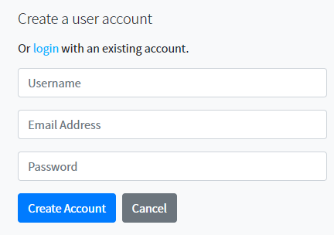
CloudIDE
CloudIDE is our cloud-based IDE which developers can simply login and start coding.
Code source:
Providing the workspace link later
Select Register
Enter information
Select Create Account
A confirmation email is sent
Confirm the account

Slide 6
ECL CloudIDE
Setting up CloudIDE
Setting up VsCode

Slide 7

VSCode
Code repository:
Link will be provided later
Clone or copy the code in your local machine
Open VSCode
Extension installation: search for ECL Language
Install the plugin
Select File/Open Folder
Select SourceCode folder

Slide 8
ECL watch

Slide 9
File Type Definitions
Physical File
Any file types that is stored on a disk.
Logical File
logical files appear to be the same as physical files,
but the underlying representation could be either physical files or distributed files.
Super File
Managed list of subfiles (Logical Files) treated as a single logical entity.

Slide 10
ECL Watch
Browser-based interface that provides admin control over a cluster
Monitor cluster status
Job information
View Data Profile
Schedule and reschedule periodic tasks
Manage data
Maintain Roxie queries
Security management
Default URL
ECL Watch: http(s)://hostname:8010
Roxie Page: http(s)://hostname:8002

Slide 11
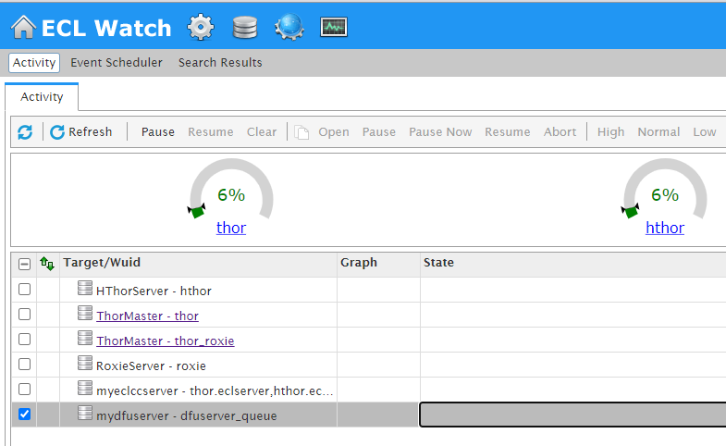
View Workunits
View Files
Published Queries
Cluster Information
Clusters Usage
Clusters Name

Slide 12
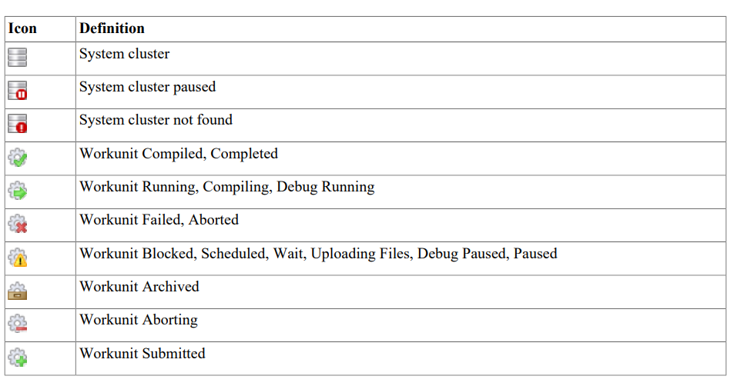
Watch Page Icons

Slide 13
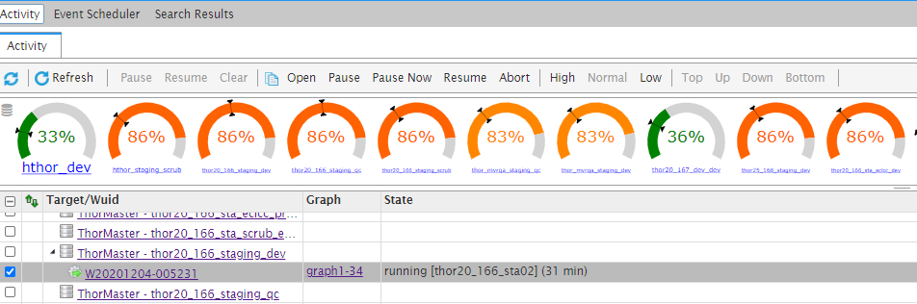
Cluster & Job Options
Cluster Actions
WU Actions
Queuing Option
Priorities

Slide 14
Cluster & Job Options
Cluster Options
Allows to work on selected cluster job queue
Pause: Pause the cluster’s job queue
current running job will complete
Resume: Resume a paused job any waiting job will resume action
Clear: Remove all WUID from a queue selected jobs are set to abort,
all jobs need to be resubmitted later
WUID Options
Clear: Remove all WUID from a queue
Open: Open the job page
Pause: Pause the job after completing
the current subgraph
Pause Now: Interrupts the current subgraph
Resume: Resume a paused job
Abort: Kill a job
Can aborted job be resumed?
No, it needs to be resubmitted if needed.
Note: User can use these options for ANY jobs, so be careful!

Slide 15
Cluster & Job Options
Priority Options
User can set priorities to jobs
High
Normal
Low
Queue Options
change the position of a job in the queue
Top
Down
Up
Bottom
Note: User can use these options for ANY jobs, so be careful!

Slide 16
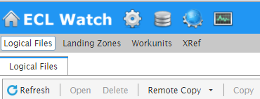
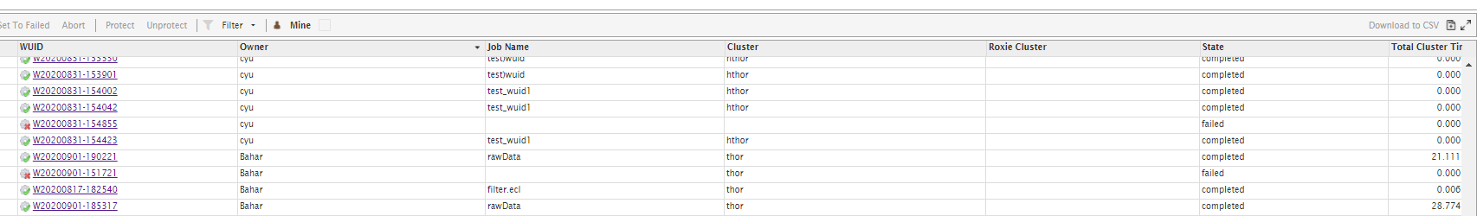
Workunits (WUID / WU)
Workunits displays:
Workunit ID
Owner
Job Name
Cluster job ran on
Job state (Compile, execute, complete, fail)
Total run time
Each workunit provides details such as:
Job information
ECL code
Outputs
Job workflow
Further action items
Publish the job
ECL

Slide 17
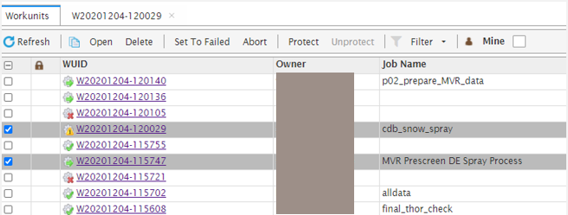
Workunits (WUID / WU)
Open to open the selected workunit(s)
Delete to delete selected workunit(s)
Set to Failed to set the state of the selected workunit(s)
Abort to stop a selected workunit that is running and abort the job
Protect to lock the selected workunit(s). This prevents it from archiving by the Sasha server
Unprotect to unlock the selected locked workunit(s)

Slide 18
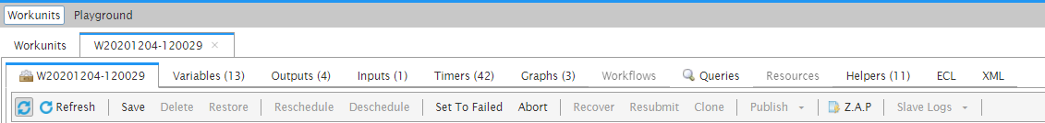
Workunits (WUID / WU) Details
ID Display job information.
Variables Saves any changes to the workunit.
Outputs Display job result(s).
Inputs Display source files.
Timers Display WU timings.
Graphs Graph generated by job.
Workflow Only exists if you have an attribute scheduled. There are multiple workflows when your code contains more than one WHEN statement.
Queries Only appear in the workunit details if the work unit is a published query.
Resources
Helpers Displays several helpful elements of a WU.
XML, Logs, C++, etc.
ECL Displays code.
XML Workunits XML record as stored in Dali..

Slide 19
Workunits (WUID / WU) Details
Refresh Redisplays the workunit details.
Save Saves any changes to the workunit.
Delete Deletes the workunit.
Restore Restores an archived workunit. (Workunits are archived by Sasha).
Reschedule Reschedules a workunit which has been descheduled.
Deschedule Stops the scheduled workunit from running.
Set To Failed Changes the workunit state to failed.
Abort Stops a running workunit and aborts the job.
Recover Resubmits the workunit without resetting the workflow. This resumes processing from the same point in the process where it ended previously.
Resubmit This resets the workflow and starts it over from the beginning.
Publish To publish a query.
Clone Creates a new copy of the workunit. The new workunit is now owned by the user who cloned it.
Publish Publishes the workunit as a published query.
Z.A.P. Packages up workunit and system information into a Zip file that can be shared.
Slave Logs Download the logs for the specified Thor cluster.
What is ZAP and Save Logs useful for?
For troubleshooting and bug reporting.

Slide 20
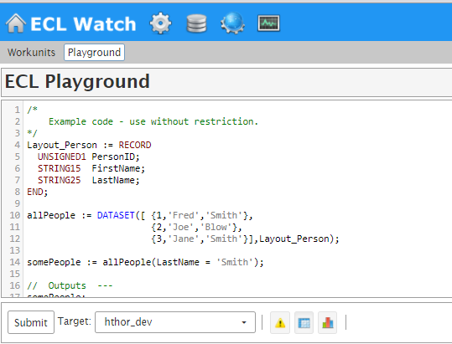
Playground
Playground is equipped with preloaded sample code for practicing and testing purposes.
User can create a new code
Modify current code

Slide 21

Let’s Get Real
//1- Run a job in playground
//2- View job result

Slide 22
Files
File
File contains followings:
Logical Files
Landing Zone
Workunits
Xref

Slide 23
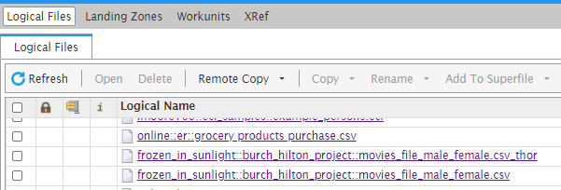
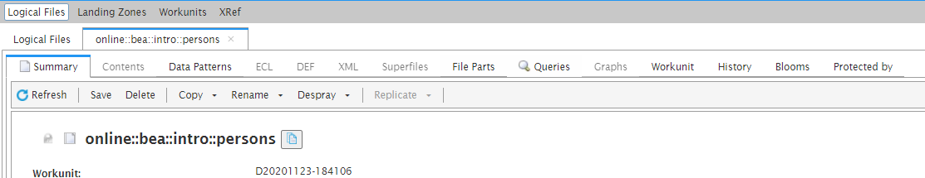
Files
Logical Files
Access to all logical files on the cluster
Selecting a logical file will give user detailed information and action options to take

Slide 24
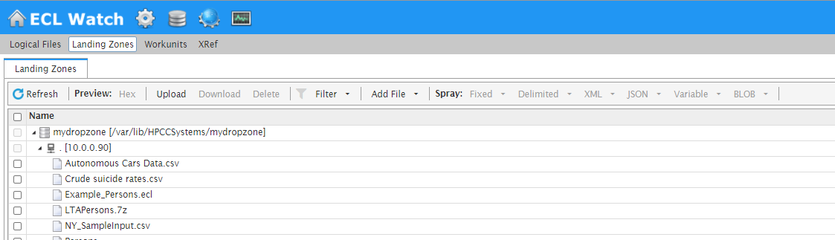
Files
Landing Zones
Upload, download files
Spray, de-spray files
View/modify file information
Supported File Types
Fixed, flat files
Delimited, CSV files
JSON
Variable
BLOB

Slide 25
Let’s Get Real
//Let’s work with USA_Cars.csv file
//Download the file from:
https://github.com/hpccsystems-solutions-lab/ECL-Workshop/tree/main/SourceCode/RawFiles
//Add your initial to file name: YourInitial_USA_Cars.csv
//Spray the file
//View the file

Slide 26
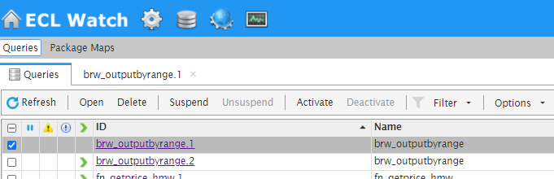
Published Queries
Published Queries
- The Queries page lists published queries for each target cluster.
- Can see the published queries
- You can also perform some actions on the selected queries.
View query
Query details
Graphs
Status
Logical files
Workunit information
Change status of a query

Slide 27
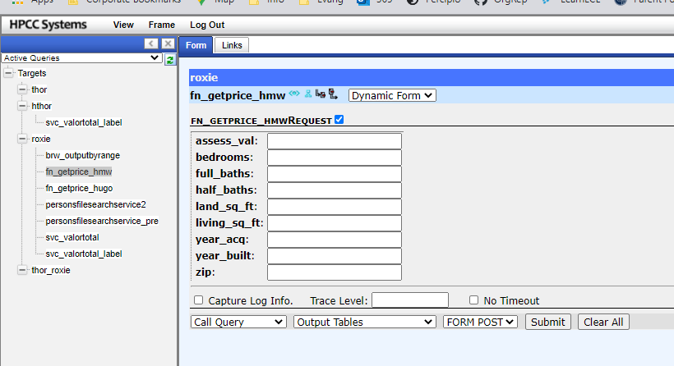
Roxie Interface

Slide 28
Operations
Operations
The Operations link provides access to several components useful for the day-to-day operation of your system, and some system administration access as well.

Slide 29
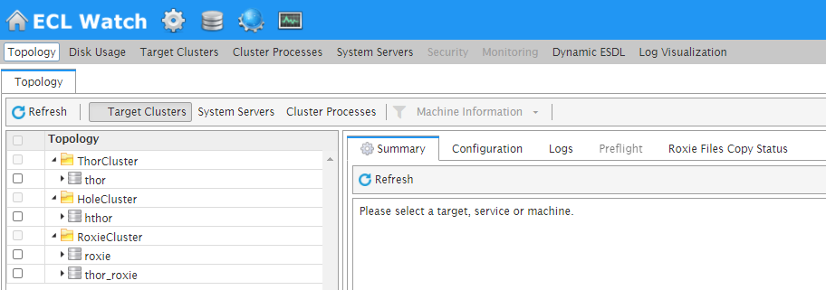
Operations
Topology provides a visual tree display with information about your clusters, services, and nodes.
Disk Usage provides information about the available space on your system, and what is using that space.
Target Clusters provides machine information on the clusters you have set up on your machine.
Cluster Processes/System Servers/Security These tabs provides more information about the specific topology for the selected clusters. They are helpful in certifying that your system is up and running properly.
Monitoring configurable monitoring system for clusters to send out alerts and notifications.
Dynamic ESDL displays the available ESP Services. You can explore the DESDL services and ESDL bindings, also known as service configurations.
Log Visualization integration with ECL Watch using ELK (ElasticSearch, Logstash and Kibana) help identify, track and predict important events and trends on HPCC Systems clusters, by spotting interesting patterns and giving you visual clues which are easier to interpret than reading through the log file itself.

Slide 30
ECL Basics

Slide 31
Objective
ECL vs SQL
House keeping
Data Types
Output
Hands-on

Slide 32
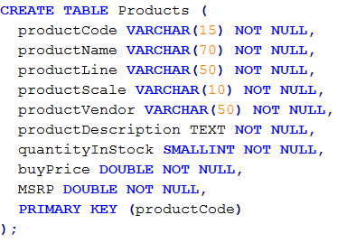
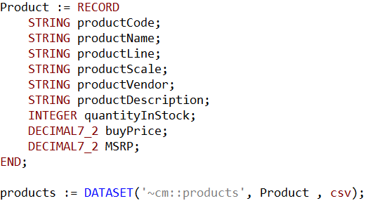
SQL vs. ECL (table and dataset)
SQL
ECL

Slide 33





SQL vs. ECL (sort, count, group)

Slide 34
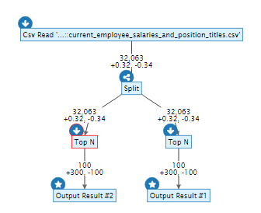

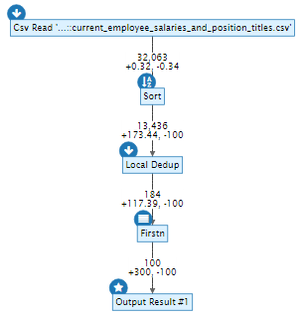

ECL: A Powerful Data Flow Language
How the system executes it
How you code

Slide 35
ECL
ECL is a language design to query/manipulate massive data and is used for ETL (Extract, Transform, Load) and data visualization.
Extract
Reading data from different type of datasets
Transform
Formatting/converting data to needed shape, so it can be used
Load
Writing dataset to it’s target location
Source
Extract
Transfer
Load
Destination

Slide 36
Statement Types
Two Statement Types
Definition
Assign an expression to an attribute
Action
Actually do something that affects the outside world
Plot Twist
You can define an attribute as an action

Slide 37
House Keeping
Declarative Lang
Not case-sensitive
White space is ignored
Formatting is recommended
// This is a single line comment
/* A block comment */
Object.Property syntax is used to qualify definition scope and disambiguate field references within datasets:
ModuleName.Definition //reference a definition from another module/folder
Dataset.Field //reference a field in a dataset or record set

Slide 38
House Keeping Cont
Definition assignment is :=
Semicolon terminator: num := 12;
Equality test is = valOne = valTwo
Attributes can be defined only once
Only those definitions that contribute to a result are actually compiled and used
There are no loops. TRANSFORM and PROJECT is used instead.
Everything is 1-based index, except Thor slave numbers that start with 0

Slide 39
Common Data Types
Character
STRING[n]
UTF8: unicode character string
UNICODE[_locale][n]: A UTF-16 encoded unicode character string of n characters
Other
BOOLEAN
SET OF <type>
RECORD
DATASET
Numeric
INTEGER[n]: An n-byte integer value. Valid values for n are: 1, 2, 3, 4, 5, 6, 7,or 8
UNSIGNED[n]:
REAL[n]: An n-byte standard IEEE floating point value.
DECIMAL<n>[_y]: A packed decimal value of n total digits. DECIMAL6_3

Slide 40
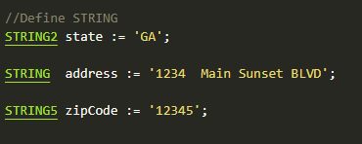

STRING
A character string of n bytes, space padded (not null-terminated)
The upper size limit for any STRING value is 4GB.
attribName: The name by which the variable will be invoked
[n]: Optional, if omitted, the string is variable length to the size needed to contain the result of the cast or passed parameter.
STRING[n] attribName
What happens if define following?

Slide 41
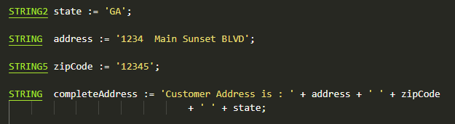
STRING Concatenation
Concatenation can happen using +
It doesn’t change the format of strings being added
- attribName: The name by which the variable will be invoked
- str1 … str_n: values to be added in sequence
attribName := str1 + str2 + .. + str_n;

Slide 42
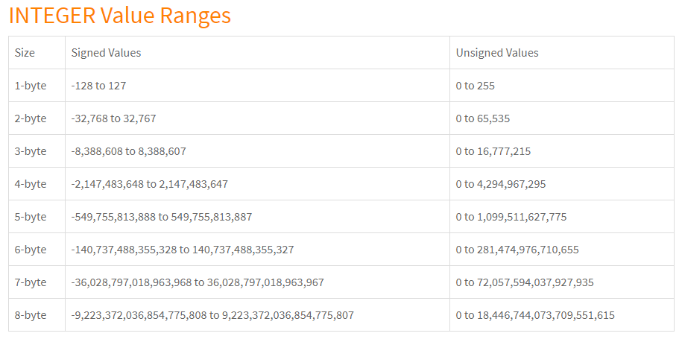
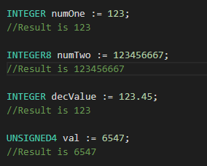
INTEGER
n-byte integer value.
Valid values for n are: 1, 2, 3, 4, 5, 6, 7,or 8. If n is not specified for the INTEGER
Default is 8-bytes.
[UNSIGNED ]: Optional, if omitted the integer is signed.
attribName: The name by which the variable will be invoked
[UNSIGNED] INTEGER attribName

Slide 43
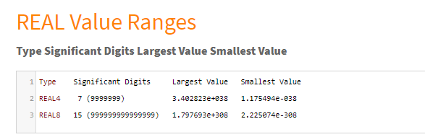
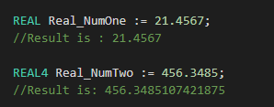
REAL
An n-byte standard IEEE floating point value.
Valid values are 4 or 8.
[n]: Optional, if omitted, REAL is a double-precision floating-point value (8-bytes).
attribName: The name by which the variable will be invoked
REAL [n] attribName
456.3485107421875 has to do with how computers represent floating points:
https://www.microsoft.com/en-us/microsoft-365/blog/2008/04/10/understanding-floating-point-precision-aka-why-does-excel-give-me-seemingly-wrong-answers/

Slide 44

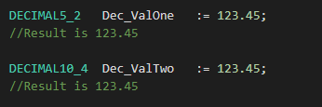

DECIMAL
A packed decimal value of n total digits.
If you have a fixed precision, use decimal instead of real.
n: total digits
[_y]: Optional, if present, the y defines the number of decimal places in the value.
y <= n
Max is 32 leading total.
[UNSIGNED]: Optional, if omitted the rightmost nibble holds the sign.
attribName: The name by which the variable will be invoked
[UNSIGNED] DECIMALn [_y] attribName
How about?
MOD operation with coercion applied. So: 123.45 % 99.9 = (DECIMAL3_1)23.5.

Slide 45
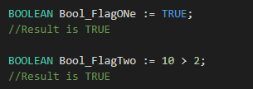
BOOLEAN
TRUE or FALSE
When BOOLEAN is used in a RECORD structure, a single-byte integer containing one (1) or zero (0) is output.
attribName: The name by which the variable will be invoked
BOOLEAN attribName

Slide 46
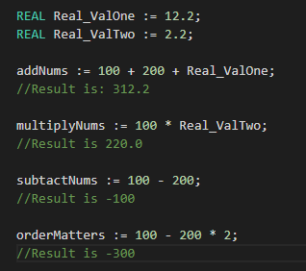
Math on Variables
Simple Math Operations
+
-
/
*
Order of Operation is important

Slide 47
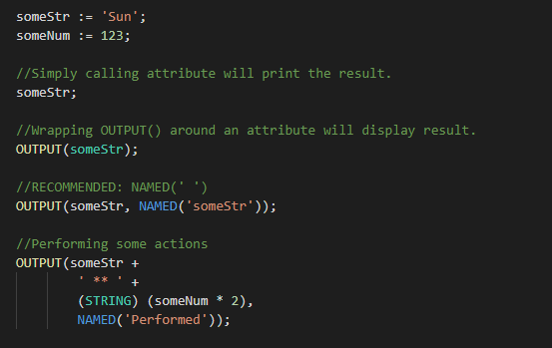
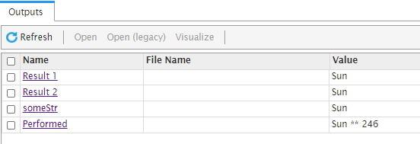
Simple OUTPUT
Used to display result.
OUTPUT: Optional, recommended.
NAMED: Optional, recommended.
OUTPUT(attribName);
OUTPUT(attribName, NAMED(‘attribName_exp’));
attribName;

Slide 48
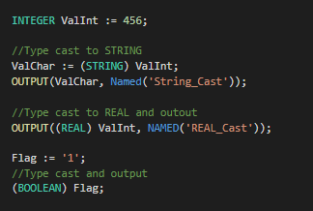


Type Casting

Slide 49
Let’s Get Real
// Open Types_Output.ecl
// Finish the TODO parts
WU Name

Slide 50
Data Structure & validation

Slide 51
Objective
Data Structure
Data Validation
ECL:
Record layout
Dataset
Choosen
Sort
Filter
Set
Math functions
Hands-on

Slide 52
Data Structure
Data structure is about data management, storage format, retrieving and processing it.
A collection of data types which are stored and organized for further usage.
Benefits:
Increased efficiency
Easy modification
Easy access to data

Slide 53

RECORD
Linear representation of file’s record structure.
Defines the layout of fields.
Defines fields types
Defines the order of fields
It can include child record.
A dataset within dataset

Slide 54
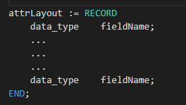
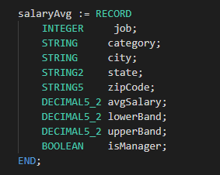
RECORD - Standalone
Standalone Record Structure:
attrLayout: The name by which the record will be invoked
RECORD: ECL Keyword, required
data_type: Data type of the field (string, integer, Boolean, …)
fieldname: The name by which the field will be invoked
END: Indicates the end of record layout

Slide 55
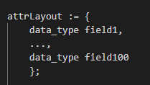
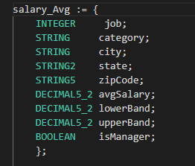
RECORD - Inline
Inline Record Structure:
No reserved keyword
attrLayout: The name by which the record will be invoked
data_type: Data type of the field (string, integer, Boolean, …)
fieldname: The name by which the field will be invoked

Slide 56
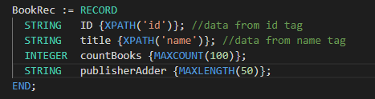
RECORD Options
Field Supplements
MAXLENGTH: { MAXLENGTH(length ) }
Specifies the maximum number of characters allowed in the field.
MAXCOUNT: { MAXCOUNT(records ) }
Specifies the maximum number of records allowed in a child DATASET field
XPATH: { XPATH('tag') }
Specifies the XML or JSON tag that contains the data, in a RECORD structure that defines XML or JSON data. This overrides the default tag name (the lowercase field identifier)
XMLDEFAULT: { XMLDEFAULT('value') }
Specifies a default XML value for the field. The value must be constant.

Slide 57
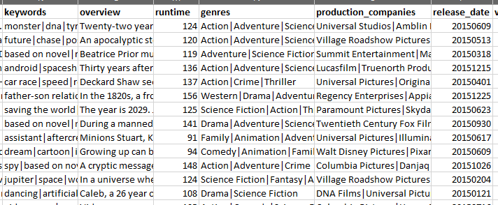
DATASET
- A collection of related data
Composed of columns and rows
Every column represents a particular value
Each column has one datatype
Each row represent a set of related data.
Child dataset

Slide 58
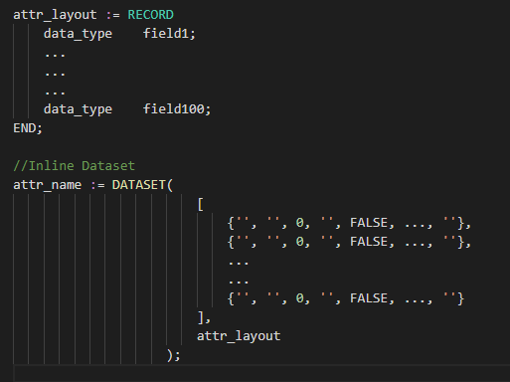
DATASET - Inline
Creates a temporary dataset in memory.
Dataset is only available at run time, unless it’s saved in a file.
Data is written manually
Will result in a logical/Thor file
attr_name : Dataset name
DATASET: ECL Keyword, required
attr_layout: Record structure the dataset is using
Smaller datasets
Defining an dataset within another functionality
- At the end it’s users choice!
Where can it be used?

Slide 59
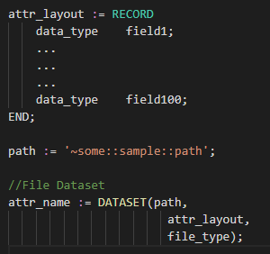
DATASET - Files
Available on disk
- attr_name : Dataset name
- DATASET: ECL Keyword, required
- path
- Physical address of file, where file is stored on disk.
- ~ : Not including the cluster the file is on.
- attr_layout: Record structure the dataset is using
- file_type: Type of file (XML, CSV, logical,…).

Slide 60
Dataset File Types
FLAT: Native file type for Thor; also used for fixed-length raw records
CSV: Any kind of delimited data, including CSV-encoded data
JSON: Data stored as a series of JSON objects
XML: Data stored as a series of XML documents
PIPE: Data obtained dynamically via process calls

Slide 61
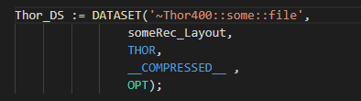
Dataset File Types – Flat Files
Thor/Flat/ logical files
Fixed length file
A few Options
__COMPRESSED__ | Specifies that file is compressed
__GROUPED__ | Specifies that dataset has been grouped, using GROUP function
UNSORTED | Specifies that file is unsorted
PRELOAD | Brings the dataset into memory and keeps it there so you can use it, without going back to storage every time.
ENCRYPT | Specifies that file is encrypted using ENCRYPT option.
OPT | Specifies that if file doesn’t exists return an empty dataset instead of an error

Slide 62
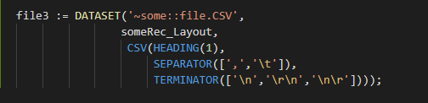
Dataset File Types – CSV Files
To read CSV(Comma Separated Values)
To read variable-length record files with defined record delimiter
Default input is in ASCII format with any UNICODE fields in UTF8 format.
A few Options
HEADING(n) | The number of header records in the file. Default is zero.
SEPARATOR | The field delimiter. Default is a comma (',')
TERMINATOR | The record delimiter. Default is a line feed ('\n')
QUOTE | The string quote character used. Default is a single quote ('\'')
ESCAPE | The string escape character used to indicate the next character. Default is the escape character(‘\’)
MAXLENGTH(size) | Maximum record length in the file in bytes
__COMPRESSED__ | Specifies that the file is compressed

Slide 63
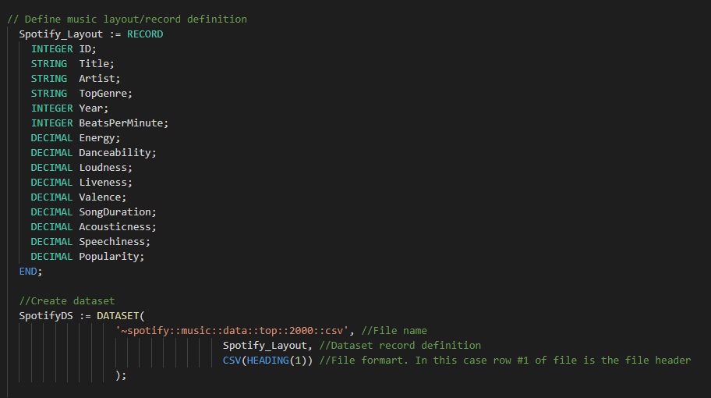
DATASET - Files

Slide 64


CHOOSEN Function
Let’s you display a certain number of rows.
Beginning with the record at the defined row number
- attr_name : The name by which the function will be invoked
- CHOOSEN: ECL Keyword, required
- dataset_name: The dataset to perform action on
n: number of records to return
Start_position: Optional, to indicate which row to start with. Default is row 1

Slide 65
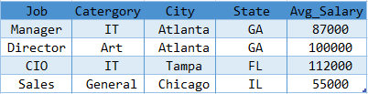
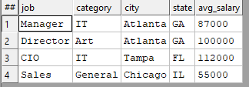
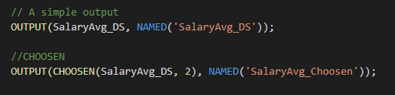

CHOOSEN
Returns the first n number of records.

Slide 66

Data Validation
Data validation is the process of ensuring data has undergone data cleansing to ensure they have data quality, that is, that they are both correct and useful.
Should happen at any stage of big data process
Mitigate any project defects
Lower defects, higher quality
Better decision making
In a business which team should focus on validation the most?
Who else focused on data validation?
All teams, from business that gathers requirements to customer delivery team.
Why is that???
CUSTOMER !!

Slide 67
Some Data Validation Consideration
Does the data make sense?
Does the data follow the appropriate rules/standards for its field?
Does it prove or disprove business/customer standards, or bring any insight to light?
Can you find trends in the data to help you form your next theory?
If not, is that because of a data quality issue?
If all the data valid and accurate?

Slide 68
Let’s Get Real
// Let’s review & work on Rec_Dataset.ecl:
// We will be working with part one:
CHOOSN
OUTPUT
WU Name

Slide 69
SORT Function
Ascending or descending sort
attr_name: The name by which the function will be invoked
SORT: ECL Keyword, required
dataset_name: The dataset to perform action on
-: sorts descendingly
field(s): field or fields to sort on

Slide 70
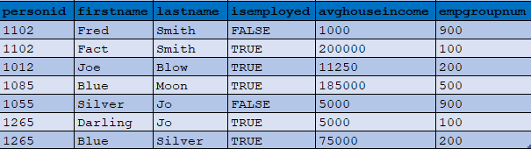
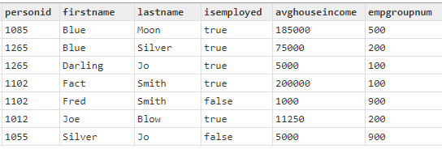

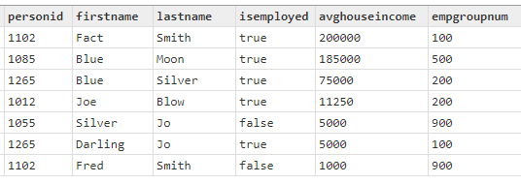
SORT

Slide 71

FILTER
Choosing a smaller part of dataset
It’s recommended to filter down to the desire dataset before any processing
If filtering on STRING value, it is case sensitive
attr_name: The name by which the function will be invoked
dataset_name: The dataset to perform action on
Filtering conditions: field and required filtering conditions

Slide 72
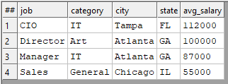

FILTER
All records within dataset will be evaluated
If boolean_expression evaluates to TRUE for a particular record, it will be included in the result
Comparison Operators
=
<> or !=
<
>
<=
>=
<=>
Logical Operators
AND
OR
NOT or ~

Slide 73

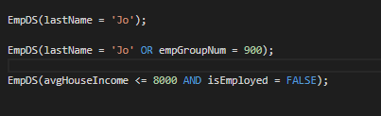


FILTER

Slide 74


BETWEEN Operator
It’s an operator for range check.
Same as <= and >=
attr_name : The name by which the operation will be invoked
seek_val: The value to be checked. Can be a dataset field
BETWEEN: ECL keyword, required
NOT: ECL keyword, optional.
Low_val: Low value in the range
AND: ECL keyword, required
high_val: High value in the range

Slide 75


LENGTH Function
Returns the length of a String value.
Spaces are counted as well.
attr_name The name by which the operation will be invoked
experssion A string expression

Slide 76
Let’s Get Real
// Let’s review & work on Rec_Dataset.ecl:
// We will be working with:
Filter
SORT
OUTPUT
WU Name

Slide 77


SET OF
An array of data elements
Elements have the same data type
Not distributed, so it has to fit into memory
Indexing start from 1
SET OF: ECL keywork, required
<dataType>: Elements type
attr_name: The name by which the operation will be invoked
elem1, elemN: input values

Slide 78



SET Function
Convert values from a field in a dataset to a SET OF
Similar to subset and IN in SQL
Doesn’t remove duplicate values
Doesn’t order the list
attr_name: The name by which the function will be invoked
SET: ECL keyword, required
dataset_name: input dataset
field_name: field/column of dataset that will be converted to SET OF

Slide 79


IN – NOT IN Operators
It’s an operator
A collection of OR conditions
Search a SET to check for result
It can be used on a dataset field

Slide 80


Math Functions
COUNT
Returns the total count of a set or a field in a dataset
SUM
Returns the total value from a set or a field in a dataset
attr_name: The name by which the function will be invoked
MAX/MIN: ECL keyword, required
setValues: input set
dataset_name: input dataset
field_name: field/column of dataset to be checked

Slide 81


Math Functions
MAX
Returns the maximum value from a set or a field in a dataset
MIN
Returns the minimum value from a set or a field in a dataset
attr_name: The name by which the function will be invoked
MAX/MIN: ECL keyword, required
setValues: input set
dataset_name: input dataset
field_name: field/column of dataset to be checked

Slide 82


Math Functions
AVE
Returns the average value from a set or a field in a dataset
Truncate
Returns the integer portion of real value
attr_name: The name by which the function will be invoked
AVE/TRUNCATE: ECL keyword, required
setValues: input set
dataset_name: input dataset
field_name: field/column of dataset to be checked

Slide 83


Math Functions
ROUND
Returns the rounded real value by using standard arithmetic rounding.
attr_name: The name by which the function will be invoked
ROUND: ECL keyword, required
value: real value to be rounded
decimals: Optional, an integer specifying the number of decimal places to be rounded

Slide 84



Slide 85
CORRELATION
When two sets of data are strongly linked together we say they have a High Correlation.
Correlation can have a value:
1 is a perfect positive correlation
0 is no correlation , no relationship between values
-1 is a perfect negative correlation

Slide 86




CORRELATION
Returns 1.0
Returns 0.4978702535543908

Slide 87
Let’s Get Real
// Let’s review & work on Set_Math.ecl:
// We will be working with:
Set
Math functions
BETWEEN operator
WU Name

Slide 88
Function, module, & import

Slide 89
Objective
Introduction to Code Structures
ECL:
IMPORT
Function
EMBED
Module

Slide 90

IMPORT
Makes EXPORT definitions within a module available for use.
Module_list: A comma-delimited list of folders or module files in the repository.
$: Makes all definitions in the current folder available.
^: Can be used as shorthand for the container of the current folder.
AS <alias>: To create a local short name for the module
*: Makes everything in that folder available
FROM: Specifies the folder name being imported
Language: The external programming language

Slide 91



IMPORT Statements
Alias

Slide 92

IMPORT

Slide 93

EMBED
Lets you add code written in certain other languages to ECL.
Similar to a FUNCTION structure
Supported lang: SQL, C++, Python, R, etc.
resulttype: ECL returned value; required
funcname: Function name
parameterlist: A comma separated list of the parameters to pass to the function.
EMBED/ENDEMBED: ECL keywords, required

Slide 94


EMBED

Slide 95
Code Structures
Code structures are about organizing logic so that it is easy to read and maintain code. ECL encapsulates logic using two main constructs:
Function is typically used to represent fine grained and reusable logic. Examples: String To Date, Date To String are functions that are used to manipulate a Date
Module is typically used to represent multiple functions and their dependencies as a group. Examples: A Date module contains String To Date, Date To String…
Benefits:
Increased Readability
Increase Reuse (if it is used in the context of declarative programming)
Encourages Modular Design (if it is used in the context of declarative programming)

Slide 96
MODULE
Is a container that allows you to group related definitions. The parameters passed to the module are shared by all the related members definitions.
Your file name should be exactly the same as Module name.
Variable Scope
Local definitions are visible only up to an EXPORT or SHARED
SHARED definitions are visible through module.
EXPORT definitions are visible within and outside of a module .

Slide 97

Module
EXPORT Optional, indicates that this module is available outside of this file.
moduleName The name of the function
MODULE ECL Keyword, required
param_data_type Data type of each parameter (string, integer, Boolean, …)
SHARED The attribute or function can be accessed within the module
EXPORT The attribute or function can be accessed from outside of the module
END Indicates the end of module

Slide 98



MODULE

Slide 99


Module Example

Slide 100


Module – Example Dataset Encapsulation
person.ecl file
person.ecl
Exported Person module. Should be named the same name as the file.
personUse.ecl
Importing the person file
Accessing the definition in the module Person

Slide 101

Let’s Get Real
// Let’s review & work on Layout/Raw/Population and Vaccine files:
// Let’s start by looking at field types, format and field definitions
WU Name

Slide 102


Let’s Get Real
// Now let’s see the data for each field using ViewRawFiles
WU Name

Slide 103
Characteristics of an ECL Function
Parameterizable: An ECL Function can accept parameters that is a data type like a STRING, INTEGER etc. or a DATASET
Statically compiled: An ECL Function is compiled statically at the location of the invocation of the function. Hence, all dependencies are evaluated during the compilation process.
Can encapsulate child functions: An ECL Function can encapsulate other child ECL functions.
Always return a result: An ECL Function can return a result that is an ECL data type, expression, record, DATASET or an ACTION (like OUTPUT)

Slide 104


FUNCTION
Function Structure:
retValueType: Optional return value data type
functionName: The name of the function
FUNCTION: ECL Keyword, required
param_data_type: Data type of each parameter (string, integer, Boolean, …)
code: placeholder for ECL code
END: Indicates the end of function

Slide 105



FUNCTION

Slide 106

One Line FUNCTION
If not much code for a function, then a short version of function can be used.
FUNCTION, RETURN and END keywords are omitted.

Slide 107
Data enrichment

Slide 108
Objective
Data Cleansing
Data Transformation
Data Enrichment
ECL:
IF
TRANSFORM
PROJECT
JOIN
Hands-on

Slide 109
Data Validation
It is often a good idea to test specific values within records for validity
What you do with the results is a different matter
Recommendation: Mark the record as having problems, but don’t delete it
Validation is usually fast and easy
Define a new record structure with new fields containing test results
BOOLEAN values with descriptive names
Include a final “is this valid” BOOLEAN field that summarizes all tests
This makes it easy to filter the records
All of the above can be done in one pass, using the PROJECT() function

Slide 110
Data Cleansing
Data Cleansing is the process of fixing or removing incorrect, corrupted, incorrectly formatted, duplicate, or incomplete data within a dataset.
Part of Data Validation process
Used upon receiving raw data and structuring the data
Also used when combining multiple datasets (in case of duplication, or incomplete data)
Data Cleansing Techniques
Removing duplicates
Removing irrelevant data
Fix structural errors/inconsistent data: “N/A” vs “Not Available”
Handling missing data

Slide 111
Data Transformation
Data Transformation is the process of converting data from one format or structure into another
Changing the shape/format of data
Part of Data Validation and Data Cleansing processes
Also used when combining multiple datasets (in case of duplication, or incomplete data)
Examples
Address cleaning: breaking one line address to different fields
Converting all SSN or DOB to a business approved format
Adding leading 0 or blanks to make all values in a field unified
Can you think of other examples?

Slide 112
Data Enrichment/Enhancement
Data Enrichment is the process of adding new data elements to an existing data for more complete data
Combining data also counts as data enrichments
Breaking apart complex field values into separate fields
Standardizing similar fields (dates, time)
It mostly happens after receiving raw data and structuring it, but keep in mind that it’s a continuous process.
Can be used to improve data quality as part of data validation process
Examples
Enhancement of a company’s customer files:
Companies often collect basic information on their clients such as phone numbers, emails, or addresses. A data append takes the information they have, matches it against a larger database of business data, allowing the desired missing data fields to be added.

Slide 113

IF Function
IF function evaluates the expression to generate a Boolean result.
A conditional expression
Boolean result: True or False
Both the true-result and false-result must be the same type
- attr_name : The name by which the function will be invoked
- IF: ECL Keyword, required
- expression: Boolean expression to be check for True or False
true_result: Result value or action if expression is True
false_result: May be omitted only if true_result is an action

Slide 114
MAP Function
Evaluates the list of Boolean expressions and returns the value associated with the first true expression.
If none of them match, the else-value is returned.
All return value and else_value values must be of the same type
All expressions must reference the same level of dataset scoping
Therefore, all expressions must either reference fields in the same dataset or the existence of a set of related child records
The expressions are typically evaluated in the order in which they appear, but if all the return values are scalar, the code optimizer may change that order.

Slide 115

MAP Function
attr_name : The name by which the function will be invoked
MAP: ECL Keyword, required
Expression1…N: Boolean expression
=>: “Result in” operator
Else_value: Optional if all other possible return values are actions, otherwise required. The value to return if all expressions are false.

Slide 116

MAP Function

Slide 117
TRANSFORM Function
Specifies exactly how each field in an output record receives its value.
The result of a call to a TRANSFORM is one record
The body of a TRANSFORM defines how fields within the resulting record are populated
TRANSFORM is used with PROJECT, JOIN, ITERATE, ROLLUP and more.

Slide 118

TRANSFORM Function - Standalone
EXPORT
ECL Keyword
Optional, used for constants, or in modules
return_dataset_layout
Record-definition/layout of result dataset
transform_name
The name by which the transform will be invoked
Input_arguments_types
The argument’s data type
If passing a dataset, the data type is DATASET(record_definition)
arg_name
Used to reference your argument in the transform

Slide 119
TRANSFORM Function - Standalone
TRANSFROM
ECL Keyword
Required
SKIP Optional. Specifies the condition under which the TRANSFORM function operation is skipped.
SELF
Reference a field in return_dataset_layout
argname.inputDataset_fieldname
Refers to the field in the input dataset
END
ECL Keyword
Required

Slide 120
TRANSFORM Function
Attribute Definition
SELF := [];
For every field in result layout that doesn’t have a defined operation or doesn’t exists in input dataset, assign default value.
For example if there is a STRING field in result layout that TRANSFORM didn’t assign a definition for, it will be assigned an empty string.
If included, it is almost always the last assignment.
SELF := LEFT;
SELF := RIGHT;
Get the original values from input dataset for all fields that don’t have an operation defined.
NOTE You can write inline function or call other functions or modules in your transform.

Slide 121

TRANSFORM Function - Standalone

Slide 122

TRANSFORM Function - Inline
Used inline with PROJECT, JOIN, ROLLUP, etc.
No Keyword END
No passing argument
Input records are referred to as LEFT and RIGHT

Slide 123

PROJECT Function
The PROJECT function processes through all records in the record-set performing the transform function on each record in turn.
PROJECT can be used with many functions such as TRANSFORM, JOIN, ROLLUP, etc.
PROJECT is like SQL's SELECT … INTO TABLE …
EXPORT
ECL Keyword
Optional, used for constants, or in modules
project_name
The name by which the project will be invoked
input_dataset
The input dataset

Slide 124



Example
NameOutRec: Result Layout
CatThem: Transform Name
Person_Layout: Input Dataset Layout
L : Reference to Person_Layout fields
SELF: Refers to fields in result dataset
C: Will do the Counting

Slide 125



Example
CatRecs: Project Name
NameDS: Input Dataset to loop through
NameOutRec: Result layout
SELF: Refers to fields in result dataset
SELF := LEFT: Assign everything with same field name from NameDS
SELF := [ ]: All un-assigned fields will be set to default values

Slide 126
Let’s Get Real
// Let’s review getCars and work on cars_projects
// We will be reviewing the TRANSFORM and add the following fields:
Old_Exp: If price >= 10000 AND year <= 2012, then it's pricey
colorType: If color is part invalidColors then 'Invalid Entry’, if part of darkColors then 'Dark', else is 'Light' color
WU Name

Slide 127
Std libraray

Slide 128
STD Library
STD (Standard) Library, provides, prebuild function to provide more support for ECL language.
This library includes supports for:
String handling
Std.Str
Std.Uni
Date & Time
Std.Date
Files
Std.File
Clusters
Std.System.Thorlib
Jobs
Std.System.Job
And more

Slide 129

STD Library – CompareIgnoreCase
CompareIgnoreCase
Ignoring any differences in the case of the letters
Returns zero (0) if the source1 and source2 strings contain the same data
Returns negative one (-1) if source1 < source2
Returns positive one (1) if source1 > source2

Slide 130

STD Library – CompareIgnoreCase

Slide 131


STD Library – CountWords
CountWords
Returns the number of words in the source string based on the specified separator
source A string containing the words to count
separator A string containing the word delimiter to use

Slide 132


STD Library – Find
Find
Return the beginning index position within the source string of the specified instance of the target string.
Returns0, if target is not found or specified instance is greater than the number of occurrences of the target.
source A string containing the data to search.
target A string containing the substring to search for.
instance An integer specifying which occurrence of the target to find.

Slide 133

STD Library – FindReplace
FindReplace
Returns the source string with the replacement string substituted for all instances of the target string .
It’s case sensitive.
If the target string is not in the source string, it returns the source string unaltered.
source A string containing the data to search
target A string containing the substring to search for.
replacement A string containing the replacement data.

Slide 134

STD Library – FindReplace

Slide 135

STD Library – SplitWords
SplitWords
Returns the list of words in the source string split out by the specified separator.
source A string containing the words to extract.
separator A string containing the word delimiter to use.
allowblank Optional. If TRUE, specifies allowing blank items in the result. Default is FALSE

Slide 136


STD Library – Case Changes
Returns, lower, upper, or title case based on the chosen function.
source A string containing the data to change case.

Slide 137



Date Data Types
Date_rec A RECORD structure containing three fields, and INTEGER2 year, an UNSIGNED1 month, and an UNSIGNED1 day.
Date_t An UNSIGNED4 containing a date value in YYYYMMDD format. This type does not support dates prior to 1AD
Days_t An UNSIGNED4 containing a date value representing the number of elapsed days since a particular base date.

Slide 138


Time Data Types
Time_rec A RECORD structure containing three fields, and INTEGER1 hour, an UNSIGNED1 minute, and an UNSIGNED1 second.
Time_t An UNSIGNED3 holding a time of day in the decimal form HHMMDD.
Seconds_t An INTEGER8 holding a number of seconds. Can be used to represent either a duration or the number of seconds since epoch

Slide 139


Year – Month – Day Functions
Year Returns the Year number from date value.
Month Returns the Month number from date value.
Day Returns the Day number from date value.
date A date value in the Date_t format (YYYYMMDD)

Slide 140


Valid Functions
IsValidDate
if the date is valid, both by range-checking the year and by validating each of the other individual components.
date A date value in the Date_t format.
yearLowerBound Optional , the minimum acceptable year. Defaults is 1800.
yearUpperBound Optional , the maximum acceptable year. defaults is 2100.
IsValidTime
Returns True if the time is valid, by validating each of the individual components (hours, minutes, and seconds)
time A time value in the Time_t format(HHMMDD)

Slide 141

FromStringToDate Function
Converts a string to a Date_t(YYYMMDD) using the relevant string format.
The resulting date must be representable within the Gregorian calendar after the year 1600.
date_text The string to be converted
format The format of the input string.

Slide 142

FromStringToDate Function

Slide 143

FromStringToDate Function

Slide 144

Today – Current Functions
Today
Returns to today’s date in YYYYMMDD format.
CurrentDate
Returns the current date.
If the Local_Date parameter is TRUE the returned value is local to the cluster computing the date, if FALSE then the UTC value is returned.
CurrentTime
Returns the current time.
If the Local_Time parameter is TRUE the returned value is local to the cluster computing the date, if FALSE then the UTC value is returned.

Slide 145

Today – Current Functions

Slide 146


Between Function
DaysBetween
Calculates and returns the number of whole days between two dates
MonthsBetween
Calculates and returns the number of whole days between two dates
fromDate The first date value in Date_t format.
toDate The last date value in Date_t format.

Slide 147
Data Append

Slide 148
Data Append
Data Append, and Enrichment are used interchangeably.
Can you think of a few more examples?
Enriching internal sales data with third party advertisement data to get a better understanding of advertising effectiveness.
Adding demographic information to customer data for target sales

Slide 149
Let’s Get Real
// Let’s review getCars and work on cars_projects
// We will be reviewing the TRANSFORM and add the following fields:
Old_Exp: If price >= 10000 AND year <= 2012, then it's pricey
colorType: If color is part invalidColors then 'Invalid Entry’, if part of darkColors then 'Dark', else is 'Light' color
WU Name

Slide 150

JOIN
JOIN is used to combine data or rows from two or more tables/datasets based on at least one boolean expression test.
Part of Data Append or Data Enrichment.

Slide 151


Join Types
INNER Join selects all rows from both the dataset if the condition satisfies.
This join will create the result-set by combining all rows from both the datasets where the condition satisfies. This is the default JOIN.
FULL OUTER Join selects all rows from both the datasets regardless of join condition.
This join will create the result-set by combining all rows from both the datasets, including matched and non matched rows.
For non matched rows, the fields from opposite dataset will remain null.

Slide 152


Join Types
LEFT ONLY Join returns all the rows of the dataset on the left side of the join that didn’t match any rows from right dataset.
LEFT OUTER Join returns all the rows of the dataset on the left side of the join and matching rows for the dataset on the right side of join.

Slide 153
Join Types
INNER Keep only those records that exist in both datasets. Default value if no type is listed.
LEFT OUTER Keep all records from LEFT, even if there are no matches.
RIGHT OUTER Keep all records from RIGHT, even if there are no matches.
LEFT ONLY One record for each left record with no match in the right.
RIGHT ONLY One record for each left record with no match in the left.
FULL ONLY One record for each left and right record with no match in the opposite.
FULL OUTER One record for each record in left and right dataset.

Slide 154

Join Types

Slide 155

JOIN
attribName The name by which the join will be invoked
LEFT_DatasetName Left dataset name
RIGHT_DatasetName Right dataset name
LEFT.fieldName = RIGHT.fieldName
Join condition
can use equal (=) or not-equal (!=)
multiple conditions can exists using AND/OR
Transform/xFormName
Join, inline or stand-alone transform
JoinType Default is Inner join.
Flags Optional
Note: When join condition is on STRING and the = operator is used, case sensitivity matters.

Slide 156
JOIN Condition & Transform
Condition
Boolean test of arbitrary complexity
Normally contains at least one equality test
Reference attributes within the input datasets via LEFT and RIGHT - ds1 = LEFT - ds2 = RIGHT
Join conditions can be arbitrarily complex but should include at least one equality test
Transform
If using an explicit TRANSFORM, it should accept at least two arguments
One representing a LEFT record and the other representing a RIGHT record
If using an inline TRANSFORM, use LEFT and RIGHT to reference input data

Slide 157
Optional Flags
LOOKUP The right dataset is relatively small and there should be only one match for any LEFT record
ALL The right dataset is relatively small and can be copied to every node in its entirety
Can have multiple matches (unlike LOOKUP)
Supports join conditions that contain no equalities
Required if there are no equality tests in the condition
Few Specifies the LOOKUP right dataset has few records, so little memory is used
NOSORT Performs the JOIN without dynamically sorting the tables. This implies that the left and/or right record-set must have been previously sorted and partitioned based on the fields specified in the join Condition
KEYED Specifies using indexed access into the right record-set
LOCAL JOIN performed on each supercomputer node independently, and maintains the pervious distribution of data
KEEP(n) Specifies the maximum number of matching records (n) to generate into the result set. If omitted, all matches are kept.
LIMIT Specifies a maximum number of matching records which, if exceeded, either fails the job, or eliminates all those matches from the result set.

Slide 158







Slide 159
Let’s Get Real
// Let’s review & complete Vacc_Analyze
// Note: PopDS_Clean will be reviewed later.
WU Name

Slide 160
Resources
ECL Document: https://d2wulyp08c6njk.cloudfront.net/releases/CE-Candidate-7.4.8/docs/EN_US/ECLLanguageReference_EN_US-7.4.8-1.pdf
ECL Cheat Sheet: https://ide.hpccsystems.com/files/ECL_Cheat_Sheet.pdf
ECL Watch: https://cdn.hpccsystems.com/releases/CE-Candidate-7.12.8/docs/EN_US/The_ECL_Watch_Manual_EN_US-7.12.8-1.pdf
Log Visualization: https://hpccsystems.com/blog/ELK_visualizations

