Slide 1
1. Numbers

Slide 2
Here is an example to define various types of numbers in C++:

Slide 3
When the above code is compiled and executed, it produces the following result:

Slide 4
1.1 Math Operations In C++
In addition to the various functions you can create, C++ also includes some useful functions you can use.
These functions are available in standard C and C++ libraries and called built-in functions.
These are functions that can be included in your program and then use. C++ has a rich set of mathematical operations, which can be performed on various numbers.

Slide 5
1.1 Math Operations In C++
Following table lists down some useful built-in mathematical functions available in C++.
To utilize these functions you need to include the math header file <cmath>.

Slide 6
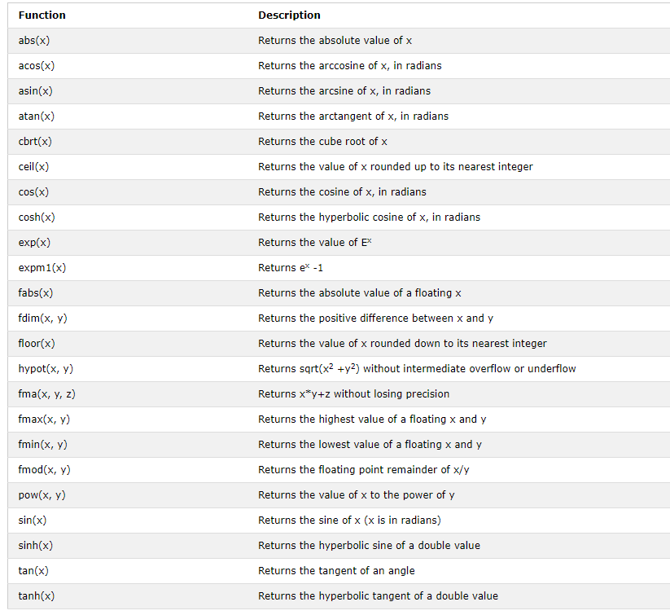
1.1 Math Operations In C++

Slide 7
1.1 Math Operations In C++
Following is a simple example to show few of the mathematical operations:

Slide 8
1.1 Math Operations In C++
When the above code is compiled and executed, it produces the following result:

Slide 9
1.2 Random Numbers in C++
There are many cases where you will wish to generate a random number.
There are actually two functions you will need to know about random number generation.
The first is rand(), this function will only return a pseudo random number.
The way to fix this is to first call the srand() function.

Slide 10
1.2 Random Numbers in C++
Following is a simple example to generate few random numbers.
This example makes use of time() function to get the number of seconds on your system time, to randomly seed the rand() function:

Slide 11
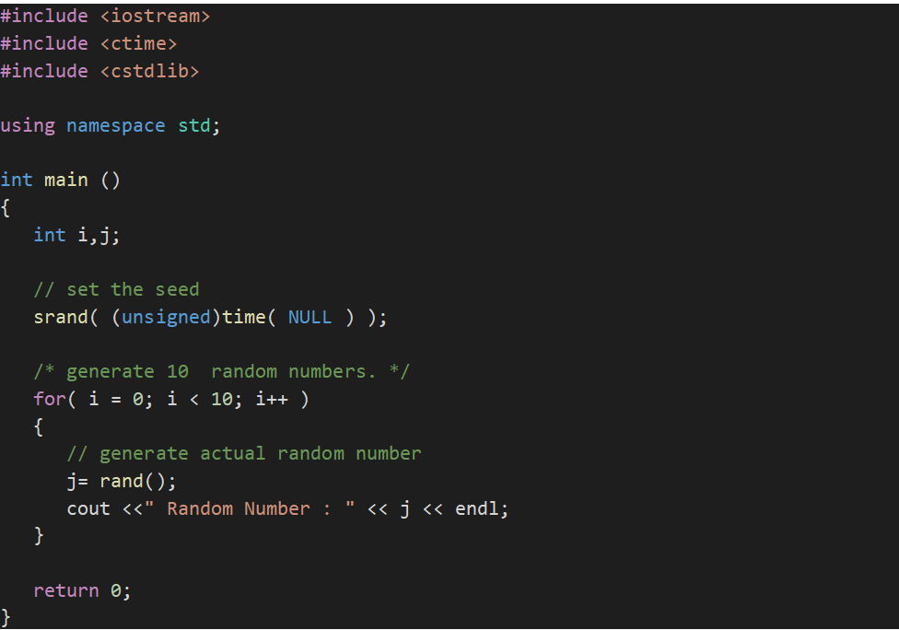
1.2 Random Numbers in C++

Slide 12
1.2 Random Numbers in C++
When the above code is compiled and executed, it produces the following result:

Slide 13
1.3 Max and min
The max(x,y) function can be used to find the highest value of x and y:
And the min(x,y) function can be used to find the lowest value of x and y:

Slide 14
2. ARRAYS

Slide 15
C++ provides a data structure, the array, which stores a fixed-size sequential collection of elements of the same type.
An array is used to store a collection of data, but it is often more useful to think of an array as a collection of variables of the same type.
Instead of declaring individual variables, such as number0, number1, ..., and number99, you declare one array variable such as numbers and use numbers[0], numbers[1], and ..., numbers[99] to represent individual variables.

Slide 16
A specific element in an array is accessed by an index.
All arrays consist of contiguous memory locations.
The lowest address corresponds to the first element and the highest address to the last element.

Slide 17
2.1 Declaring Arrays
To declare an array in C++, the programmer specifies the type of the elements and the number of elements required by an array as follows:
This is called a single-dimension array.
The arraySize must be an integer constant greater than zero and type can be any valid C++ data type.

Slide 18
2.1 Declaring Arrays
For example, to declare a 10-element array called balance of type double, use this statement:

Slide 19
2.2 Initializing Arrays
You can initialize C++ array elements either one by one or using a single statement as follows:
The number of values between braces { } cannot be larger than the number of elements that we declare for the array between square brackets [ ].

Slide 20
2.2 Initializing Arrays
Following is an example to assign a single element of the array:
If you omit the size of the array, an array just big enough to hold the initialization is created.
Therefore, if you write:

Slide 21
2.2 Initializing Arrays
You will create exactly the same array as you did in the previous example.
The above statement assigns element number 5th in the array a value of 50.0.
Array with 4th index will be 5th, i.e., last element because all arrays have 0 as the index of their first element which is also called base index.

Slide 22
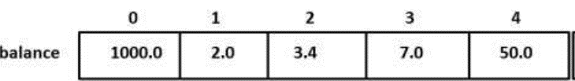
2.2 Initializing Arrays
Following is the pictorial representation of the same array we discussed above:

Slide 23
2.3 Accessing Array Elements
An element is accessed by indexing the array name.
This is done by placing the index of the element within square brackets after the name of the array.
For example:
The above statement will take 10th element from the array and assign the value to salary variable.

Slide 24
2.3 Accessing Array Elements
Following is an example, which will use all the above mentioned three concepts viz. declaration, assignment and accessing arrays:

Slide 25
2.3 Accessing Array Elements
This program makes use of setw() function to format the output.
When the above code is compiled and executed, it produces the following result:

Slide 26
2.4 Arrays in C++
Arrays are important to C++ and should need lots of more detail.
There are following few important concepts, which should be clear to a C++ programmer:
Concept | Description
Multi-dimensional arrays | C++ supports multidimensional arrays. The simplest form of the multidimensional array is the two-dimensional array.
Pointer to an array | You can generate a pointer to the first element of an array by simply specifying the array name, without any index.
Passing arrays to functions | You can pass to the function a pointer to an array by specifying the array's name without an index.
Return array from functions | C++ allows a function to return an array.

Slide 27
2.5 Arrays in C++
C++ allows multidimensional arrays.
Here is the general form of a multidimensional array declaration:
For example, the following declaration creates a three dimensional 5 . 10 . 4 integer array:

Slide 28
2.6 Two Dimensional Arrays
The simplest form of the multidimensional array is the two-dimensional array.
A two-dimensional array is, in essence, a list of one-dimensional arrays.
To declare a two-dimensional integer array of size x,y, you would write something as follows:

Slide 29
2.6 Two Dimensional Arrays
Where type can be any valid C++ data type and arrayName will be a valid C++ identifier.
A two-dimensional array can be think as a table, which will have x number of rows and y number of columns.
A 2-dimensional array a, which contains three rows and four columns can be shown as below:

Slide 30
2.6 Two Dimensional Arrays
Thus, every element in array a is identified by an element name of the form a[ i ][ j ], where a is the name of the array, and i and j are the subscripts that uniquely identify each element in a.

Slide 31
2.7 Initializing Two-Dimensional Arrays
Multidimensioned arrays may be initialized by specifying bracketed values for each row.
Following is an array with 3 rows and each row have 4 columns.

Slide 32
2.7 Initializing Two-Dimensional Arrays
The nested braces, which indicate the intended row, are optional.
The following initialization is equivalent to previous example:

Slide 33
2.8 Accessing Two-Dimensional Array Elements
An element in 2-dimensional array is accessed by using the subscripts, i.e., row index and column index of the array.
For example:
The above statement will take 4th element from the 3rd row of the array

Slide 34
2.8 Accessing Two-Dimensional Array Elements

Slide 35
2.8 Accessing Two-Dimensional Array Elements
When the above code is compiled and executed, it produces the following result:

Slide 36
2.9 Pointer to an Array
An array name is a constant pointer to the first element of the array. Therefore, in the declaration:
balance is a pointer to &balance[0], which is the address of the first element of the array balance.
Thus, the following program fragment assigns p the address of the first element of balance:

Slide 37
2.9 Pointer to an Array
It is legal to use array names as constant pointers, and vice versa. Therefore, *(balance + 4) is a legitimate way of accessing the data at balance[4].
Once you store the address of first element in p, you can access array elements using *p, *(p+1), *(p+2) and so on.

Slide 38
2.9 Pointer to an Array

Slide 39
2.9 Pointer to an Array
In the above example, p is a pointer to double which means it can store address of a variable of double type.
Once we have address in p, then *p will give us value available at the address stored in p, as we have shown in the above example.

Slide 40
2.9 Pointer to an Array
When the above code is compiled and executed, it produces the following result:

Slide 41
2.10 Passing Arrays to Functions
C++ does not allow to pass an entire array as an argument to a function.
However, You can pass a pointer to an array by specifying the array's name without an index.
If you want to pass a single-dimension array as an argument in a function, you would have to declare function formal parameter in one of following three ways and all three declaration methods produce similar results because each tells the compiler that an integer pointer is going to be received.

Slide 42
2.10 Passing Arrays to Functions
Method-1 : Formal parameters as a pointer as follows:

Slide 43
2.10 Passing Arrays to Functions
Method-2 : Formal parameters as a sized array as follows:

Slide 44
2.10 Passing Arrays to Functions
Method-3 : Formal parameters as an unsized array as follows:

Slide 45
2.10 Passing Arrays to Functions
Now, consider the following function, which will take an array as an argument along with another argument and based on the passed arguments, it will return average of the numbers passed through the array as follows:

Slide 46
2.10 Passing Arrays to Functions
Now, let us call the above function as follows:

Slide 47
2.10 Passing Arrays to Functions
As you can see, the length of the array doesn't matter as far as the function is concerned because C++ performs no bounds checking for the formal parameters.

Slide 48
2.11 Return Array from Functions
C++ does not allow to return an entire array as an argument to a function.
However, you can return a pointer to an array by specifying the array's name without an index.

Slide 49
2.11 Return Array from Functions
If you want to return a single-dimension array from a function, you would have to declare a function returning a pointer as in the following example:

Slide 50
2.11 Return Array from Functions
Second point to remember is that C++ does not advocate to return the address of a local variable to outside of the function so you would have to define the local variable as static variable.
Now, consider the following function, which will generate 10 random numbers and return them using an array and call this function as follows:

Slide 51
2.11 Return Array from Functions

Slide 52
2.11 Return Array from Functions
When the above code is compiled together and executed, it produces result something as follows:

